Slide 1
MUSIC: A MELODIC METHODOLOGY INTO TEACHING AND LEARNING 2018-1-ES01-KA229-050761 SCHOOL EXCHANGE PARTNERSHIP
THE ROMANIAN TEAM PRESENTS:
'Music- What and Why I Listen to.’
based on an online survey applied to 101 Romanian students

Slide 2
1. What music genres do you listen to the most?
The students could choose 5 music genres that they enjoy listening to and the Romanian respondents answered, as follows: 81,2% prefer listening to pop music, 54,5 % like rock music, 53,5 % stated that rap/hip hop music was among the favourite one and trap was listened to by 41,6 % from the students who participated in the survey.

Slide 3
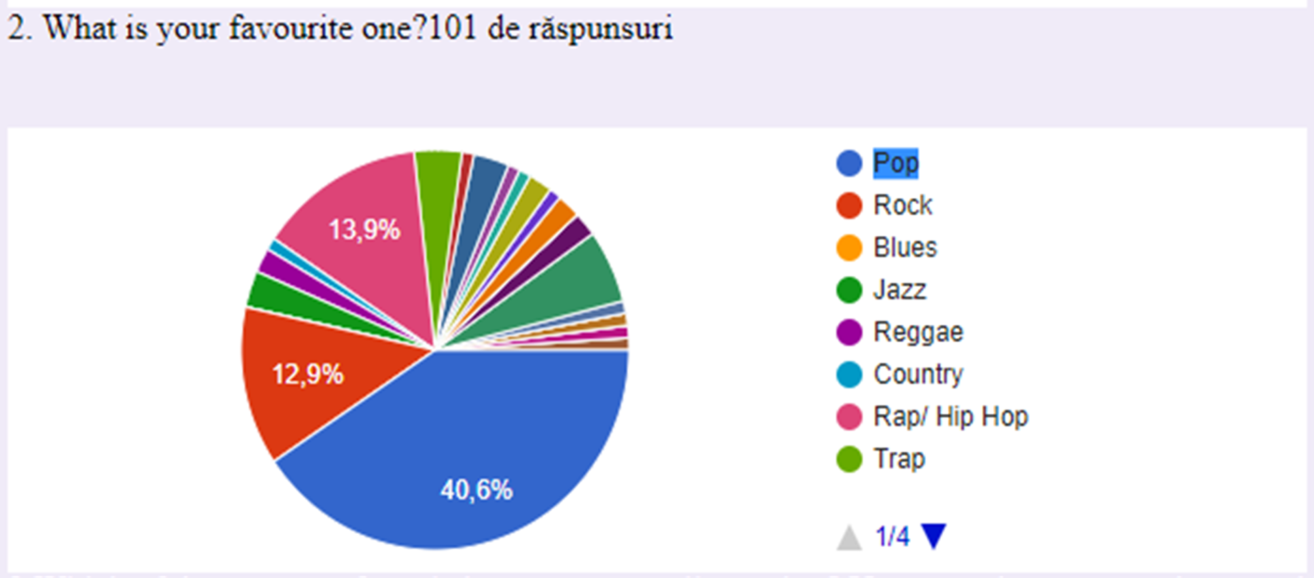
2. What is your favourite one?
In order to identify the students’ favourite type of music, the respondents had to choose only one genre from the ones that they said they would rather listen to. From the chart, it can be seen that almost half of the students (40,6%) listen to pop music, followed by rap/hip hop (13,9 %) and rock (12,9%) and alternative rock (5,9 %).

Slide 4
3. Which of those types of music have you never listened to?
There were 40,6 % respondents who said they had never listened to K-pop, 34,7% never listened to Grind-Core, 31,7 % mentioned Trance while 17,8 % told about industrial music.

Slide 5
4. How do you listen to music? Number the options below from 1 to 8 ( 1 being the one you use the most).
Most Romanian students listen to music on You Tube, followed by Spotify, whereas the least used media are Pandora and iTunes.

Slide 6
5. What are your favorite 3 songs right now?
The Romanian students’ answers were varied but there were a number of songs that had been mentioned more than once, as follows:
1.Memories-25 votes
2.Someone You Loved-18 votes
3.Castle On The Hill-16 votes
4.Yummy-6 votes
5.Girls Like You-4 votes
6.Dance Monkey-3 votes
7.Perfect-2 votes
8.Highest In The Room-2 votes
9.November Rain-2 votes
10.Beautiful People-2 votes
11.Young blood-2 votes
12.Teeth-2 votes
13.Bohemian Rhapsody-2 votes
14.Enter Sandman-2 votes
15.Everything I Wanted-2 votes
16.Goosebumps-2 votes
17.Lovely-2 votes
18.Feeling Good-2 votes
19.Venom-2 votes
20.Nothing Else Matters-2 votes

Slide 7
6. What are your favorite 3 groups or singers right now?
For this question, the answers showed the fact that the Romanian students mostly prefer listening to American- English groups and singers, as there were just a few Romanian groups and singers mentioned. Top three are held by Ed Sheeran (29 times), Imagine Dragons (25 times) and Maroon 5 (24 times). The other entries that appeared more than once were: Metallica (10 times);Queen (8 times); Billie Eilish (6 times); Travis Scott (5 times); Justin Bieber (4 times); Skillet (4 times); Little Mix (4 times); 5 Seconds of Summer (3 times); The Neighborhood (3 times); Camila Cabello (3 times);Lady Gaga (3 times);Eminem (3 times);The weeknd (3 times); Nirvana (3 times); AC/DC (3 times); Arctic Monkeys (3 times); Jonas Brothers (3 times); Delia (3 times); One Direction (2 times);Blackpink (2 times); BTS (3 times); Demi Lovato (2 times); Adelle (2 times); Guns N' Roses (2 times); Slipknot (2 times); Shawn Mendes (2 times); Hozier (2 times); Michael Jackson (2 times); CNCO (2 times); Beyoncé (2 times); Sam Smith (2 times); Xxxtentacion (2 times); Tyler the Creator (2 times); BROCKHAMPTON (2 times); System of a down (2 times); Fifth Harmony (2 times); NF (2 times) and Cargo (2 times).
7. Have you been to any of their concerts?
Most respondents (80,2 % ) have never been to their favourite groups’ or singers’ concerts whereas 19,8% have gone to their concerts.
8. Do you prefer to listen to music on you own or with friends?
There were 76, 2 % from the respondents who have said that they prefer to listen to music on their own while 36,6% would rather do this with their friends.
9. Do you prefer to listen to music coming from loudspeakers, using headphones or earphones?
There were 39,6 % from the respondents who prefer listening to music coming from loudspeakers and an equal percentage of 39,6% who would rather use headphones while 20,8 % listen to music using their earphones.

Slide 8
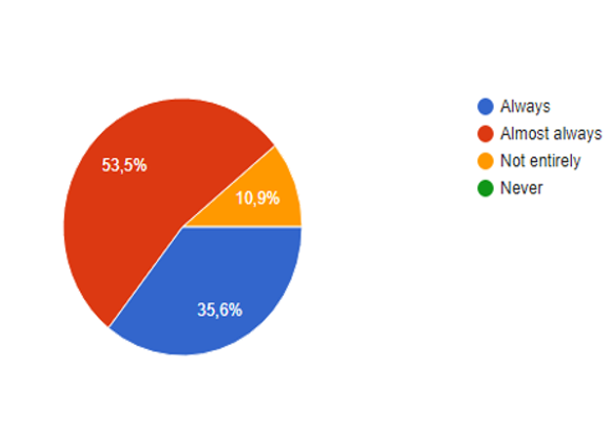
10. Do you know the lyrics to all the songs you like?
More than half of the Romanian respondents have stated that they almost always know the lyrics of all the songs they like; there were 36,6 % who have declared that they always know the lyrics, moreover, 10,9 % admitted to knowing them but not entirely whereas there was not even an answer with never.

Slide 9
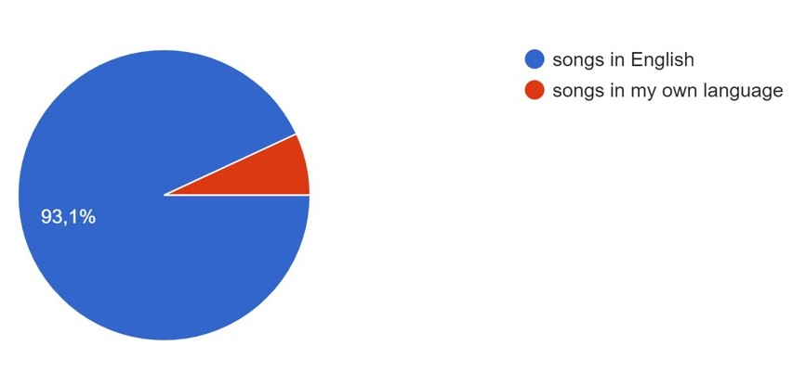
11. Where do you usually listen to music?
Most Romanian respondents usually listen to music at home (84,2 %). There are 66,3 % who listen in their bedroom, an approximately equal percentage of 47,5 %, respectively 46, 5 % who listen to music at their friends’ house, respectively while walking in the street. There are 41,6% from the respondents who listen to music while having a shower, 38,6 % do this on the public transport whereas 36,6 % listen to music while working out or jogging.
12. Which do you prefer, songs in English or songs in your own language?
The vast majority of the Romanian students (93,1%) said that they preferred songs in English whereas only 6,9% listened to the ones in their mother tongue.

Slide 10
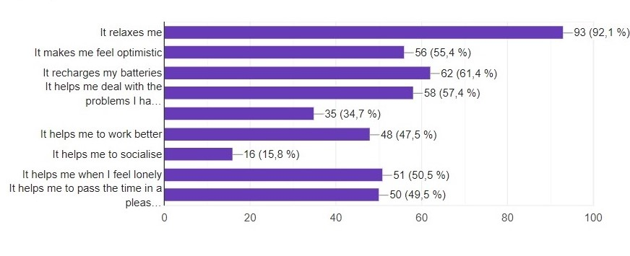
13. Why do you listen to music?
The students have chosen more than one reason why they listen to music. Most students, 92,1%, state that listening to music relaxes them, 61,4% believe that this recharges their batteries, for 57,4 % this activity helps them deal with the problems they have. There are 50,5 % who say that listening to music helps them when they feel lonely and for 49,5 % music helps them pass the time in a pleasant way. For 47,5 % listening to music makes them work better while for 15,8 %, this is a way to socialise.

Slide 11
"This project has been funded with support from the European Commission. This publication reflects the views only of the author, and the Commission cannot be held responsible for any use which may be made of the information contained therein."

