Slide 1
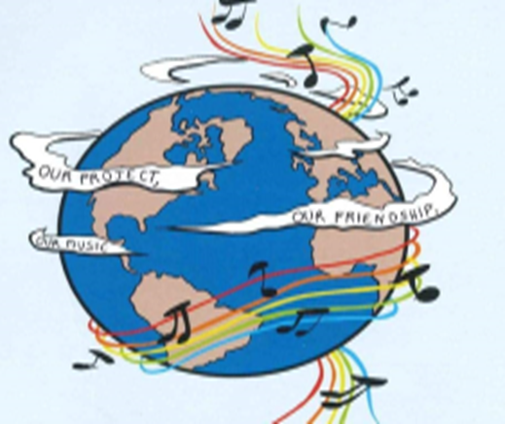
MUSIC: A MELODIC METHODOLOGY INTO TEACHING AND LEARNING 2018-1-ES01-KA229-050761_2 SCHOOL EXCHANGE PARTNERSHIP
The Italian team presents
Co-funded by The Erasmus
Plus Programme
Of the European Union
Friendship through songs

Slide 2
Friends will be friends (Queen)
Another red letter day
So the pound has dropped and the children are creating
The other half ran away
Taking all the cash and leaving you with the lumber
Got a pain in the chest
Doctors on strike what you need is a rest
It's not easy love, but you've got friends you can trust
Friends will be friends
When you're in need of love they give you care and attention
Friends will be friends
When you're through with life and all hope is lost

Slide 3
Hold out your hand 'cause friends will be friends
Right till the end
Now it's a beautiful day
The postman delivered a letter from your lover
Only a phone call away
You tried to track him down but somebody stole his number
As a matter of fact
You're getting used to life without him in your way
It's so easy now, 'cause you got friends you can trust
Friends will be friends
When you're in need of love they give you care and attention
Friends will be friends

Slide 4
When you're through with life and all hope is lost
Hold out your hand 'cause friends will be friends
Right till the end
Friends will be friends
When you're in need of love they give you care and attention
Friends will be friends
When you're through with life and all hope is lost
Hold out your hand 'cause right till the end, friends will be friends
Yeah, yeah

Slide 5
"Friends Will Be Friends" is a song performed by Queen and written by Freddie Mercury and John Deacon, included on the album A Kind of Magic. It was the band's 30th single in the UK upon its release on 9 June 1986, reaching number 14 in the UK.
"Friends Will Be Friends" was performed live on The Magic Tour. It is remarkable in that it was the first and only song that was sung at the end of concerts between "We Will Rock You" and "We Are the Champions" since the News of the World Tour in 1977.
The song was included in various greatest hits compilations by Queen such as, Greatest Flix II and Greatest Video Hits II.
‘’Friends will be friends
When you're in need of love they give you care and attention...’’

Slide 6
1)Warm up
-What is true friendship for you?
-When you’re sad, do you call your friends?
- Is frienship a priority in your life?

Slide 7
2) Listen to the first part of the song and fill the blanks with the words you hear.
Another red letter day
So the pound……. and the children…….
The other half…… away
…… all the cash and…… you with the lumber
Got a pain in the chest
Doctors on strike what you…..is a rest
It's not easy love, but you've got friends you can trust
Friends……friends
When you're in need of love they…..you care and attention
Friends will be friends
When you're through with life and all hope is lost
……out your hand 'cause friends will be friends
Right till the end
ran-hold-taking-give-leaving-has dropped-need-will be-are creating

Slide 8
3) Mark if the following sentences are true or false.
1. The song talks about love: true | false
2. The song is written by a band: true | false
3. It’s an attual song: true | false
4. Lady Gaga sings this song: true | false
5. This song also talks about friendship: true | false

Slide 9
4) Focus on grammar
Put the verbs under the right heading
Present Simple | Future Tense | Present Perfect | Present Continuous

Slide 10
5) Vocabulary
Match the the words of the song to the meanings
1) Lumber A) In reality
2) Rest B) it is a confident expectation
3) As a matter of fact C) “partly” is a synonym
4) Hope D) place where the confusion reigns
5) Half E) when you take a break

Slide 11
6) The song refers to some feelings and some jobs
Complete the table below
Feelings | Jobs

Slide 12
7)Write questions for the following answers.
Use Wh-questions
1).............................................?
I’ve got a pain in the chest
2).............................................?
Tom stole his number
3).............................................?
I called you because I’m so sad and I need someone

Slide 13
You’ve got a friend - James Taylor
When you're down and troubled And you need a helping hand And nothing, nothing is going right Close your eyes and think of me And soon I will be there To brighten up even your darkest night You just call out my name And you know wherever I am I'll come running, oh yeah baby, to see you again Winter, spring, summer or fall All you've got to do is call And I'll be there, ye, ye, ye You've got a friend If the sky above you Should turn dark and full of clouds And that old north wind should begin to blow Keep you head together And call my name out loud now Soon you'll hear me knocking at you door

Slide 14
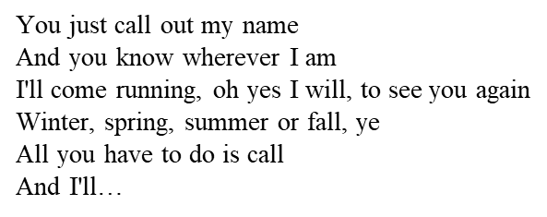
Written and recorded by Carole King in 1971, this song became the biggest, and most well-known hit for then 23
year-old James Taylor, and his only #1 in America. It was the first single off of his third album
Taylor was the first to record it, putting down the track at Crystal Sound studios on Vine Street in Los Angeles with
his band, which included King on piano.
Days later, King recorded her version at A&M studios on La Brea Avenue.
‘When you're down and troubled
And you need a helping hand…’

Slide 15
Warm up
- How important is friendship in your life?
- Can social media help implement friendship?
- When you are down and troubled who do you lean on?

Slide 16
2. Listen to the first part of the song and fill the blanks with the words you hear.
brighten up, call, darkest, down, fall, helping, right, troubled, wherever
When you're __________ and _________ and you need a _________ hand and nothing, oh nothing is going ________, close your eyes and think of me and soon I will be there to _________even your ________night.
You just call out my name and you know ___________I am I´ll come running, oh yeah baby, to see you again. Winter, spring, summer or _________-, all you got to do is __________ and I'll be there yeah yeah yeah you've got a friend.

Slide 17
3)Say if the statements are true or false
1.When the sky grows dark he will not be knocking on the door true | false
2. People never hurt you and desert you true | false
3. Friendship can brighten up your darkest nights true | false

Slide 18
4) Focus on Grammar
Put the verbs under the right heading
Infinitives | Future tense | Conditional sentences | Present perfect

Slide 19
5) Vocabulary
Match the verbs with their definition
1)To brighten up a) to abandon
2)To Desert b) To remain calm
3) To call out c)To become lighter
4)Keep your head together d) To shout something

Slide 20
6) The song refers to moments of the day, seasons, natural elements
Complete the table below
Moment of the day | Season | Natural element

Slide 21
7)Write questions for the following answers.
Use Wh-questions
1).............................................................................?
You will hear me knocking on your door
2)..............................................................................?
Soon I will be there with you
3) …………………………………………………………………………..?
Because you’ve got a friend

Slide 22
Thanks for your Attention

