Slide 1
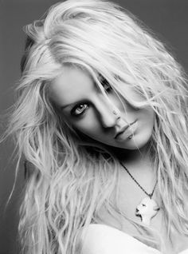
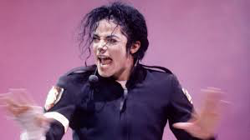
8. Songs that make you think about TOLERANCE:
→RESULTS:
“ Beautiful” by Cristina Aguilera: Christina María Aguilera, known as Christina Aguilera, is a singer, songwriter, actress, model, fashion designer, producer, television personality and American businesswoman of Ecuadorian descent. He was born on December 18, 1980 (age 39), Staten Island, New York, United States.
“Black or White” by Michael Jackson: Michael Joseph Jackson (Gary, Indiana; August 29, 1958-Los Angeles, California; June 25, 2009) was an American singer, songwriter, record producer, dancer, actor and philanthropist. Known as the «King of Pop», his contributions and recognition in the history of music and dance, as well as his publicized personal life, made him an international figure in popular culture for more than four decades. He is recognized as the most successful pop music star in the world. However, his music included a wide range of subgenres such as rhythm and blues (soul and funk), rock, disco and dance.

Slide 2
“Beautiful”
LYRICS OF THE SONGS
Don´t look at me
Every day is so wonderful
And suddenly, it's hard to breathe.
Now and then, I get insecure
From all the fame, I'm so ashamed.
I am beautiful, no matter what they say.
Words can't bring me down.
I am beautiful in every single way.
Yes, words can't bring me down.
So don't you bring me down today.
To all your friends, you're delirious.
So consumed in all your doom,
Trying hard to fill the emptiness.
The piece is gone
And the puzzle undone.
That's the way it is.
You are beautiful, no matter what they say.
Words won't bring you down.
You are beautiful in every single way.
Yes, words won't bring you down.
Don't you bring me down today.
No matter what we do,
No matter what they say,
We're the song inside the tune
Full of beautiful mistakes.
And everywhere we go
The sun will always shine.
And tomorrow we might wake on the other side.
All the other times.
We are beautiful, no matter what they say.
Yes, words won't bring us down.
We are beautiful, no matter what they say.
Yes, words can't bring us down.
Don't you bring me down today.
Don't you bring me down today.
The first lines lines talk about insecurity.Some people go through life conditioned by other people´s opinion
Next, lyrics express that beauty isn´t just on the outside, it´s also on
the inside, and it doesn´t correspond to stereotypes because perfection doesn´t exist and imperfections makes you special and “beautiful” in every way.
She is giving a positive message, encouraging everybody to embrace and love themselves despite people´s negative comments or opinions.

Slide 3
"Black or White”
I took my baby on a Saturday bang
Boy, is that girl with you?
Yes, we're one and the same
Now, I believe in miracles
And a miracle has happened tonight
But, if you're thinking about my baby
It don't matter if you're black or white
They print my message in the Saturday Sun
I had to tell them I ain't second to none
And I told 'em about equality
And it's true, either you're wrong or you're right
But, if you're thinking about my baby
It don't matter if you're black or white
am tired of this devil
I am tired of this stuff
I am tired of this business
So when the going gets rough
II ain't scared of your brother
I ain't scared of no sheets
I ain't scared of nobody
Girl, when the going gets mean
Michael points out that color or race separates the world, but he would
prefer that the world not be that way. Instead, he wants to be looked
at not by his skin, but by who he is.
Protection for gangs, clubs and nations
Causing grief in human relations
It's a turf war on a global scale
I'd rather hear both sides of the tale
See, it's not about races
Just places, faces
Where your blood comes from is where your space is
I've seen the bright get duller
I'm not going to spend my life being a color
Don't tell me you agree with me
When I saw you kicking dirt in my eye
But, if you're thinking about my baby
It don't matter if you're black or white
But, if you're thinking about my baby
It don't matter if you're black or white
I said, if you're thinking of being my brother
It don't matter if you're black or white
It's black, it's white
It's tough for you to get by
It's black, it's white
He also explains that young people are often stereotyped to be part of gangs and often go to clubs. Then, they need protection from everyday danger but they
are often unnoticed and left vulnerable, as governments focus their
money on fighting wars, this is the reason for the metaphor of being a small “turf war”.
In general, the lyrics of this song are a plea for racial tolerance.

Slide 4
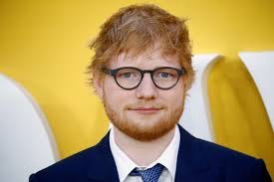
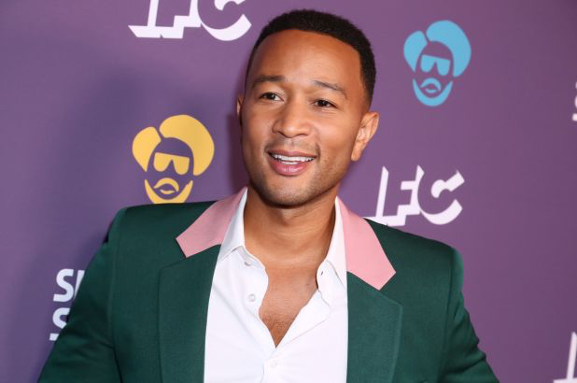
The songs that make us feel love in Spain are:
All of me-John legend
John Roger Stephens (born December 28, 1978), known professionally as John Legend, is an American singer, songwriter, producer, actor, and philanthropist.In 2007, Legend received the Hal David Starlight Award from the Songwriters Hall of Fame. He has also won ten Grammy Awards.
Perfect- Ed sheeran
Edward Christopher Sheeran ( born 17 February 1991) is an English singer, songwriter, record producer, and actor.Sheeran has sold more than 150 million records worldwide, making him one of the world's best-selling music artists.. Spotify named him the second most streamed artist of the decade.
Si por mi fuera-Beret
Francisco Javier Álvarez Beret (born in Seville on July 2, 1996), known as Beret is a Spanish singer of "urban" music.He suffered depression 4 years before launching himself to fame or before publishing simple subjects. Its content is mostly for teenagers and they carry a lesson so that no teenagers will pass what happened to him. Francisco (Beret) achieved greater recognition by the public with the song Sorry, simple with which many of his fans felt identified.
9.Songs that make you think about LOVE: → RESULTS:
The songs that make us feel love in Spain are:
“Perfect” by Ed sheeran: Edward Christopher Sheeran ( born 17 February 1991) is an English singer, songwriter, record producer, and actor.Sheeran has sold more than 150 million records worldwide, making him one of the world's best-selling music artists.. Spotify named him the second most streamed artist of the decade.
“All of me” by John Legend: John Roger Stephens (born December 28, 1978), known professionally as John Legend, is an American singer, songwriter, producer, actor, and philanthropist.In 2007, Legend received the Hal David Starlight Award from the Songwriters Hall of Fame. He has also won ten Grammy Awards.

Slide 5
LYRICS OF THE SONGS
All Of Me
What would I do without your smart mouth
Drawing me in, and you kicking me out
You got my head spinning, no kidding, I can't pin you down
What's going on in that beautiful mind
I'm on your magical mystery ride
And I'm so dizzy, don't know what hit me, but I'll be alright
My head's underwater
But I'm breathing fine
You're crazy and I'm out of my mind
Cause all of me
Loves all of you
Love your curves and all your edges
All your perfect imperfections
How many times do I have to tell you
Even when you're crying you're beautiful too
The world is beating you down, I'm around through every mood
You're my downfall, you're my muse
My worst distraction, my rhythm and blues
I can't stop singing, it's ringing in my head for you
My head's underwater
But I'm breathing fine
You're crazy and I'm out of my mind
Here John legends talks about his wife´s particular way of speaking and he says he loves that.
Cause all of me
Loves all of you
Love your curves and all your edges
All your perfect imperfections
Give your all to me
I'll give my all to you
You're my end and my beginning
Even when I lose I'm winning
Cause I give you all ...
Cause I give you all of me
And you give me all of you,
Cause I give you all of me
And you give me all of you
He is completely in love, he loves everything in this woman
Finally, he says that his love for this girl is sincere and will never change.
Here John says that Love can feel overwhelming, like swimming in powerful ocean currents, but he he is fine with that

Slide 6
Perfect
I found a love for me
Darling just dive right in
And follow my lead
Well I found a girl beautiful and sweet
I never knew you were the someone waiting for me
'Cause we were just kids when we fell in love / Not knowing what it was
I will not give you up this time
But darling, just kiss me slow, your heart is all I own
And in your eyes you're holding mine
Baby, I'm dancing in the dark with you between my arms
Barefoot on the grass, listening to our favorite song
When you said you looked a mess, I whispered underneath my breath
But you heard it, darling, you look perfect tonight
Well I found a woman, stronger than anyone I know
She shares my dreams, I hope that someday I'll share her home
I found a love, to carry more than just my secrets
To carry love, to carry children of our own
We are still kids, but we're so in love
Fighting against all odds
I know we'll be alright this time
Darling, just hold my hand
Be my girl, I'll be your man
I see my future in your eyes
Baby, I'm dancing in the dark, with you between my arms
Barefoot on the grass, listening to our favorite song
When I saw you in that dress, looking so beautiful
I don't deserve this, darling, you look perfect tonight
Baby, I'm dancing in the dark, with you between my arms
Barefoot on the grass, listening to our favorite song
I have faith in what I see
Now I know I have met an angel in person
And she looks perfect
I don't deserve this
You look perfect tonight
Here he explains he was the first to fall in love and that they met when they we still kids but he didn´t know she would be his woman.
Here he confirms his commitment to his girl, he is ready for marriage.
He wants her to be the mother of his children.
This emphasizes how close they are. He stares at her because he loves her a lot.
He shows that dancing in silence with your love is an important sign of affection.

Slide 7
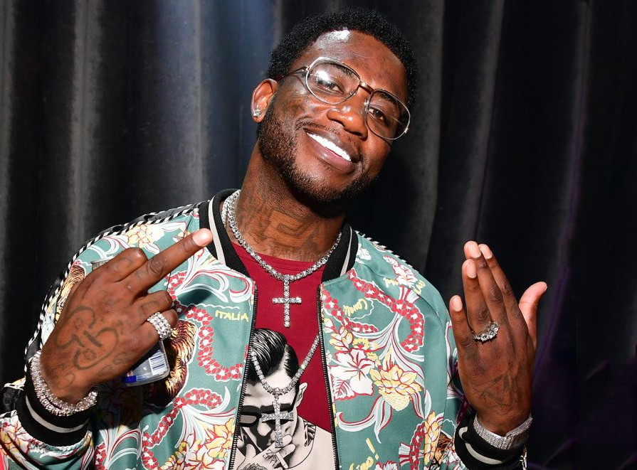
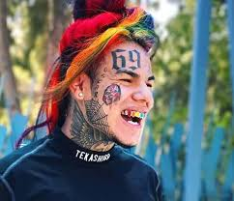
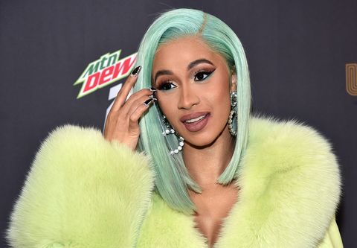
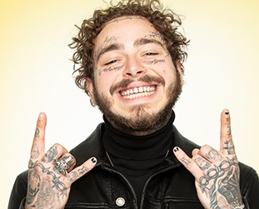
10. What kind of music do you usually listen to if you are sad?
The music genre students have mentioned the most related to feeling sad is TRAP:
Trap is a style of hip hop music that originated in the Southern United States during the late 1990s. The term trap refers to buildings where illegal substances are sold.
Typical lyrical themes include street life, violence and hard life experiences that artists have faced in their southern American surroundings.
Trap music employs multilayered textured monophonic drones with a melodic accompaniment expressed with synthesizers; crisp, grimy, and rhythmic snares and a cinematic and symphonic use of string, brass, woodwind, and keyboard instruments to create an energetic and variant atmosphere.
During the early- to mid-2000s, trap music began to emerge as a recognized genre after the mainstream success of a number of albums and singles with lyrics that covered life in "the trap” and the struggle for success.
Several Southern rappers such as Gucci Mane produced crossover hits and helped expand the popularity of the genre. Some other famous trap singers nowadays are, 6IX9INE, Cardi B or Post Malone.
Gucci Mane
6IX9INE
Cardi B
Post Malone

Slide 8
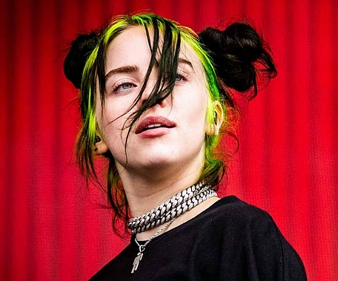
11. Songs you listen when you feel SAD: → RESULTS:
“CHANGES” by XXXTentacion (January 23, 1998 – June 18, 2018), an American rapper, singer, songwriter and musician. Despite being a controversial figure he developed a great popularity during his short career. He was often credited by critics and fans for his musical versatility, exploring trap, R&B or rock.
He was born in Florida and started his music career on SoundCloud in 2013, becaming a popular figure with the single "Look at Me”. His debut album, (2017), was number two on the Billboard 200 and his second album, (2018), was number one on the Billboard 200. In the week following his death, XXXTentacion's highest-charting single, "Sad!", went from number 52 to number one on the Billboard Hot 100.
“LOVELY” by Billie Eilish (December 18, 2001), an American singer and songwriter. She first gained media attention in 2016 when she uploaded the song "Ocean Eyes" to SoundCloud. The song was written and produced by her brother. Her debut EP, Don't Smile at Me (2017), reached the top 15 in the US, UK, Canada, and Australia.
Eilish's debut studio album, When We All Fall Asleep, Where Do We Go? (2019), became the best-performing album of 2019 in the US. It also reached number one in the UK. The album contains six Billboard Hot 100 top 40 singles.
She has won five Grammy Awards, two American Music Awards, two Guinness World Records, and three MTV Video Music Awards. She is the youngest person and first woman to win the four main Grammy categories, Best New Artist, Record of the Year, Song of the Year, and Album of the Year in the same year.

Slide 9
LYRICS OF THE SONGS
Billie Eilish believes she found a way out of their depression, but she realises it hasn’t gone away. Rather than continue to fight these feelings, she accepts that depression will always be a piece of her.
Changes
Mmm, baby, I don't understand this
You're changing, I can't stand it
My heart can't take this damage
And the way I feel, can't stand it
Mmm, baby, I don't understand this
You're changing, I can't stand it
My heart can't take this damage
And the way I feel, can't stand it
Mmm, baby, I don't understand it
Girl, you're making it hard for me
Girl, you're making it hard for me
Girl, you're making it hard for me
Girl, you're making it hard for me
Girl, you're making it hard for me
Girl, you're making it hard for me
Mmm, baby, I don't understand this
You're changing, I can't stand it
My heart can't take this damage
And the way I feel, can't stand it
Mmm, baby, I don't understand this
You're changing, I can't stand it
My heart can't take this damage
And the way I feel, can't stand it (x2) broke his heart
Lovely
Thought I found a way
Thought I found a way, yeah (found)
But you never go away (never go away)
So I guess I gotta stay now
Oh, I hope some day I'll make it out of here
Even if it takes all night or a hundred years
Need a place to hide, but I can't find one near
Wanna feel alive, outside I can fight my fear
Isn't it lovely, all alone?
Heart made of glass, my mind of stone
Tear me to pieces, skin to bone
Hello, welcome home
Walkin' out of town
Lookin' for a better place
Something's on my mind
Always in my headspace
But I know some day I'll make it out of here
Even if it takes all night or a hundred years
Need a place to hide, but I can't find one near
Wanna feel alive, outside I can fight my fear
Isn't it lovely, all alone?
Heart made of glass, my mind of stone
Tear me to pieces, skin and bone
Hello, welcome home / Woah, yeah Yeah, ah
Woah, woah Hello, welcome home
The singer expresses he is struggling a lot with a love, he suffers and can´t understand the situation.
This woman has broken his heart and he finds difficult to deal with the situation
Here she says that she is vulnerable but she has also become cold and hard.
At the end she is optimistic and she thinks that one day she will recover from this bad situation.

Slide 10
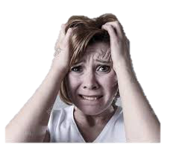
12. If music were removed from the world, how would you feel?
Among all the different answers the ones expressing VERY BAD FEELINGS are the ones that stand up. These are some examples:
Devastated!
Utterly sad
Very sad
Sad
I would feel very bad , disappointed and very sad.
Discouraged
I would feel sad
Alone
I would feel blue because I love music
very bad because not without music I can not live without it
Very sad because music is what makes me feel alive
Empty without feelings
I would feel terrible, because there can't be a world without music, we are music since we were born, nobody can take it away from us.
I would be dissapointed...
Depressed
Discontent
Empty inside
Frustrated, I woudln´t have any way to disconect from my problems

Slide 11
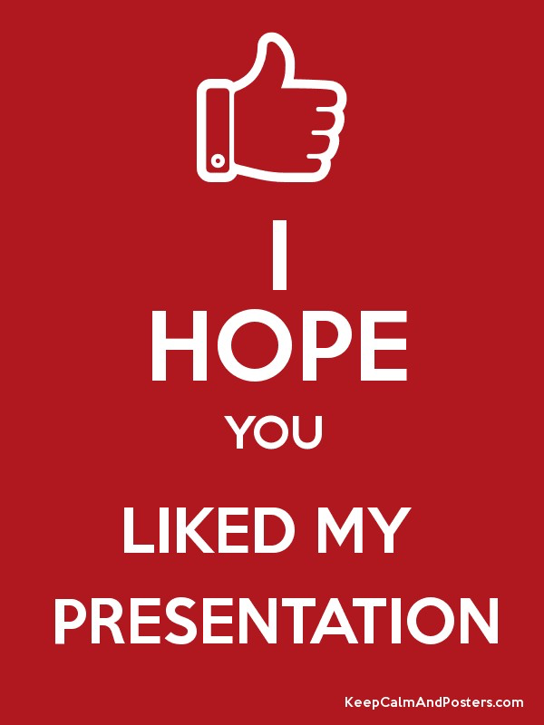
MARÍA
RAÚL
MANU
ÓSCAR
JOSE MARÍA

