Slide 1
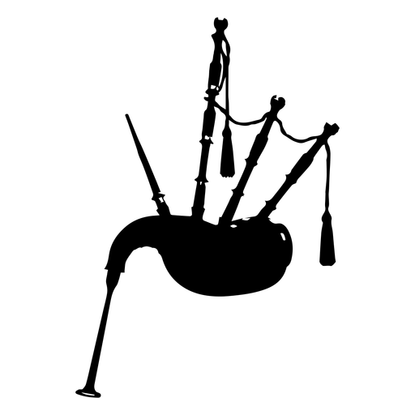
Traditional Instruments
ANALYSIS OF 5 SPANISH MUSIC INSTRUMENTS
Gaita Gallega (Gallician Gaita)
Cajón (Drum Box)
Castañuelas (Castanets)
Guitarra Flamenca (Spanish Guitar)
Acordeón (Accordion)

Slide 3
History of the instrument

Slide 5
History of the instrument

Slide 7
History of the instrument

Slide 9
History of the instrument

Slide 11
History of the instrument

