Slide 1
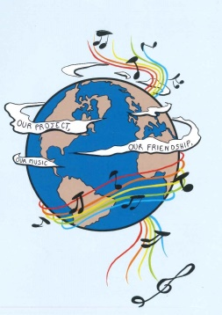
MUSIC: A MELODIC METHODOLOGY INTO TEACHING AND LEARNING 2018-1-ES01-KA229-050761 SCHOOL EXCHANGE PARTNERSHIP
SONGS ABOUT TOLERANCE - GREECE

Slide 2
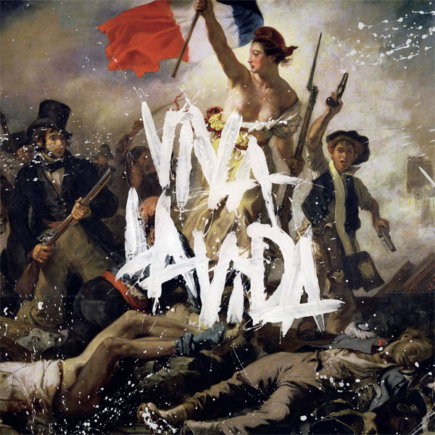
1. “VIVA LA VIDA” - COLDPLAY
https://www.youtube.com/watch?v=dvgZkm1xWPE

Slide 3
1. “VIVA LA VIDA” - COLDPLAY
I used to rule the world
Seas would rise when I gave the word
Now in the morning I sleep alone
Sweep the streets I used to own
I used to roll the dice
Feel the fear in my enemy's eyes
Listened as the crowd would sing
Now the old king is dead long live the king
One minute I held the key
Next the walls were closed on me
And I discovered that my castles stand
Upon pillars of salt and pillars of sand

Slide 4
1. “VIVA LA VIDA” - COLDPLAY
I hear Jerusalem bells are ringing
Roman cavalry choirs are singing
Be my mirror, my sword and shield
Missionaries in a foreign field
For some reason I can't explain
Once you'd gone there was never
Never an honest word
And that was when I ruled the world
It was a wicked and wild wind
Blew down the doors to let me in
Shattered windows and the sound of drums
People couldn't believe what I'd become
Revolutionaries wait
For my head on a silver plate
Just a puppet on a lonely string
Oh who would ever want to be king?

Slide 5
1. “VIVA LA VIDA” - COLDPLAY
I hear Jerusalem bells are ringing
Roman cavalry choirs are singing
Be my mirror, my sword and shield
My missionaries in a foreign field
For some reason I can't explain
I know St Peter won't call my name
Never an honest word
But that was when I ruled the world
Hear Jerusalem bells are ringing
Roman cavalry choirs are singing
Be my mirror, my sword and shield
My missionaries in a foreign field
For some reason I can't explain
I know St Peter won't call my name
Never an honest word
But that was when I ruled the world

Slide 6
ANALYSIS:
"Viva La Vida" is a song by British rock band, Coldplay. It was written by all members of the band for their fourth album, Viva La Vida or Death and All His Friends (2008).The lyrics to the song contain historical and Christian references. The song won the Grammy Award for Song of the Year in 2009. The song's Spanish title, "Viva la Vida", is taken from a painting by 20th-century Mexican artist Frida Kahlo. In Spanish viva is an expression used to acclaim someone or something, so "Long Live Life" is an accurate translation and the painting reflects the artistic irony of acclaiming life while suffering physically, and this is a situation of tolerance. When asked about the album's title, referring to Frida Kahlo's strength, enduring polio, a broken spine, and a decade of chronic pain, lead singer Chris Martin said: "She went through a lot of pain, of course, and then she started a big painting in her house that said 'Viva la Vida', I just loved the boldness of it."

