Slide 1
Co-funded by The Erasmus Plus Programme Of the European Union
MUSIC: A MELODIC METHODOLOGY INTO TEACHING AND LEARNING 2018-1-ES01-KA229-050761_2 SCHOOL EXCHANGE PARTNERSHIP The Italian team presents:
Music -what and why I listen to.

Slide 2
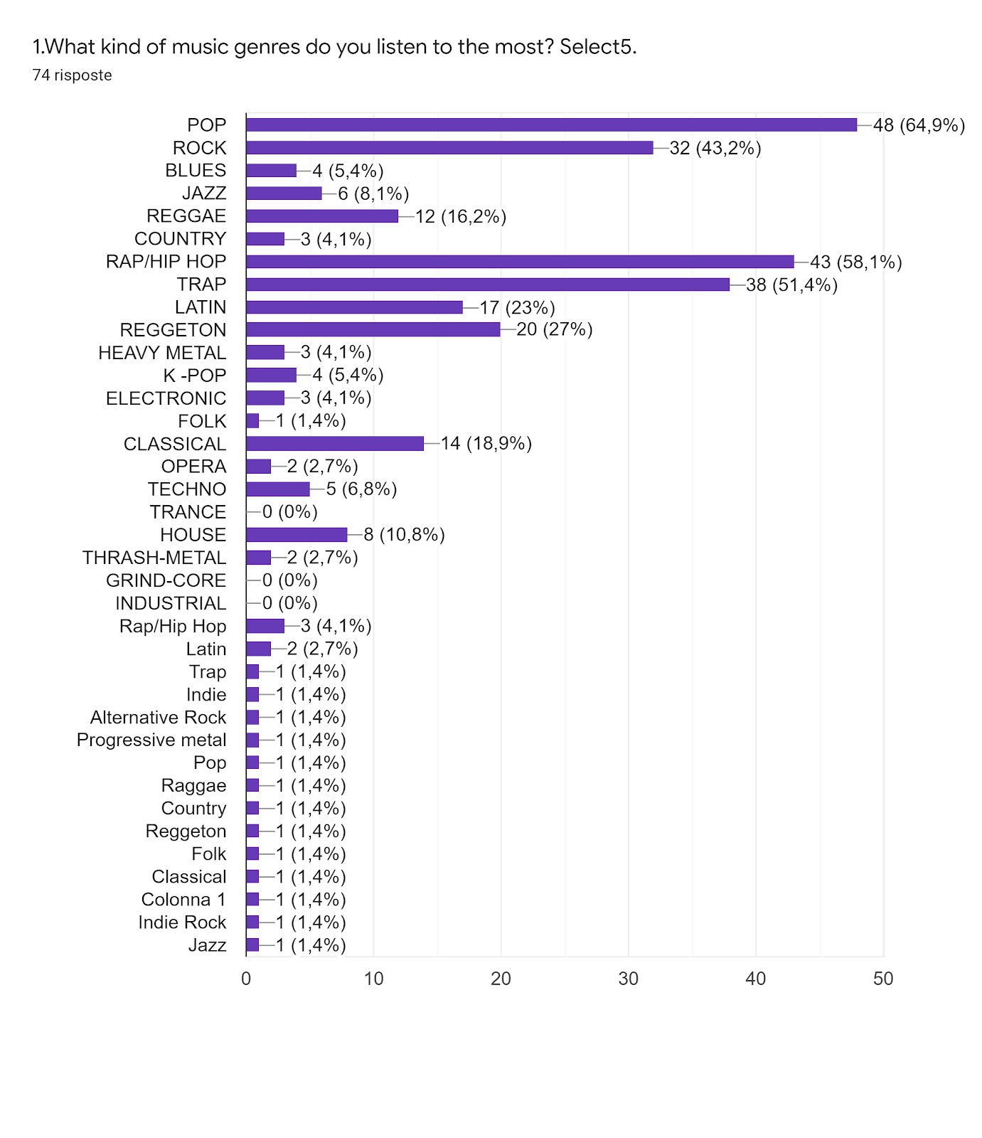
RESULTS
Pop -64,9% Rap/HipHop – 58,1% Trap – 51,4% Rock 43,2% Reggeton – 27% Latin- 23%
Classical – 18,9% Raggae – 16,2% House 10,8% Techno 6.8% K-Pop 5,4% Electronic 4,1%
Thrash-Metal 2,7% Opera 2,7% Folk 1,4% Others 1,4%

Slide 3
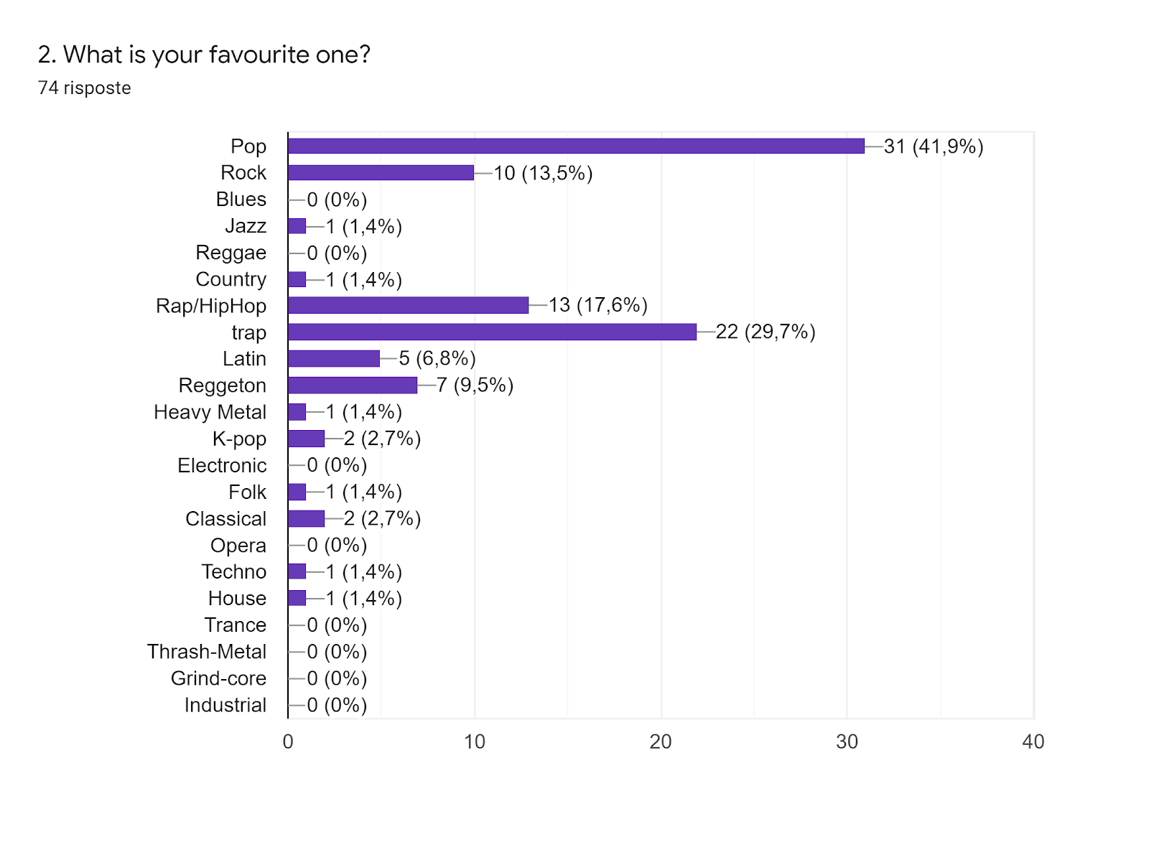
RESULTS
Pop 41,9% Trap 29,7% Rap/HipHop 17,6% Rock 13,5% Reggeton 9,5% Latin 6,8% K-pop 2,7%
Classical 2,7% Techno 1,4% Heavy Metal 1,4% Folk 1,4 % House 1,4% Country 1,4% Jazz 1,4 %

Slide 4
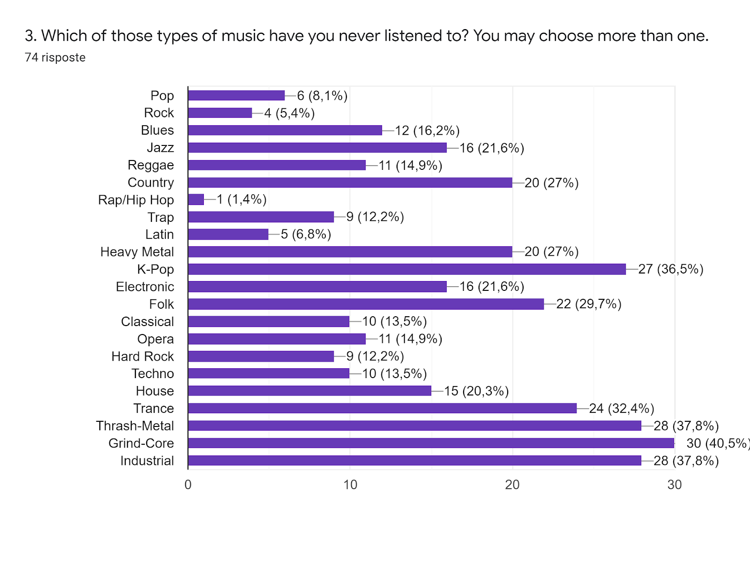
RESULTS
Grind –core 40,5% Industrial 37,8% Thrash metal 37,8% K-pop 36,5 Trance 32,4% Folk 29,7%
Heavy metal 27% Country 27% Electronic 21,6% Jazz 21,6% House 20,3% Blues 16,2 Reggae 14,9%
Opera 14,9% Techno 13,5% Classical 13,5% Trap 12.2% Hard Rock 12,2% Pop 8,1% Latin 6,8% Rock 5,4%
Rap/HipHop 1,4%

Slide 5
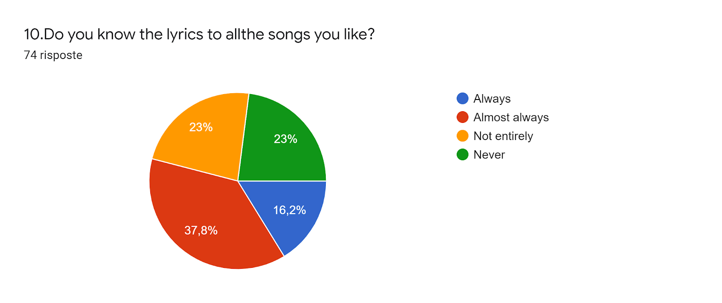
RESULTS
Always - 23%
Almost Always – 37,8%
Not entirely - 23%
Never – 23%

Slide 6
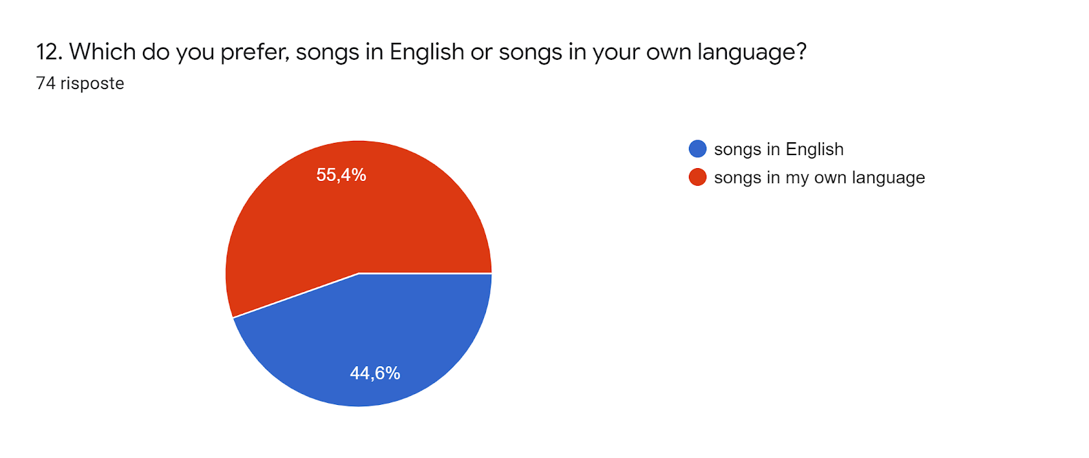
RESULTS
Songs in my own language 55,4%
Song in English 44,6 %

Slide 7
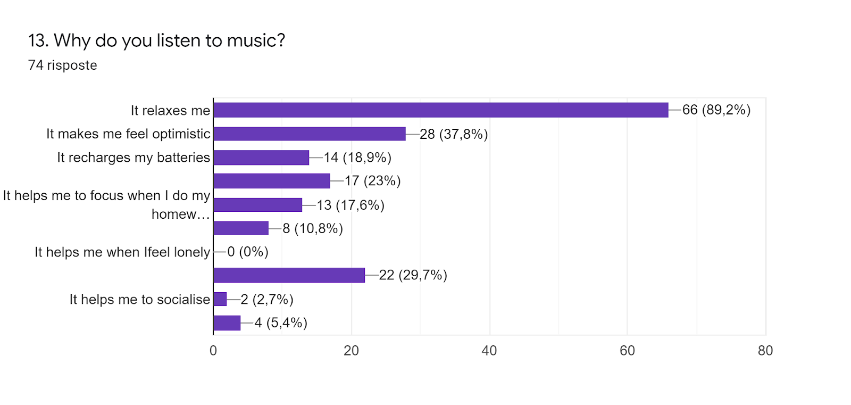
RESULTS
It relaxes me 89,2%
It makes me feel optimistic 37,8%
It helps me deal with the problem I have 23%
It recharge my batteries18,9%
It helps me focus when I do my homework 17,6%
It helps me to work better 10,8%
It helps me to socialise 2,7%
It helps me to pass the time in a special way 5,4%

Slide 8
THANKS FOR YOU ATTENTION

