Slide 1
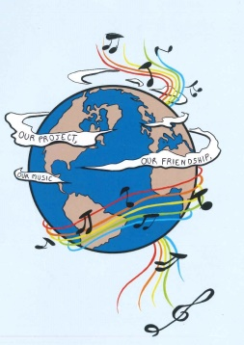
MUSIC: A MELODIC METHODOLOGY INTO TEACHING AND LEARNING 2018-1-ES01-KA229-050761 SCHOOL EXCHANGE PARTNERSHIP
A GEEK SONG ABOUT…
ΤΑ ΠΑΙΔΙΑ ΖΩΓΡΑΦΙΖΟΥΝ ΣΤΟΝ ΤΟΙΧΟ (TA PEDIA ZOGRAFIZOUN STON TIHO) - GREECE

Slide 2
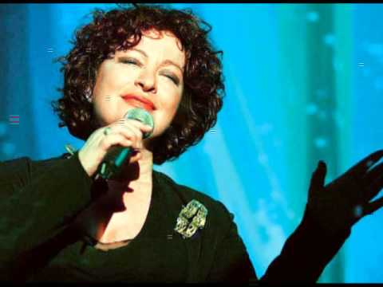
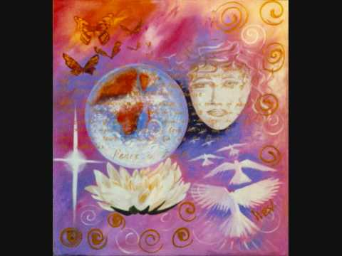
ΤΑ ΠΑΙΔΙΑ ΖΩΓΡΑΦΙΖΟΥΝ ΣΤΟΝ ΤΟΙΧΟ (TA PEDIA ZOGRAFIZOUN STON TIHO) - TANIA TSANAKLIDOU
https://www.youtube.com/watch?v=9VBrDybLai0
https://www.youtube.com/watch?v=uF4iIFBtr1I

Slide 3
ΤΑ ΠΑΙΔΙΑ ΖΩΓΡΑΦΙΖΟΥΝ ΣΤΟΝ ΤΟΙΧΟ (TA PEDIA ZOGRAFIZOUN STON TIHO)
Τα παιδιά ζωγραφίζουν στον τοίχο (The children are painting on the wall)
δυο καρδιές κι έναν ήλιο στη μέση (two hearts with a sun between them)
παίρνω φως από τον ήλιο (I get light from the sun)
και φτιάχνω την αγάπη (and I construct love)
και μου λες πως σ’ αρέσει (and you’re telling me you like it)
Τα παιδιά τραγουδούν μες στους δρόμους(The children are singing in the streets)
κι η φωνή τους τον κόσμο αλλάζει(And their voices change the world)
τα σκοτάδια σκορπάνε (Darkness is shattered)
κι η μέρα λουλουδίζει (And the day blooms)
σαν άνθος στο περβάζι (just like a flower on the window sill)
Ένα σύννεφο είναι η καρδιά μου (My heart is a cloud)
κι η ζωή μου γιορτή σε πλατεία (and my life a feast in a park)
σ’ αγαπώ κι ο απέραντος κόσμος (I love you and the vast world)
πόσο μοιάζει με μικρή πολιτεία (looks so much like a small town)

Slide 4
ANALYSIS:
«Τα παιδιά ζωγραφίζουν στον τοίχο»- “The children are painting on the wall” is a song by Yiorgos Chatzinasios (music) and Michalis Bourboulis (verse) sung by the Greek singer Tania Tsanaklidou in 1980, but it is still sung by almost everyone in Greece, as it is a hymn to optimism and portrays images of the Greek culture and life, as well as images of Greece: The sun is always present in Greece, giving life and uplifting the spirits of the Greeks. The flower on the window sill is an image so common in every Greek house! And the life, which is a feast in the park, it is just typical of the Greek celebrations: every village and town has a central square (park) where all important events take place, it is a meeting point, a point where people exchange ideas, a place where all kinds of revolutions begin. The children sing and their voices alone can change the world… Imagine a world where children’s voices were not heard…it would be a devastating thing, a nightmare. Children represent hope, a better future, innocence and unconditional love.

