Slide 1
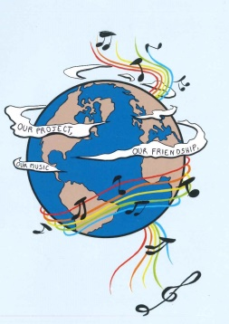
MUSIC: A MELODIC METHODOLOGY INTO TEACHING AND LEARNING 2018-1-ES01-KA229-050761 SCHOOL EXCHANGE PARTNERSHIP
SONGS ABOUT PEACE - GREECE

Slide 2
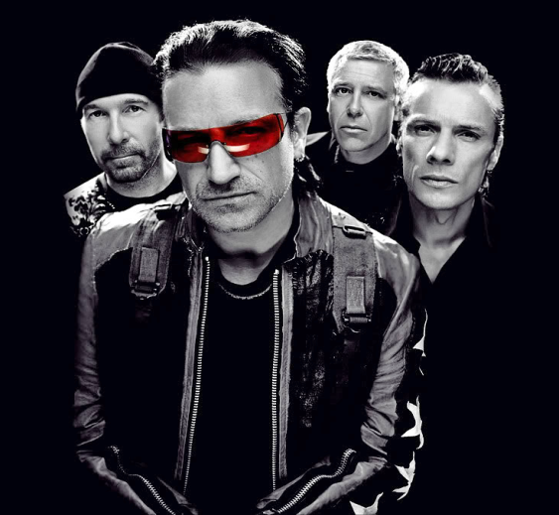
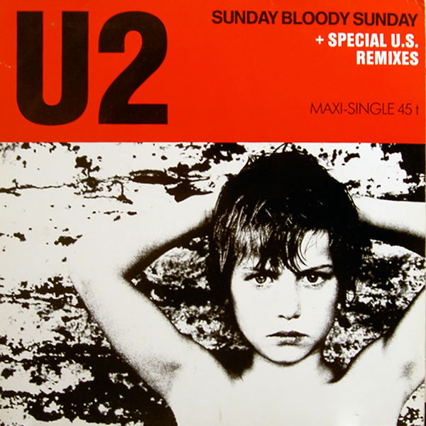
2.SUNDAY, BLOODY SUNDAY- U2
https://www.youtube.com/watch?v=EM4vblG6BVQ

Slide 3
2.SUNDAY, BLOODY SUNDAY- U2
I can't believe the news today Oh, I can't close my eyes And make it go away How long... How long must we sing this song How long, how long... 'cause tonight...we can be as one Tonight... Broken bottles under children's feet Bodies strewn across the dead end street But I won't heed the battle call It puts my back up Puts my back up against the wall Sunday, Bloody Sunday Sunday, Bloody Sunday Sunday, Bloody Sunday And the battle's just begun There's many lost, but tell me who has won The trench is dug within our hearts And mothers, children, brothers, sisters Torn apart Sunday, Bloody Sunday Sunday, Bloody Sunday

Slide 4
2.SUNDAY, BLOODY SUNDAY- U2
How long... How long must we sing this song How long, how long... 'cause tonight...we can be as one Tonight...tonight... Sunday, Bloody Sunday Sunday, Bloody Sunday Wipe the tears from your eyes Wipe your tears away Oh, wipe your tears away Oh, wipe your tears away (Sunday, Bloody Sunday) Oh, wipe your blood shot eyes (Sunday, Bloody Sunday) Sunday, Bloody Sunday (Sunday, Bloody Sunday) Sunday, Bloody Sunday (Sunday, Bloody Sunday) And it's true we are immune When fact is fiction and TV reality And today the millions cry We eat and drink while tomorrow they die (Sunday, Bloody Sunday) The real battle just begun To claim the victory Jesus won On... Sunday Bloody Sunday Sunday Bloody Sunday...

Slide 5
ANALYSIS:
"Sunday Bloody Sunday" is a song by the Irish rock band U2. It is the opening track from their 1983 album War. "Sunday Bloody Sunday" is noted for its militaristic drumbeat, harsh guitar, and melodic harmonies. One of U2's most overtly political songs, its lyrics describe the horror felt by an observer of the Troubles in Northern Ireland, mainly focusing on the 1972 Bloody Sunday incident in Derry where British troops shot and killed 13 unarmed Catholics. The incidents and warlike situation in Northern Ireland involved the battles, dispute, between Catholics and Protestants. People are dying every single day through bitterness and hate, and we're saying why? What's the point? Let's forget the politics, let's stop shooting each other and sit around the table and talk about it.

