Slide 1
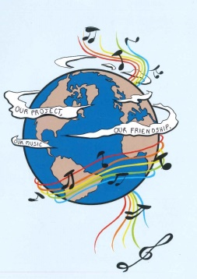
MUSIC: A MELODIC METHODOLOGY INTO TEACHING AND LEARNING 2018-1-ES01-KA229-050761 SCHOOL EXCHANGE PARTNERSHIP
SONGS ABOUT PEACE - GREECE

Slide 2
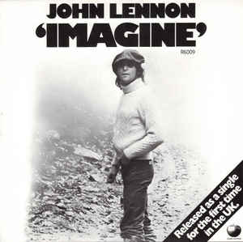
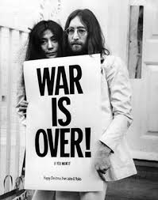
1.IMAGINE-JOHN LENNON
https://www.youtube.com/watch?v=YkgkThdzX-8

Slide 3
1.IMAGINE-JOHN LENNON
Imagine there's no heaven It's easy if you try No hell below us Above us only sky Imagine all the people Living for today... Aha-ah... Imagine there's no countries It isn't hard to do Nothing to kill or die for And no religion, too Imagine all the people Living life in peace... You... You may say I'm a dreamer But I'm not the only one I hope someday you'll join us And the world will be as one

Slide 4
1.IMAGINE-JOHN LENNON
Imagine no possessions I wonder if you can No need for greed or hunger A brotherhood of man Imagine all the people Sharing all the world... You... You may say I'm a dreamer But I'm not the only one I hope someday you'll join us And the world will live as one

Slide 5
ANALYSIS:
"Imagine" is a song co-written and performed by English musician John Lennon from his 1971 album of the same name. The best-selling single of his solo career, its lyrics encourage the listener to imagine a world at peace without the barriers of borders or the divisions of religion and nationality and to consider the possibility that the whole of humanity would live unattached to material possessions. Shortly before his death, Lennon said that much of the song's "lyric and content" came from his wife Yoko Ono, and in 2017, she received a co-writing credit. Her poems inspired him with “Imagine”, which is one of the 100 most-performed songs of the 20th century. In the song, the fact that there are borders, different religions, greed, materialism etc is what causes wars. However, nobody seems to think that we all live under one sky and no matter what we do, we will all die someday.

