Slide 1
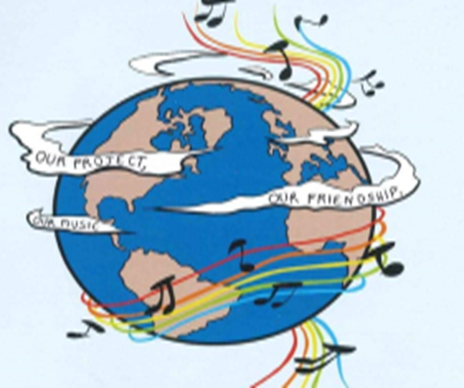
MUSIC: A MELODIC METHODOLOGY INTO
TEACHING AND LEARNING 2018-1-ES01-KA229-050761_2 SCHOOL EXCHANGE PARTNERSHIP The Italian team presents:
Co-funded by The Erasmus Plus Programme Of the European Union
Music unites people

Slide 2
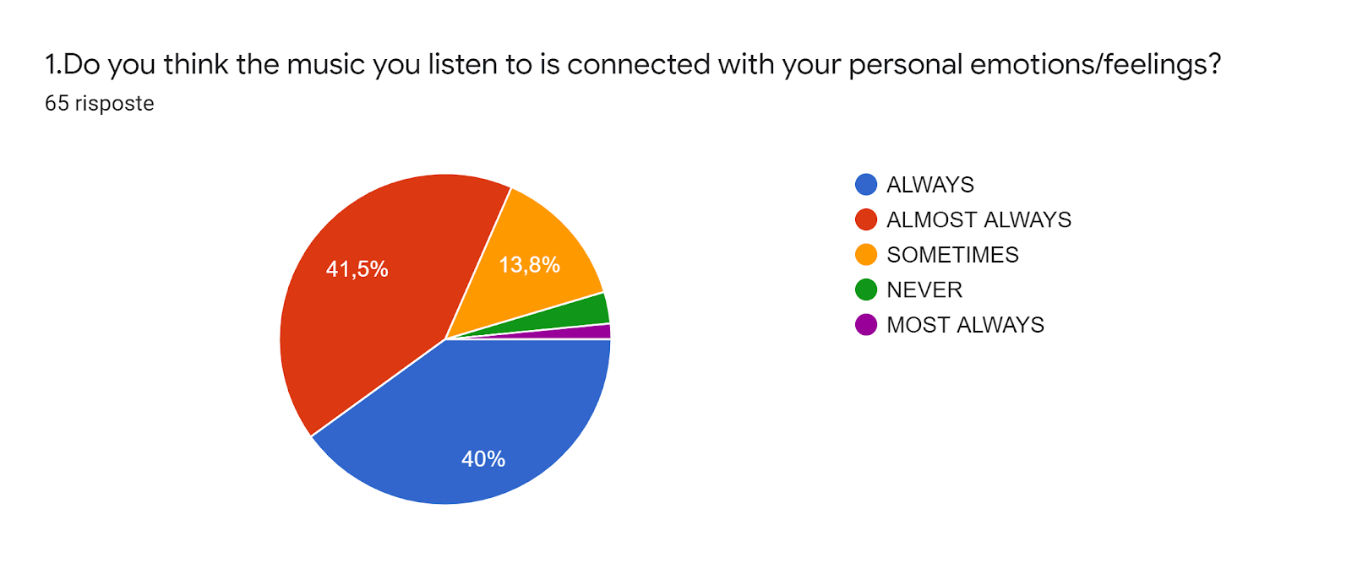
Results
Almost always 41,5%
Always 40%
Sometimes 13,8%

Slide 3
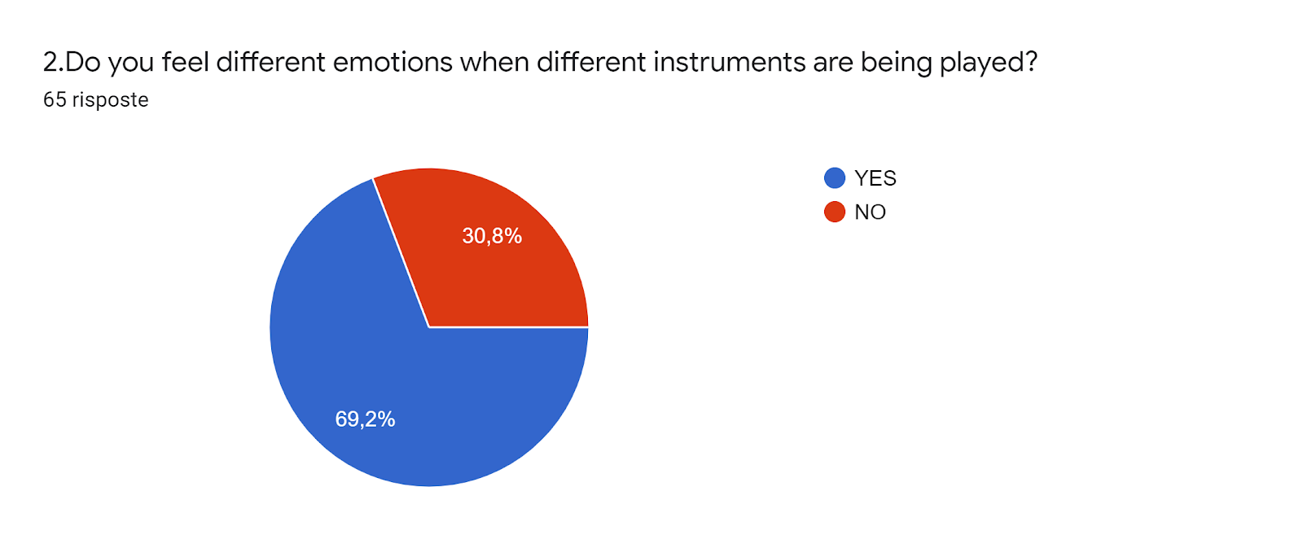
Results
Yes 62%
No 38,8%

Slide 5
4.1 On what type of music do you dance The top 3 Italian responses were: Pop Rock Latin/Reggae

Slide 6
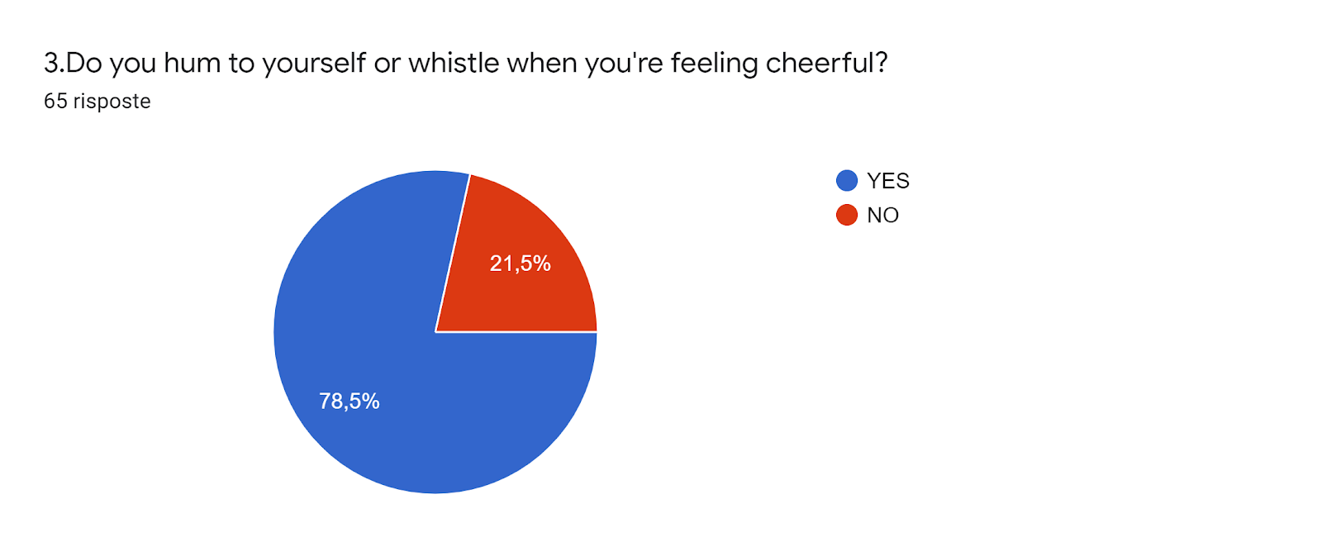
Results
Yes 78,5
No 21,5

Slide 7
Results
Yes 78,5
No 18,5

Slide 8
7. Name one song in English that comforts you if you feel blue and another one in your mother tongue: song in English The Italian responses are: Hold my Hand Something just like this Perfect

Slide 9
8. What song makes you think about tolerance? Name one in English and one in your mother tongue: song in English The Italian responses are Black or white Where is the love Heal the world
9. What song makes you think about love? Name one in English and one in your mother tongue: song in English
The Italian responses are:
All of me
Love of my life
Perfect

Slide 10
10. What song makes you think about peace? Name one in English and one in your mother tongue: song in English The Italian responses are Imagine Mandela day We are the world

Slide 11
SONGS OF LOVE

Slide 12
ALL OF ME:
(chorus)
What would I do without your smart mouth
Drawing me in and you kicking me out?
Got my head spinning, no kidding
I can't pin you down
What's going on in that beautiful mind?
I'm on your magical mystery ride
And I'm so dizzy, don't know what hit me
But I'll be alright
(pre-chorus)
My head's underwater
But I'm breathing fine
You're crazy and I'm out of my mind
(chorus)
Cause all of me loves all of you
Love your curves and all your edges
All your perfect imperfections
Give your all to me, I'll give my all to you
You're my end and my beginning
Even when I lose, I'm winning
How many times do I have to tell you
Even when you're crying, you're beautiful too?
The world is beating you down
I'm around through every move
You're my downfall, you're my muse
My worst distraction, my rhythm and blues
Can't stop singing, this ringing in my head for you
(pre-chorus)
My head's underwater
But I'm breathing fine
You're crazy and I'm out of my mind
(chorus)
Cause all of me loves all of you
Love your curves and all your edges
All your perfect imperfections
Give your all to me, I'll give my all to you
You're my end and my beginning
Even when I lose, I'm winning
Cause I give you all of me
And you give me all, all of you
Cards on the table
We're both showing hearts
Risking it all though it's hard
Cause all of me loves all of you
Love your curves and all your edges
All your perfect imperfections
Give your all to me
I'll give my all to you
You're my end and my beginning
Even when I lose, I'm winning
Cause I give you all of me
You give me all, all of you, oh
I give you all, all of me, yeah,
And you give me all, all of you, oh
DESCRIPTION:
«ALL OF ME» is a song written by John Legend in 2013 for his wife
Chrissy Teigen, before their wedding.
The lyrics are a whole great declaration of love wich completely
fills the life of the singer.

Slide 13
LOVE OF MY LIFE:
Love of my life - you've hurt me
You've broken my heart and now you leave me
Love of my life can't you see
Bring it back, bring it back
Don't take it away from me, because you don't know
What it means to me
Love of my life don't leave me
You've taken my love, (all of my love) and now desert me
Love of my life can't you see(Please bring it back) bring it back, bring it back (back)
Don't take it away from me (take it away from me)
Because you don't know (ooh ooh ooh know means to me)
What it means to me
You'll remember
When this is blown over
And everything's all by the way - (ooh yeah)
When I grow older
I will be there at your side to remind you
How I still love you - (i still love you)
Ooh, back - hurry back
Please bring it back home to me
Because you don't know what it means to me
Love of my life
Love of my life
Ooh, ooh
DESCRIPTION:
«LOVE OF MY LIFE» is a song written by Freddie Mercury in 1975 for
his girlfriend: Mary Austin. In fact, she was the only true love of his life.
The song is a poem that mixes happy and painful love.

Slide 14
SONGS OF PEACE

Slide 15
IMAGINE:
Imagine there’s no heaven
It’s easy if you try
No hell below us
Above us only sky
Imagine all the people
Living for today…
Imagine there’s no countries
It isn’t hard to do
Nothing to kill or die for
And no religion too
Imagine all the people
Living life in peace…
You may say I’m a dreamer
But I’m not the only one
I hope someday you’ll join us
And the world will be as one
Imagine no possessions
I wonder if you can
No need for greed or hunger
A brotherhood of man
Imagine all the people
Sharing all the world…
You may say I’m a dreamer
But I’m not the only one
I hope someday you’ll join us
And the world will live as one
DESCRIPTION:
«IMAGINE» is a song written by John Lennon in 1971.
The lyrics of the song created an image of the ideal world,
Where love, peace and equality reign.
This song is a reason of hope for a better world.

Slide 16
MANDELA DAY:
It was 25 years they take that man away
Now the freedom moves in closer every day
Wipe the tears down from your saddened eyes
They say Mandela's free so step outside
Oh, oh, oh, oh Mandela day
Ooh, ooh, ooh, ooh Mandela's free
It was 25 years ago this very day
Held behind four walls all through night and day
Still the children know the story of that man
And we know what's going on right through your land
25 years ago
Na, na, na-na Mandela day
Oh, oh, oh Mandela's free
If the tears are flowing wipe them from your face
I can feel his heartbeat moving deep inside
It was 25 years they took that man away
And now the world come down say Nelson Mandela's free
Oh, oh, oh, oh Mandela's free
The rising suns sets Mandela on his way
Its been 25 years around this very day
From the one outside to the ones inside we say
Oh, oh, oh, oh Mandela's free
Oh, oh, oh set Mandela free
Na, na, na, na Mandela day
Na, na, na, na Mandela's free
It's 25 years ago
What's going on?
And we know what's going on
'Cause we know what's going on
DESCRIPTION:
«MANDELA DAY» is a song written by
«SIMPLE MINDS» in 1989 for Nelson
Mandela 70° birthday tribur; as an expression
of solidarity with the imprisoned Mandela.
This song wants to remember a great person
of human history that overcame all prejudices.

Slide 17
SONGS OF HAPPINESS

Slide 18
CAN’T STOP THE FEELING
Ah, yeah, ah, yeah
I got this feelin' inside my bones
It goes electric, wavy when I turn it on
All through my city, all through my home
We're flyin' up, no ceilin', when we in our zone
I got that sunshine in my pocket
Got that good soul in my feet
I feel that hot blood in my body when it drops (ooh)
I can't take my eyes up off it, movin' so phenomenally
Room on lock, the way we rock it, so don't stop
And under the lights when everything goes
Nowhere to hide when I'm gettin' you close
When we move, well, you already know
So just imagine, just imagine, just imagine
Nothin' I can see but you when you dance, dance, dance
Feel a good, good creepin' up on you
So just dance, dance, dance, come on
All those things I shouldn't do
But you dance, dance, dance
And ain't nobody leavin' soon, so keep dancin'
I can't stop the feelin'
So just dance, dance, dance
I can't stop the feelin'
So just dance, dance, dance, come on
Ooh, it's something magical
It's in the air, it's in my blood, it's rushin' on (rushin' on)
I don't need no reason, don't need control (need control)
I fly so high, no ceiling, when I'm in my zone
'Cause I got that sunshine in my pocket
Got that good soul in my feet
I feel that hot blood in my body when it drops (ooh)
I can't take my eyes up off it, moving so phenomenally
Room on lock, the way we rock it, so don't stop (stop, stop, stop)
Under the lights when everything goes
Nowhere to hide when I'm gettin' you close
When we move, well, you already know
So just imagine, just imagine, just imagine
Nothing I can see but you when you dance, dance, dance
Feel a good, good, creepin' up on you
So just dance, dance, dance, come on
All those things I shouldn't do
But you dance, dance, dance

Slide 19
And ain't nobody leavin' soon, so keep dancin'
I can't stop the feelin'
So just dance, dance, dance
I can't stop the feelin'
So just dance, dance, dance
I can't stop the feelin'
So just dance, dance, dance
I can't stop the feelin' (yeah)
So keep dancin', come on
Oh, yeah, yeah
I can't stop the, I can't stop the
I can't stop the, I can't stop the
I can't stop the feelin'
(chorus)
Everybody sing (I can’t stop the feelin’)
Got this feeling in my body (I can't stop the feelin')
Got this feeling in my body (I can't stop the feelin')
Wanna see you move your body (I can't stop the feelin')
Got this feelin' in my body
Break it down
Got this feelin' in my body (ah)
Can't stop the feelin'
Got this feelin' in my body, come on (ooh)
DESCRIPTION:
‘Can’t stop the feeling’ is a song written by Justin Timberlake in 2016.
It expresses a sense of lightheartedness and it says to not worry and live the moment.
Can’t stop the feeling in 2017, won the Grammy Award for the best song written for a film and HeartRadio Music Award as song of the year.

Slide 20
DON’T WORRY BE HAPPY
Here's a little song I wrote
You might want to sing it note for note
Don't worry, be happy
In every life we have some trouble
But when you worry you make it double
Don't worry, be happy
Don't worry, be happy now
don't worry
(Ooh, ooh ooh ooh oo-ooh ooh oo-ooh) be happy
(Ooh, ooh ooh ooh oo-ooh ooh oo-ooh) don't worry, be happy
(Ooh, ooh ooh ooh oo-ooh ooh oo-ooh) don't worry
(Ooh, ooh ooh ooh oo-ooh ooh oo-ooh) be happy
(Ooh, ooh ooh ooh oo-ooh ooh oo-ooh) don't worry, be happy
Ain't got no place to lay your head
Somebody came and took your bed
Don't worry, be happy
The landlord say your rent is late
He may have to litigate
Don't worry, be happy
Oh, ooh ooh ooh oo-ooh ooh oo-ooh don't worry, be happy
Here I give you my phone number, when you worry, call me, I make you happy, don't worry, be happy)
Don't worry, be happy
Ain't got no cash, ain't got no style
Ain't got no gal to make you smile
Don't worry, be happy
'Cause when you worry your face will frown
And that will bring everybody down

Slide 21
So don't worry, be happy
(chorus)
Now there, is this song I wrote
I hope you learned note for note
Like good little children, don't worry, be happy
Now listen to what I said, in your life expect some trouble
When you worry you make it double
But don't worry, be happy, be happy now
don't worry
(Ooh, ooh ooh ooh oo-ooh ooh oo-ooh) be happy
(Ooh, ooh ooh ooh oo-ooh ooh oo-ooh) don't worry, be happy
don't worry
(Ooh, ooh ooh ooh oo-ooh ooh oo-ooh) be happy
(Ooh, ooh ooh ooh oo-ooh ooh oo-ooh) don't worry, be happy
don't worry, don't worry
(Ooh, ooh ooh ooh oo-ooh ooh oo-ooh) don't worry, don't do it, be happy
(Ooh, ooh ooh ooh oo-ooh ooh oo-ooh) put a smile in your face
(Ooh, ooh ooh ooh oo-ooh ooh oo-ooh) don't bring everybody down like this
don't worry
(Ooh, ooh ooh ooh oo-ooh ooh oo-ooh) it will soon pass, whatever it is
(Ooh, ooh ooh ooh oo-ooh ooh oo-ooh) don't worry, be happy
(Ooh, ooh ooh ooh oo-ooh ooh oo-ooh) I'm not worried, I'm happy
DESCRIPTION:
’Don’t worry be happy’ is a song written by Bobby McFerrin in 1988.
This song reassures the person to who it’s dedicated and says that everybody has problems but if you think about that, it’s just worse, and so be happy!
It was the first ‘a cappella’ song to reach number-one on the Billboard Hot 100 chart.

Slide 22
SONGS OF SADNESS

Slide 23
SOMETHING JUST LIKE THIS
I’ve been reading books of old
The legends and the myths
Achilles and his gold
Hercules and his gifts
Spiderman’s control
And Batman with his fists
And clearly I don’t see myself upon that list
She said “Where’d you wanna go?
How much you wanna risk?
I’m not looking for somebody
With some superhuman gifts
Some superhero
Some fairytale bliss
Just something I can turn to
Somebody I can kiss”
“I want something just like this
Do-do-do, do-do-do
Do-do-do, do-do
Do-do-do, do-do-do
Oh I want something just like this
Do-do-do, do-do-do
Do-do-do, do-do
Do-do-do, do-do-do”
“Oh I want something just like this
I want something just like this”
I’ve been reading books of old
The legends and the myths
The testaments they told
The moon and its eclipse
And Superman arose
The suit before he lifts
But I’m not the kind of person that it fits
She said “Where’d you wanna go?
How much you wanna risk?
I’m not looking for somebody
With some superhuman gifts
Some superhero
Some fairytale bliss
Just something I can turn to
Somebody I can miss”
(chorus)
“Where’d you wanna go?
How much you wanna risk?
I’m not looking for somebody
With some superhuman gifts
Some superhero
Some fairytale bliss
Just something I can turn to
Somebody I can kiss
I want something just like this”
“Oh I want something just like this (4 times)
DESCRIPTION:
’Something just like this’ is a song written by Coldplay and Chiainsmokers in 2017.
It expresses that the writer is sorrounded by the greatness and richness of the world, but he’s not interested in that but he just wants something simple, someone that can give little actions to him.
The song reached the top ten of many charts around the world and it was nominated for the Grammy Award for Best Pop Duo/Group Performance.

Slide 24
Hold my, hold, hold my, hold my hand, hold my hand
The nights are gettin' darker (Darker) (Hold my hand)
And there's no peace, inside (Inside) (Hold my hand)
So why make our lives harder (Hold my hand)
By fighting love tonight (So hold)
(chorus)
I can tell that you're tired of being lonely (Yeah)
Take my hand don't let go, baby hold me (Yeah)
Come to me and let me be your one and only (Hold my hand)
'Cause I can make it alright till the morning (Hold my hand)
Hold my hand, (Yeah)
Baby I promise that I'll do all I can (Hold my hand)
Things will get better if you just, hold my hand
Nothing can come between us if you just hold,
Hold my, hold, hold my, hold my hand, hold my hand
Hold my hand (Yeah, yeah)
All I can (Hold my hand)
Hold my hand
Nothing can come between us if you just (Ooh)
Hold my (Ooh) hold my (Ooh) hold my hand, hold my hand
HOLD MY HAND Akon and MJ oh yeah yeah
This life don't last forever (Hold my hand)
So tell me what we're waiting for (Hold my hand)
We're better off being together (Hold my hand)
Being miserable alone (Hold my hand)
'Cause I been there before and you've been there before
But together we can be alright (Alright) (Yeah)
'Cause when it gets dark and when it gets cold we hold
Each other till we see the sunlight (Yeah)
So if you just hold my hand
Baby I promise that I'll do all I can
Things will go better if you just, hold my hand
Nothing can come between us if you just hold,
DESCRIPTION:
’Hold my hand’ is a song written by Michael Jackson in 2007.
This song expresses that it is better stay together, so all could be simple and the darkness could become light.
The song was an international top ten hit in nations such as Austria, Belgium, Denmark, Germany, Hungary, Italy, New Zealand, Norway, Poland, Spain, Sweden, Switzerland and the United Kingdom.

Slide 25
SONGS OF TOLERANCE

Slide 26
BLACK OR WHITE
I took my baby on a Saturday bang
Boy is that girl with you?
Yes we're one and the same
Now I believe in miracles
And a miracle has happened tonight
But, if you're thinkin' about my baby
It don't matter if you're black or white
They print my message in the Saturday Sun
I had to tell them I ain't second to none
And I told about equality and it's true
Either you're wrong or you're right
But, if you're thinkin' about my baby
It don't matter if you're black or white
I am tired of this devil
I am tired of this stuff
I am tired of this business
Sew when the going gets rough
I ain't scared of your brother
I ain't scared of no sheets
I ain't scared of nobody
Girl, when the going gets mean
Protection
For gangs, clubs, and nations
Causing grief in human relations
It's a turf war on a global scale
I'd rather hear both sides of the tale
See, it's not about races
Just places, faces
Where your blood comes from
Is were your space is
I've seen the bright get duller
I'm not going to spend my life being a color

Slide 27
Don't tell me you agree with me
When I saw you kicking dirt in my eye
But, if you're thinkin' about my baby
It don't matter if you're black or white
I said if you're thinkin' of being my baby
It don't matter if you're black or white
I said if you're thinkin' of being my brother
It don't matter if you're black or white
Ooh, ooh
Yea, yea, yea now
Ooh, ooh
Yea, yea, yea now
It's black, it's white
It's tough for you to get by (yeah, yeah, yeah)
It's black, it's white
It's black, it's white
It's tough for you to get by (yeah, yeah, yeah)
It's black, it's white
DESCRIPTION:
’Black or white’ is a song written by Michael Jackson in 1991.
The main topic of this song is racism in fact in the videoclip on youtube he dances with people from all over the world as a symbol of peace and tolerance.
The videoclip of the song is one of the most expensive ever with 4 million dollar used to produce it.
But at that time, not all people liked and approved Michael’s song, considered too explicit.

Slide 28
(Where's the love)
I think they all distracted by the drama and
Attracted to the trauma, mamma
(Where's the love)
I think they don't understand the concept or
The meaning of karma
(Where's the love)
Overseas, yeah they trying to stop terrorism
(Where's the love)
Over here on the streets the police shoot
The people put the bullets in 'em
(Where's the love)
But if you only got love for your own race
(Where's the love)
Then you're gonna leave space for others to discriminate
(Where's the love)
And to discriminate only generates hate
And when you hate then you're bound to get irate
Madness is what you demonstrate
And that's exactly how hate works and operates
Man, we gotta set it straight
Take control of your mind and just meditate
And let your soul just gravitate
To the love, so the whole world celebrate it
(chorus)
It just ain't the same, always in change
(Where's the love)
New days are strange, is the world insane?
(Where's the love)
Nation droppin' bombs killing our little ones
WHERE IS THE LOVE
People killin' people dyin'
Children hurtin', I hear them cryin'
Can you practice what you preachin'?
Would you turn the other cheek again?
Mama, mama, mama, tell us what the hell is goin' on
Can't we all just get along?
Father, father, father help us
Send some guidance from above
'Cause people got me, got me
Questioning
(Where's the love)
Yo what's going on with the world, momma
(Where's the love)
Yo people living like they ain't got no mommas

Slide 29
(Where's the love)
Ongoing suffering as the youth die young
(Where's the love)
Where's the love when a child gets murdered
Or a cop gets knocked down
Black lives not now
Everybody matter to me
All races, y'all don't like what I'm sayin'? Haterade, tall cases
Everybody hate somebody
Guess we all racist
Black Eyed Peas do a song about love and y'all hate this
All these protests with different colored faces
We was all born with a heart
Why we gotta chase it?
And every time I look around
Every time I look up, every time I look down
No one's on a common ground
(Where's the love)
And if you never speak truth then you never know how love sounds
(Where's the love)
And if you never know love then you never know God, wow
(Where's the love)
Where's the love y'all? I don't, I don't know
Where's the truth y'all? I don't know
(chorus)
Love is the key
(Where's the love)
Love is the answer
(Where's the love)
Love is the solution
(Where's the love)
(Where's the love)
They don't want us to love
(Where's the love)
Love is powerful
(Where's the love)
(Where's the love)
My mama asked me why I never vote never vote
'Cause police men want me dead and gone (Dead and gone)
That election looking like a joke (Such a joke)
And the weed man still sellin' dope
Somebody gotta give these niggas hope (Please hope)
All he ever wanted was a smoke (My gosh)

Slide 30
Said he can't breathe with his hands in the air
Layin' on the ground died from a choke
(Where's the love)
I feel the weight of the world on my shoulders
As I'm gettin' older y'all people gets colder
Most of us only care about money makin'
Selfishness got us followin' the wrong direction
Wrong information always shown by the media
Negative images is the main criteria
Infecting the young minds faster than bacteria
Kids wanna act like what they see in the cinemas
What happened to the love and the values of humanity?
(Where's the love)
What happened to the love and the fairness and equality?
(Where's the love)
Instead of spreading love we're spreading animosity
(Where's the love)
Lack of understanding leading us away from unity
(Where's the love)
DESCRIPTION:
’Where is the love’ is a song written by The Black Eyed Peas featuring Justin Timberlake in 2003.
This is a hymn against war and the group sing about various problems that affect the world, such as terrorism, corruption and racism.
They simulate a call to God asking “where is the love”.
Lots of people considered it as a critic with the Afghanistan’s invasion but also with the attack of the Twin Towers in 2001.

Slide 31
THANKS FOR YOUR ATTENTION

