Slide 1
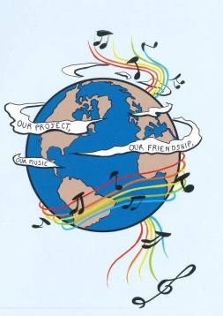

MUSIC: A MELODIC METHODOLOGY INTO TEACHING AND LEARNING
2018-1-ES01-KA229-050761
'FRIENDSHIP THROUGH MUSIC’

Slide 2
ROMANIA
“TEACHING ENGLISH THROUGH SONGS”

Slide 3
A FRIEND LIKE YOU
The proposed activities for teaching English through songs are based on a the song “A Friend Like You” , which was composed by Andy Grammer, and appears on the Captain Underpants: The First Epic Movie (Original Motion Picture Soundtrack). The official soundtrack of this film was released on June 2nd, 2017.
The 1st sequence of teaching techniques.
Minecraft
1.1 The teacher divides the class into groups and she/he gives them a sheet of paper with a table in which some words are written and she/he tells them that they have to identify 5 pairs of synonyms/antonyms.
1.2 The students will identify the topics that these words are characteristic of and they have to write 3 words for each topic
a)jobs
b)friendship
c) enmity
1.3 The teacher tells the students to find the expressions and words representative of the friendship message and to colour them in red. They have to colour in blue the fields containing expressions and words that are opposites of friendship. They will tell what the image in red represents.
challenges |  | get in a fight |  | Difficult life | low self-esteem |  | failing
anger |  | sadness |  |  | nobody to help you |  | heated argument
breakup |  | teamwork |  |  | friends |  | hate
bitterness | helping each other |  |  | trust | trying to progress |  |  | enemies
dislike | happy times |  | communication |  | happiness | agreement |  | conflicts
lack of politeness |  | a big happy family |  | gifts | harmony |  | disappointment
cruelty | quarrel |  | parties | learning together |  | deceit/ lie |  | abandon
to give up |  | tears |  | smiles | distrust |  | envy

Slide 4
challenges |  | get in a fight |  | Difficult life | low self-esteem |  | failing
anger |  | sadness |  |  | nobody to help you |  | heated argument
breakup |  | teamwork |  |  | friendship |  | hate
bitterness | Helping each other |  |  | trust | trying to progress |  |  | enemies
dislike | happy times |  | communication |  | happiness | agreement |  | conflicts
lack of politeness |  | A big happy family |  | gifts | harmony |  | disappointment
cruelty | quarrel |  | parties | Learning together |  | Deceit/ lie |  | abandon
to give up |  | tears |  | smile | distrust |  | envy

Slide 5
2. Debate. The students are asked: a)Why is the heart the symbol of love? b)Can the heart be the symbol of friendship? The students bring arguments for their answers.
3. Brainstorming. Group Work. The teacher tells the students that in groups they will name 3 songs about friendship and each group will choose one to talk about its message.
4. Identifying. The teacher informs the students that they are going to listen to a song about friendship and they will identify the elements through which friendship is defined. The teacher gets feedback.
5. Vocabulary. American cultural background. The teacher gives the students the first verse of the song and tells them to find items that are specific to the American cultural background and to explain the ones they know something about. Then the teacher gives extra information or explain the meaning of the words that the students do not know about.
‘Right from the start, couldn't pull us apart, it just works
Nobody else ever gets me as well on this earth
Like rock and roll, Marshall’s and Telly’s
Mac and cheese, PBs and jellies
Some things are better together, and that’s you and me’
a) Mac and cheese- ‘macaroni and cheese’ is one of the most popular American dishes;
b) Marshall's and Telly's expression from the song refers to the Telly Awards that honor “excellence in video and television across all screens and to the fact that USC Marshall’s Online MBA program was twice honored at the 39th annual Telly Awards;
c)Mac and cheese- ‘macaroni and cheese’ is one of the most popular American dishes
Marshall's and Telly's expression from the song refers to the Telly Awards that honor “excellence in video and television across all screens and to the fact that USC Marshall’s Online MBA program was twice honored at the 39th annual Telly Awards;

Slide 6
c) Rock and roll - a genre of popular music that originated and evolved in the United States during the late 1940s and early 1950s from musical styles such as gospel, jump blues, jazz, boogie woogie, rhythm and blues, and country music.;
d) The students are asked: ‘Why are these elements presented in twos, as a pair?’ They are to find other examples of pairs in the text and explain what they think they have been used.
7. Matching items of vocabulary. The teacher gives the students a worksheet in which they have to match items of vocabulary from the song with their explanation. They will try to understand the meaning from the context.
1.Pull somebody apart | a)a homeboy, a boy or man from your own town, or someone who is a close friend
2.Dude /d(j)uːd/ | b) a person who treats diseases by pressing a person's joints (= places where two bones are connected), especially those in the back
3.Chiropractor /ˈkʌɪrə(ʊ)ˌpraktə/ | c)to be willing and prepared to help or defend someone; to look out for someone in case they need assistance.
4. Homie/homey | d)to thoroughly understand one's personality
5.To get somebody | e)a man; a guy (often as a form of address, mainly US slang)/any man, or one who comes from a city and dresses in a stylish way
6. To get (someone's) back | f)to separate/ to make the relationships between people in a group bad or difficult
Answers.
1-f; 2-e; 3-b; 4-a; 5-d; 6-c

Slide 7
8. Group Work. The students will make up sentences using the new items of vocabulary
9. Homework. The students will write an argumentative essay with the title ‘What would I do without a friend like you?’ (140-160 words)
2nd sequence of teaching techniques
1. Unjumble the lines of the lyrics. The teacher divides the class into five groups and tells them to choose a spokesperson for each group. The teacher announces the students that each group will receive a set of sentences with the verses and the choruses of the selected song. For this, the teacher prepares five sets of sentences that contain the lines for the two verses of the song and for the three choruses. These are written on separate sheets of paper, they are jumbled, and the students’ task is to put them in order. The students solve the task and the spokesperson from each group reads what the respective group has solved.
2. Making predictions. The teacher asks the students which ones they consider that there are the versus and the choruses and they should give arguments for their choice.
3. Making suggestions. The teacher sets the class in groups and asks the students to make suggestions of a possible title for the song. The students read their answers.
3. Listening and checking. The teacher plays the song and the students check their findings.
4. Atmosphere and feelings. The students are set in groups and they are to describe the feelings the song transmits and how the general atmosphere is. The teacher gets feedback.

Slide 8
3rd sequence of teaching techniques
1.Brainstorming Activity. The teacher divides the class into groups and writes down on the whiteboard the title of the song. The students’ task is to come up with ideas that the song might refer to. The teacher gets the students’ feedback.
2. Right or Wrong. The teacher plays the song and the students see if their predictions have been right or not. They report this to the class.
3. Discussion. The students discuss the main ideas of the song.
4. Sharing experience. In groups, the students share their own experience about friendship.
Homework. As homework they will write an essay with the title ‘A Friend like You’
The 4th sequence of teaching techniques
1. Brainstorming. The teacher divides the class into groups and asks them to name words related to friendship. The students might give the following answers: relations, relationship, ties, admiration, harmony, affection, love, unity, cooperation, fellowship, friends, friendly, pal, company, companionship, partnership, understanding, happiness, dialogue, trust, empathy, compassion, solidarity, gratitude. The teacher gets feedback.
2. Explaining. The teacher tells the students to explain why the words they have mentioned have only a positive meaning.
3. Characteristics. In groups the students will choose five characteristics of friendship they consider the most important. The teacher writes the answers on the whiteboard/blackboard and the characteristics that will be mentioned the most times will be considered the defining ones for the respective class. In the case these will not be mentioned many times, the students will vote for the top five. The teacher tells the students to explain why they have chosen these attributes as the most important ones for friendship.

Slide 9
4. The teacher tells the students that they are going to listen to a song about friendship and as a task they have to:
a) identify how the singer defines friendship
b) tell if some characteristics of friendship that they have mentioned are present in the song
5. The teacher plays the song again and the students will be given two tasks
Read the following sentences and tell if the following lines are in the song. Answer with TRUE(T) or FALSE(T).
a) Sis, I love you
b) Like the sun and the moon, all the best things come when they have to
c) You’re my brother, from another ‘nother mother
d) What would I do without a friend like my brother ?
e) Nobody else ever gets me as well on this earth
II ) Choose the correct word:
a) Right from the start/end, couldn’t pull us apart, it just works
b) Dude, I like/love you
c) Some things are better together/on their own, and that is you and me
d) Like rock and roll/ball, Marshall’s and telly’s
Mac and cheese, PB’s and jellies/candies
e) Like the sun and the moon all the best things come/comes in twos
The teacher gets feedback.
6. As homework the students will write a composition/ an opinion essay with the following title ’Friendship – the key to happiness’ ( 120-140 words)

Slide 10
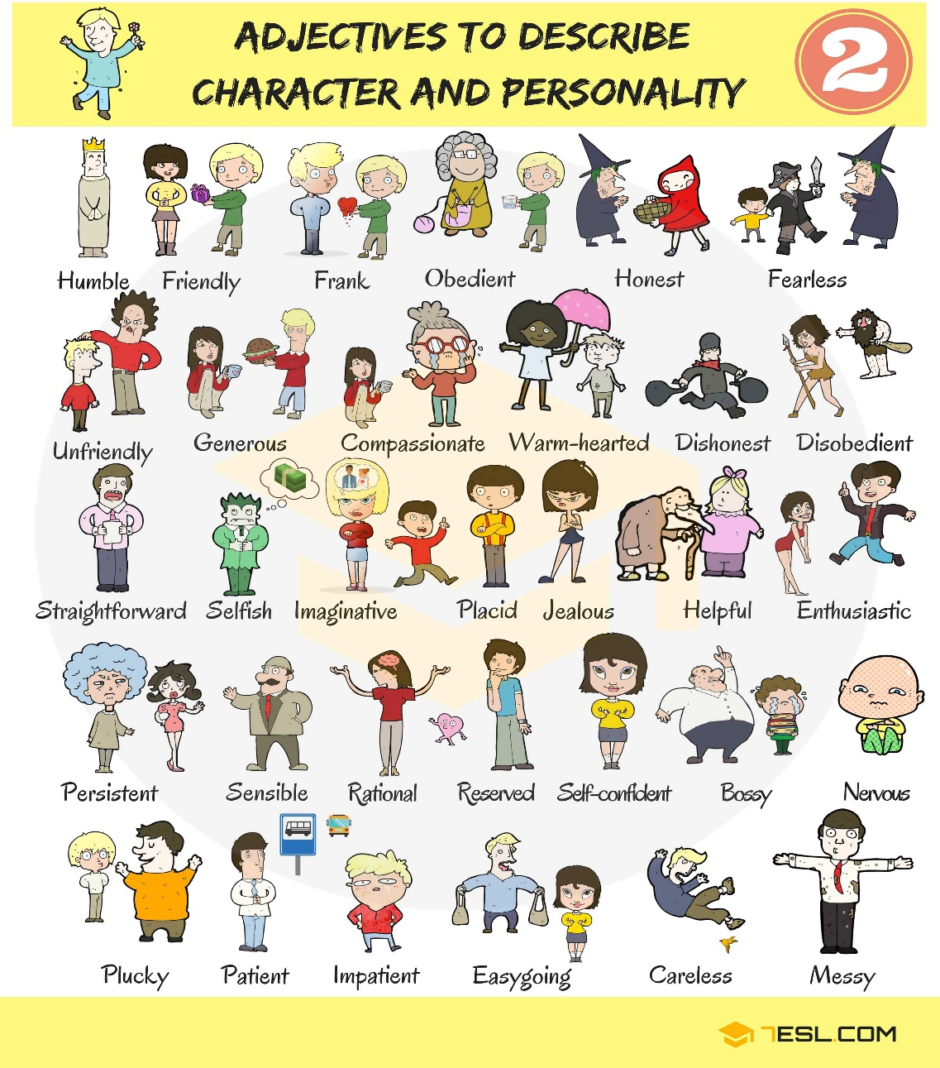
The 5th sequence of teaching techniques
1.Warm up. This is an activity to help students explore the qualities of healthy relationships. Have the students stand up behind their desks or in a circle at the front of the room. Toss the ball to someone in the group, and ask them to call out a word that represents qualities of a healthy relationship (for example; trust, supportive, kind, fun…). Ask that person to then toss the ball to someone else. Each time a new student catches the ball, ask them to share a new quality… and so on. Here is a list to help you at lower levels.

Slide 11
2. Pre-speaking task 1 - Write the word FRIEND on the board. Tell the students that you are going to leave the room for 5 minutes. While you are gone they have to fill up the whole board with words connected to this theme. They can use their dictionaries if they like. Nominate a student as the secretary; give them the board marker or chalk and leave. Come back after 5 minutes (or before if you think it’s too long!) and go over what they have written.
3.Pre-speaking task 2 – Group formation Tell the students that they are going to do a listening activity related to friends. They must change places with another student if the sentence you read out to them are true for them . Read out the following sentences and stop when you think people have moved around enough. They then form groups of three with the new people they are sitting next to. Change places if…
• You have few friends.
• Your best friend is your pet.
•You have many friends .
• You have a pen friend.
• Your best friend is a boy.
• Your best friend is a girl.
• You would like a different job.
4.Speaking task – Rank the cards. Now tell the students to imagine that their partner/friend could have one of these jobs. Which one would be the best? Why? Give an example for yourself and write it on the board. Then tell the students the rules for the speaking activity
1. Put the cards in order from best to worst job for your partner/friend.

Slide 12
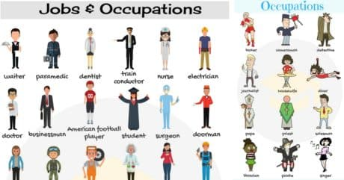
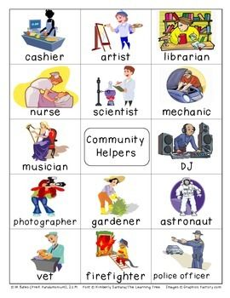
2. Decide in your group what is the best order and why.
3. Talk only in English. When they are finished, ask a couple of groups to explain their order.
5. Extra activity. Learners can try this fun quiz worksheet on the topic of friends:
1. Choose the answer! Are you a good friend? Choose the answer that’s true for you.
1. Your friend hasn’t done their homework. What do you do?

Slide 13
a. promise not to tell b. help your friend do it quickly c. tell the teacher
2. It’s your friend’s birthday. Do you …
a. give them a present? b. say ‘Happy Birthday’? c. forget?
3. Your friend has forgotten their lunch. What do you do?
a. share yours b. eat yours in front of them c. lend them money
4. Your friend calls you while you are watching your favourite TV programme. Do you …
a. ignore them? b. chat to them? c. ask them to call later?
5. You get a very good mark in a school test and your friend gets a bad mark. Do you …
a. help them next time? b. call your friend ‘stupid’? c. say ‘oh dear’?
6. You are playing football and your friend falls over. What do you do?
a. run on and score a goal b. stop and help c. kick the ball out
7. You borrow money from a friend. Do you …
a. forget to pay it back? b. wait for them to ask? c. give it back soon?

Slide 14
8. Your best friend is on holiday for three weeks. Do you …
a. text/email every day? b. text/email once? c. find another friend?
9. Your friend looks sad. What do you do?
a. ignore them b. ask them what’s wrong c. make a joke
10. Your friend tells you a really interesting secret. Do you …
a. tell your mum? b. tell no one? c. tell everyone?
2. Find your score! Now calculate your score and find out how good a friend you are!
1. a. 1 b. 2 c. 0
2. a. 2 b. 1 c. 0
3. a. 2 b. 0 c. 1
4. a. 0 b. 2 c. 1
5. a. 2 b. 0 c. 1
6. a. 0 b. 2 c. 1
7. a. 0 b. 1 c. 2
8. a. 2 b. 1 c. 0
9. a. 0 b. 2 c. 1
10. a. 1 b. 2 c. 0
0- 7 points or less: Oh dear! You don’t think about your friends much at all! Next time your friend is in need, try to help them whatever the situation!
8–15 points: You’re a pretty good friend most of the time, but sometimes you need to think more about others and less about yourself!
16 points or more: Wow! What a great friend you are! You always help a friend in need! Are your friends this good to you too?

Slide 15
“A Friend Like You”
[Verse 1]
Right from the start, couldn't pull us apart, it just works
Nobody else ever gets me as well on this earth
Like rock and roll, Marshall's and Telly's
Mac and cheese, PBs and jellies
Some things are better together, and that’s you and me
[Chorus]
Dude, I love you, bro, I love you
Man, I love you
You're my brother from another, 'nother mother
You are my favorite, I'm not ashamed to admit
Cause I do, dude, I do
Dude, I love you, bro, I love you
Man, I love you
You're my homie, no one knows me like you know me
Like the sun and the moon, all the best things come in twos
What would I do without a friend like you?

Slide 16
[Post-Chorus]
W-w-w-w-what would I do?
Without a friend like you
W-w-w-w-what would I do?
Without a friend like you?
[Verse 2]
Laughed and we cried when we're passing the time away
Even our fights always end with a smile on our face
Like black and white, keys on a whirley
Sounds just right when we're in harmony
Some things are better together and that's you and me.
[Chorus]
Dude, I love you, bro, I love you
Man, I love you
You're my brother from another, 'nother mother
You are my favorite, I'm not ashamed to admit
Cause I do, dude, I do
Dude, I love you, bro, I love you
Man, I love you
You're my homie, no one knows me like you know me
Like the sun and the moon, all the best things come in twos
What would I do without a friend like you?

Slide 17
[Post-Chorus]
W-w-w-w-what would I do?
Without a friend like you
W-w-w-w-what would I do?
Without a friend like you
[Bridge]
Without a friend like you
Without a friend like you
W-w-w-w-what would I do? (I wouldn't be the same, man)
Without a friend like you? (I wouldn't be the same, man)
Without a friend like you
[Chorus]
Dude, I love you, bro, I love you
Man, I love you (bro, love you)
You're my homie, no one knows me like you know me
You are my favorite, I'm not ashamed to admit

Slide 18
Cause I do, dude, I do
Dude, I love you, bro, I love you
Man, I love you
Got my back, I got your back, like chiropractors
Like the sun and the moon, all the best things come in twos
What would I do without a friend like you?
[Outro]
W-w-w-w-what would I do?
Without a friend like you
W-w-w-w-what would I do?
Without a friend like you

Slide 19
Gift of a Friend
The teaching techniques are based on the song about friendship ‘Gift of a Friend’ sung by Demi Levato. The song belongs to the album ‘Here we Go Again”. This song was released as a soundtrack single for the Disney movie ‘Tinker Bell and the Lost Treasure’ on December 16, 2009. The song was written by Adam Watts, Andy Dodd, and Demi Lovato.
Warm-up
Pre- reading activity
1. Look at the quotes bellow and express your opinion on it .Do you agree? Why? /Why not?
Friends are the most important ingredients in the recipe of life.
Good friends are like stars. You don’t always see them but you know they are always there.
A true friend is the greatest of all blessings.
Walking with a friend in the dark is better than walking alone in the light.
Friends make good times better and hard times easier.
A friend is one of the nicest things you can have and one of the best things you can be.
A journey is best measured in friends rather than miles.
Friends make life a lot more interesting.
A friend is someone to share your last bar of chocolate with.
Spending some quality time with friends is the best therapy.
True friendship never dies.
.

Slide 20
As iron sharpens iron, so a friend sharpens a friend
Friendship is a sheltering tree.
While -reading activity
2. You are going to listen to a song. Please pay attention to the lyrics and try to get the message the singer is trying to convey. Does the message have any connection to the GIVEN/DEBATED quotes ?
After-reading activity
3.Unjumble the given sentences so as to create the original text.
Sometimes you think you'll be fine by yourself
'Cause a dream is a wish that you make all alone
It's easy to feel like you don't need help
But it's harder to walk on your own
When you realize
You'll change inside
The world comes to life
And everything's bright
From beginning to end
When you have a friend
By your side

Slide 21
The beauty you are
That helps you to find
When you open your heart
And believe in
The gift of a friend
The gift of a friend
Someone who knows when you're lost and you're scared
Beside you wherever you go
There through the highs and the lows
You'll change inside
When you realize
And everything's bright
The world comes to life
From beginning to end
When you have a friend
By your side
That helps you to find
The beauty you are
And believe in
When you open your heart
The gift of a friend
When your hope crashes down
Shattering to the ground
You, you feel all alone
When you don't know which way to go

Slide 22
There's no sign leading you home
You're not alone
The world comes to life
And everything's bright
When you have a friend
From beginning to end
By your side
That helps you to find
The beauty you are
When you open your heart
And believe in
When you believe in
You can believe in
When you believe in
The gift of a friend
Pre -listening activity
4.Look at the sentences. Which verb forms are incorrect?
Sometimes you thinks you be fine by yourself
'Cause a dream is a wish that you make all alone
It's easy to feeling like you don't need help
But it's harder to walk on your own

Slide 23
You changed inside
When you’ll realize
The world come to life
While-listening activity
5.Listen to the song carefully identify and underline all the affirmative present forms.
After-listening activity
6.Make up sentences with the following words and idioms related to friendship:
a best friend: to describe the person they are closest to. A 'best friend' is usually your best friend for life
a close friend: a good friend
a pal:(informal): a friend
a mate:(informal): a friend
a girlfriend: a girl or woman who is your friend or a girl or woman you have a relationship with
a boyfriend: a boy or man who is your friend or you have a relationship with
a shoulder to cry on: someone who listens to your problems
It's always good to talk to Hilary, she's so sympathetic. She's a real shoulder to cry on
see eye to eye: to agree with someone
(usually used in the negative) They don't always see eye to eye on politics but they're still great friends
clear the air: two people talk about a problem they have been avoiding discussing
I hated the way he kept borrowing things without asking me but we had a chat about it and cleared the air so now he knows to check with me first
through thick and thin: people who have had some good times and difficult times together
They've been friends for 20 years. They've had a lot of fun over the years but he was unemployed after university and she was very ill for a long time recently. They've really been through thick and thin together.

Slide 24
Pre-writing activity
7. You are supposed to write an essay about friendship. Invent an essay title related to the given topic. Brainstorm for ideas and make a note of them.
While-writing activity
8.Write a paragraph plan for your essay. You need to take into account the following steps:
Use topic sentences to begin each paragraph.
Write a clear introduction, but do not go into detail. You will discuss your ideas in the main paragraphs.
Finish with a brief conclusion that summarises your ideas.
Post-writing activity
9.Present your plan
Homework
Write your reply to your friend’s email who asked you to listen to Demi Lovato’s song “A Gift from a Friend”. Explaining him/her why you liked it or not.
Puzzle
The method proposes un exercise – a game of logic and attention, that consists in putting in order the words from the chorus of the song Gift of a friend.
Students must work in pairs or groups and they have to rearrange the words in order to obtain the song’s chorus. An advantage of the method is that it prompts the students to develop their teamwork spirit with a touch of the competitive aspect.
The task is:
Rearrange the words in order to create the song’s chorus (The students can number the words in the order they should be in each line of the chorus). The winner will be the team who completes the task in the shortest time.

Slide 26
The chorus is:
You'll change inside when you realize
The world comes to life and everything's bright
From beginning to end when you have a friend by your side
That helps you to find the beauty you are
When you open your heart and believe in the gift of a friend

Slide 27
ITALY
“TEACHING ENGLISH THROUGH SONGS”

Slide 28
Friends will be friends (Queen)
Another red letter day
So the pound has dropped and the children are creating
The other half ran away
Taking all the cash and leaving you with the lumber
Got a pain in the chest
Doctors on strike what you need is a rest
It's not easy love, but you've got friends you can trust
Friends will be friends
When you're in need of love they give you care and attention
Friends will be friends
When you're through with life and all hope is lost

Slide 29
Hold out your hand 'cause friends will be friends
Right till the end
Now it's a beautiful day
The postman delivered a letter from your lover
Only a phone call away
You tried to track him down but somebody stole his number
As a matter of fact
You're getting used to life without him in your way
It's so easy now, 'cause you got friends you can trust
Friends will be friends
When you're in need of love they give you care and attention
Friends will be friends

Slide 30
When you're through with life and all hope is lost
Hold out your hand 'cause friends will be friends
Right till the end
Friends will be friends
When you're in need of love they give you care and attention
Friends will be friends
When you're through with life and all hope is lost
Hold out your hand 'cause right till the end, friends will be friends
Yeah, yeah

Slide 31
"Friends Will Be Friends" is a song performed by Queen and written by Freddie Mercury and John Deacon, included on the album A Kind of Magic. It was the band's 30th single in the UK upon its release on 9 June 1986, reaching number 14 in the UK.
"Friends Will Be Friends" was performed live on The Magic Tour. It is remarkable in that it was the first and only song that was sung at the end of concerts between "We Will Rock You" and "We Are the Champions" since the News of the World Tour in 1977.
The song was included in various greatest hits compilations by Queen such as, Greatest Flix II and Greatest Video Hits II.
‘’Friends will be friends
When you're in need of love they give you care and attention...’’

Slide 32

1)Warm up
-What is true friendship for you?
-When you’re sad, do you call your friends?
- Is frienship a priority in your life?

Slide 33
2) Listen to the first part of the song and fill the blanks with the words you hear.
Another red letter day
So the pound……. and the children…….
The other half…… away
…… all the cash and…… you with the lumber
Got a pain in the chest
Doctors on strike what you…..is a rest
It's not easy love, but you've got friends you can trust
Friends……friends
When you're in need of love they…..you care and attention
Friends will be friends
When you're through with life and all hope is lost
……out your hand 'cause friends will be friends
Right till the end
ran-hold-taking-give-leaving-has dropped-need-will be-are creating

Slide 34
3) Mark if the following sentences are true or false.
1. The song talks about love: true | false
2. The song is written by a band: true | false
3. It’s an attual song: true | false
4. Lady Gaga sings this song: true | false
5. This song also talks about friendship: true | false

Slide 35
4) Focus on grammar
Put the verbs under the right heading
Present Simple | Future Tense | Present Perfect | Present Continuous

Slide 36
5) Vocabulary
Match the the words of the song to the meanings
1) Lumber A) In reality
2) Rest B) it is a confident expectation
3) As a matter of fact C) “partly” is a synonym
4) Hope D) place where the confusion reigns
5) Half E) when you take a break

Slide 37
6) The song refers to some feelings and some jobs
Complete the table below
Feelings | Jobs

Slide 38
7)Write questions for the following answers.
Use Wh-questions
1).............................................?
I’ve got a pain in the chest
2).............................................?
Tom stole his number
3).............................................?
I called you because I’m so sad and I need someone

Slide 39
You’ve got a friend - James Taylor
When you're down and troubled
And you need a helping hand
And nothing, nothing is going right
Close your eyes and think of me
And soon I will be there
To brighten up even your darkest night
You just call out my name
And you know wherever I am
I'll come running, oh yeah baby, to see you again
Winter, spring, summer or fall
All you've got to do is call
And I'll be there, ye, ye, ye
You've got a friend
If the sky above you
Should turn dark and full of clouds
And that old north wind should begin to blow
Keep you head together
And call my name out loud now
Soon you'll hear me knocking at you door

Slide 40
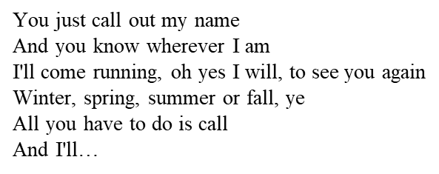
Written and recorded by Carole King in 1971, this song became the biggest, and most well-known hit for then 23
year-old James Taylor, and his only #1 in America. It was the first single off of his third album
Taylor was the first to record it, putting down the track at Crystal Sound studios on Vine Street in Los Angeles with
his band, which included King on piano.
Days later, King recorded her version at A&M studios on La Brea Avenue.
‘When you're down and troubled
And you need a helping hand…’

Slide 41

Warm up
- How important is friendship in your life?
- Can social media help implement friendship?
- When you are down and troubled who do you lean on?

Slide 42
2. Listen to the first part of the song and fill the blanks with the words you hear.
brighten up, call, darkest, down, fall, helping, right, troubled, wherever
When you're __________ and _________ and you need a _________ hand and nothing, oh nothing is going ________,
close your eyes and think of me
soon I will be there
to _and________even your ________night.
You just call out my name
and you know ___________I am
I´ll come running, oh yeah baby, to see you again.
Winter, spring, summer or _________-,
all you got to do is __________
and I'll be there yeah yeah yeah
you've got a friend.

Slide 43
3)Say if the statements are true or false
1.When the sky grows dark he will not be knocking on the door true | false
2. People never hurt you and desert you true | false
3. Friendship can brighten up your darkest nights true | false

Slide 44
4) Focus on Grammar
Put the verbs under the right heading
Infinitives | Future tense | Conditional sentences | Present perfect

Slide 45
5) Vocabulary
Match the verbs with their definition
1)To brighten up a) to abandon
2)To Desert b) To remain calm
3) To call out c)To become lighter
4)Keep your head together d) To shout something

Slide 46
6) The song refers to moments of the day, seasons, natural elements
Complete the table below
Moment of the day | Season | Natural element

Slide 47
7)Write questions for the following answers.
Use Wh-questions
1).............................................................................?
You will hear me knocking on your door
2)..............................................................................?
Soon I will be there with you
3) …………………………………………………………………………..?
Because you’ve got a friend

Slide 48
SPAIN
“TEACHING ENGLISH THROUGH SONGS”

Slide 49
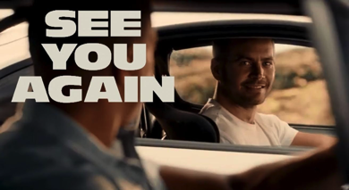
SONG 1: “SEE YOU AGAIN”
‘Friendship through music’
Analysis of songs by using seven teaching techniques .
Wiz Khalifa and Charlie Puth

Slide 50




Technique 1
BRAINSTORMING: Asking some questions about the title.
SONG 1: “SEE YOU AGAIN”
→ In this case, the title is “See you again” so you can ask the following questions:
WHY DO YOU THINK THESE PEOPLE HAVEN´T SEEN EACH OTHER IN A WHILE?
WHAT DO YOU THINK THE SONG IS ABOUT?
WHAT IS THE POSSIBLE RELATIONSHIP BETWEEN THAT PERSON AND THE PERSON HE OR SHE WANTS TO SEE AGAIN?
A FRIENDSHIP RELATIONSHIP? A LOVE RELATIONSHIP? A FAMILY ONE?

Slide 51
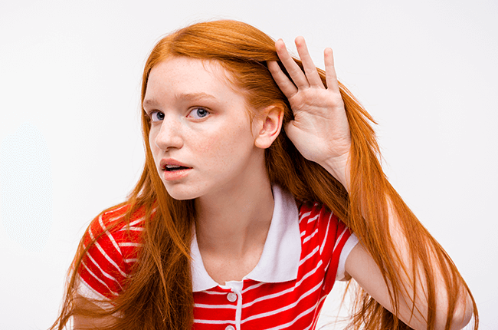

Technique 2
Technique 2
SOUND DISCRIMINATION - LISTENING without lyrics
Prior to having listened to the song you can teach a couple of words and give a simple task for the first listening.
You can give students a word list that they have to number as they hear them.
You can also give three or four words from the song and ask to them to listen out for the words that rhyme with them.
SONG 1: “SEE YOU AGAIN”
→In the song “See you again” you can distinguish many rhymes at the end of the verses.
LOOK AT ACTIVITY 1
You can give the students the words FRIEND and PATH and they have to find the other words rhyming with them. Example:
1. FRIEND
2. PATH
“________my friend
________see you again
________from where we began”
“________another path
________ the road and laugh
________it wouldn't last”

Slide 52

Technique 3
WORDS IDENTIFICATION - LISTENING without lyrics
You can make cut-out strips of selected missing words and make a lyric worksheet as a gap fill; this way learners match the word strips to the gaps as they listen.
You can also make something as simple as a lyric worksheet as a gap fill; learners fill in the gaps as they listen to the song.
SONG 1: “SEE YOU AGAIN”
→ For example, this could be a fill in the gaps activity with “See you again”
FILL IN THE GAPS WITH THE FOLLOWING WORDS:
everything – family - ride - side
Everything
family
“How could we not talk about ___________ when family's all that we got?
____________I went through you were standing there by my ____________
And now you gonna be with me for the last ________________”
side
ride

Slide 53

Technique 4
READING and PRONOUNCIATION PRACTISE - LISTENING with lyrics
This time, we can give learners the chance to read the lyrics of the song. Learners can read them while they listen and we can work with reading in different ways:
Students can possibly highlight unknown words for later discussion.
Teachers can make them read some lines to check if they paid attention to pronounciation.
SONG 1: “SEE YOU AGAIN”
→ This is a possible fragment of the song “See you again” we can work with:
“First you both go out your way - And the vibe is feeling strong and what's
Small turn to a friendship, a friendship - Turn into a bond and that bond will never - Be broken and the love will never get lost”
TEACHERS CAN CHECK THE PROPER PRONOUNCIATION OF THE VOWEL: /tɜːn/)
AND THE MEANING OF THE WORDS “VIBE” OR “BOND”

Slide 54

Technique 5
TEACHING AND REVIEWING VOCABULARY
Songs often serve as really good contexts to review and learn vocabulary, phrases expressions and idioms, but it’s good to make sure that the meaning is clear.
Then, teachers can:
Go through the meanings explaining them and illustrating with other examples if necessary.
Make questions to raise a debate.
SONG 1: “SEE YOU AGAIN”
Paying attention to the “See you again” lyrics we find many expressions we can explain. Look at this paragraph:
“Had to switch up look at things different see the bigger picture
Those were the days hard work forever pays now I see you in a better place”
Then, so we can make questions like:
WHAT DOES ‘SWITCH UP’ MEAN?
WHAT DOES THE AUTHOR WANT TO SAY WITH THE PHRASE ‘DAYS HARD WORK FOREVER PAYS’ ?
It means to change one's mood, attitude, personality, or state of mind
WHAT DOES ‘SEE THE BIGGER PICTURE’ REFER TO?
It means that when you work really hard you get great benefits from your efforts.
It means to focus on he most important facts about a situation instead of the small details

Slide 55

Technique 6
GRAMMAR REVIEW:
Songs are also a good opportunity to review grammar. Teachers can tell students to focus on verb tenses or aspects of grammar.
SONG 1: “SEE YOU AGAIN”
→We can start with the question: How many different tenses can you find in the lyrics? Let´s have a look at these paragraphs:
“It's been(1) a long day without you, my friend /
And I'll tell(2) you all about it when I see (3) you again /
We've come(4) a long way from where we began(5).”
“How could we not talk(6) about family when family's (7) all that we´ve got(7)?
Everything I went(8) through you were standing(9) there by my side /And now you gonna(10) be with me for the last ride.”
Present Simple (3) (7) – Present Perfect (1) (4) – Future simple “will”(2) – Past Simple (5) (8) – Past Continuous (9) – Future “be going to” informal contracted form (10) – Conditional “when – clause ” (3) – Modal to express “possibility” (6)
→This acts as an excuse for discussing the function of a specific tense, as well as examining its form. Furthermore, it sometimes helps to raise awareness of grammatical flexibility and ‘poetic licence’ in the construction of song lyrics.

Slide 56



Technique 7
CREATIVE WRITING: Round things off with creativity!
Creativity is an important part of motivation. Then, depending on factors like age or language level. Teachers can finish the song activity with an exercise that stimulates creative thoughts.
Here is an example of an activity you can do to work on a creative writing:
Write another verse of lyrics, maintaining the same mood and style as the original. This can be done individually or in groups. These new lyrics can be presented to the rest of the class. Perhaps several groups can work on this to come up with a completely new set of lyrics for the whole song.
→This is an example of a POSSIBLE NEW VERSE for the song “See you again”
SONG 1: “SEE YOU AGAIN”
“Since the loss of you,
I've learned to live for each day
And take it as a blessing,
Knowing it may not always be this way.”

Slide 57

‘Friendship through music’
Analysis of songs by using seven teaching techniques .
SONG 2: “ I’LL BE THERE FOR YOU”
The Rembrands

Slide 58

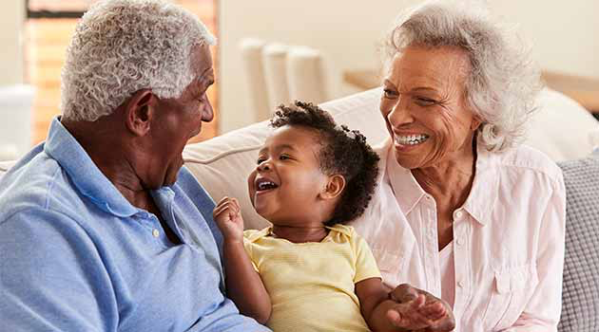


Technique 1
BRAINSTORMING: Asking some questions about the title.
SONG 2: “ I’LL BE THERE FOR YOU”
→In this case, the title is “I'll be there for you” so you can ask the following questions:
WHAT DO YOU THINK THE SONG IS ABOUT?
WHAT DO YOU THINK THE WORD “THERE” REFERS TO IN THE TITLE?
WHOM WOULD YOU SAY “I´LL BE THERE FOR YOU” TO?
→ Such questions trigger an initial discussion so students together get feedback from each other on their thoughts before the initial listening.

Slide 59


Technique 2
SOUND DISCRIMINATION - LISTENING without lyrics
Before listening you can give three or four words from the song and ask to them to listen out for the words that rhyme with them.
SONG 2: “ I’LL BE THERE FOR YOU”
→In the song “I'll be there for you” you can also distinguish many rhymes in the middle of the verses and at the end of them.
Then, before listening to the song you can give to the students some words from the verses, for example:
WAY
JOKE
GEAR
EIGHT
→ Once the students know theses words, they have to find the other words rhyming with them.
“So no one told you life was gonna be this way
Your job's a joke, you're broke
Your love life's D.O.A”
2. GEAR
3. EIGHT
“It's like you're always stuck in second gear
When it hasn't been your day, your week, your month
Or even your year”
“You're still in bed at ten
And work began at eight
You've burned your breakfast,
So far things are going great”

Slide 60


Technique 3
WORDS IDENTIFICATION - LISTENING without lyrics
SONG 2: “ I’LL BE THERE FOR YOU”
You can make a lyric worksheet as a gap fill
→This could be a fill in the gaps activity with “I'll be there for you”
1. FILL IN THE GAPS WITH THE FOLLOWING WORDS: began – warned - great - bed
bed
“You're still in________ at ten
And work_________ at eight
You've burned your breakfast
So far things are going__________
Your mother___________ you”
began
great
warned
→Depending on the students´ level you can also make the fill in the gaps activity more complicated. You can take out part of the lyrics and leave spaces in blank that the students have to complete by themselves. For example:
2. FILL IN THE GAPS WITH WORDS OR PHRASES:
“No one could ever _________me
No one could ever __________me
Seems you're _______________
who knows
What it's _____________to be me
Someone to face the _______with
Make it through all the ________with
Someone I'll always _________with
Even at __________, I'm ________with you, yeah”

Slide 61


Technique 4
READING and PRONOUNCIATION PRACTISE - LISTENING with lyrics
SONG 2: “ I’LL BE THERE FOR YOU”
Teachers can make them read some lines to check if they paid attention to pronounciation.
→ These are possible fragments of the song “I'll be there for you” we can work with:
“I'll be there for you
(When the rain starts to pour)
I'll be there for you
(Like I've been there before)
I'll be there for you
('Cause you're there for me too)”
When students are reading these lines teachers will check the pronounciation. They can pay attention to the pronounciation of the vowels in theses words:
Stuck: [ˈstʌk]
Pour: [ˈpɔː^{r}]
Too: [ˈtuː]
Gear: [ˈgɪə^{r}]
“It's like you're always stuck in second gear
When it hasn't been your day, your week, your month
Or even your year”
‪

Slide 62

Technique 5
TEACHING AND REVIEWING VOCABULARY
SONG 2: “ I’LL BE THERE FOR YOU”
Songs often serve as really good contexts to review and learn vocabulary, phrases expressions and idioms,
→ Paying attention to the “I'll be there for you” lyrics we find many expressions we can explain. Look at this paragraph:
“So no one told you life was gonna be this way
Your job's a joke, you're broke, your love life's D.O.A.
It's like you're always stuck in second gear”
Then, we can make questions like:
WHAT DOES ‘YOUR LOVE LIFE’S D.O.A’ MEAN?:
D.O.A means “dead on arrival”, so it means your sentimental life is dead because you don´t have one.
WHAT DOES ‘STUCK IN SECOND GEAR’ REFER TO?:
WHAT DOES THE AUTHOR WANT TO SAY WITH THE PHRASE ‘YOUR JOB’S A JOKE’ ?:
The author wants to say that person has a bad job, probably with a low salary.
WHAT DOES THIS EXPRESSION MEAN: “YOU´RE BROKE”? :
I refers to the gear in a car, so it means you cannot move fast, you cannot make progress in your life.
It means that person has no money at all.

Slide 63
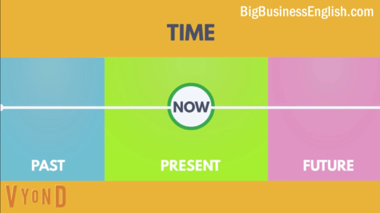
Technique 6
GRAMMAR REVIEW:
Songs are also a good opportunity to review grammar. Teachers can tell students to focus on verb tenses or aspects of grammar.
SONG 2: “ I’LL BE THERE FOR YOU”
→Once again we can start with the question: How many different tenses can you find in the lyrics? Let´s have a look at these paragraphs:
So no one told(1) you
Life was going to be(2) this way
Your job’s(3) a joke, you're broke(3)
Your love life's(4) D.O.A.
It's like you’re (4) always stuck
In second gear
You've burned(5) your breakfast
So far things are going(6) great
Your mother warned(7) you
There'd be(8) days like these
But she didn't tell(9) you
when the world has brought(10) you down to your knees
TENSES
Present Simple (3) (4) – Present continuous (6) - Present Perfect (10)(5) – Past Simple (1) (7) (9) in the negative form with the use of the auxiliary “did” – Past form of “be going to” (2) – Contracted form of “would” (8)

Slide 64



Technique 7
CREATIVE WRITING: Round things off with creativity!
SONG 2: “ I’LL BE THERE FOR YOU”
Teachers can finish the song activity with an exercise that stimulates creative thoughts.
→ This is an example of a POSSIBLE NEW VERSE for the song “I'll be there for you”
“If ever there is tomorrow when we're not together
There is something you must always remember
But the most important thing is, even if we're apart
I'll always be with you
I'll be there for you”

Slide 65
GREECE
“TEACHING ENGLISH THROUGH SONGS”

Slide 66
SONG 1
1.Listening Task:
Listen to the following song and try to fill in the missing words.
STAND BY ME
When the night …… ……..
And the ……..is dark
And the …….. is the only ……..we see
No I won't ……. ………
No I won't ……. ………
Just as …….. ……you stand, stand by me
And darling, darling stand by me
Oh, now, now, stand by me
Stand by me, stand by me
If the …… that we …….. …….
Should ………..and ……….
And the…………. should ……….to the sea
I won't cry, I won't cry
No I won't ………..a tear
Just as ………. …..you stand, stand by me
And darling, darling stand by me
Oh, stand by me
Stand by…

Slide 67
2.Grammar Task:
a) Form sentences using the Present Perfect
(you / keep a pet for three years)
(you / eat Thai food before)?
(it / rain all day)?
(we / not / hear that song already)
(he / not / forget his books)
(she / steal all the chocolate)
(I / explain it well)?
(what countries / they / visit in Europe)?
(we / not / lose our tickets)
10)(he / take a taxi)?

Slide 68
b) Change the verb into the correct form of the past simple or present perfect
Last night I………………….(lose) my keys - I had to call my flatmate to let me in.
I……………..(lose) my keys - can you help me look for them?
I………………(visit) Paris three times.
Last year I ……………….(visit) Paris.
I…………………………(know) Julie for three years - we still meet once a month.
She……………………(play) hockey at school but she didn't like it.
I'm sorry, John isn't here now. He…………………………(go) to the shops.
She…………………………..(live) in London since 1994.
I…………………………..(drink) three cups of coffee today.
I…………………(miss) the bus and then I…………………….(miss) the aeroplane as well!

Slide 69
3.Grammar Task:
Finish the sentences with a clause in the correct conditional:
1: If it is sunny tomorrow _______________________________________________
2: If you sit in the sun too long __________________________________________
3: If I were you _______________________________________________________
4: If I were the Prime Minister ___________________________________________
5: If she had studied harder _____________________________________________
6: If I won the lottery __________________________________________________
7: If I hadn’t gone to bed so late _________________________________________
8: If I hadn’t come to London ___________________________________________
9: If you mix water and electricity ________________________________________
10: If she hadn’t stayed at home __________________________________________

Slide 70
4. Vocabulary Task:
Put the following words in the right group (similar meaning):
stumble, cast, dingy, shatter, luminous, black, fall over, obscure, collapse, bright, murky, decompose, trip, dim, reject, shady, spill, break up, fall, illuminated, capsize, dusk, refuse, fritter, perish, pour
DARK:
SHED:
CRUMBLE:
LIGHT:

Slide 71
SONG 2
1.Listening Task:
Listen to the following song and try to fill in the missing words.
SUMMER OF '69
I got my ……….real six-string
………..it at the five-and-dime
Played it 'til my fingers …….
Was the summer of '69
Me and some ……….from school
Had a band and we ……..real hard
Jimmy………, Jody got married
I should've …………we'd never get …….
Oh, when I ………… ………. now
That summer …………..to last forever
And if I ……….the ………….
Yeah, I'd always wanna be there
Those ……….the best days of my ………..
Ain't ……. ……..in complainin'
When you've got a ……….to do
………….my evenings down at the ……………..
And that's when I met you, yeah

Slide 72
………….. on your mama's ………..
You told me that you'd wait forever
Oh, and when you ……….. my hand
I ……….that it was ……….or never
Those ……….the best days of my ……….
Oh, yeah
Back in the summer of '69, oh
Man, we were killin' time
We were …………and………….
We needed to …………..
I guess nothin' can ………forever
Forever, no...
Yeah!
And now the times are ……………….
Look at everything that's ……….and …………..
Sometimes when I play that old six string
I think about ya 'n ……….what ………. ………..
…………… on your mama's ……….
You told me it would last forever
Oh, the way you ……….my hand
I ………..that it was ………..or never
Those were the best days of my ………
Oh yeah
Back in the summer of '69, oh
………

Slide 73
Task 1
Use the correct words for the numbers in brackets. Write the cardinal or ordinal numbers into the gaps.
I have breakfast at ............…(6)o'clock.
My brother is in the …………(6) grade.
Jamie is………..(21) years old.
Today is the……….(22) of April.
It costs only ………..(1) Euro.
I am so happy that he won the ………..(1) prize!
It takes …………(3) hours to get from Athens to London.
It is the ………..(3) day of our holiday in Rome.
He scored………..(2) goals in the ……….(8) game.
10)He was among the…………. (100) who ran the race in less than an hour. In fact, he was ……(99)

Slide 74
Task 2
Give advice using the words/phrases given:
1.We’ve got our bag stolen! What should we do? (why)
2.I have a terrible headache. (should)
3.I regret not having gone to the party. (should)
4.I never have money. I am always broke!(if)
5.I moved here last week and I still know nobody!(ought)
6.My parents don’t like my friends!(perhaps)

Slide 75
Task 3
Put the following into Indirect speech:
1. He said, "I am flying to Rome tomorrow"
2. George said, "I have lived in this village all my life"
3. Peter said to me “I can't go out with you because I am not feeling well".
4. The teacher said, "You must answer this question in 5 seconds"
5. The teacher said to me,"write your name on this paper."
6. He asked me, "How much did you pay for this book?"
7. He asked me "Do you know anything about the accident?"
8. He asked her, "Has the plane left?"
9. Peter said to Tom, "Don't do it again".
10. He said to me, "I saw your friend at the cinema yesterday"

Slide 76
Task 4
Change from Indirect into Direct Speech:
1. Peter said he had enjoyed himself very much.
2. She said that she was almost sure.
3. He asked me how long it would take me to go home.
4. She asked me if I had listened to the 9 o'clock news
5. He asked me if I was going to stay in.
6. She asked him if he would go home by bus.
7. My friend asked me where I had bought my car from.
8. Helen told Peter to be careful.
9. He told the children to stop that noise.
10. She told him not to wait for her outside the cinema

Slide 77
Task 5
Based on what the singer accounts, write about how you think life was in the summer of ’69 and in what aspects it differs from yours. Point out the negative or positive aspects between now and then. Write about 120-150 words.

Slide 78
PORTUGAL
“TEACHING ENGLISH THROUGH SONGS”

Slide 79

Song 1 – True friend (Miley Cyrus)
We sign our cards and letters bff (Uh uh)
You've got a million ways to make me laugh(Yeah)
You're looking out for me
You've got my back
It's so good to have you around
You know the secrets I could never tell(Uh huh)
And when I'm quiet you break through my shell
Don't feel the need to do a rebel yell
Cuz you keep my feet on the ground
You're a true friend
You're here till the end
You pull me aside when somethin ain't right
Talk with me now and into the night
Till it's alright again
You're a true friend
You don't get angry when I change the plans
Somehow you're never out of second chances
Won't say I told you when I'm wrong again
I'm so lucky that I found
A true friend
You're here till the end
You pull me aside when somethin ain't right
Talk with me now and into the night
Till it's alright again
True friends will go to the ends of the earth
Til they find the things you need
Friends hang on through the ups and the downs
Cuz they've got someone to believe in
A true friend
You're here till the end
You pull me aside when somethin ain't right
Talk with me now and into the night
No need to pretend
Oh you're a true friend
You're here till the end
You pull me aside when somethin ain't right
Talk with me now and into the night
Till it's alright again
You're a true friend
You're a true friend
You're a true friend

Slide 80

Song 2 - That's What Friends Are For (Dionne Warwick)
And I never thought I'd feel this way
And as far as I'm concerned
I'm glad I got the chance to say
That I do believe, I love you
And if I should ever go away
Well, then close your eyes and try
To feel the way we do today
And then if you can remember
Keep smiling, keep shining
Knowing you can always count on me, for sure
That's what friends are for
For good times and bad time
I'll be on your side forever more
That's what friends are for
Well, you came in loving me
And now there's so much more I see
And so by the way
I thank you
Oh and then for the times when we're apart
Well, then close your eyes and know
The words are coming from my heart
And then if you can remember
Keep smiling and keep shining
Knowing you can always count on me, for sure
That's what…

Slide 81
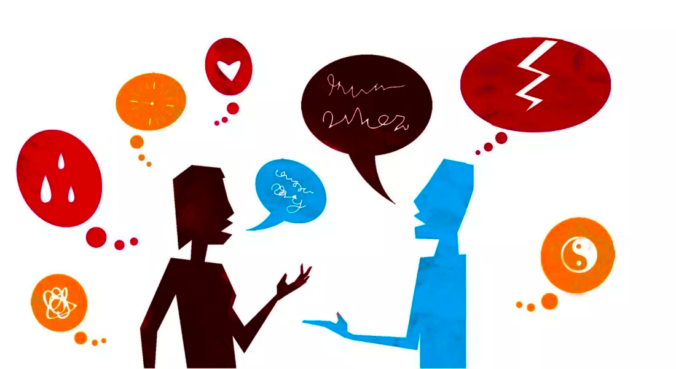
Introduction
The songs that we are presenting today have in common the topic: friendship. This is a very pleasant topic, but also a good motto to show you how songs can be very rich to learn new words, grammar, pronunciation, reading and writing. We decided to explore the songs in all those components, so that you could have the opportunity to learn while you sing. It is fundamental, after solving the tasks, to sing along to feel the words and pronounce them freely and comfortably.

Slide 82
True Friends – Miley Cyrus
1. Listen to the song by Miley Cyrus and fill in the gaps using the words from the box.
a) pretend b) true c) angry d) earth
e) laugh f) quiet g) BBF h) alright
i) around j) wrong k) pretend l) lucky

Slide 83
True Friends – Miley Cyrus
A true friend
You're here till the end
You pull me aside when somethin ain't right
Talk with me now and into the night
Till it's alright again
True friends will go to the ends of the ______________________¹⁰
Til they find the things you need
Friends hang on through the ups and the downs
Cuz they've got someone to ___________________________¹¹ in
A true friend
You're here till the end
You pull me aside when somethin ain't right
Talk with me now and into the night
No need to _____________________¹²
Oh you're a true friend
You're here till the end
You pull me aside when somethin ain't right
Talk with me now and into the night
Till it's alright again
You're a true friend
You're a true friend
You're a true friend
We sign our cards and letters _______________¹ (Uh uh)
You've got a million ways to make me _____________² (Yeah)
You're looking out for me
You've got my back
It's so good to have you _____________ ³
You know the secrets I could never tell(Uh huh)
And when I'm _________________ ⁴ you break through my shell
Don't feel the need to do a rebel yell
Cuz you keep my feet on the ground
You're a __________________⁵ friend
You’re here till the end
You pull me aside when somethin ain't right
Talk with me now and into the night
Till it's _____________________ ⁶ again
You're a true friend
You don't get __________________⁷ when I change the plans
Somehow you're never out of second chances
Won't say I told you when I'm ___________________⁸ again
I'm so ___________________⁹ that I found

Slide 84

True Friends – Miley Cyrus
2. Choose the correct meaning for the parts of the lyrics below according to its context.
2.1. “You’re looking out for me” (l.3)
a) to take care of me
b) to try to find me
2.2.”You’ve got my back” (l.4)
a) you are behind me
b) you protect me
2.3. “break through my shell”( l.7)
a) take me out of my solitude
b) take me out of the peel
2.4.”keep my feet on the ground “(l.9)
a) be rational
b) Stop flying
2.5. “Friends hang on through the ups and the downs” (l.27)
a) Friends tolerate good and bad moments
b) Friends can’t stand going up and down

Slide 85

True Friends – Miley Cyrus
3. In your opinion, what’s the message of the song? Choose the correct idea and explain.
a) True friends support us every time in bad and good moments, but they should walk away when they are fade up.
b) True friends support us every time in bad and good moments. They never give up on us.
c) True friends support us every time in bad and good moments, because they want to receive something back.

Slide 86
True Friends – Miley Cyrus
4. “And when I'm quiet you break through my shell/
Don't feel the need to do a rebel yell”
4.1. Identify the verb tense underlined in the lyrics above. ____________________
4.2. Friendship should be a permanent state a general truth. Complete the test with the verbs in brackets in the Present Simple.
Renato and Beatriz ______________________¹ (be) good friends. They ___________² (be) Portuguese and they ____________________³ (attend) the same school.
_________________________⁴ (there to be) many students in their school and they________________⁵ (get) along very well. They _______________ ⁶(not/know) how to speak Italian, but they ________________ ⁷(be) eager to learn. Renato ________________ (study) new words every day.

Slide 87
True Friends – Miley Cyrus
5. “You pull me aside”
Complete the sentences with the correct Personal Pronouns, object or subject.
Catarina is Portuguese. ___________¹ studies in a school in the north of Portugal. ______________² is not in the centre of the city of Penafiel, but _______³ is surrounded by great historical monuments. Catarina has got many friends. _______________⁴ are always together. Their teachers suggested _______________⁵ the participation in the Erasmus project and _____________⁶ loved the idea. ___________⁷ is a fantastic opportunity to meet new cultures and share experiences. Pedro is another Portuguese student and Catarina’s friend too. ___________⁸ goes to the same school. His parents also supported ____________⁹ to enrol in this experience.

Slide 88
True Friends – Miley Cyrus
6. Create a lexical cloud for the adjective “TRUE”.
TRUE

Slide 89

True Friends – Miley Cyrus
7. If you could add a new line to the song written by you what would it be?

Slide 90
Song 2 - That’s What Friends Are For (Dionne Warwick)
1. Listen to the song and underline the correct word. In some cases they are homophones.
And I never thought/though I'd feel/fill this way ¹
And as/has far as I'm concerned ²
I'm glad I got the chance/change to say ³
That I do believe I love you
And if I should ever go away/way ⁴
Well then close your eyes and die/try ⁵
To feel the way we do today/yesterday ⁶
And then if you can remember
Keep smilin' keep shinin'
Knowing you can always bounce/count on me for sure ⁷
That's what friends are foe/for ⁸
For god/good times and bad/bed times ⁹
I'll be on your side forever nor/more ¹⁰
That's what friends are for
Well/wheel you came and opened me ¹¹
And know/now there's so much more I see ¹²
Hand/And so by the way I thank you ¹³
And then/than for the times when we're apart ¹⁴
Well then close your eyes and know/now ¹⁵
These/this words are coming from my heart ¹⁶
And then if you can remember
Keep smilin' keep shinin'
Knowing you can always count on me for sure/shore ¹⁷
That's what friends are for
For good times and bad times
I'll be on your side forever more
That's what friends are for

Slide 91

Song 2 - That’s What Friends Are For (Dionne Warwick)
2. Find in the dictionary the definitions of the misused words in the lyrics.

Slide 92

Song 2 - That’s What Friends Are For (Dionne Warwick)
3. Find in the first and second stanzas opposites for the words below:
1. Distressed ________________
2. Unhappy _________________
3. Disbelieve ________________
4. Open ____________________
5. Forget ___________________
6. Mistrust __________________
7. Doubtful _________________
8. Temporary ________________
9. Antagonists _______________

Slide 93

Song 2 - That’s What Friends Are For (Dionne Warwick)
4. Write three sentences using three of the opposites above with the topic Friendship.
__________________________________________________________________________________________________________________________________________________________________________________________

Slide 94
Song 2 - That’s What Friends Are For (Dionne Warwick)
5. “For good and bad times”
Complete the sentences with the adjectives from the line above. (Superlative or Superiority and Comparative of Superiority)
1. Reading is _____________________ for our literacy.
2. Friendship is one of the ___________________ parts of youths’ lives.
3. Enemies can create the ____________________ moments of our lives.
4. Travelling by plane is ______________________ than by train.
5. Hiding our worries is __________________ than getting problems from our chest.

Slide 95
Song 2 - That’s What Friends Are For (Dionne Warwick)
6. “You came and opened my eyes”
Identify the tense of the verbs above. _______________________________________
Complete the sentences.
Yesterday the students _________________¹ (arrange) everything for their trip to Italy. They____________________² (be) very excited about it. They ___________________³ (not/want) to miss a thing, so they ________________⁴ (check) their luggage twice. They _______________ ⁵ (go) to bed early.

Slide 96
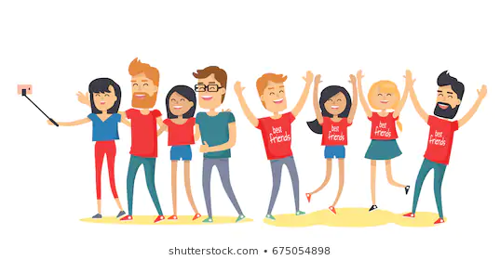
Song 2 - That’s What Friends Are For (Dionne Warwick)
7. What’s a “true friend” for you? Give your own definition.
____________________________________________________________________________________________________________________________________________________________________________________________________________________________________________________________________________________________________

Slide 97
"This project has been funded with support from the European Commission. This publication reflects the views only of the author, and the Commission cannot be held responsible for any use which may be made of the information contained therein."

