Slide 1
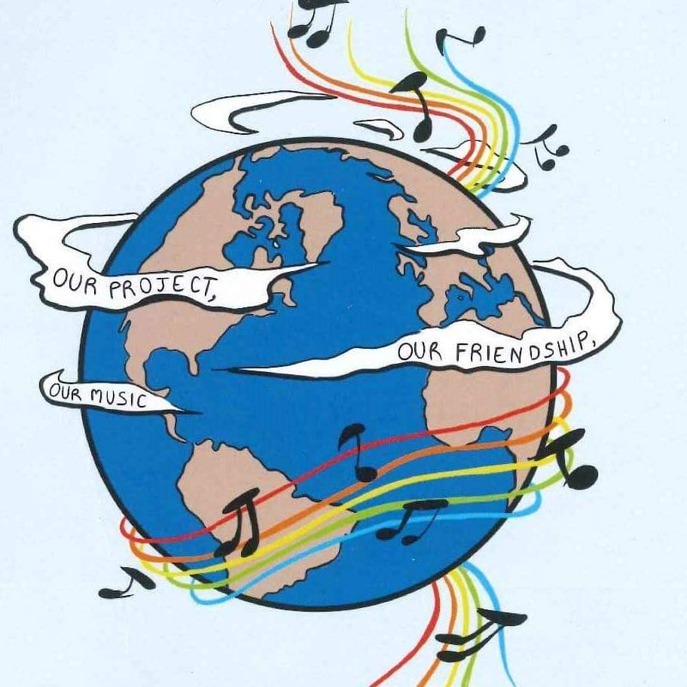
MUSIC: A MELODIC METHODOLOGY INTO TEACHING AND LEARNING 2018-1-ES01-KA229-050761_2 SCHOOL EXCHANGE PARTNERSHIP The Italian team presents:
Co-funded by The Erasmus + Programme
Of the European Union
LANDSCAPE AND TRADITIONAL DANCES

Slide 2
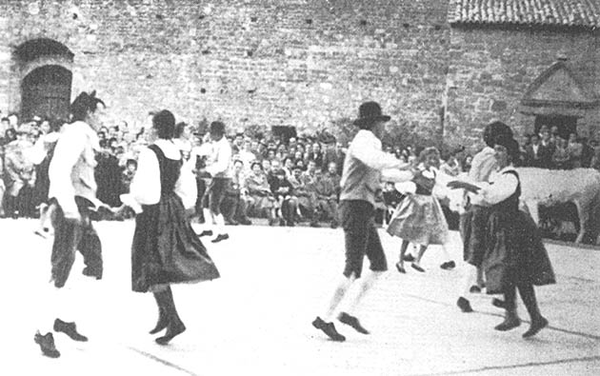
What is Trescone?
Trescone is a traditional Italian dance born in the territories of: Tuscany, Umbria, Romagna, Veneto and Lombardy. It was born in the mediaval age and its name came from the German word thriskan (to seize). That’s because the sounds that the feet produce when people dance remember the seizing of the grain, In fact they usually stick iron wedges to shoes to remind it.

Slide 3
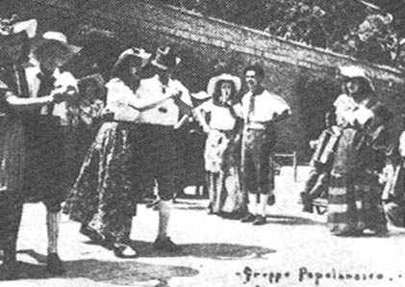

Slide 5
Trescone.
Svegliatevi dal sonno o’ briaconi Che giunta l’è per noi la gran cuccagna S’ha da mangiar de’ polli e de’ piccioni E ber del vin che vien dalla campagna E la Menica con il cembalo, la frullana la suonerà (2volte) Addio Carola – Carola addio Sarà de nostri anche Beppin del noce E detto gli ho che porti l’organino N’ha compro giusto uno a sette voce Lo fa cantar che sembra un cardellino Gli è un tremoto gli è un accidente tutti i versi li sa far (2volte) Addio Carola – Carola addio.
Wake up from sleep,drunkards
It’s time for the big lunch.
You have to eat chickens and de
pigeons
And drink the wine coming from
Countryside.
And the Menica with the harpsichord,
the frullana will play it (2 times)
Goodbye Carola - Carola goodbye
Beppin della noce will also be
one of us.
And said I him to bring the accordion
I buy just one to seven voices
It makes him sing that looks like a goldfinch
for him it is a pleasure
he knows how to do all the verses .
Goodbye Carola - Carola goodbye

Slide 6
Avevo anche invitato il sor dottore Perché anche lui venisse al ritrovato Ma ha mandato a dir pel servitore Che gli è nel letto tutto ammalazzato Gli’ è in cucina co’ la su serva ad aiutarla a risciaquar (2volte) Addio Carola – Carola addio S’ha da invitare pure il sor Priore perchè intervenga al nostro ritrovato ma ci ha mandato a dir dal servitore che stà nel letto tutto ammalazzato. Rit. L’è in cucina con la su serva che l’aiuta a risciaquà, l’è in cucina con la su serva che l’aiuta a risciaquà, Addio Carola – Carola addio
I had also invited the doctor
Because he too came to the
Meeting But his servant said to me
That he is in his bed all sprawled
Now the servant is with his colleague
to help her to clean.(2times)
Goodbye Carola - Carola goodbye.
I also invited Mr.Priore
so he’ll have fun with us
but his servant said to me
that he is in his bed all sprawled.
Rit.Now the servant is with his colleague
to help her to clean.
Now the servant is with his colleague
to help her to clean.
Goodbye Carola - Carola goodbye

Slide 7
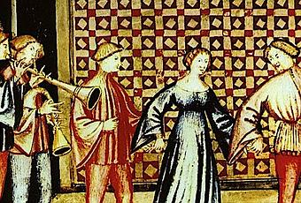
What is Schiarazula Marazula?
Schiarazula Marazula is a very particular dance that was used by the inhabitants of the territory of Friuli in the north of Italy to make it rain. We don’t have reliable sources,but we know that this dance wass probably born in the medieval age.

Slide 8
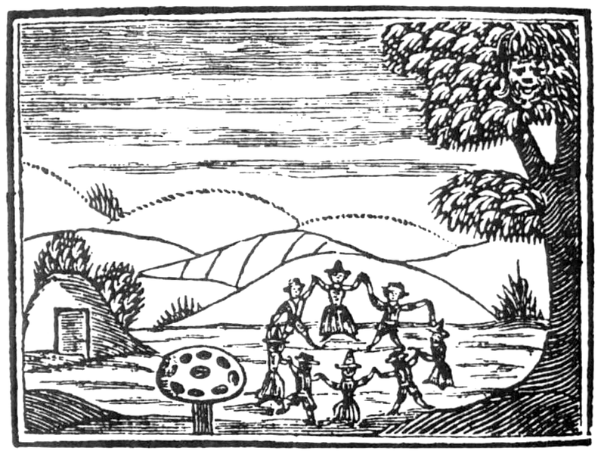
During the Middle Ages, the belief in witches able to influence the weather, attributed to special people called storms, the ability to navigate in the air and to unleash hail or storm. The original text has been lost, not even dance they know steps and choreography, but how much charm music emanates! We can only assume it was a sacred dance, one of those that dance with simple repetitive steps often accompanied by gyrations, to help in the ecstatic experience

Slide 9
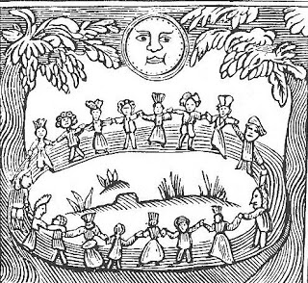

Slide 11
Schiarazula Marazula
Schiarazula marazuIa
la lusigne, la cracule,
la piciule si niciule
di polvar a si tacule
O schiarazule maraciule
cu la rucule e la cocule
la fantate jè une trapule
il fantat un trapolon.
Scjaraciule and Maraciule
the firefly and the tree frog,
the little one sways
and stains with dust.
O 'scjaraciule maraciule,
with rocket salad and walnut,
the girl is a trap (a liar),
the boy is a bigger trap.

Slide 12
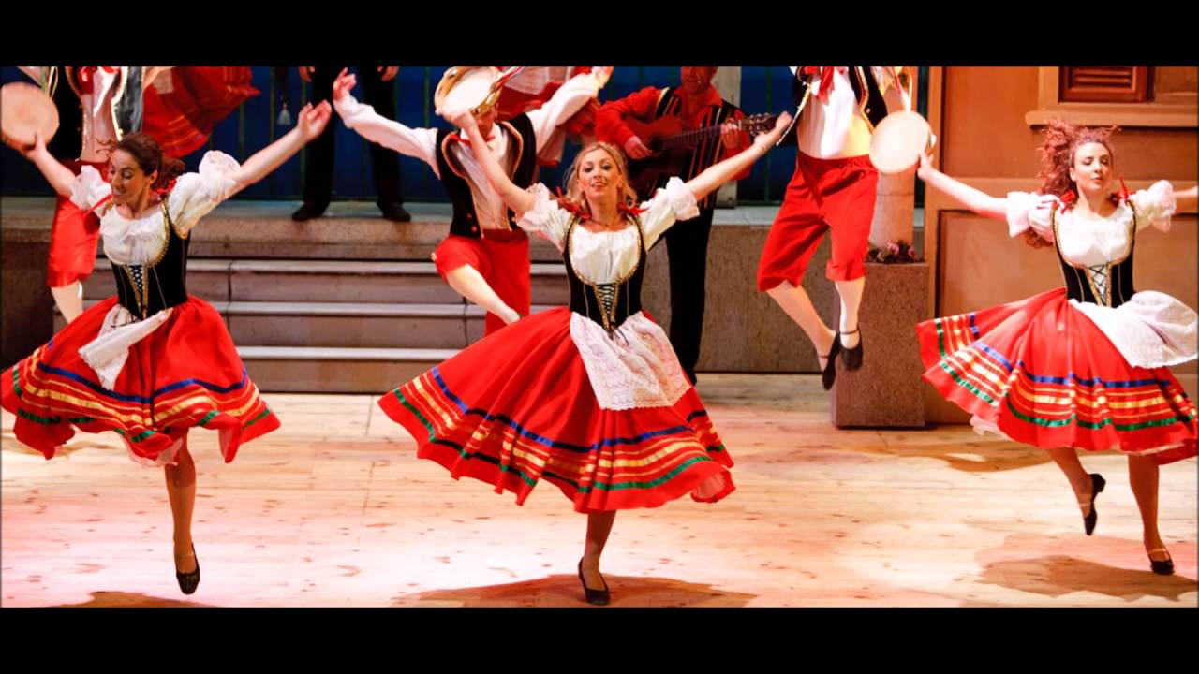
Tarantella
Tarantella does not have got a lyrics but it has got a very fast rythm. This dance was born for a very particular reason: in the south of Italy there is a very dangerous spider. This spider is called the Tarantula. People were very afraid about this spider and when they got a bite ,they began to do a sort of ritual dance: The Tarantella, to “heal” themselves.

Slide 13
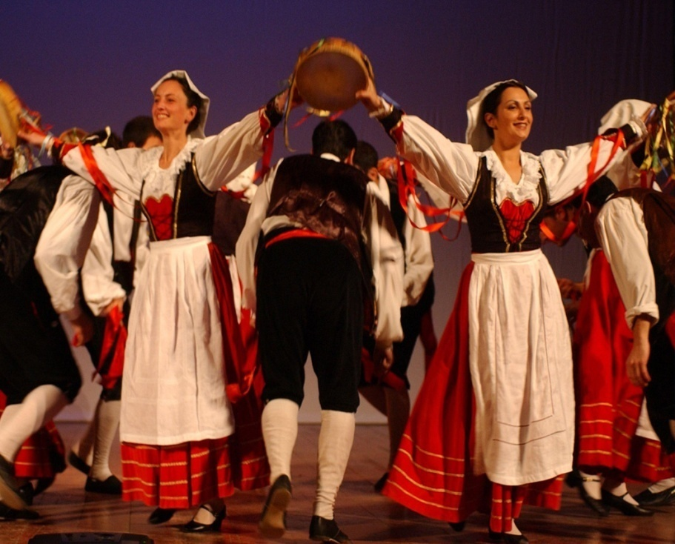
The term "tarantella" is linked to the name of a spider, the tarantula, whose bite according to ancient beliefs triggered violent psychomotor crises. The typical movements of this folk dance in fact reproduce those attributed to the bite of this arachnid. The dance, usually accompanied by the sound of rattle tambourines, therefore served to bring out the tarantolate from the state of delirium in which it found itself. The Lycosa tarentula, the spider present in the areas of Southern Italy where this dance spread, is poisonous

Slide 15
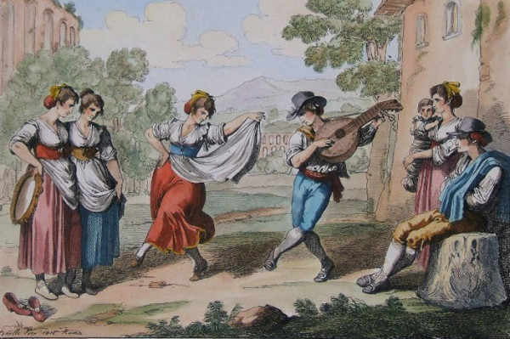
Saltarello
Saltarello is a typical dance of the center of Italy. It was born because in this territory people often make wine.
In the ancient years people used to jump on the grapes to make wine and,by the time, this practice became a dance: the Saltarello (name that derives from the Italian verb “Saltare” in English “To Jump”).
Salarello does not have a lyrics and his rythm is progressive. It starts with a medium-slow rythm that become very fast.

Slide 16
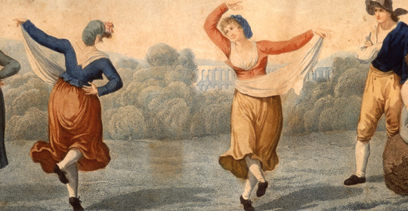

Slide 18
Taranta
Taranta (or “Pizzica”) is a dance born in the south of Italy. This dance’s history and Tarantella’s one are very similar but they have got a diffrent rythm. Taranta’s movements are slower and the instruments used to make its base are louder.
The history of this dance has very different origins: popular origins, rooted in the land and work of peasants and in a certain obscure and primordial relationship with life and with the most mysterious forces of human nature.
Taranta was born as a "medicine": it happened very often, especially during the harvest, that the peasants felt sick, and it was believed that the cause of this was the bite of a very common spider in the warm lands of Salento, especially in summer. Abdominal pain, depression and catatonia were the typical symptoms of "tarantolati", that is those who had received the tarantula bite. The victims fell into a real trance state against which traditional medicine could do nothing.
The only way to "get out" of the evil seemed to be to subject the patient to the obsessive sound of the tambourine, sometimes even for entire weeks. The convulsive and violent movements unleashed by the sound of the drums freed from the poison of the spider, bringing the patient back to life: there was talk, due to the profoundly magical nature of this phenomenon, of even "musical exorcism".

Slide 19
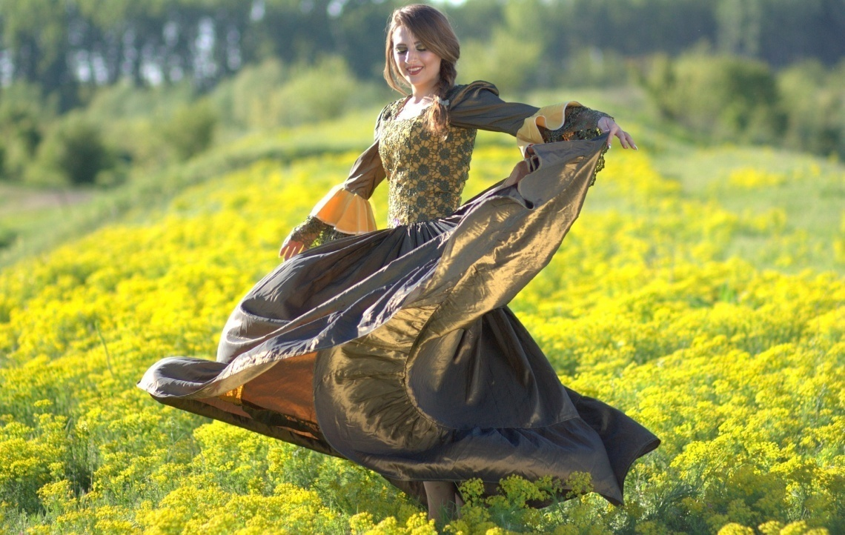

Slide 21
Thanks for your attention

