Slide 1
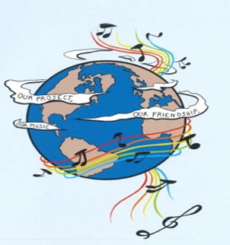
MUSIC: A MELODIC METHODOLOGY INTO TEACHING AND LEARNING 2018-1-ES01-KA229-050761 SCHOOL EXCHANGE PARTNERSHIP
TRADITIONAL INSTRUMENTS

Slide 2
THE ROMANIAN TRADITIONAL INSTRUMENTS

Slide 3
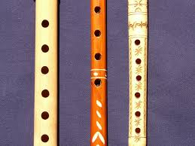
Folk music is the oldest form of Romanian musical creation, characterized by great vitality; it is the defining source of the cultured musical creation, both religious and lay. The earliest music was played on various pipes with rhythmical accompaniment. The religious musical creation, born under the influence of Byzantine music adjusted to the intonations of the local folk music, saw a period of glory between the 15th-17th centuries, when reputed schools of liturgical music developed within Romanian Monasteries. Let’s discover now some important musical instruments that played a key role in our mentality and our cultural dimension as a nation.
The Whistle
The whistle is a musical blowing instrument, made of wood, bone, and occasional made of metal. All types of whistles have the shape of a cylindrical tube, with or without holes.The traditional Romanian whistle was made by shepherds from different types of wood. Sometimes they used soft wood such as: walnut, elder tree or willow. Other times they took the wood from the orchard, which is harder to process and produce low sounds, such as: apricot, cherry or plum, the latter having the most beautiful sound.
First the shepherds harvested and brought the wood home, kept it dry for about two weeks, then carved it and polished it in a round shape, along the fiber, all the holes being made manually by carving.
The whistle has at one end the hole half-blocked, this being the hole through which the interpreter blows air inside. The side holes are closed in a row with the fingers to produce the scales.
The whistle was a traditional musical instrument, used especially by the shepherds in ancient times when they went with the sheep up in the mountains or down the hills according to season. It is melodious, it produces slightly melancholic sound, it is small and very easy to carry.

Slide 4
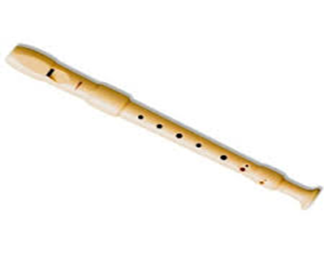
In the old Romanian fairy tales, the whistle was used by heroes for its magical powers to act on the forces of evil, to tame wild animals and as a weapon to fight against the supernatural powers of evil characters.
An example of an ancient song, in which the hero loses his flock of sheep and then uses this instrument in order to find it, is the ballad When The Shepherd Lost His Sheep, a song that shows the close connection between the shepherds and their favourite instrument which accompanied them all the time witnessing daily problems, but also their moments of joy. The ballad is an old folk legend, according to which a shepherd, with his great flock of sheep on a plain far from the village, on the hill, on the mountain or near a frightening forest at a certain moment, sleeps in the middle of nature. When he wakes up after a certain time, he no longer finds his flock. Overwhelmed with fear, pain and worry, he sets off in search of the lost flock, playing whistle songs well known by his animals, but also songs of sorrow that express his sadness. He hopes that this way the flock will hear him and that the sheep, attracted by the magical sound of his instrument, will come to him. In his journey, the shepherd goes through many trials, but his whistle seems to have magical powers, helping him to defeat the forces of nature, evil spirits, and wild animals. After many searches, the shepherd finds his flock. At this moment, the feeling of sadness is changed into a state of joy and optimism. Finally, the songs performed by the shepherd's whistle are cheerful.

Slide 5
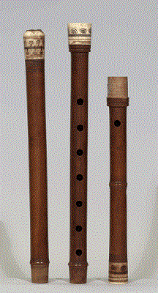
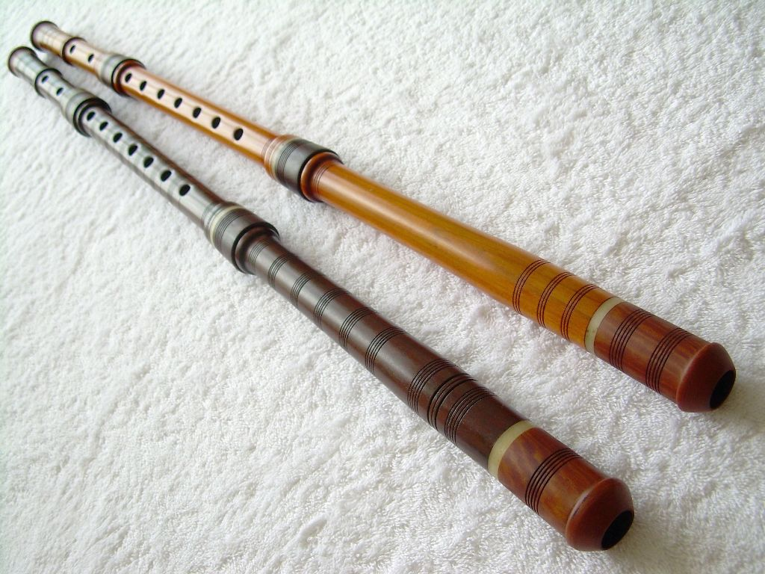
The Kaval (Cavalul)
The Romanian Kaval is a blowing instrument, a similar whistle with 8 holes, but bigger than this, made in general of hazelnut wood or sycamore wood. It is fully open at both ends, and is played by blowing on the sharpened edge of one end. There are seven holes in front, one in the back for the thumb and usually other four near the bottom of the kaval. These holes improve the tone and the intonation. The Kaval is an aerophore instrument of big sizes which belongs to the family of whistle without stopper.
Usually this instrument is made of wood (hazelnut, sycamore, plum, apricot etc.); the Kaval is also made of water buffalo horn, metal or plastic. It can be in one piece, in two pieces or three pieces. The ones of two and three pieces are made to be easy to carry. Shepherds played an important role, because they spread the instrument by practising transhumance.
The legend of the instrument said that one day, after the God created the world, the Devil stole the fire from people. As God did not like and accept this, He went with Saint Peter to take it back. While the Devil wasn’t there Saint Peter hid some pieces of coal into this musical instrument. And from that moment on, the world has had fire.
This instrument is usually used in songs in which the feeling is of sorrow.

Slide 6
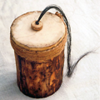
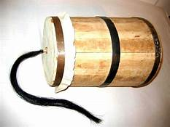
The buhai ( Buhaiul)
The buhai is a Romanian traditional instrument. It is made of a wood coffer and on the bottom is covered by goat or sheep skin which form a resonance box. The skin is well stretched, fixed with a rope. In the middle of the skin, there is some horse hair. To make sounds, you must pull the horse hair, but your fingers must be wet. When the horse hair slides between your fingers it makes a sound that reminds us of an angry bull.
The origin of buhai is Romanian, but it was popular in the whole Europe. The Czech call it “bukal” or “bukaci”. In Europe, the buhai disappeared but not in Romania. We have a tradition on Christmas Eve: the carolers sing and play the buhai in order to announce Christ’s Birth. This musical instrument is used so as to raise awareness of the outmost importance of this event.
The composer Orlando Gibbons (1583–1625) wrote a keyboard fantasia in which he quotes the Dutch melody De Rommelpot. In modern times, the buhai has been used by several Western composers. Edgard Varèse used it in Hyperprism (1924) and Ionisation (1933). Alexander Goehr specifies a Lion’s roar in his Romanza for cello and orchestra (1968). Carl Orff used a whirled friction drum in A Midsummer Night’s Dream (1934–52) and Benjamin Britten, in his Children’s Crusade (1969), calls for a string drum to be struck with drumsticks and bowed by means of the stretched string.

Slide 7
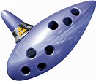
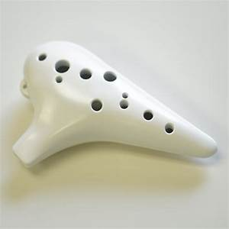
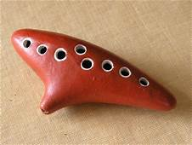
Ocarina
Ocarina, is a folk musical instrument made of ceramic (burnt clay), metal or wood (especially plum tree), having the shape of a larger and slightly elongated egg. Each manufacturer can change the shape of this instrument depending on the sound effects that are pursued. A typical ocarina has an enclosed space in which there are from four to twelve finger holes and there is the mouthpiece which is the place where the performer blows the instrument. The holes are arranged in such a way that the performer can cover them with the fingers, as at the whistle, changing the height of the sounds. Air pulses in and out of the ocarina, as the vessel resonates at a specific pitch. When the performer covers the holes, the pitch lowers. When this uncovers the holes, the pitch raises. When he/she blows more softly, the pitch lowers while if he/she blows more strongly, the pitch raises. The pitch can be changed by three semitones using the breath force. This blowing instrument produces sounds similar to those of the flute.

Slide 8
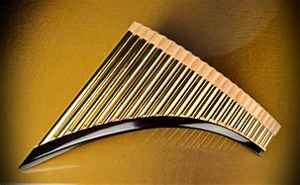
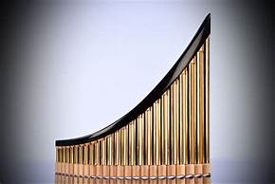
The Pan Flute
The pan flute is a musical instrument whose function is based on the principle of the closed tubes. There are multiple pipes that gradually increase their length. Multiple varieties of pan flutes have been popular as folk instruments in Romania. These pipes are typically made from bamboo, giant reeds or local reeds. Other materials that are used include wood, plastic, metal and ivory.
The pan flute is named after Pan, the Greek God of Nature and shepherds are often depicted with such an instrument.
In Greek mythology, Syrink was a forest Nymph. In her attempt to escape the affection of god Pan (a creature half he-goat and half he-man), she was transformed into a water-reed. Then, Pan cut several reeds, placed them in parallel one next to the other, and bound them together to make a melodic musical instrument. Ancient Greeks called this instrument Syrinx, in honour of the Muse, and Pandean, or Pan-pipes and Pan-flute, after Pan.
Conservation of Romanian folk music has been aided by a large and enduring audience, and by numerous performers who helped propagate and further develop the folk sound. One of them, Gheorghe Zamfir is famous throughout the world today, and helped popularization of a traditional Romanian folk instrument, the pan flute.

Slide 9
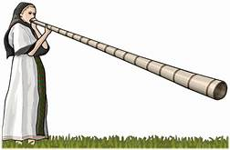
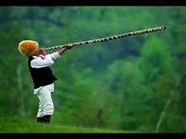
The Bucium ( Buciumul)
This is usually 1.5m to 3m in length and made of well-seasoned deal, maple, ash, lime or hazel wood which is conical or cylindrical bored, slit lengthways, hollowed out and then glued together. In the north it can be made of galvanised iron and folded like a trombone. As it does not have valves or finger holes, it can only play the pitches in the natural harmonic series. The generic term ‘bucium’, is used in the Muntenian Carpathians of Argeş and Prahova, and in the Moldavian Carpathians of Vrancea and Neamţ. The name ‘bucium’ is derived from the Latin bucinum = trumpet blast. In the Apuseni mountains it is known as ‘tulnic’, and is often played by women.
The bucium has several different functions: Integrated into pastoral life, it is used to call the sheep into the sheep-folds in the afternoons and evenings. In the Apuseni mountains it is also used in the morning when taking the sheep out. In Oaş there are two types of melodies, at the sheepfold and at the end of the milking the sheep, when the instrument plays a high tune. In Bucovina, Oaş, Maramureş, and some villages in the north of Neamţ it is used to lead the funeral processions. In the Apuseni it is also used for communication for people in the highlands who are situated at great distances from one another.

Slide 10
THE ITALIAN TRADITIONAL INSTRUMENTS

Slide 11
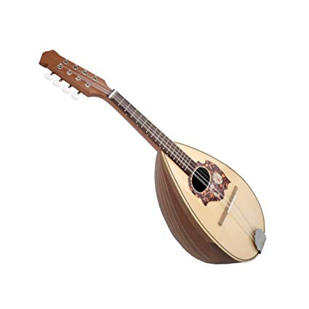
THE MANDOLIN:THE ORIGINS
The mandolin is a small, lute-like instrument with eight strings. Originally appearing in 18th-century Italy, this bright-toned instrument has become a staple in styles of music all over the world, ranging from classical to bluegrass and even to jazz. But that’s only a small part of the story of the mandolin.
History
The instrument we now call the mandolin first truly appeared in the workshops of Naples, Italy, in the middle of the 1700s. But similar instruments going by the names mandora, mandola, and mandore preceded the Neapolitan mandolin by centuries.
The mandora first appeared as early as the 15th century in Italy. Starting out with only four or five strings, its name probably came from the word mandorla, or almond.
With gut strings, a pear shaped body carved from a single piece of wood, and no frets, this instrument had a deeper, sweeter tone than today’s mandolins. The term mandora has since come to refer more broadly to mid-sized mandolins.
By the Baroque period (roughly 1600–1750), a new instrument had developed that was known as the mandolino, or little mandola.
It was primarily a melodic instrument, which differentiated it from the lute, which played both harmonic and melodic roles in the music of that time.

Slide 12
The modern mandolin developed from the mandolino between 1750 and 1850.
The Vinaccia family in Naples played a crucial role in this development throughout that period, and Pasquale Vinaccia (1806–82) is the man who was most responsible for establishing the standard design of the instrument.
Among the developments that differentiate the mandolin from the Baroque mandolin were a bent soundboard, a raised fret board, more frets (and therefore more notes), and 8 metal strings.
The strings are paired in sets, known as courses, of two, in which each pair of strings is tuned to the exact same pitch.
This means there are actually only four pitches represented by the eight strings. The strings are tuned to the same pitches as are the strings of a violin – G, D, A, and E, from low to high.
In the second half of the 1800s, the mandolin began to become a worldwide phenomenon. Virtuoso performers such as Carlos Munier, grandon of Pasquale Vinaccia, toured Europe and persuaded audiences that the mandolin was more than just an Italian folk instrument. And, from the 1870s onward, masses of immigrants to the United States from Italy brought their mandolins along with them
Styles of music
The earliest music for the mandolin is found in Italian classical music and folk music. In the classical world, composers like Antonio Vivaldi (1678–1741) incorporated the mandolin into the orchestra.
Vivaldi himself wrote two concertos for the instrument; one for mandolin solo and one for two mandolins.
Another composer, Wolfgang Amadeus Mozart (1756–1791), wrote music for the mandolin in his opera Don Giovanni.

Slide 13
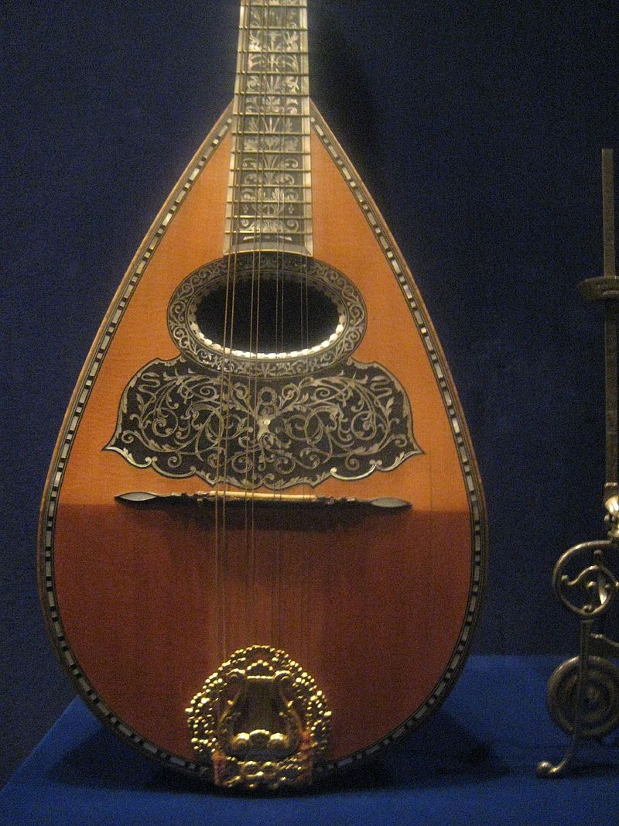
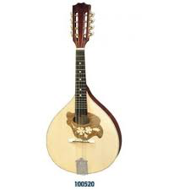
TYPES OF MANDOLIN
The classic mandolin, also known as neapolitan,is characterized by a paunchy drop-shaped body made of staves that join at the top at the handle; while the back of the case is strengthened by the shield :a wooden band that sorrounds the soundboard of the perimeter. The classic mandolinhas a delicate and very expressive tone and the sound is sweet and argentine.
The Italian nordic mandolin is very similar to the previous one with the only characteristic that the shield is langer. The bottom is flat; the instrument has better projection capability and is used for more aggressive use.
The Portuguese mandolin, also called bandolim has the table very wide and has parallel chains arranged perpendicularly to the centerline . The handle joins the case in a more backward position than the classic one and has a thin dorsal profile favoring the emission of more acute sounds.

Slide 14
THE MANDOLIN: characteristics and materials
The mandolin has a relatively short neck comprised of two main parts: a fingerboard and frets. The fingerboard is a flat piece of wood attached to the neck, while the frets are thin pieces of metal that are hammered into channels on the fretboard.
The frets stop the vibration of the strings at a specific point along the neck of the instrument, creating a different pitch depending on the length of the string.
The strings end at the final major part of the mandolin, its head. The head is a solid piece of wood that hosts the tuners, a set of eight pegs attached to gears that are turned to tighten or loosen the strings, which in turn raises or lowers the pitch of that string.
The rope is a plate equipped with hooks to which the strings are normally fixed in harmonic steel.

Slide 15
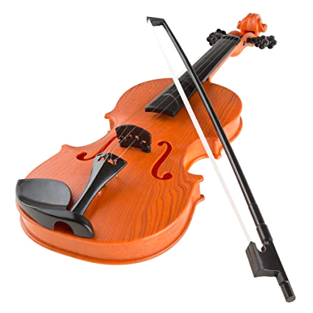
The violin is a string instrument which has four strings and is played with a bow.It is held between the left collar bone (near the shoulder) and the chin.. Most historians agree that today’s violin emerged in the early 16th century in northern Italy, an area which would maintain the violin-making tradition over the coming centuries. Maple and spruce, the two types of wood most favored by violin makers then and since, were readily available in the Lombardy region. The city of Brescia, located at the foot of the Alps, was the earliest to excel in the crafting of violins, but Cremona, home to the world’s most famous luthiers, Giuseppe Guarneri, Antonio Stradivari, and the Amati family, became synonymous with the art of violin making The violin’s sound continued to expand through the centuries, embraced by fiddlers and virtuosos alike. During the 17th century, the violin became an important instrument in the orchestra as composers like Claudio Monteverdi incorporated it into their compositions. Composers and musicians, such as Antonio Vivaldi (1678-1741), Franz Joseph Haydn (1731-1809), and Niccolò Paganini (1782-1840), continued to focus on the sounds of the strings, bringing the violin to greater prominence in the orchestra.
THE VIOLIN: THE ORIGINS

Slide 16
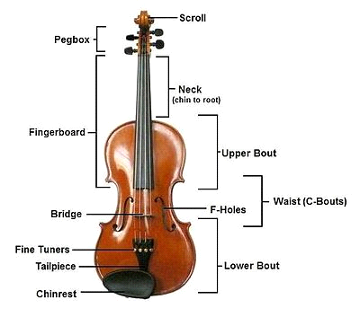
The biggest part of the violin is the wooden body. This acts as a resonating box. It makes the vibrating strings sound louder. Many of the parts of the violin are named after parts of the body. The front is called the “belly”. The back is called the “back”. The sides are the “ribs”. The strings go from near the top of the “neck” down the “fingerboard” and on to the “tail piece”. The strings go across the bridge halfway between the end of the fingerboard and the tailpiece. The bridge is not fixed onto the violin. It is held in place by the strings. The strings keep it in place because they are so tight. If the strings are completely loosened, the bridge will not stay on. The bridge helps to send the vibrations of the strings down to the body of the instrument. Inside the body there is a “soundpost”. This is a small piece of wood. It looks like a small finger. It goes from the belly to the back. The soundpost is also held in place by the strings. In the middle of the belly there are two long, curved holes. They are called “f holes”. This is because of their shape. The top of the strings are wound around pegs. The violin can be tuned by turning the pegs. The very top of the neck is called the scroll. Violins today also have a chinrest. This helps to hold the violin against the player's shoulder.
THE VIOLIN: characteristics and materials

Slide 17
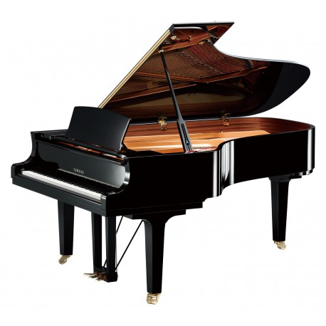
The piano is an italian musical instrument invented by Bartolomeo Cristofori around the year 1700 in which the strings are struck by hammer. It is played using a keybord with 88 keys; 52 white for the notes of the c major scale (C,D,E,F,G,A,B) and 36 black. The black keysareaccidental. There are different types of piano: The Grand Piano; The Upright Piano; The electric, electronic and digital piano. This instrument it's very diffucult and expensive but it's very great and to play
THE PIANO: THE ORIGINS
The story of the piano begins in Padua, Italy in 1709, in the shop of a harpsichord maker named Bartolomeo di Francesco Cristofori (1655-1731). Many other stringed and keyboard instruments preceded the piano and led to the development of the instrument as we know it today. First exhibited in Florence in 1709, Cristofori’s new instrument was named gravicembalo col piano e forte (roughly “soft and loud keyboard instrument”). Eventually, it was shortened to fortepiano or pianoforte, and finally just piano.
The piano as a musical instrument suffered various transformations since its invention in 1700, according to the needs and exigencies of the musicians. Bartolomeo Cristofori fabricated 20 pianos before his death, and the first piano recital open to the public in history occurred in 1768, performed by Johann Christian Bach, son of Johan Sebastian Bach.
What’s the piano made of?
Pianos are made of the optimum materials, not only for looks but for excellent sound creation. The long fibers of maple wood are strong and flexible for construction of the border, but long fibers of spruce are needed for the strength of the brackets. Wood is also needed for making patterns of other parts. Metal is used for a variety of parts, counting the cast iron plate; and sand is needed for casting molds. The character of the sand is altered by using additives and folders such as bentonite (a type of clay) and firewood powder. Molten iron for the casting is made of pig iron with some steel and scrap iron to add strength. Strings are made of high tensile steel cable that is manufactured at specialized piano string mills.
.

Slide 18
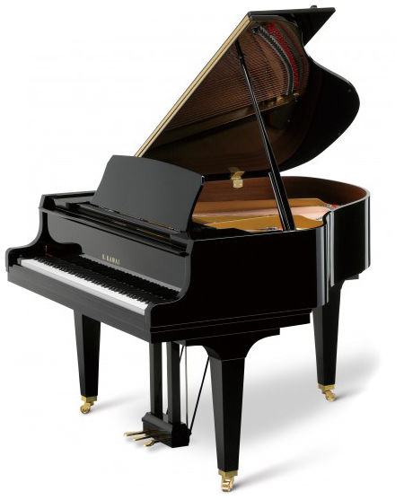
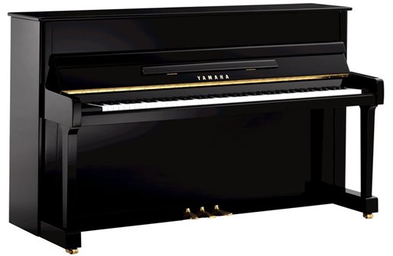
UPRIGHT PIANO Upright pianos, also called vertical pianos, are more compact due to the vertical structure of the frame and strings. In an upright piano, the strings are strung vertically to make the instrument more compact, which allows the piano to be played in a limited space. In contrast, the grand piano retains the shape of the original pianoforte in which the strings are strung horizontally, and has a greater potential for expression.
GRAN PIANO
In grand pianos the frame and strings are horizontal, with the strings spreading away from the keyboard. F
Features of the grand piano include:
More rich and varying sonority with wide dynamics-from pianissimo to fortissimo.
Smoother sustain.
More substantial tone.
Higher ability to add subtle expression to notes.
Sound is uniform and well balanced.
Higher ability of note repetitions

Slide 19
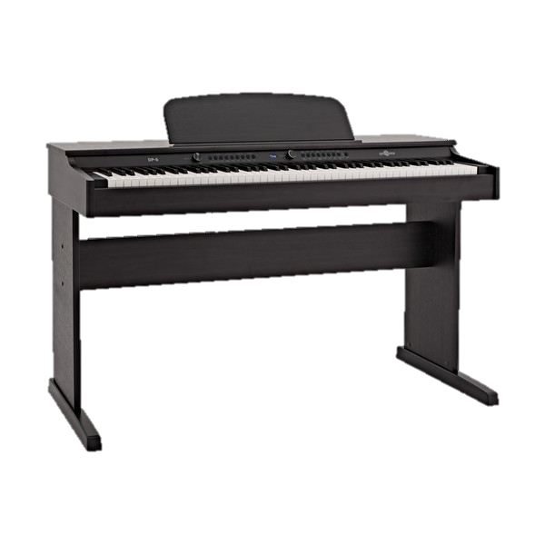
Digital piano - Electronic keyboards designed to sound and feel like an ordinary acoustic piano. They typically contain a amplifier and loudspeakers built into the instrument. In most cases they can fully replace acoustic pianos and provide several features, such as recording and saving files to a computer. Digital pianos are a mix between an acoustic piano and an electronic keyboard. ... Electronic keyboards are typically smaller than a full acoustic piano in that they tend to have approximately 61 keys (4 or 5 octaves) whereas a full acoustic has 88 keys (6 octaves Digital piano features: Keyboard action and touch response. One of the main differences between pianos and electronic keyboards is the feel of the keys. ... Digital piano sound quality. ... Polyphony. ... Number of sounds/tones. ... Learning tools. ... Amplification and speakers. ... Amps and Cables. ... Piano benches.
Electric Digital Piano

Slide 20
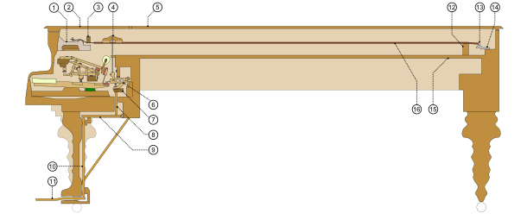
Pianos can have over 12,000 individual parts,supporting six functional features: keyboard, hammers, dampers, bridge, soundboard, and strings. Many parts of a piano are made of materials selected for strength and longevity. T It is most commonly made of hardwood, typically hard maple or beech." Hardwood rims are commonly made by laminating thin, hence flexible, strips of hardwood, bending them to the desired shape immediately after the application of glue. Previously, the rim was constructed from several pieces of solid wood, joined and veneered, and European makers used this method well into the 20th century. A modern exception, Bösendorfer the Austrian manufacturer of high-quality pianos, constructs their inner rims from solid spruce. the same wood that the soundboard is made from, which is notched to allow it to bend; rather than isolating the rim from vibration, their "resonance case principle" allows the framework to resonate more freely with the soundboard, creating additional coloration and complexity of the overall sound.

Slide 21
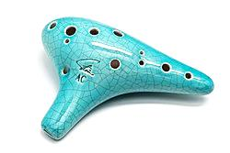
The modern ocarina was created by Giuseppe Donati in 19th century Budrio, northern Italy. At the time, the only available vessel flutes were crude toys capable of playing just a few notes. Donati developed an instrument and fingering system capable of playing chromatically over an octave and a fourth. The word 'ocarina' comes from a historic dialect of Italian, and means 'little goose'. It originally referred to sculptural ceramic whistles shaped like a goose, and Donati adopted the name for his instrument. Donati's instrument was shaped like a cone, with a protruding mouthpiece and 10 finger holes. Modern instruments generally retain this same design, but have evolved in a number of ways. Most notably, 'subholes’ were added by Asian makers, which extend the sounding range of the instrument downwards. Ocarinas often have one or two subholes; the one shown below has one. .Various sizes were made which enabled ocarina players to form ensembles. One such ocarina ensemble is the famed Gruppo Ocarinistico Budriese which is still actively performing today. .
THE OCARINA:THE ORIGINS

Slide 22
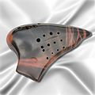
There are many different styles of ocarinas varying in shape and the number of holes: Transverse – This is the best known style of ocarina. It has a rounded shape and is held with two hands horizontally. Depending on the number of holes, the player opens one more hole than the previous note to ascend in pitch. The two most common transverse ocarinas are 10-hole (invented by Giuseppe Donati in Italy) and 12-hole. English Pendant – These are usually very small and portable, and use an English fingering system (4–6 holes). Peruvian Pendant – Dating from the time of the Incas, used as instruments for festivals, rituals and ceremonies. They are often seen with designs of animals. They usually have 8–9 holes. Inline – These are often called a "fusion" of the pendant and transverse ocarinas. This style is known for being very small and compact, with more holes than the pendant. This allows one to ascend in pitch with the linear finger pattern rather than finger combinations. Multi-chambered ocarinas – exist within the three broad categories of ocarina. These ocarinas overcome the ocarina's usual limited range of notes. A transverse double ocarina typically plays two octaves plus a major second, and a transverse triple ocarina plays with a range about two octaves plus a fifth. Double ocarinas for pendant and inline ocarinas also exist. Double inline ocarinas are specially designed to play chords, for harmonic playing. Several makers have produced ocarinas with keys, mostly experimentally, beginning in the late 19th century. Keys and slides either expand the instrument's range, help fingers reach holes that are widely spaced, or play notes not in the native key of the instrument.
TYPES OF OCARINA

Slide 23
Characteristics and materials
CLAY OCARINAS
Clay ocarinas are the most abundant type of ocarina. Various types of clay are used to make ocarinas.
Clay ocarinas may be glazed, painted, lacquered, or left unglazed.
WOOD OCARINAS
Many different types of wood can be used to make a wooden ocarina. Common woods include, walnut, bloodwood, coccobolo.
PLASTIC OCARINAS
Plastic ocarinas are known for their relative indestructibility making them a popular choice for younger children or for those worried about breaking their ocarina while traveling.
Several types of plastic are commonly used such as polycarbonate, corian.
METAL OCARINAS
Ocarinas made of metal are typically made of aluminum

Slide 24
Musical performance
To understand the ocarina's capability, it is important to take the right point of view: the ocarina is a limited instrument which works brilliantly in some situations. Limited does not mean useless, and no instrument is inherently 'better' than any other. Music is a collage of sound, and which instruments are best depends on the desired effect. Interest in music comes from the interplay of multiple instruments, rarely any single instrument in isolation. Ocarinas can be used to play quite a wide range of music from lyrical vocal melodies to more upbeat music like Scottish dance tunes. They are functionally similar to the tin whistle, Uilleann pipe, and cornemuse du Centre. Single chambered ocarinas have a range of about an octave and a fourth, with multichambers breaking two octaves. They respond very quickly to both pressure changes and finger movements
Ocarinas work best when paired with limited and simple accompaniment like acoustic guitar, ukulele, harp, and piano. The instrument's tone is close to but not exactly a pure sine wave: they have other tonal components including some quiet overtones and a portion of wind noise. These things are required to make the instrument listenable. However, it's very easy to drown them out with overpowering accompaniment, leaving you with an unpleasant sound as a result.

Slide 25
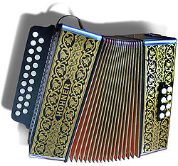
THE ACCORDION :THE ORIGIN
The Accordion is a bellows-driven, free reed, aerophone musical instrument. For many years it was tied to traditional folk dancing, but it has undergone an evolution that actually began at the time of its inception and which has continued to this day, gaining widespread popularity. It is believed that the forefather of the accordion is the ”sheng”, a Chinese wind instrument dating back 4,500 years which uses the principle of an oscillating reed, a metal tongue placed in a pipe which vibrates and produces a sound, thanks to the passage of air.
In the year 1500 Leonardo da Vinci designed a musical instrument that was very similar to an accordion; it had a double-action bellows with a vertical keyboard for the right hand and the sound was produced by flattened pipes made of paper or very thin wood.
Castelfidardo a little city on the Hill of Marche in Italy is recognized internationally as the home of the accordion. Paolo Soprani, a local craftsman, created the prototype of the instrument in the nineteenth century and founded one of the first Italian manufacturers. The International Museum of the Accordion of Castelfidardo hosts a collection consisting of about 150 specimens that also includes tools such as a rare forerunners accordions cheng Chinese and Harmoniflute of 1836. It ‘also revived a faithful reconstruction of a workshop of the early twentieth century.

Slide 26
Types of Accordions There are three main styles of accordion: diatonic, chromatic and keyboard. Diatonic and chromatic accordions have buttons for keys and keyboard accordions have a piano keyboard for keys. In a standard instrument, the keys are on the player's right-hand side of the instrument. The left-hand side has chord or bass notes, used to play rhythm. Diatonic accordions have either one, two or three rows of buttons, and each row is tuned to a specific key, having only the notes of that scale. Each button plays a different note depending on whether the bellows are being compressed ("pushed") or expanded ("pulled"). Diatonic accordions generally have two or four left-hand buttons, providing bass notes and/or chords tuned to the same key of the melody buttons. Chromatic accordions have three to five rows of buttons on the melody side of the instrument. Unlike the diatonic accordion, these buttons are tuned to a specific note, regardless of whether the bellows are being pushed or pulled. Chromatic accordions can generally play in any key, having at least one button for every standard note, whether natural, sharp, or flat. The left-hand side of the instrument contains a variety of chords. Piano accordions are generally the most recognizable to the general public, having been popularized by people like Lawrence Welk and "Weird Al" Yankovic. The right-hand side is simply a piano keyboard and works just the same. The left-hand has anywhere from eight to 120 chord buttons.

Slide 27
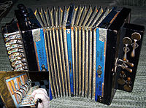
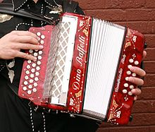
Accordions make noise when the bellows fill with air and this air is forced out of holes which have a small reed over them. Accordion makers tune these reeds by hand, and each note may trigger anywhere from one to four reeds—the more reeds, the more volume you have. Characteristics and Materials Literally hundreds of different parts are used to make an accordion. These can be made of a variety of materials, including wood, metal, plastic, and others. The larger parts of the instrument, such as the frame, pallets, and reed block are typically made of poplar wood. This wood is useful because it is sturdy and lightweight. The bellows are made of strong manilla cardboard which is folded and pleated. Leather gussets are put on each inner corner, and metal protectors are fashioned on the outer corners to strengthen and protect the bellows. The treble grill is a fretted metal cover. It is often decorated with the manufacturer's logo and is vented to allow greater sound production. Metal is also used to make many of the smaller pieces. For example, the reeds are made of highly tempered, watch-spring steel. They are riveted to an aluminum alloy reed plate. To minimize the amount of air that goes through a slot, leather or plastic flaps are used to cover the side opposite the reed. The rods which connect the bass buttons to the pallets and register slides that control the reed blocks on the inside of the accordion are also made of metal. The straps which allow the player to wear the accordion are made of strong leather and are usually padded. Leather or plastic washers are used throughout the instrument to keep it airtight. Additionally, wax is also used in some areas to prevent air leaks. Finally, the keys on the treble keyboard and the many buttons and switches are primarily made of plastic.

Slide 28
Accordion Today
Today there is a renewed enthusiasm for the accordion, with increased attention to higher quality instruments rather than the emphasis being on mass production. The study of the instrument has been included in musical conservatories, while several workshops have started . Furthermore there has been an emphasis on the attention to musical literature, while the idea that the accordion is exclusively a solo instrument is gradually changing, thanks to influential artists such as Richard Galliano and Marc Perrone in France, Gianni Coscia in Italy, and Frank Marocco in the USA
Further innovations followed and continue to the present. Various buttonboard and keyboard systems have been developed, as well as voicings (the combination of multiple tones at different octaves), with mechanisms to switch between different voices during performance, and different methods of internal construction to improve tone, stability and durability. These companies will only have a future if they can correctly interpret market demands, as Paolo Soprani did in 1863.

Slide 29
THE SPANISH TRADITIONAL INSTRUMENTS

Slide 30
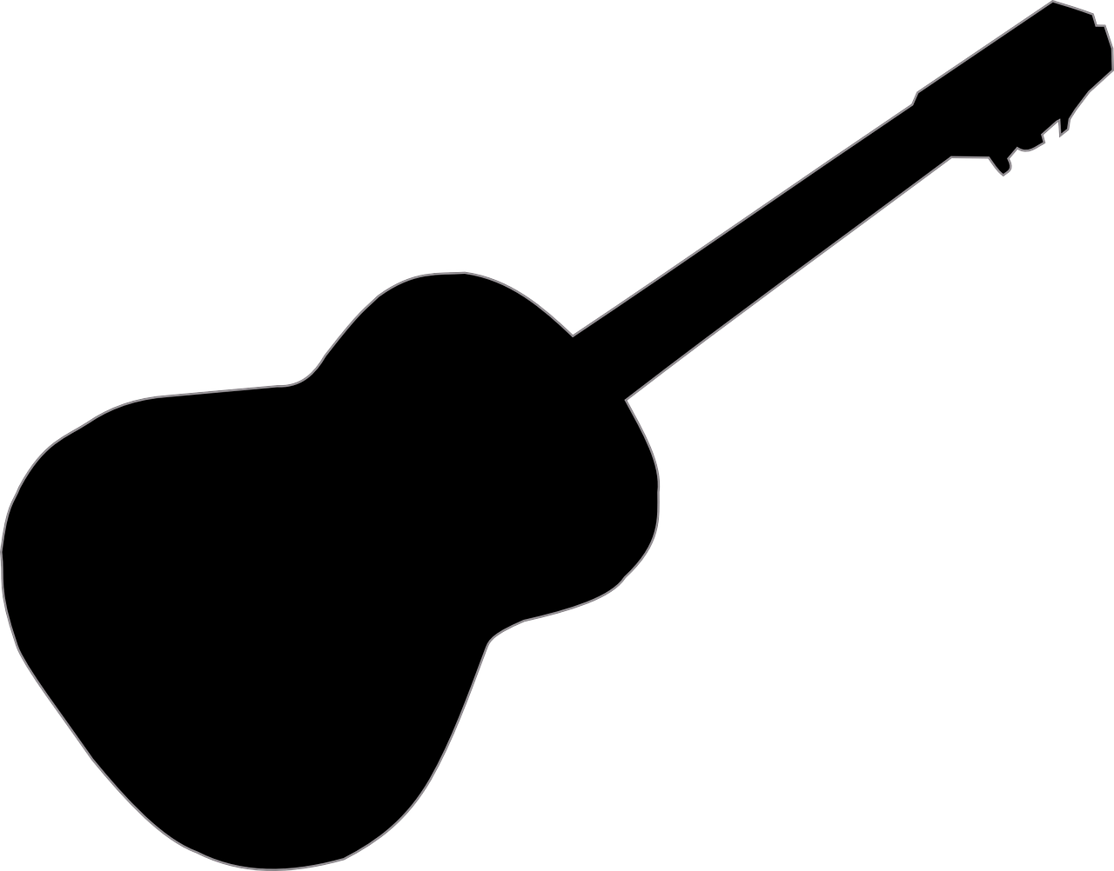
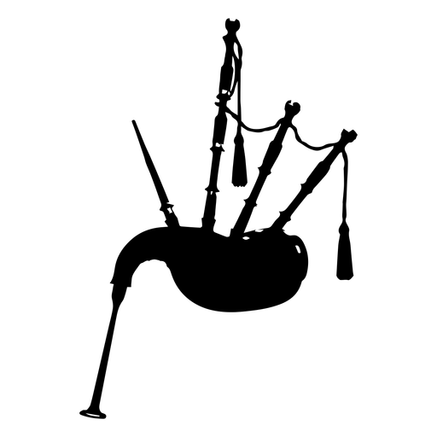
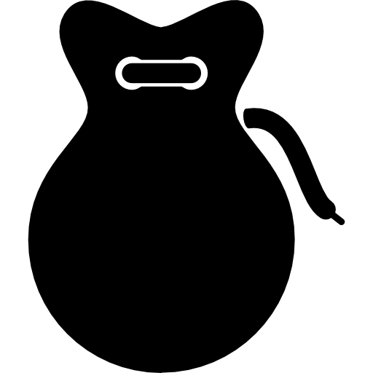
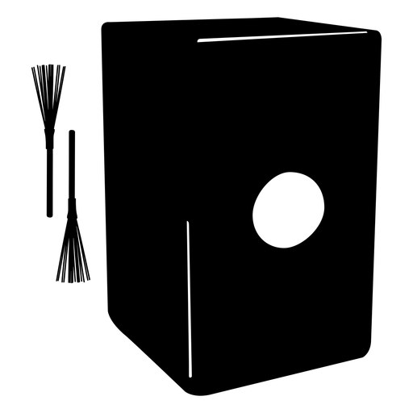
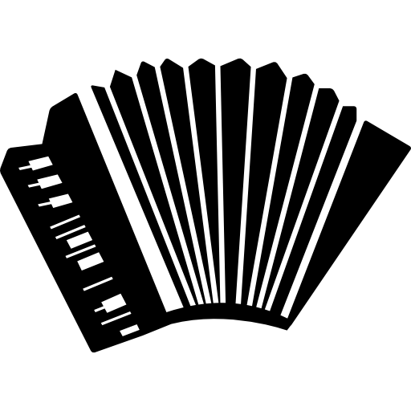
Traditional Instruments
ANALYSIS OF 5 SPANISH MUSIC INSTRUMENTS
Gaita Gallega (Gallician Gaita)
Cajón (Drum Box)
Castañuelas (Castanets)
Guitarra Flamenca (Spanish Guitar)
Acordeón (Accordion)

Slide 32
History of the instrument

Slide 34
History of the instrument

Slide 36
History of the instrument

Slide 38
History of the instrument

Slide 40
History of the instrument

Slide 41
THE GREEK TRADITIONAL INSTRUMENTS

Slide 42
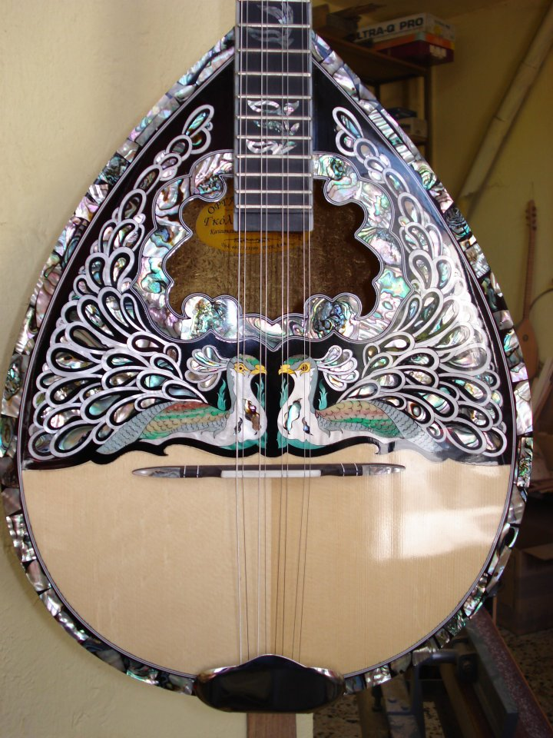
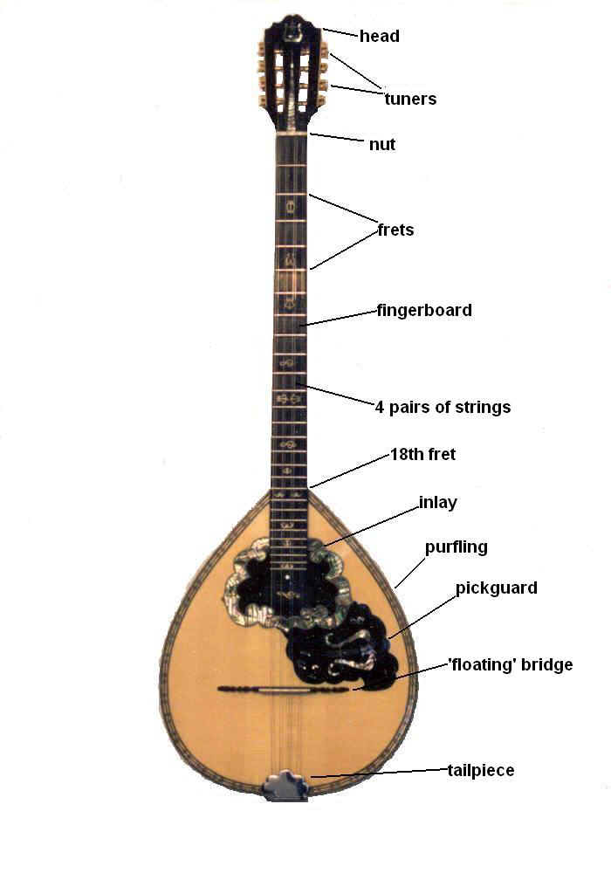
1. BOUZOUKI
Bouzouki is the most beloved instrument in Greece and perhaps the only that has minimal, mainly aesthetic, differences from his ancient ancestor, the Pandoura

Slide 43
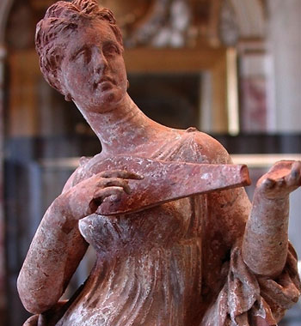
Pandoura was an instrument with a round belly, arm of double length and three double strings with the same precisely relation that is also used in the bouzouki.
The big success of Pandoura is owed in the possibility of production of big wealth of sounds with a small number of strings. The bouzouki belongs in the family of instruments with long neck, like the Saz, the Tamboura etc.
The name Bouzouki is believed that comes from the word Bozouk that means broken obviously in the change that came to the instrument from the Eastern and Central Asia.

Slide 44
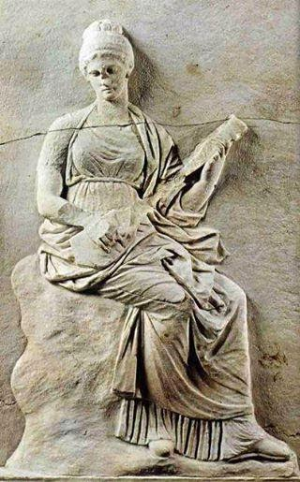
The bouzouki arrived in Greece following the 1919–1922 war in Asia Minor and the subsequent exchange of populations between Greece and Turkey when the ethnic Greeks fled to Greece.
The early bouzoukis were mostly three-string (trichordo), with three courses (six strings in three pairs) and were tuned in different ways, as to the scale one wanted to play.
At the end of the 1950s, four-course (tetrachordo) bouzouki started to gain popularity. The four-course bouzouki was made popular by Manolis Chiotis, who also used a tuning akin to standard guitar tuning, which made it easier for guitarists to play bouzouki, even as it angered purists.
However it allowed for greater virtuosity and helped elevate the bouzouki into a truly popular instrument capable of a wide range of musical expression. Recently the three-course bouzouki has gained in popularity.
The first recording with the 4-course instrument was made in 1956.

Slide 45
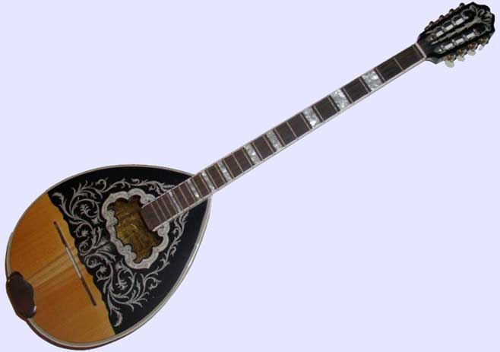
Following the Minor Asia destruction, the first Bouzouki orchestras appear, first and foremost the orchestra of Markos Vamvakaris.
The bouzouki becomes henceforth the king of the popular orchestra. The fourth pair of strings that Manolis Chiotis adds at the end of the 1950s is the more important perhaps change in the form of the bouzouki in the 2300 years of its Greek history.
A change that in a critical turning point of its course offered new, enormous, expressive possibilities and rendered it the absolute sovereign of the Greek music.

Slide 46
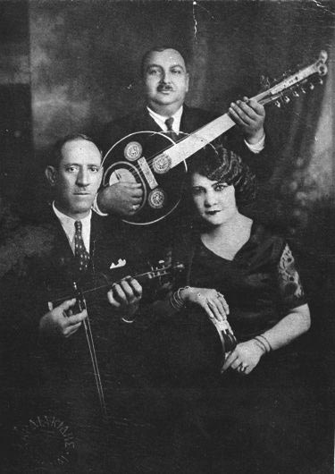
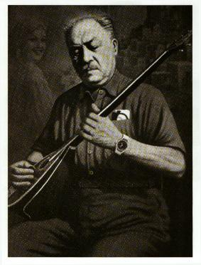
CONSTRUCTION
From a construction point of view, the bouzouki can have differences not only in the number of strings but also in other features, e.g. neck length, width, height, depth of the bowl or main body, the width of the staves (the wooden gores or slices of the bowl) etc.
These differences are determined by the manufacturer, who, in his experience and according to the sound that the instrument should make, modifies his functional elements to achieve a more piercing, deeper or heavier sound.

Slide 47
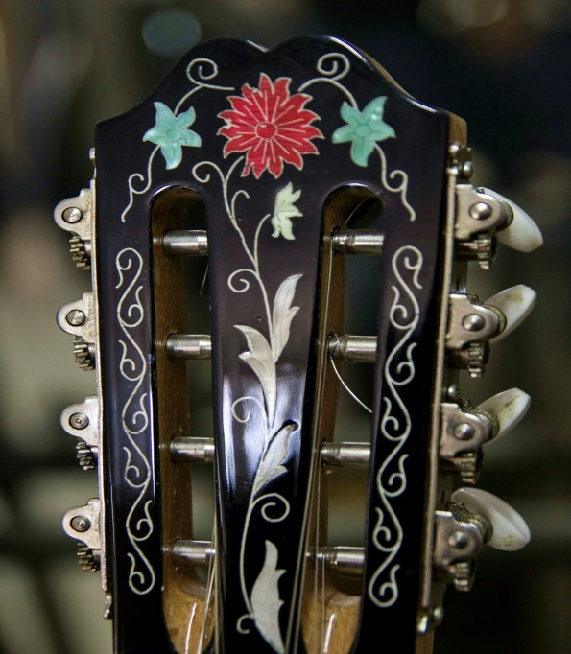
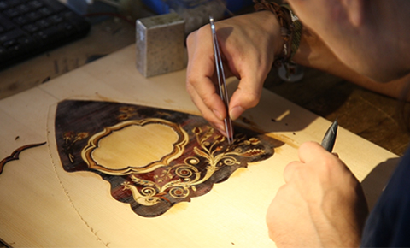
The size and type of the resonating body largely determine the instrument's timbre, while the length of the neck and, by extension the strings, determines the instrument's pitch range, as well as influencing the timbre.
While neck length can vary from instrument to instrument, most bouzoukis have the same number of frets, spaced such as to provide a chromatic scale in 12-tone equal temperament.
On modern instruments the frets are metal, and set into fixed position in the fingerboard (in contrast to early instruments and the related baglama, in which frets were of gut or cord tied onto the neck, and moveable.)
The quality of the wood from which the instrument is made is of great importance to the sound. For the construction of the bowl, mulberry, apricot, cherry, acacia, and elm are considered to be the best woods with walnut, plane, and chestnut being slightly inferior.
The wood must be solid and sourced from slow growth trees. The top or soundboard should be cedar or spruce (preferably spruce) if possible, cut in one piece.

Slide 48
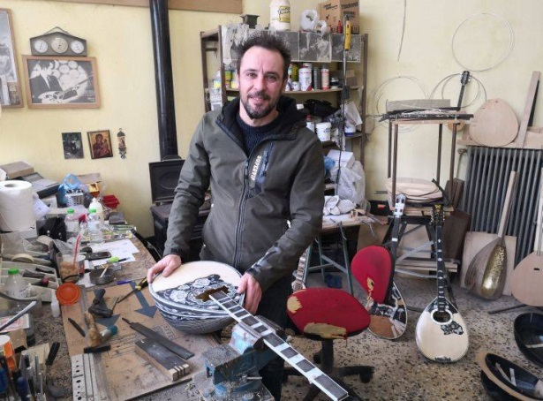
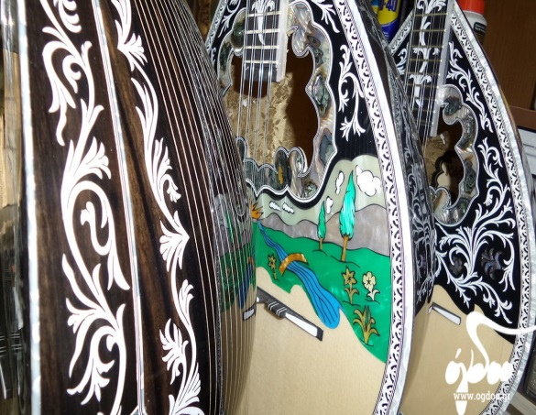
The top plays a major role in the sound because it resonates and strengthens and prolongs the vibration of the strings.
Another factor that affects the quality of the sound is the varnish and the method of its application.
The best varnish is a natural one made of shellac, which is applied by hand in many layers in the traditional way, for both acoustic and visual effect.
The neck must be of very dry hardwood in order not to warp and increase the distance of the strings from the fret board (the action height) which makes playing the instrument more laborious.
To achieve this, manufacturers use different techniques, each one having their own secrets. Many modern instruments have a metal rod or bar set in a channel in the neck, under the fingerboard, which adds some weight, but increases rigidity, and allows adjustment of the neck should it begin to warp.
https://www.youtube.com/watch?v=kp_j0FJ-wMQ

Slide 49
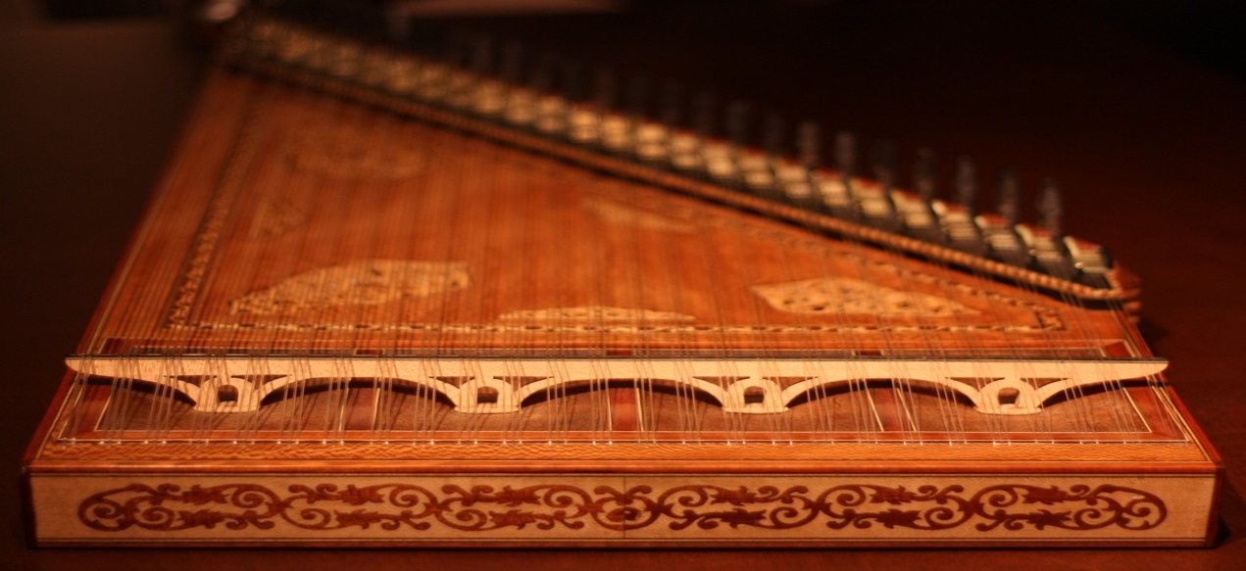
2. KANONAKI
Kanonaki has been known in Greece from antiquity.
It is named after the experimental one-chord instrument that Pythagoras made in the 6th century BC however may have originated since Minoan or Mycenaean times between 3000BC and 1600BC

Slide 50
CONSTRUCTION
Kanonaki is made in various sizes, out of maple or other wood and has the shape of a table, with the right side vertical to the long one and the chords. The lid is also wooden, except for the right side (about 15 cm), which is made of leather and where round or oval holes are opened, usually ornated.
Kanonaki is usually placed and played on the lap. The instrument player put two thimbles or “nails” as they are called on the pointers of his hand.
They used to be silver or gold, made out of turtle shell or ox horn, but nowadays they are plastic. With these nails the player can touch the chords more easily and firmly, which helps him to produce stronger sound.
https://www.youtube.com/watch?v=kMxnHyBEYS8

Slide 51
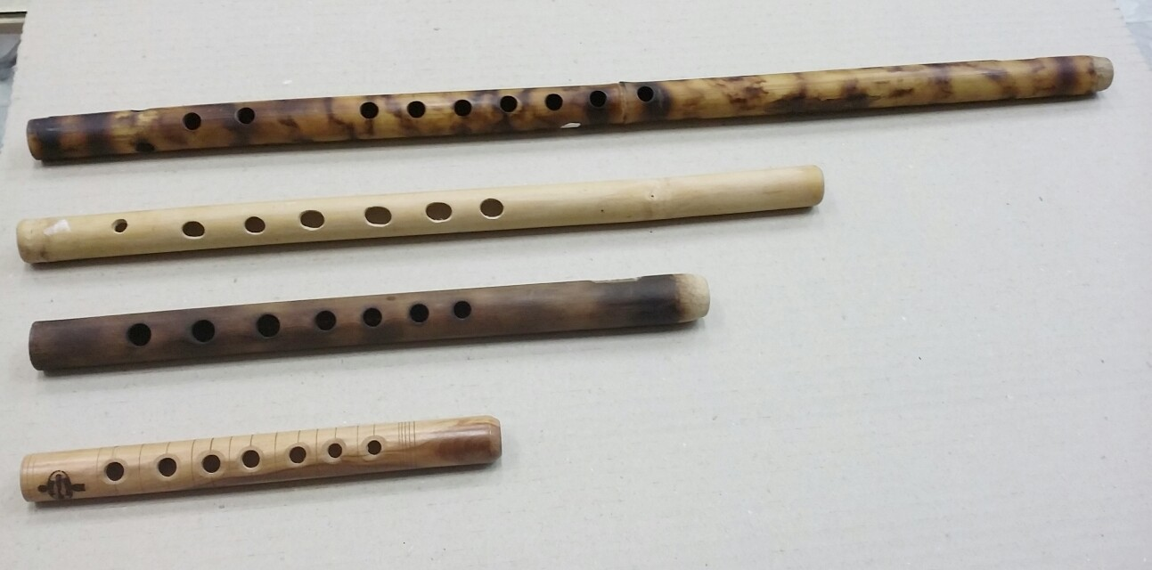
3. FLOGERA
The flogera is a type of flute used in Greek folk music.
It is a simple end-blown bamboo flute without a fipple, which is played by directing a narrow air stream against its sharp, open upper end. It typically has seven finger holes.
It belongs to the “shepherd instruments”, along with Souravli, Mantoura and Thiampoli.
It comes in various sizes, from 15 to 80 cm and is used in traditional music.
It is quite often wrongly taken for flute, from which it differs profoundly. Students in Greece are instructed how to play the flogera.

Slide 52
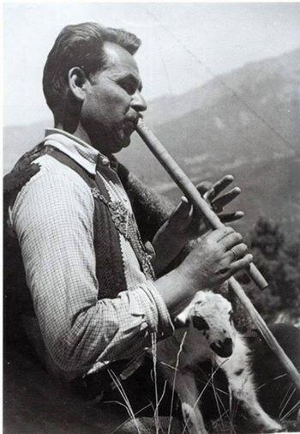
CONSTRUCTION
The construction of a flogera requires patience, experience and love.
From the very moment a shepherd decides to look for the wood till the moment that he will open the holes, there are a lot of things to check over and over again.
As far as the bamboo flogera is concerned, the bamboo has to be dry and without knobs, with the same thickness throughout its length.
The internal surface also has to be smooth and the holes have to be of the same diameter and be apart from each other the same distance.
The holes are usually opened with a scorching nail.
https://www.youtube.com/watch?v=A-nJzkYWafY

Slide 53
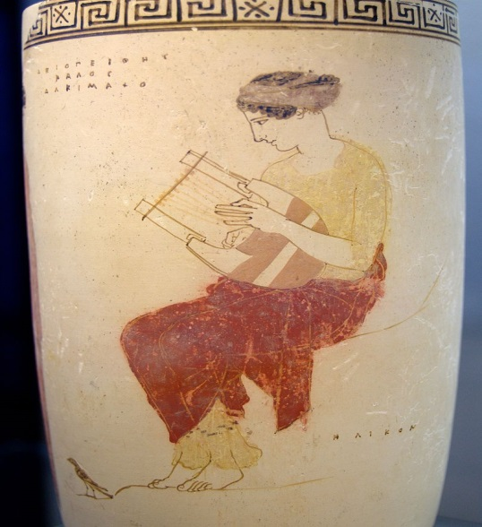
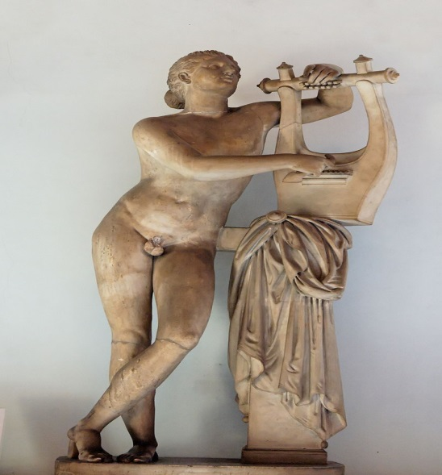
4. The Lyre
The lyre is a string instrument known for its use in Greek classical antiquity and later periods. The lyre is similar in appearance to a small harp but with distinct differences.
According to ancient Greek mythology, the young god Hermes stole a herd of sacred cows from Apollo.
In order not to be followed, he made shoes for the cows which forced them to walk backwards. Apollo, following the trails, could not follow where the cows were going. Along the way, Hermes slaughtered one of the cows and offered all but the entrails to the gods. From the entrails and a tortoise/turtle shell, he created the Lyre.
Apollo, figuring out it was Hermes who had his cows, confronted the young god.
Apollo was furious, but after hearing the sound of the lyre, his anger faded. Apollo offered to trade the herd of cattle for the lyre. Hence, the creation of the lyre is attributed to Hermes

Slide 54
In organology, lyre is defined as a "yoke lute", being a lute in which the strings are attached to a yoke that lies in the same plane as the sound-table and consists of two arms and a cross-bar.
In Ancient Greece, recitations of lyric poetry were accompanied by lyre playing.
The lyre of classical antiquity was ordinarily played by being strummed with a plectrum (pick), like a guitar or a zither, rather than being plucked with the fingers as with a harp.
T he fingers of the free hand silenced the unwanted strings in the chord

Slide 55
CONSTRUCTION
A classical lyre has a hollow body or sound-chest (also known as soundbox or resonator), which, in ancient Greek tradition, was made out of turtle shell.
Extending from this sound-chest are two raised arms, which are sometimes hollow, and are curved both outward and forward. They are connected near the top by a crossbar or yoke. An additional crossbar, fixed to the sound-chest, makes the bridge, which transmits the vibrations of the strings.
The deepest note was that farthest from the player's body. Since the strings did not differ much in length, more weight may have been gained for the deeper notes by thicker strings, as in the violin and similar modern instruments, or they were tuned by having a slacker tension. The strings were of gut.
They were stretched between the yoke and bridge, or to a tailpiece below the bridge. There were two ways of tuning: one was to fasten the strings to pegs that might be turned, while the other was to change the placement of the string on the crossbar. It is likely that both expedients were used simultaneously.
https://www.youtube.com/watch?v=yQgwO386S6o

Slide 56
5. BAGLAMAS
The baglamas or baglamadaki a long necked bowl-lute, is a plucked string instrument used in Greek music.
It is a tiny version of the bouzouki pitched an octave higher with unison pairs on the four highest strings and an octave pair on the lower D. Musically, the baglamas is most often found supporting the bouzouki

Slide 57
CONSTRUCTION
The body is often hollowed out from a piece of wood or else made from a gourd, but there are also baglamades with staved backs.
Its small size made it particularly popular with musicians who needed an instrument transportable enough to carry around easily or small enough to shelter under a coat, as it was prohibited during the Turkish occupation and later during the Greek dictatorship.

Slide 58
THE PORTUGUESE TRADITIONAL INSTRUMENTS

Slide 60
GUITARRA PORTUGUESA
Portuguese Fado Guitar
This instrument has such an unmistakable tone that, wherever it is played, any Portuguese recognizes it at the first chords.
Of very remote origin (13th century), it was called Moorish guitar, because it has many similarities with the lute, which the Arabs introduced in the Iberian Peninsula, but the characteristics of the two instruments are somewhat distinct.

Slide 61
GUITARRA PORTUGUESA
Portuguese Fado Guitar
The Portuguese guitar is a musical instrument used mainly in Fado. Destiny, longing and fado are words that are naturally associated with the Portuguese guitar.
For the construction of any Portuguese guitar, imported woods like maple and mahogany have been used since the Middle Ages. It is pear shaped and has six pairs of strings.
Players use a skillful strumming
technique.

Slide 62
RECO-RECO
The reco-reco has probably origin in Africa, introduced in Portugal due to our maritime discoveries in the 15th century.
The Dikanza, from Angola, is probably the “mother instrument”.

Slide 63
RECO-RECO
The most common form consists of a bamboo bud or a small wooden slat with transverse cuts.
Rubbing a chopstick over the butts produces a scraping sound.
It is mainly used in Folklore music.

Slide 64
CAVAQUINHO
The cavaquinho is originally from the north of Portugal, emerged in the province of Minho and was diffused throughout the country and even abroad.

Slide 65
CAVAQUINHO
The famous Hawaian Ukelele has its origins from the portuguese Cavaquinho.
The cavaquinho is used mostly in folklore music, but also in Fado.
It is made from wood and has only four metal strings.

Slide 66
VIOLA CAMPANIÇA
The Viola Campaniça, also designated viola Alentejana, is typical of the Alentejo region.
It is used in the famous Alentejo songs, the Cante Alentejano (Unesco World Heritage).

Slide 67
VIOLA CAMPANIÇA
This traditional 8 string guitar belongs the family of the cordophones.
It is about 110cm long, has an 8 shaped box with a circular mouth. In geral, the flanks are made of Australian wood, the lid from pinewood of Flandres, the arm in mahogany and the scale from blackwood. It is played with the thumb.

Slide 68
ADUFE
The Adufe is a portuguese percussion instrument that evolved from the membranofones.
Was introduced in the Iberian Peninsula by the Arabs, between the eighth and twelfth centuries. Muslim influence does not stop at instruments, but rhythms have migrated from North Africa.

Slide 69
ADUFE
Adufes accompany folklore or religious songs. An adufe is in fact a tambourine, made from a wooden frame covered with goat or sheep skin on both sides. Usually one side is made from the male animal and the other side of a female. The corners of the instrument have colorful ribbons made of fabric.It is traditionally played by women but built by men.

Slide 70
"This project has been funded with support from the European Commission. This publication reflects the views only of the author, and the Commission cannot be held responsible for any use which may be made of the information contained therein."

