Slide 1
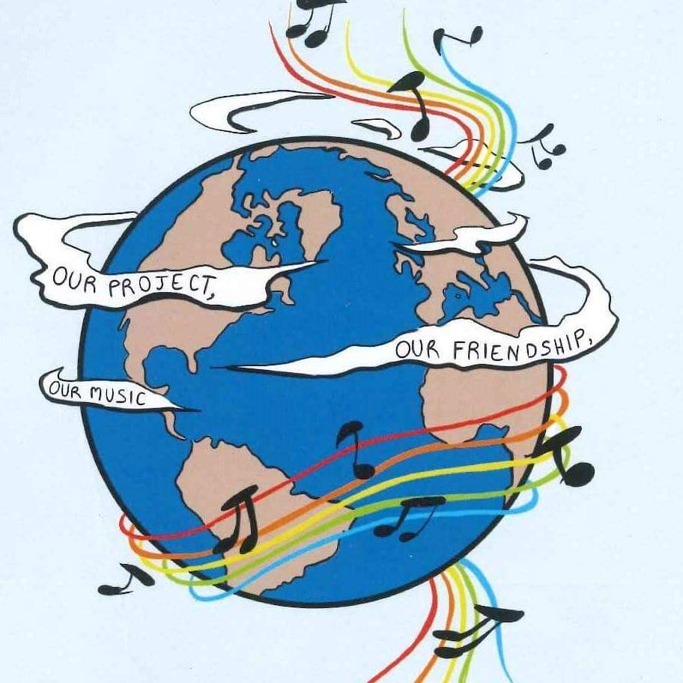
MUSIC: A MELODIC METHODOLOGY INTO TEACHING AND LEARNING 2018-1-ES01-KA229-050761_2 SCHOOL EXCHANGE PARTNERSHIP The Italian team presents:
Co-funded by The Erasmus + Programme
Of the European Union
Landscape in songs

Slide 2
LANDSCAPE IN SONGS

Slide 3
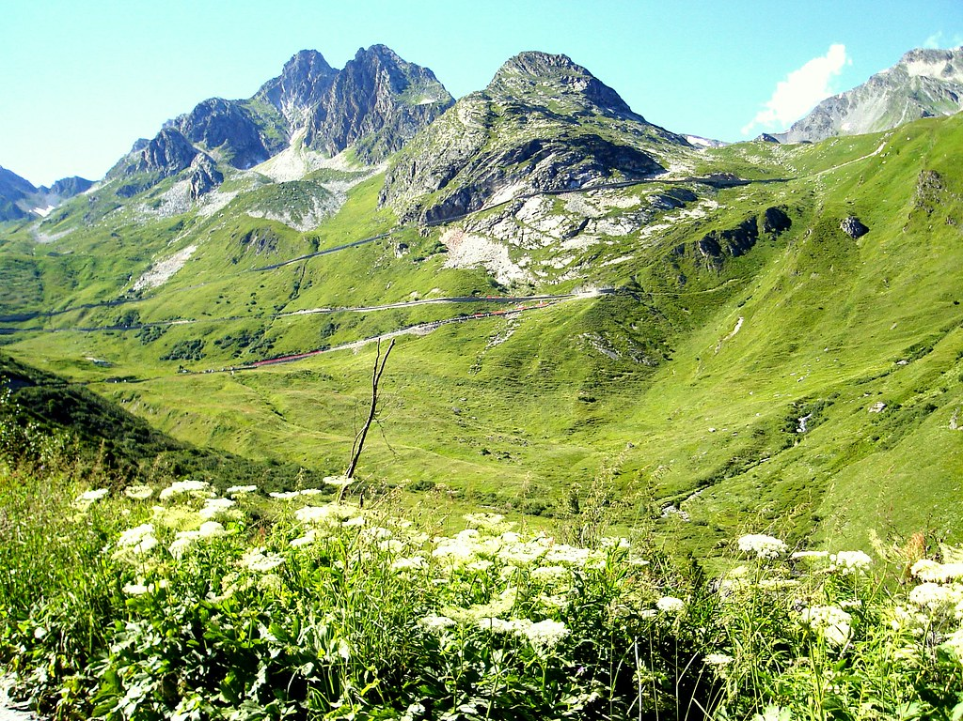
MONTAGNE VERDI
Di Marcella Bella

Slide 4
ENGLISH TEXT
ITALIAN TEXT
I remember green mountains and a little girl running With my most sincere friend, a rabbit with a black face Then one day the train took me The grass, the lawn and what was mine They disappeared slowly, slowly, and wept, talking to God How many times have I looked for the sun How many times I ate salt The city had a thousand looks I dreamed of green mountains My destiny is to stand next to you With you near me more fear I won't have And I'll be back a little girl
Mi ricordo montagne verdi e le corse di una bambina Con l'amico mio più sincero, un coniglio dal muso nero Poi un giorno mi prese il treno L'erba, il prato e quello che era mio Scomparivano piano, piano e piangendo parlai con Dio
Quante volte ho cercato il sole Quante volte ho mangiato sale La città aveva mille sguardi Io sognavo montagne verdi
Il mio destino è di stare accanto a te Con te vicino più paura non avrò E un po' bambina tornerò

Slide 5
remember green mountains that night in your eyes When you said, "It's getting late I'll accompany you if you want it " Your words in the fog Your story and my story Then in the dark without speaking I slept with you on the heart I love you my great love I love you my first love How many times have I looked for the sun How many times have I looked for the sun My destiny is to stand next to you With you near me more fear I won't have And a little more woman I will be Green mountains in your eyes I will see again
Mi ricordo montagne verdi quella sera negli occhi tuoi Quando hai detto, "Si è fatto tardi Ti accompagno se tu lo vuoi" Nella nebbia le tue parole La tua storia e la mia storia Poi nel buio senza parlare ho dormito con te sul cuore
Io ti amo mio grande amore Io ti amo mio primo amore Quante volte ho cercato il sole Quante volte ho cercato il sole
Il mio destino è di stare accanto a te Con te vicino più paura non avrò E un po' più donna io sarò Montagne verdi nei tuoi occhi rivedrò

Slide 6
ANALYSIS
Written by his brother Gianni Bella, "Green Mountains" was sung by Marcella Bella in 1972 at the Sanremo Festival, she did not win but was still a success that is still remembered today. This song represents a metaphor for the young age of the protagonist who dives into the sea of memories, from her childhood to her first love, remembering landscapes where she was very happy .
The childhood of the protagonist is evoked in a mythical place but real (the Apennines of southern Italy, not yet reached by progress) with a touch of melancholy.
A lonely childhood is evoked , probably in a country depopulated by emigration, but where the joy of living in full contact with nature and the ability to invent a world, typical of children, live in the memories of the protagonist.
The territories of her childhood disappear in memory
In Italy we had a great migration from the South to the colder North and often families were split and suffered of homesickness

Slide 7
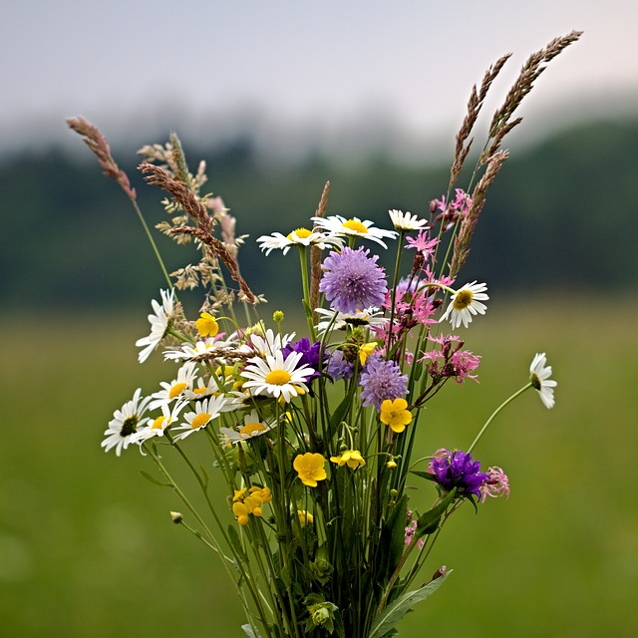
QUEL MAZZOLIN DI FIORI

Slide 8
ENGLISH TEXT
ITALIAN TEXT
That bunch of flowers, that comes from the mountain and look well that he does not get wet that I want to give him. I want to give it away because it is a nice bunch, I want to give it to my brunette tonight when it comes. Tonight when it comes it will be a bad evening and why he Saturday night he is not by my side. .
Quel mazzolin di fiori, che vien dalla montagna e guarda ben che non si bagna che lo voglio regalar.
Lo voglio regalare perché l’è un bel mazzetto, lo voglio dare al mio moretto questa sera quando vien.
Stasera quando viene sarà una brutta sera e perché lui sabato sera lui non è vegnù da me.

Slide 9
Non l'è vegnù da me, l'è andà dalla Rosina... Perchè mi son poverina mi fa pianger e sospirar, perchè mi son poverina mi fa pianger e sospirar. Mi fa piangere e sospirare sul letto dei lamenti e che mai diran le genti, cosa mai diran di me, e che mai diran le genti, cosa mai diran di me. Diran che son tradita, tradita nell'amore e a me mi piange il cuore e per sempre piangerà, e a me mi piange il cuore e per sempre piangerà. Abbandonato il primo, abbandonà il secondo, abbandono tutto il mondo e non mi marito più, abbandono tutto il mondo e non mi marito più.
He is not from me, it went from Rosina ... Because I am poor makes me weep and sigh, because I am poor makes me weep and sigh. It makes me cry and sigh on the bed of complaints and that the people never say, what ever they say about me, and that the people never say, what ever they say about me. Diran that I am betrayed, betrayed in love and my heart cries for me and forever will cry, and my heart cries for me and forever will cry. Abandoned the first, abandon the second, abandon the whole world and I don't marry anymore, abandon the whole world and I don't marry anymore.

Slide 10
ANALYSIS
"Quel mazzolin di fiori" speaks of a woman who, on his way back from work, picks up a bunch of wildflowers for his boyfriend to make him happy because he likes them a lot but when she gets home he can't find her boyfriend, who left her a letter where he explains that they are not made for each other and then the man in a moment of anger throws the bouquet of flowers on the ground and in fact in the last it says "my heart will forever cry“
There is a contrast between the beautiful landscape of the Italian Alps with its beautiful flowers and the sadness of the denied love.
This song, although it had no relation to the war, was the most sung by the Alpini during the First World War [2] and since then it has become famous all over Italy.

Slide 11
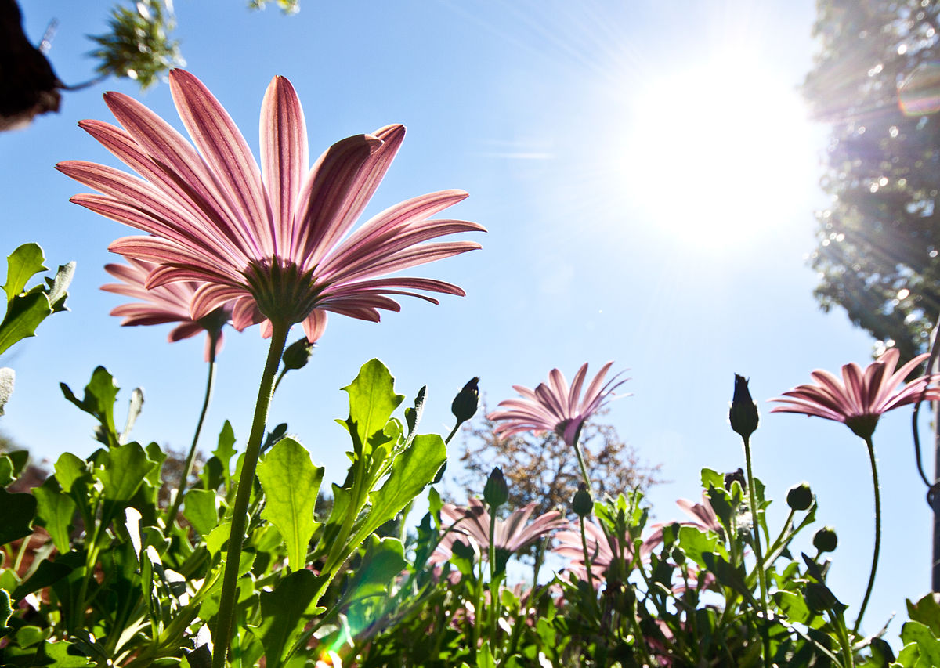
VUOLE UN FIORE
Di Sergio Endrigo

Slide 12
ENGLISH TEXT
ITALIAN TEXT
Wood is needed to make a table You need a tree to make wood The seed is needed to make the tree The fruit is needed to make the seed The flower is needed to make the fruit We need a flower, we need a flower To make a table you need a flower Wood is needed to make a table You need a tree to make wood The seed is needed to make the tree The fruit is needed to make the seed The flower is needed to make the fruit We need a flower, we need a flower To make a table you need a flower It takes a branch to make a flower We need a tree to make the branch You need a forest to make the tree The mountain is needed to make the forest The earth wants us to make the mountain To make the earth we need a flower To do everything you need a flower It takes a branch to make a flower
Per fare un tavolo ci vuole il legno Per fare il legno ci vuole l'albero Per fare l'albero ci vuole il seme Per fare il seme ci vuole il frutto Per fare il frutto ci vuole il fiore Ci vuole un fiore, ci vuole un fiore Per fare un tavolo ci vuole un fiore
Per fare un tavolo ci vuole il legno Per fare il legno ci vuole l'albero Per fare l'albero ci vuole il seme Per fare il seme ci vuole il frutto Per fare il frutto ci vuole il fiore Ci vuole un fiore, ci vuole un fiore Per fare un tavolo ci vuole un fiore
Per fare un fiore ci vuole un ramo Per fare il ramo ci vuole l'albero Per fare l'albero ci vuole il bosco Per fare il bosco ci vuole il monte Per fare il monte ci vuol la terra Per far la terra ci vuole un fiore Per fare tutto ci vuole un fiore

Slide 13
It takes a branch to make a flower We need a tree to make the branch You need a forest to make the tree The mountain is needed to make the forest The earth wants us to make the mountain To make the earth we need a flower To do everything you need a flower Wood is needed to make a table You need a tree to make wood The seed is needed to make the tree The fruit is needed to make the seed The flower is needed to make the fruit We need a flower, we need a flower To do everything you need a flower To do everything you need a flower To do everything you need a flower To do everything you need a flower To do everything you need a flower To do everything you need a flower ...
Per fare un fiore ci vuole un ramo Per fare il ramo ci vuole l'albero Per fare l'albero ci vuole il bosco Per fare il bosco ci vuole il monte Per fare il monte ci vuol la terra Per far la terra ci vuole un fiore Per fare tutto ci vuole un fiore
Per fare un tavolo ci vuole il legno Per fare il legno ci vuole l'albero Per fare l'albero ci vuole il seme Per fare il seme ci vuole il frutto Per fare il frutto ci vuole il fiore Ci vuole un fiore, ci vuole un fiore Per fare tutto ci vuole un fiore Per fare tutto ci vuole un fiore Per fare tutto ci vuole un fiore Per fare tutto ci vuole un fiore Per fare tutto ci vuole un fiore Per fare tutto ci vuole un fiore...

Slide 14
ANALYSIS
Probably, many people did not understand the important and simple meaning of the text written by Gianni Rodari, set to music by Sergio Endrigo and arranged by Luis Bacalov. The song describes the life cycle of a "something" that is one with the environment: be it a flower, a tree, a mountain or the Earth. We are all on the same planet, we breathe the same air, we drink the same water and yet we do not realize the environmental impacts such as industrial products. Rodari tells us between the lines to play with the imagination and then we play: let's imagine taking this song and singing it in all the languages ​​of the Earth. Let's record it and send it to all the inhabitants of the planet but above all to the "Great" rulers of the world. Let us hear it once, twice, three times ... and who knows what could happen? It would take a flower ... no, it takes a flower to do everything!

Slide 15
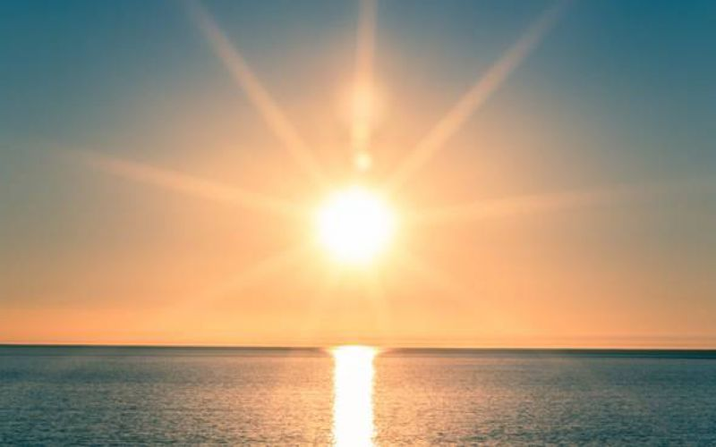
O’ SOLE MIO
Di Edoardo Di Capua

Slide 16
ENGLISH TEXT
ITALIAN TEXT
What a beautiful thing na jurnata 'and sun N'aria serene after a storm! Pe 'll'aria fresh seems already na party What a beautiful thing na jurnata 'and sun But n'atu sun Cchiu 'beautiful, oi it 'O my sun It's in front of you! 'O sun,' or my sun It's in front of you It's in front of you! Luceno 'and llastre of fenesta toia 'Na lavannara sings and boasts of it And for the sake of it, torches, spans and sings Luceno 'and llastre of fenesta toia
Che bella cosa na jurnata 'e sole N'aria serena dopo na tempesta! Pe' ll'aria fresca pare già na festa Che bella cosa na jurnata 'e sole
Ma n'atu sole Cchiu' bello, oi ne' 'O sole mio Sta 'nfronte a te! 'O sole, 'o sole mio Sta 'nfronte a te Sta 'nfronte a te!
Luceno 'e llastre d'a fenesta toia 'Na lavannara canta e se ne vanta E pe' tramente torce, spanne e canta Luceno 'e llastre d'a fenesta toia

Slide 17
It is night here or it is sunny if it breaks Me veins quase 'na malincunia Underneath a fenesta toia restarria It is night here or it is sunny if it breaks But n'atu sun Cchiu 'beautiful, oi it 'O my sun It's in front of you! 'O sun,' or my sun It's in front of you It's in front of you!
Quanno fa notte e 'o sole se ne scenne Me vene quase 'na malincunia Sotto 'a fenesta toia restarria Quanno fa notte e 'o sole se ne scenne
Ma n'atu sole Cchiu' bello, oi ne' 'O sole mio Sta 'nfronte a te! 'O sole, 'o sole mio Sta 'nfronte a te Sta 'nfronte a te!

Slide 18
ANALYSIS
Written by the composer Eduardo Di Capua, in collaboration with the poet Giovanni Capurro, the now hymn of the city of Naples is famous throughout the world.
Behind this score, and these magnificent stanzas, there is much more to be found. Involuntarily become a symbol of Neapolitanism linked to the fact that in "Naples never rains" and the "Sun always shines high in the sky", that Sun is the star that beats strongly on the rocks of Mergellina or this sun can be also seen as the face of the woman loved because there is nothing that shines more than love.
Sun is Love and Happiness!

Slide 19
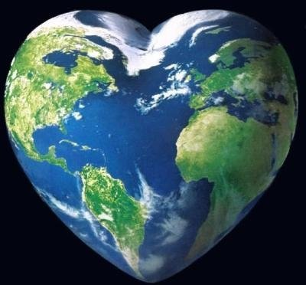
SORELLA TERRA
Di Laura Pausini

Slide 20
ENGLISH TEXT
ITALIAN TEXT
Sister earth, I listen to you every ocean shell is and then, every leaf is a beat who knows, vibrate at the unison with us if you want sister earth, what peace come from with your deserts and your glaciers so I feel in my spirit, about you that infinite longing, why your forests I'm my breath, you know and the emotion you give me is no longer terrestrial that you give me so, until I lost myself in the celestial harmony of this ecstasy
Sorella terra, ascolto te ogni conchiglia oceano è e poi, ogni foglia è un battito che sa, vibrare all'unisono con noi se vuoi sorella terra, che pace dai coi tuoi deserti e i tuoi ghiacciai così sento nel mio spirito, di te quell'infinito anelito, perché le tue foreste sono il mio respiro, sai e non è più terrestre l'emozione che mi dai che mi dai così, fino a perdermi nell'armonia celeste, di quest'estasi

Slide 21
but look at you sometimes that hurts wounded to death by incivility so, I too become dust, and I scatter inside, a gusty wind, why your forests are my breath, you know and the emotion you give me is no longer terrestrial that you give me so, until I lost myself, in the heavenly harmony of this ecstasy
ma guardarti a volte che male fa ferita a morte dall'inciviltà così, anch'io divento polvere, e mi disperdo dentro, un vento a raffiche, perché le tue foreste sono il mio respiro, sai e non è più terrestre l'emozione che mi dai che mi dai così, fino a perdermi, nell'armonia celeste di quest'estasi

Slide 22
ANALYSIS
Because your forests / I am my breath you know ".
A mysterious and unpublished atmosphere here, accompanies the words on environmental changes, on the pain of the Earth" wounded to death by incivility. “The singe sings her prayer for the world and the color of a joy that flies away only in the final choirs.
Sister Earth" is musically fascinating. The words, however, are certainly not happy, even if they have a fund of hope that fits well into the positivity of the whole album. Respecting the earth means having understood who we are. Unfortunately the earth is the reflection of our rudeness.

Slide 23
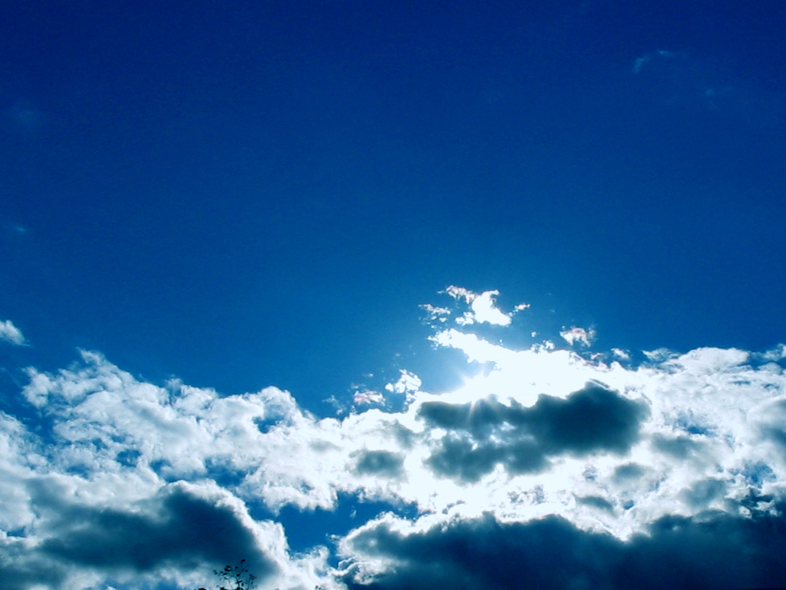
NEL BLU DIPINTO DI BLU
Di Domenico Modugno

Slide 24
ENGLISH TEXT
ITALIAN TEXT
I think a dream like this never comes back I painted my hands and my face blue Then, suddendly, I was kidnapped by the wind And I began to fly in the infinite sky Flying oh, oh Sing oh, oh, oh In the blue painted blue Happy to be up there And I flew, I flew happily higher than the sun And even higher While the world slowly disappeared far away there Sweet music only played for me Flying oh, oh Sing oh, oh, oh In the blue painted blue Happy to be up there But all the dreams in the dawn vanished because When the moon sets, he takes them with him But I continue to dream in your beautiful eyes Which are blue like a star-studded sky
Penso che un sogno così non ritorni mai più Mi dipingevo le mani e la faccia di blu Poi d'improvviso venivo dal vento rapito E incominciavo a volare nel cielo infinito
Volare oh, oh Cantare oh, oh, oh Nel blu dipinto di blu Felice di stare lassù E volavo, volavo felice più in alto del sole Ed ancora più su Mentre il mondo pian piano spariva lontano laggiù Una musica dolce suonava soltanto per me
Volare oh, oh Cantare oh, oh, oh Nel blu dipinto di blu Felice di stare lassù
Ma tutti i sogni nell'alba svaniscono perché Quando tramonta la luna li porta con sé Ma io continuo a sognare negli occhi tuoi belli Che sono blu come un cielo trapunto di stelle

Slide 25
Flying oh, oh Sing oh, oh, oh In the blue of your blue eyes Happy to be down here And I continue to fly happily higher than the sun And even higher While the world slowly disappears into your blue eyes Your voice is a sweet music that plays for me Flying oh, oh Sing oh, oh, oh In the blue of your blue eyes Happy to be down here In the blue painted blue Happy to be down here In the blue painted blue Happy to be down here With you
Volare oh, oh Cantare oh, oh, oh Nel blu degli occhi tuoi blu Felice di stare quaggiù E continuo a volare felice più in alto del sole Ed ancora più su Mentre il mondo pian piano scompare negli occhi tuoi blu La tua voce è una musica dolce che suona per me
Volare oh, oh Cantare oh, oh, oh Nel blu degli occhi tuoi blu Felice di stare quaggiù Nel blu dipinto di blu Felice di stare quaggiù Nel blu dipinto di blu Felice di stare quaggiù Con te

Slide 26
ANALYSIS
This song was written in Rome in the summer of 1957 by Domenico Modugno and Franco Migliacci. There are various stories about the birth of the hit. As the Apulian singer confessed, the idea occurred to his friend lyricist observing the picture "Le coq rouge dans la nuit" by Marc Chagal.
This song is the story of a dream, as confirmed by the authors. On the other hand, the reference to the beginning of the piece is very clear, with that phrase, "I think a dream like this will never come back", which introduces the dreamlike vision of a man who merges with the color of the sky and eyes of the beloved woman to stand out in a flight of freedom, towards the infinite.
It is difficult to think that the idea of this text was born, according to the author , following a nightmare he had in the saddest day of his life, when he suffered because of some sentimental penalties. This is why for many it is not excluded that just that imagined flight was nothing more than an unconscious will to end it.

Slide 27
THANK’S FOR THE ATTENTION

