Slide 1
MUSIC: A MELODIC METHODOLOGY INTO TEACHING AND LEARNING 2018-1-ES01-KA229-050761_2 SCHOOL EXCHANGE PARTNERSHIP The Italian team presents
Co-funded by The Erasmus + Programme
Of the European Union
SONGS IN THE ENGLISH CLASS

Slide 2
Can’t Stop the Feeling by Justin Timberlake https://www.youtube.com/watch?v=ru0K8uYEZWw
1. What makes you feel happy? Write some ideas on the mind map below. Then, share your ideas with your classmates
Ha
Happiness

Slide 3
2. You are going to listen to the song Can’t Stop the Feeling, by Justin Timberlake. But, first, read an excerpt of a review of the song. Check (✓) the correct words to complete the sentences about it
“After years of waiting for Justin Timberlake to return to his roots, the boy band member turned solo artist on the music scene. Even better, he's bringing you the perfect anthem to start your day with. His latest single, ‘Can't Stop The Feeling,’ was released Friday, May 6, and it's hard to stop the smiling (and grooving) after just one listen. Aside from the songs catchy beat, Timberlake's ‘Can't Stop The Feeling’ lyrics will flood you with feelings of joy, good times, and pure sunlight. And, no, I'm seriously not exaggerating.”
The review is __________________.
[ ] positive [ ] negative [ ] neutral
According to the review, Can’t Stop the Feeling is a great song to__________________.
[ ] return to your roots [ ] smile and groove [ ] start the day
c. The reviewer says that Timberlake’s song inspires ______________________ feelings.
[ ] positive [ ] negative [ ] neutral

Slide 4
Can’t Stop the Feeling by Justin Timberlake
3. Complete the lines with words from the box (not all of them will be used). Pay attention to the rhymes. Then, listen to the song and check your answers.
Close fast near off on phenomenally place zone
“I got this feeling inside my bones It goes electric, wavy when I turn it _________. All through my city, all through my home We’re flying up, no ceiling, when we’re in our _____
“I got that sunshine in my pocket Got that good soul in my feet I feel that hot blood in my body when it drops, ooh I can't take my eyes up off it, moving so _________.”
c. “And under the lights when everything goes
Nowhere to hide when I'm getting you _________.”
4. Listen to the song again. How does the song make you feel? Take notes while listening
______________________________________________________________________________________________________________________________________________________________________________________________________________________________________________________________________________________________________________________________________________________________________________________________________________________________________________________________________________
https://www.youtube.com/watch?v=ru0K8uYEZWw

Slide 5
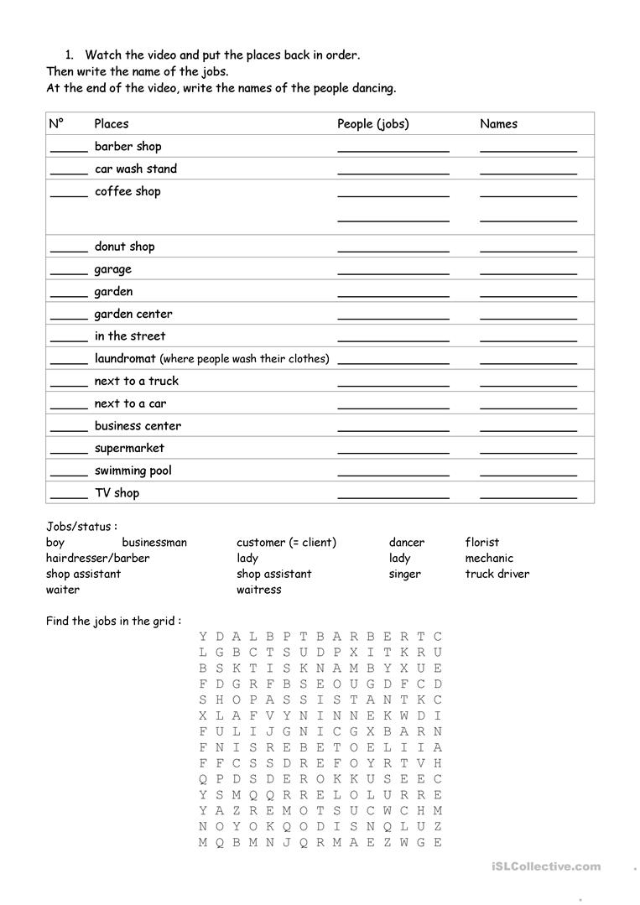
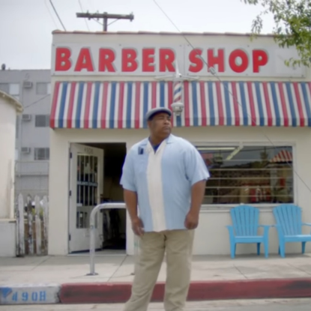
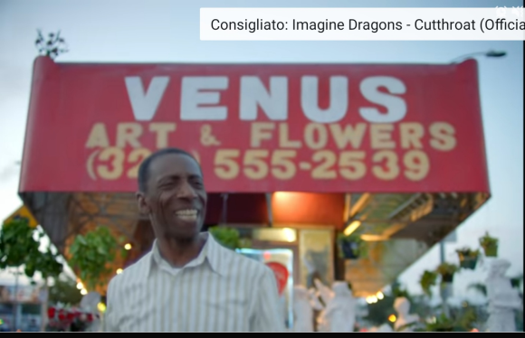
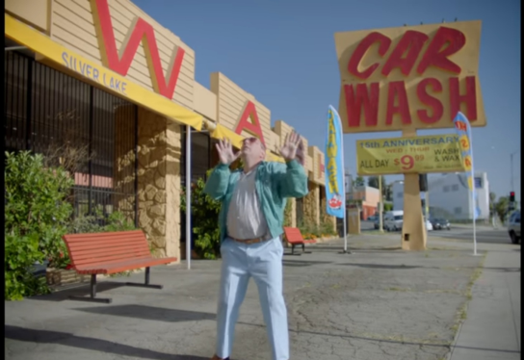

Slide 6
FEELINGS OR EMOTIONS | I FELT THIS WAY WHEN
HAPPY
SCARED
UPSET
SURPRISED
BORED
CONFUSED
ANGRY

Slide 7
Video quiz questions
1)
Fill the gap: I got this ________________________ inside my ________________________
2)
Put the words in order: electric, When It on turn goes I wavy it
3)
Fill the gap: All through my ________________________ All through my ________________________
4)
Fill the gap: We're flying up, no ceiling, ________________________ we in our ________________________
5) In my body when it
draps
drops
drop
6)
Fill the gap: Moving ________________________ phenomenally
7)
Put the words in order: Under lights goes the when everything
8)
Put the words in order: Nowhere when getting hide to close I'm you
9)
Put the words in order: know move you well already we When
10)
Put the words in order: you dance when you dance dance but can see I Nothing
11)
Put the words in order: dance shouldn't I All do But things dance dance you those
12)
Fill the gap: So ________________________ dancing
13)
Fill the gap: I ________________________ stop the ________________________
14)
Put the words in order: Ooh, something it's magical
l15)
Put the words in order: in blood, air, the It's it's rushing in my on it's
16) t the words in order: so my When no high, in ceiling, fly I'm I zone

Slide 8
THANKS FOR YOUR ATTENTION

