Slide 1
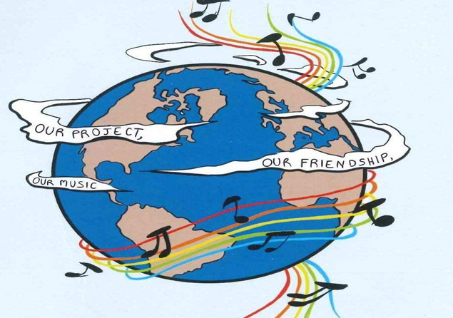
MUSIC: A MELODIC METHODOLOGY INTO TEACHING AND LEARNING 2018-1-ES01-KA229-050761_2 SCHOOL EXCHANGE PARTNERSHIP
The Italian team presents:
LANDSCAPE AND TRADITIONAL CLOTHES
Co-funded by The Erasmus +
Programme
Of the European Union

Slide 2
Traditional Italian clothes

Slide 3
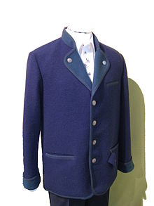
SARNER
The sarner is typical jumper of "val di sarentino" in " trentino alto adige" in the north of Italy
The original saner is made in a black color, it's similar to a cardigan but it has a polo neck, it's made of gray or brown wool with a board of different colour.
The modern sarner has small bottoms but the original one had just an hook to be closed .
It was made in thick wool ,taken from the Alps sheep to protect the shepherds from the iceness of the mountains in the north of Italy.

Slide 4
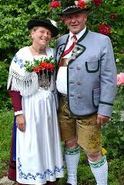
TRACHT
The tracht is a typical dress of the North of Italy. Although the word is most often associated with Bavarian and Austrian garments, many people in the North of Italy have it. It is made only in natural materials like wool, linen and silk.
This coth was influenced by the customs of peasants, villagers and the rural population, characterized by the use of linen, loden (a traditional type of felt) and embroidery.
In the past, the quality of the Tracht indicated the wealth or social status of a person or family, depending on the decorations and beads that it carried, especially in women's clothes.
The use of flowers on garments riminds to the beautiful nature landscape in the north- east of Italy

Slide 5
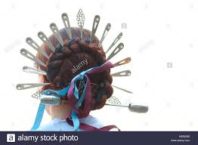
GUAZZE
“Guazze" is a type of hairstyle: hair was taken into braiding on the sides of the head, the braiding were interwind togheter for made a circle after of it they were stopped with a "spontone".
The Guazze were used by the Lombard peasant women around the seventeenth century to keep their hair in order while working in the fields.
Over time it has become a fashion ornament and a sign of high social status
This type of hairstyle was used by a famous Italian poet, Alessandro Manzoni, in his well-known novel called «I promessi sposi» (the betrothed) from «Lucia Mondella» (The female protagonist of the novel)

Slide 6
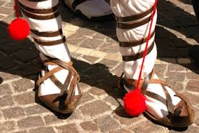
LE CIOCIE
The " ciocithe" are the typical shoes of the south of Lazio, in particular of our area called Ciociaria . In fact this shoes gives the name to the people of “Ciociaria" called “Ciociari"
They are traditional socks used by shepherds and perhaps the very first product of the Ciociaria tradition.
In the last few centuries, they have been the cheapest self-made made with natural, tanned bovine, ovine, pig, buffalo and donkey skins.
They were robust and suitable for walking on worked fields and on impervious paths, as well as resistant to strenuous work, such as digging in the fields.
Nowadays they are considered the symbol of the rural life of Ciociaria.

Slide 7
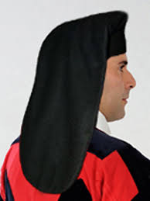
BERRITA
The Berrita is a typical hat of Sardinia.
It Has a tube form and it's long about 1,50cm. .
Sardinian peasants put it during the work in the fields under a wide-brimmed straw hat to protect the head from the sun.
Sardinia is an island and the climate is characterized by very hot and sunny summers so it was necessary to well protect heads while working in the fields.

Slide 8
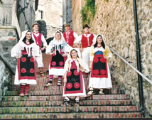
Costume Ciociaro
The typical costume Ciociaro, at the beginning belonged to the poorer classes composed of peasants.You can fin it in the museum of popular art in Rome.
The "fazzolettone“( A big hunkerchief) pinned on the head, helped women to protect their heads while working in the fields
The apron on the wide skirts, which with wisdom was tucked in to make it a kind of saddleba for the harvest of te field.
.Both men and women brought bands to protect themselves, and the famous "ciocie", very recognizable ancient footwear, symbol, and pride of a working, and proud people.

Slide 9
THANKS FOR YOU ATTENTION

