Slide 1
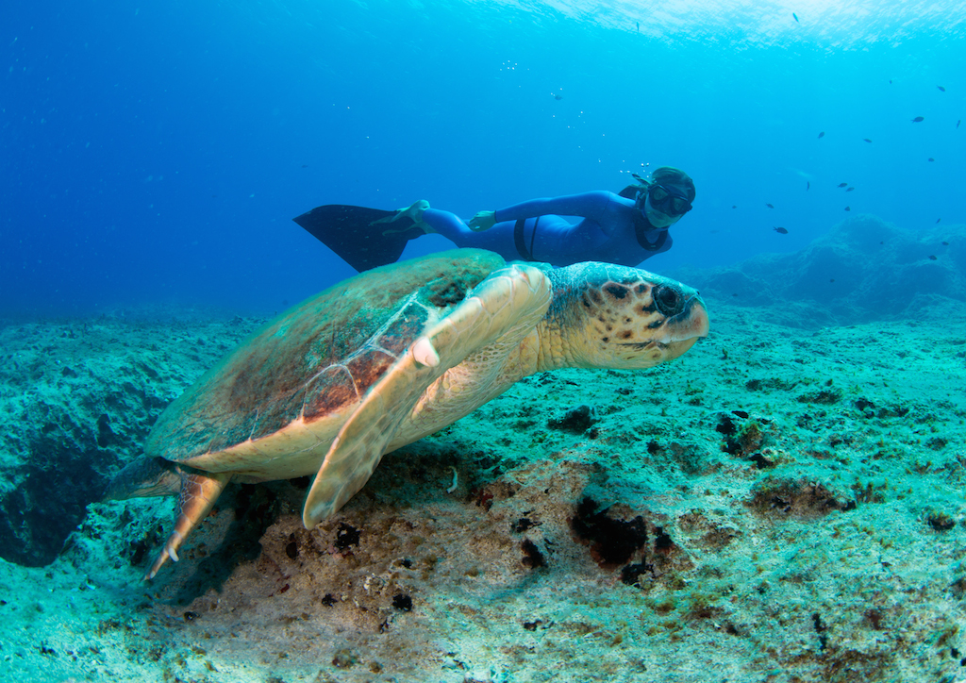
Sahika Ercümen

Slide 2
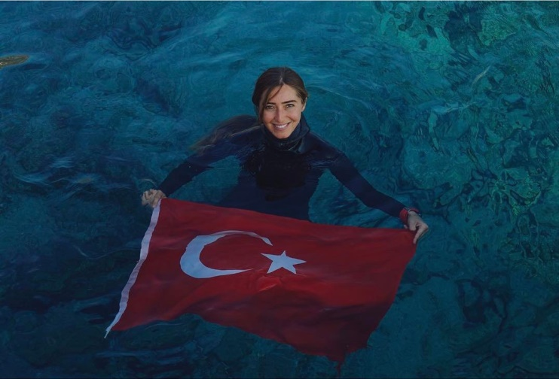
Şahika Ercümen is a Turkish world record holder free-diver. She was born on January 16, 1985 in Çanakkale. She was educated at Gazi Primary School, and received a secondary education at Milli Piyango Anatolian High School in her hometown.

Slide 3
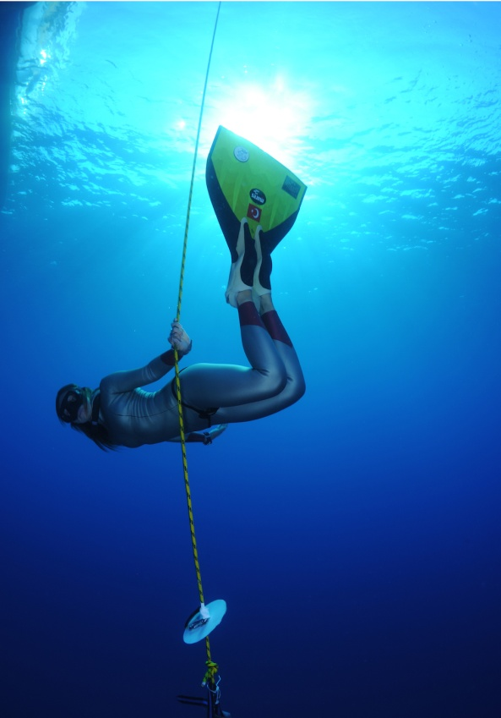
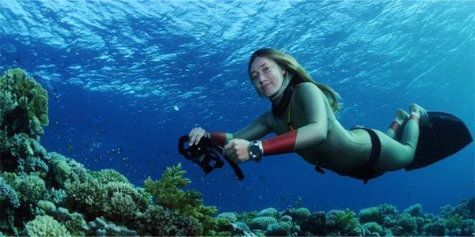
"Despite all the difficulties, when you really want it, when you believe it to the end and you work with all your strength, your heart, no difficulty can stand in front of you.“
Sahika Ercümen

