Slide 1
Romanian Team
COLEGIUL NATIONAL ALEXANDRU IOAN CUZA
GALATI

Slide 2
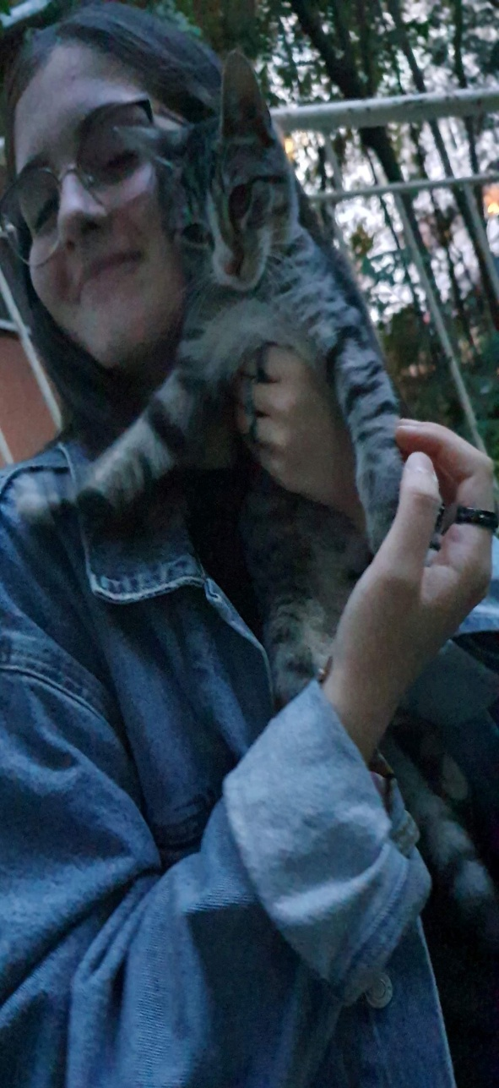
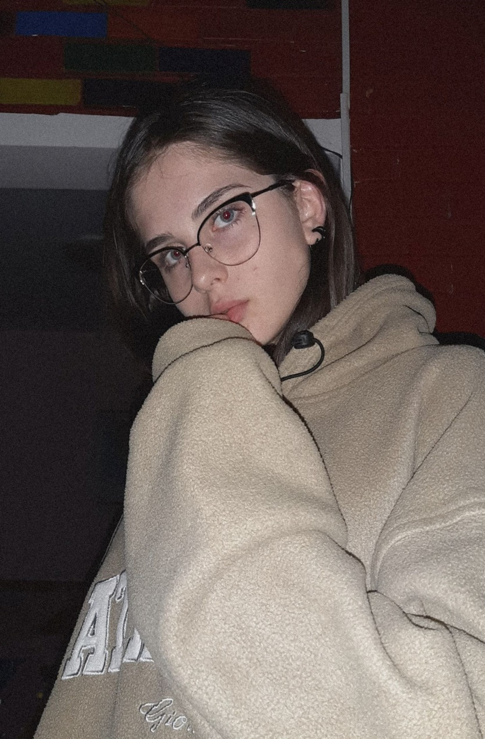
Sava Cristina (Christine)
Hi. I'm Cristina Sava, I am 15 years old and I'm from Romania. I'm tall, skinny and I’ve always wanted to be like Kendall Jenner when I will grow up. I'm almost always sad and shy because I'm a sensitive person but when I'm with my friends I'm very talkative and creative. I love cats and I want a cat a lot but I will wait until I will be 18 and alone in my house. I also love to draw bodies and abstract things to forget about my sadness. My inspiration is from the interesting things and people that I see in this world.
P.S.: Here’s my Instagram: cristina_sava

Slide 3
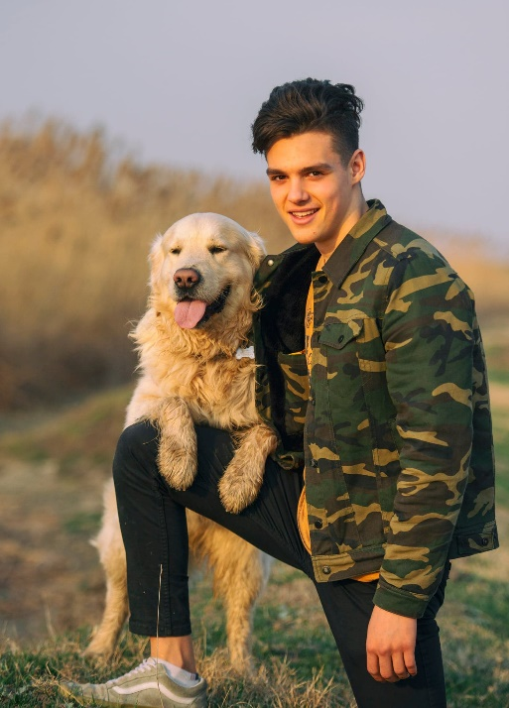
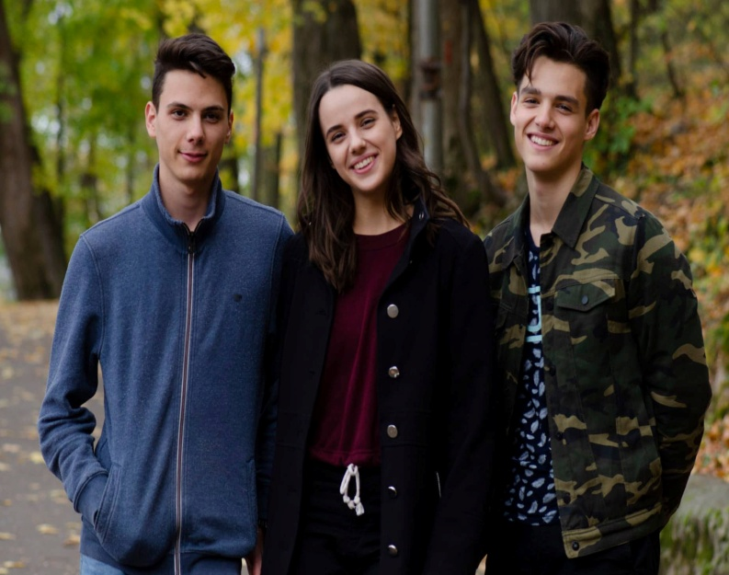
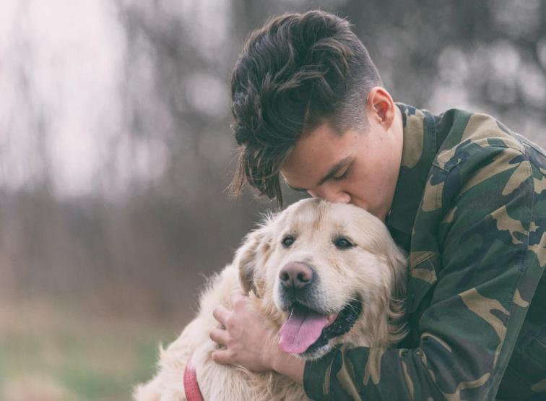
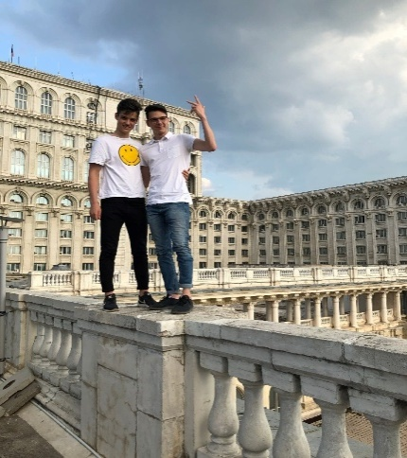
Stoica Fabian (Fabian)
My name is Fabian Stoica. I am fifteen and I am from Romania. I am an average person of stature, I have brown eyes, brown hair. I am an active person and I like it so much that I go running every morning. I love animals, I also have a dog, Thor. I have a twenty year old brother and an eighteen year old sister.

Slide 4
Mirza Cristian (Christian)
Hello! My name is Cristian Mirza, I’m from Romania, I am 16 years old, my hobbies include playing the guitar and today, for you, I will play the national hymn of Romania.

Slide 5
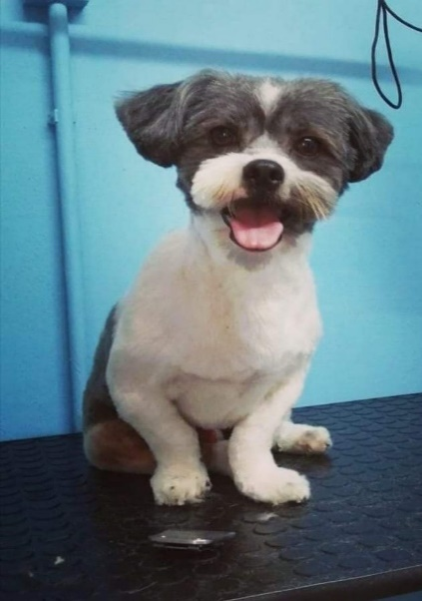
Moldoveanu Andrei (Andrew)
Hello! My name is Andrew. I am sixteen years old and my hobby is playing video games. In my free time, I practice handball and I have been doing it for, like, six years...I think...Anyway, I love animals, that’s why I have a dog. He is a Shih Tzu, meaning “lion dog”, but I don’t think he looks like a lion at all. He is small and annoying, sometimes, but for a dog, he is pretty clever and lively.

Slide 6
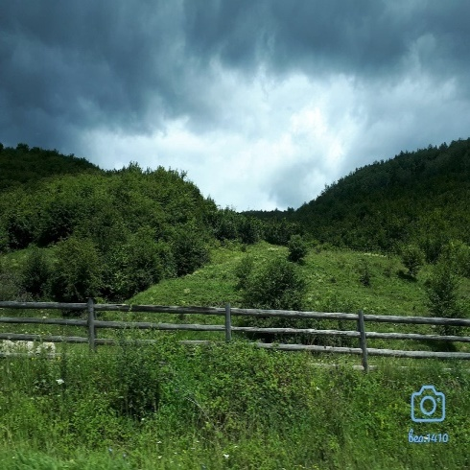
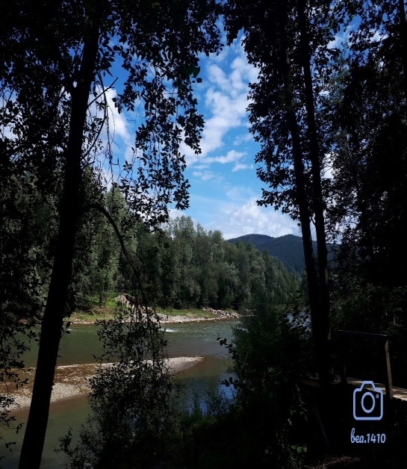
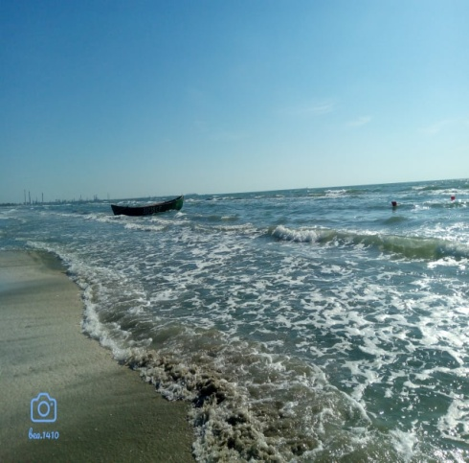
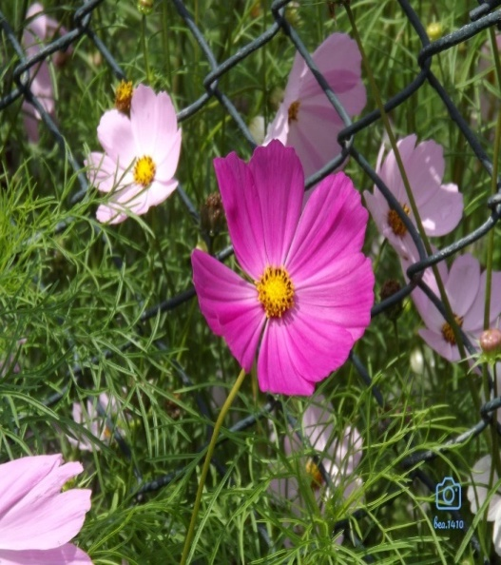
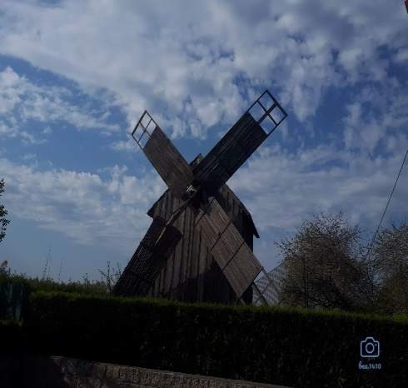
Moraru Beatrice (Beatrice)
Hi! I'm Beatrice and I'll be 16 in October. I like photography -especially mountain photos- and playing mobile games. I'm shy -even if sometimes I don't really show it- and friendly. I am ~5'2" (1.58 cm) tall, I got blue to grey eyes and brown hair. It is nice to be in this project! ☺
P.S.: Here’s my Instagram: bea.1410

Slide 7
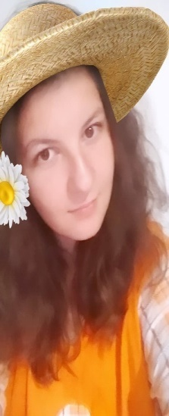
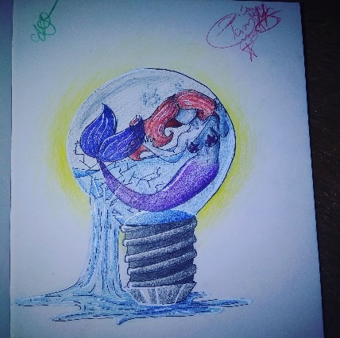
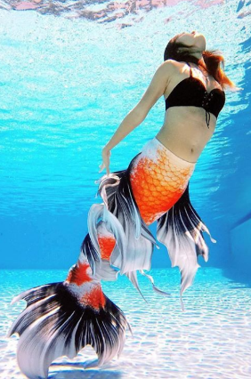
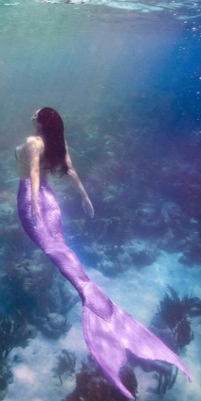
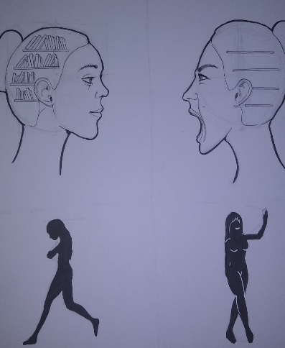
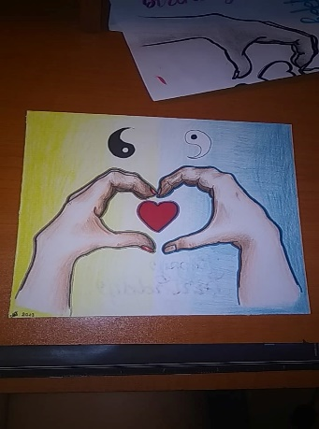
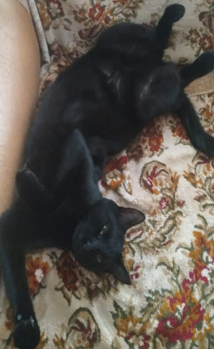
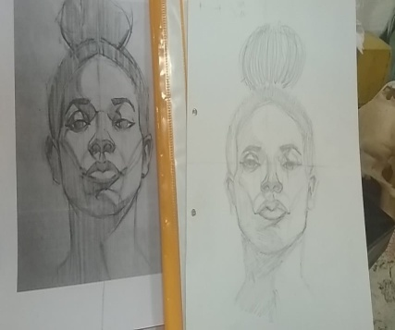
Neagu Diana (Diane)
Hey everyone! I am Diane, a 16 year old, soon to be turning 17. I’m medium tall, got brown eyes and medium dark-brown hair along with a light skin tone. My family is made of my mother, father, and this ferocious cat I named Ninja.
My hobbies include drawing and rarely writing.. that until my creativity lets me down and unfortunately, I cannot build an artistic future for myself due to the fact that I cannot get the guarantee that it would be successful, not to mention it’s high costs, so, thanks to the help of my I.T. teacher, I have decided to become a programmer. Also, it’s been a year since I started fancying swimming. I have not known how to swim until I went on vacation, last year, with my parents. I had a pool at my service, in which I managed to make my first steps into becoming ‘half fish’, which then made me take the decision of going to swimming courses. Slowly, I am making my way to a dream that I have had since I was a little girl: becoming a mermaid. I’m even planning on getting a tail!
In my spare time, besides drawing, I like watching movies, my favourite ones being some of Marvel’s, or some TV series such as Star Trek, or just cartoons (on rare occasions, though) like Gravity Falls.
Being part of this project is an honour and I would gladly join it,
every year.
P.S.: Here’s my Instagram: voidlessdiane

Slide 8
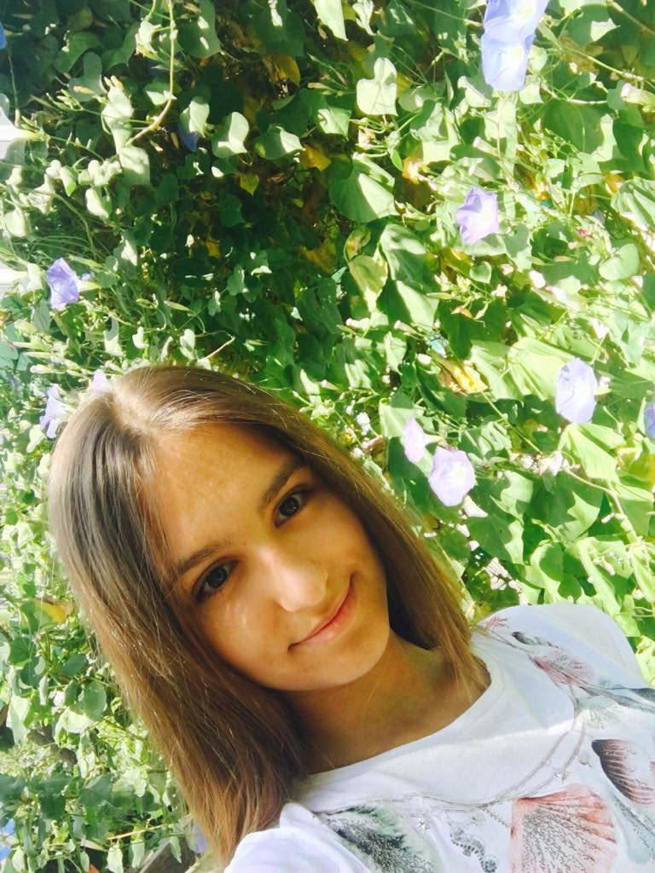
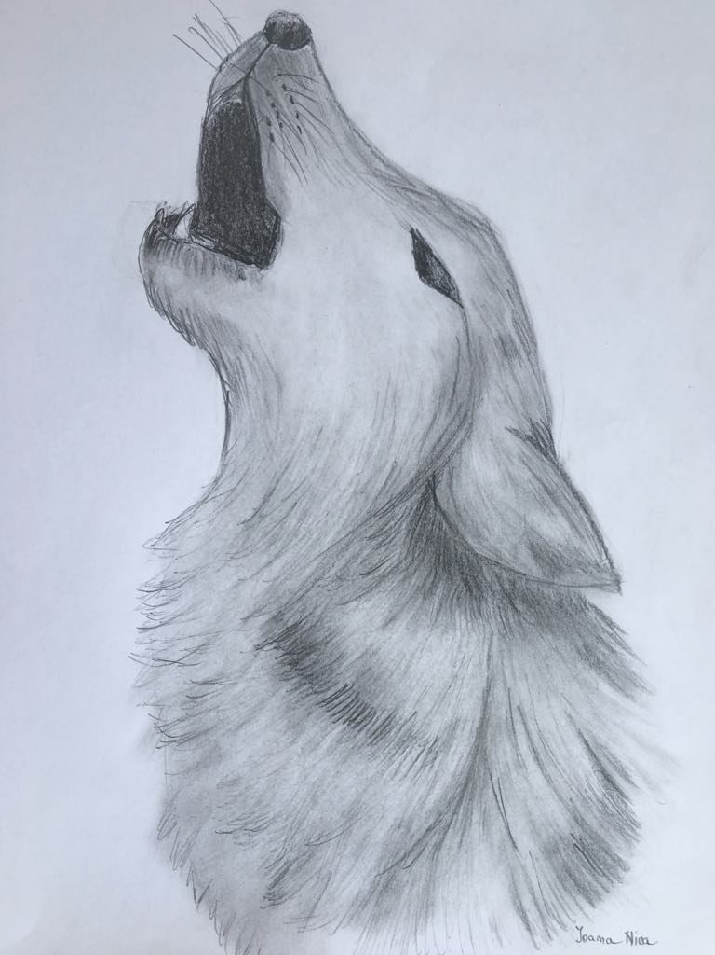
Nica Ioana Maria (Joanne)
My name is Ioana Maria Nica and I am 16 years old. I live with my parents and I have no siblings.
In my free time I like going out with my friends, watching TV series and listening music. My favorite TV series is Riverdale. I like the most rap and pop music. I also like reading. My favorite book is “Mara Dyer” by Michelle Hodkin.
I am short and I have brown eyes and brown hair.
When I was in the 1st grade, I took ballet lessons, but I gave up because it wasn’t really for me, and then, in the third grade, I started taking drawing lessons and graduated 3 years later. Despite this fact, I decided not to have a career in drawing. Now I like informatics more and I wish to have a career in this domain.

Slide 9
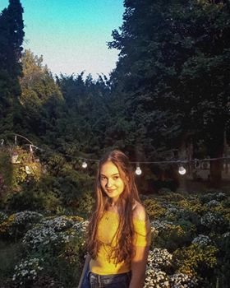
Nicodim Melisa (Melissa)
Hi, my name is Melisa Nicodim, I'm 16 and I'm from Romania. I'm at Alexandru Ioan Cuza High School in Galați city. I am a cheerful, energetic person with a quite developed sense of humor. I have many hobbies and those are: listening to music, singing, traveling a lot with my family, walking, hanging out with friends and watching movies. I’ve always liked to help certain people as much as I can, because every time I see a cheerful person, it makes me feel happy.
P.S.: Here’s my Instagram: melysa_17

Slide 10
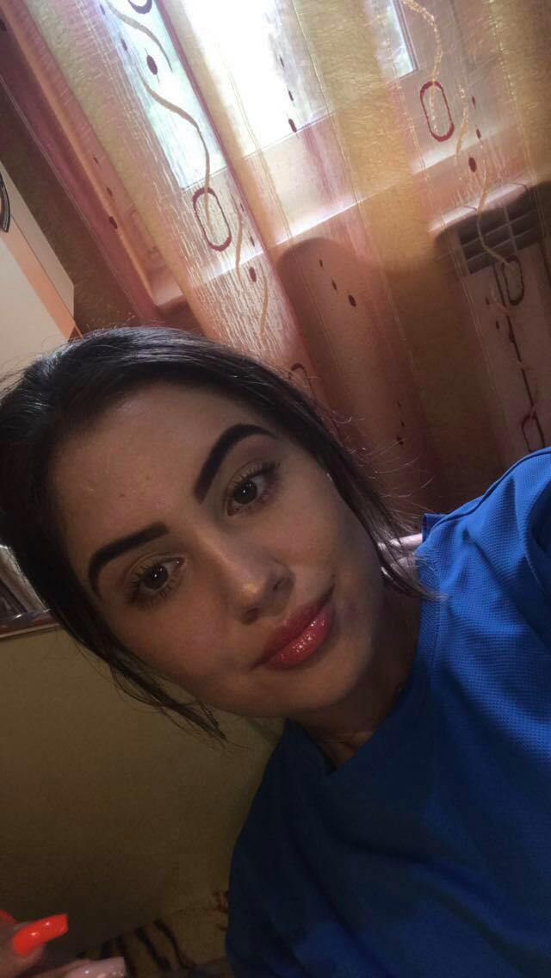
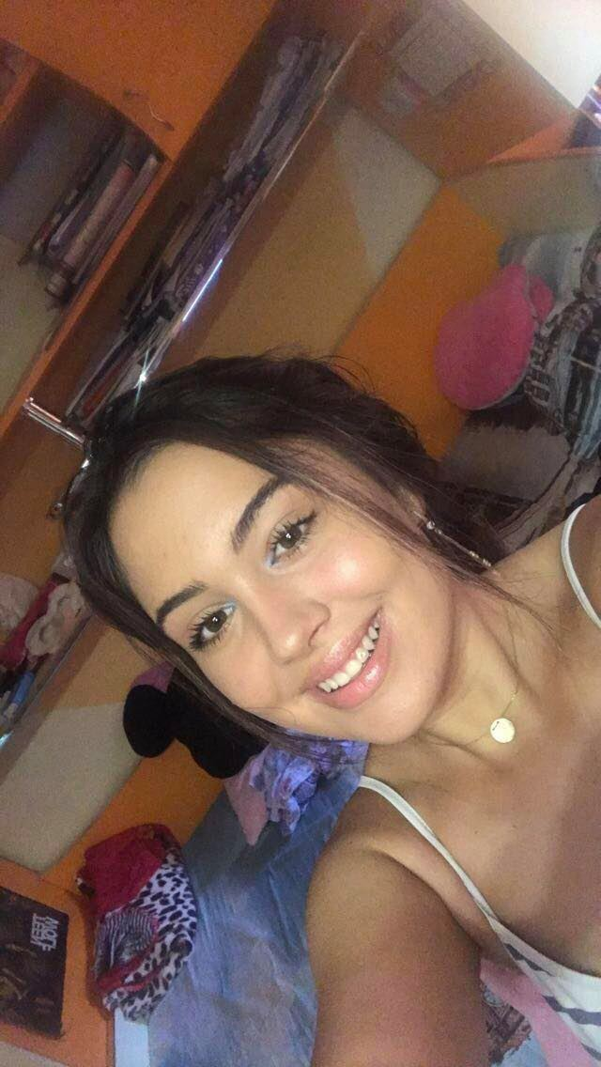
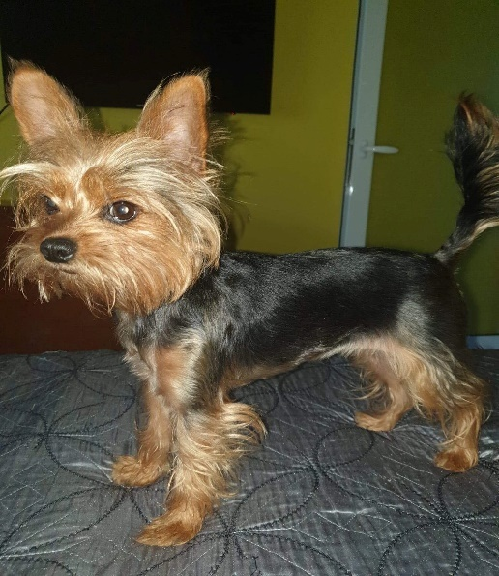
Pelin Denisa (Denise)
My name is Denisa and I'm 15 years old. I am the only child at parents and I have a dog named Dolly (she is 5 years old). In my free time, I like going out with my friends, walking with Dolly and watching movies and TV series. My favorite TV series is Grey's Anatomy (my favorite charachter being dr. Derek Shepherd). When I was in the 2nd, grade I took dancing lessons but I didn't really enjoy them. Now that I am in highschool, I discovered that I like biology and informatics. I don't know yet what I want to be in the future, but I want to donate monthly money to animal shelters because I really love dogs and my heart breaks when I see them sad and abandoned in the streets. I'm not that tall and I'm brown eyed and brown haired.
P.S.: Here’s my Instagram: dnsdns27

Slide 11
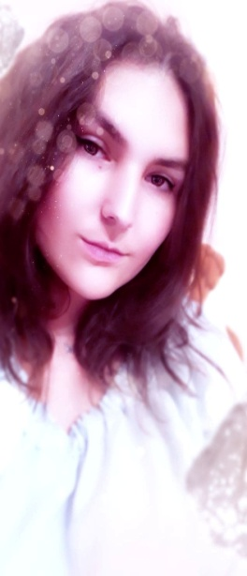
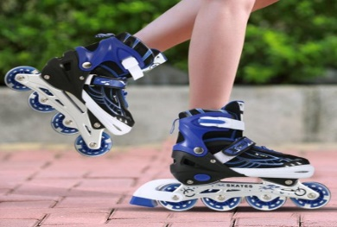
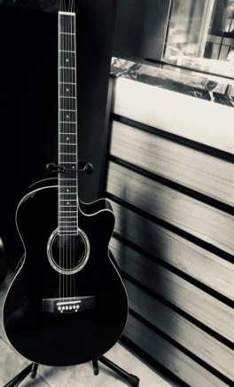
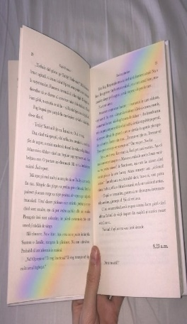
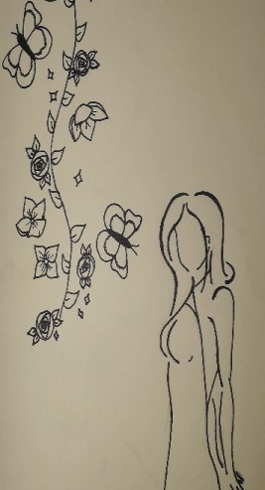
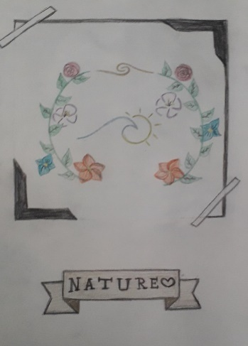
Petrea Ana-Maria (Ann-Marie)
Hi there! My name is Ann-Marie and I am 16 years old. I’m a bit weird but in a good way. I can be cold sometimes, mean, but when you get to know me better, I am a sweet and loving person. When I’m overwhelmed by feelings, I usually just take a break and calm down to prevent from doing something that I might regret later because of those emotions. My favourite activities are drawing, roller-skating, playing the guitar, reading and recently, swimming. My favourite book is ‘The will of Sherlock Holmes’ by Bob Garcia. ‘Doctor Who’ is the series of my heart and I love the movie ‘V from Vendetta’. I watch it every year on the 5th of November.

Slide 12
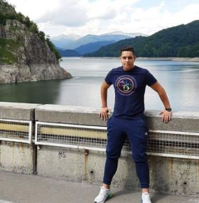
Stroiu Robert Gabriel (Robert Gabriel)
Hello ! My name is Stroiu Robert Gabriel and I am 16 years old . I like all kinds of sports and video games !! I usually listen to trap music. I like to spend my free time going out with friends and or family.

