Slide 1
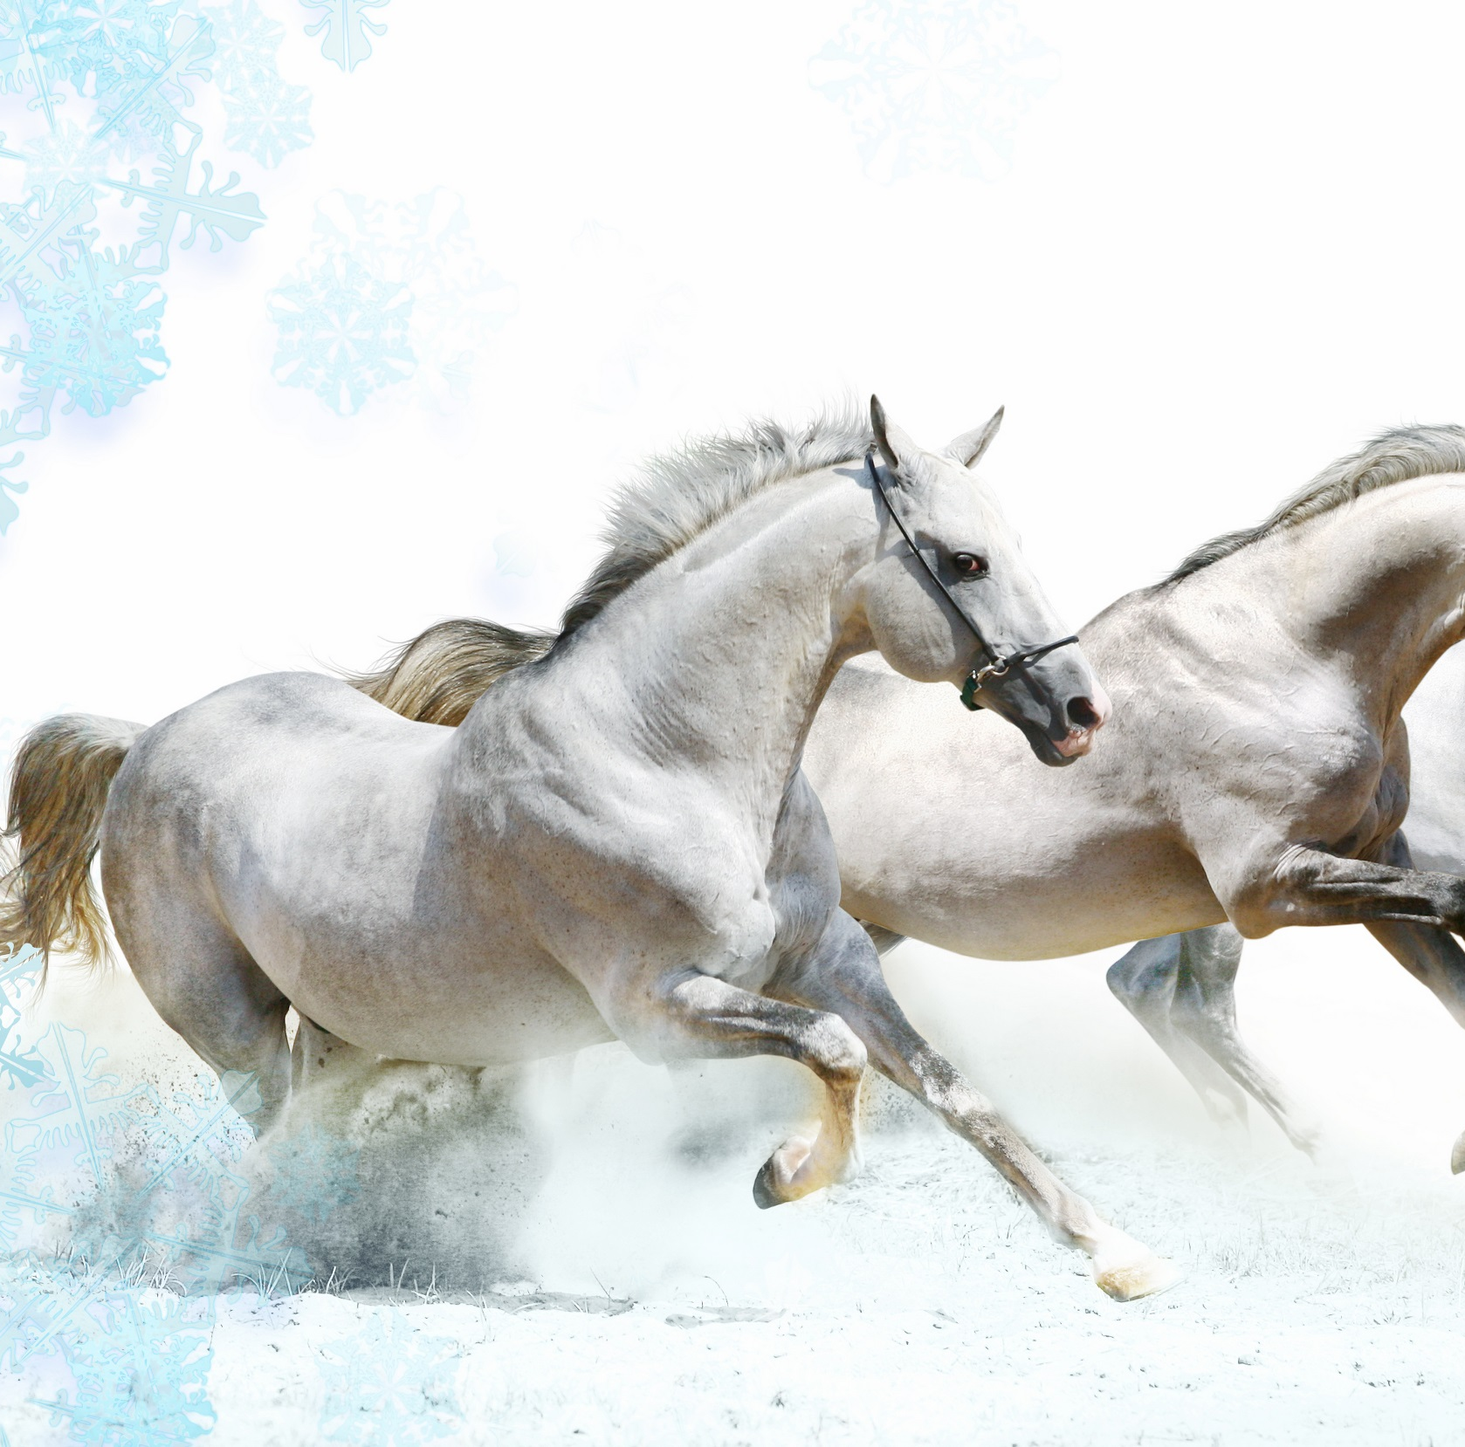
HORSES
LIPIZZANERS

Slide 2
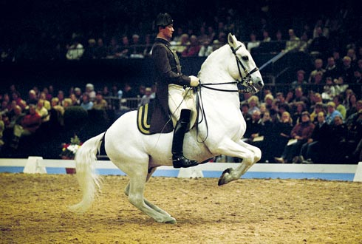
LIPIZZANERS
They are closely associated with the Spanish Riding School of Vienna, Austria, where they demonstrate the ''haute école'' or ''high school'' movements of classical dressage, including the highly controlled, stylized jumps and other movements known as the "airs above the ground."

Slide 3
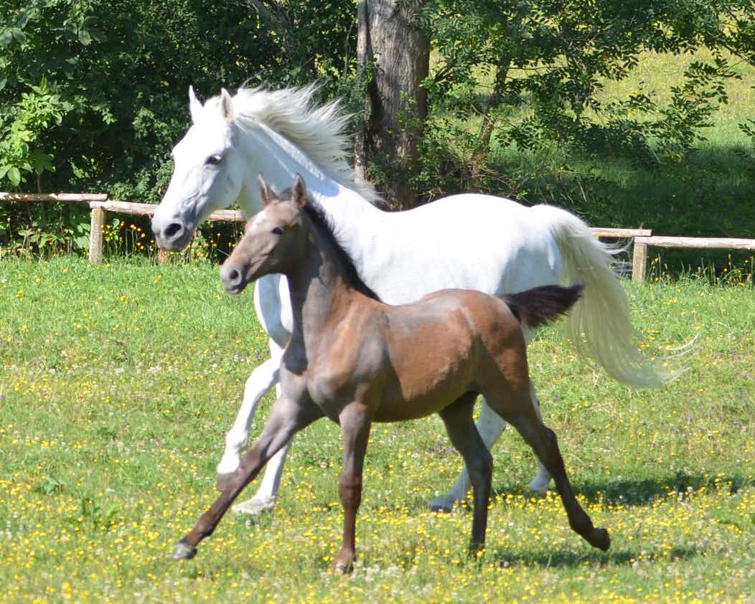
The rescue of the Lipizzans during World War II by American troops was made famous by the Disney movie Miracle of the White Stallions.Also,they showed up in Europe in the beginning of the 16th century (in 1508.).
Usually,baby lipizzaners are black and when they are at the age of the 4-7 they are becoming grey.When they are young they follow their mom everywhere because they feel safer that way.

Slide 4
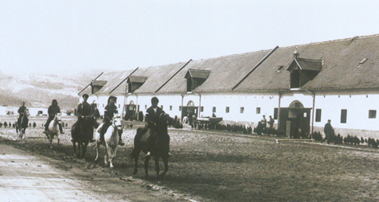
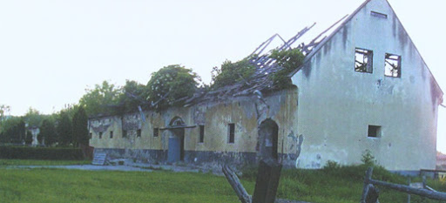
In October 1991, the largest Lipizzaner horse-farm in Croatia, situated near the town of Lipik, was bombed with napalm bombs. This horse farm has existed since 1905.It was bombarded by the side of Serbian army.

Slide 5
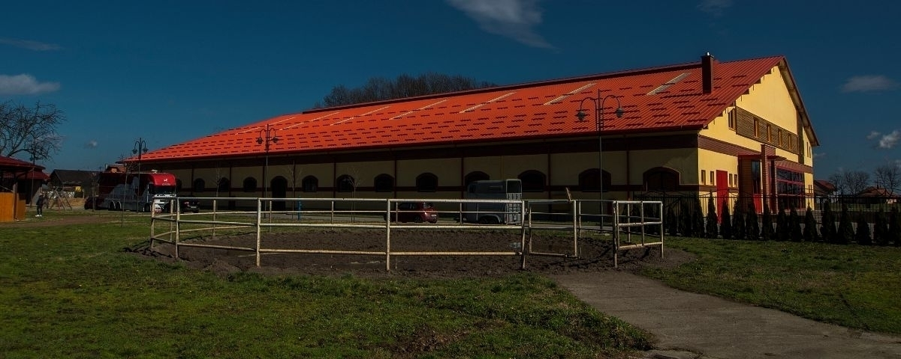
One of the most famous horse stables in Croatia is the Đakovo stable.The Đakovo stable is one of the most popular tourist's destinations where the kids are the volunteers.The Đakovo stable is home to more than 160 lipizzaner horses.At the Christmas ball,the lipizzan horses are the main theme.The lipizzans in the Đakovo stable are very well trained.

Slide 6
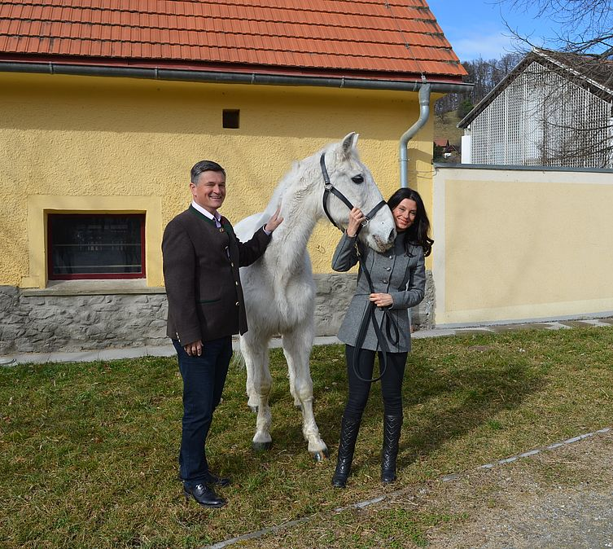
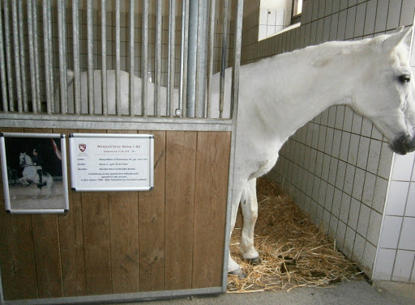
Lipizzaner horses are long lived animals.They can live 'till the age of 25 and if the are very well treated they can live even 'till they are 35.The oldes Lipizzaner horse is called Neapolitano Nima.He lived 'till the age of 40.

Slide 7
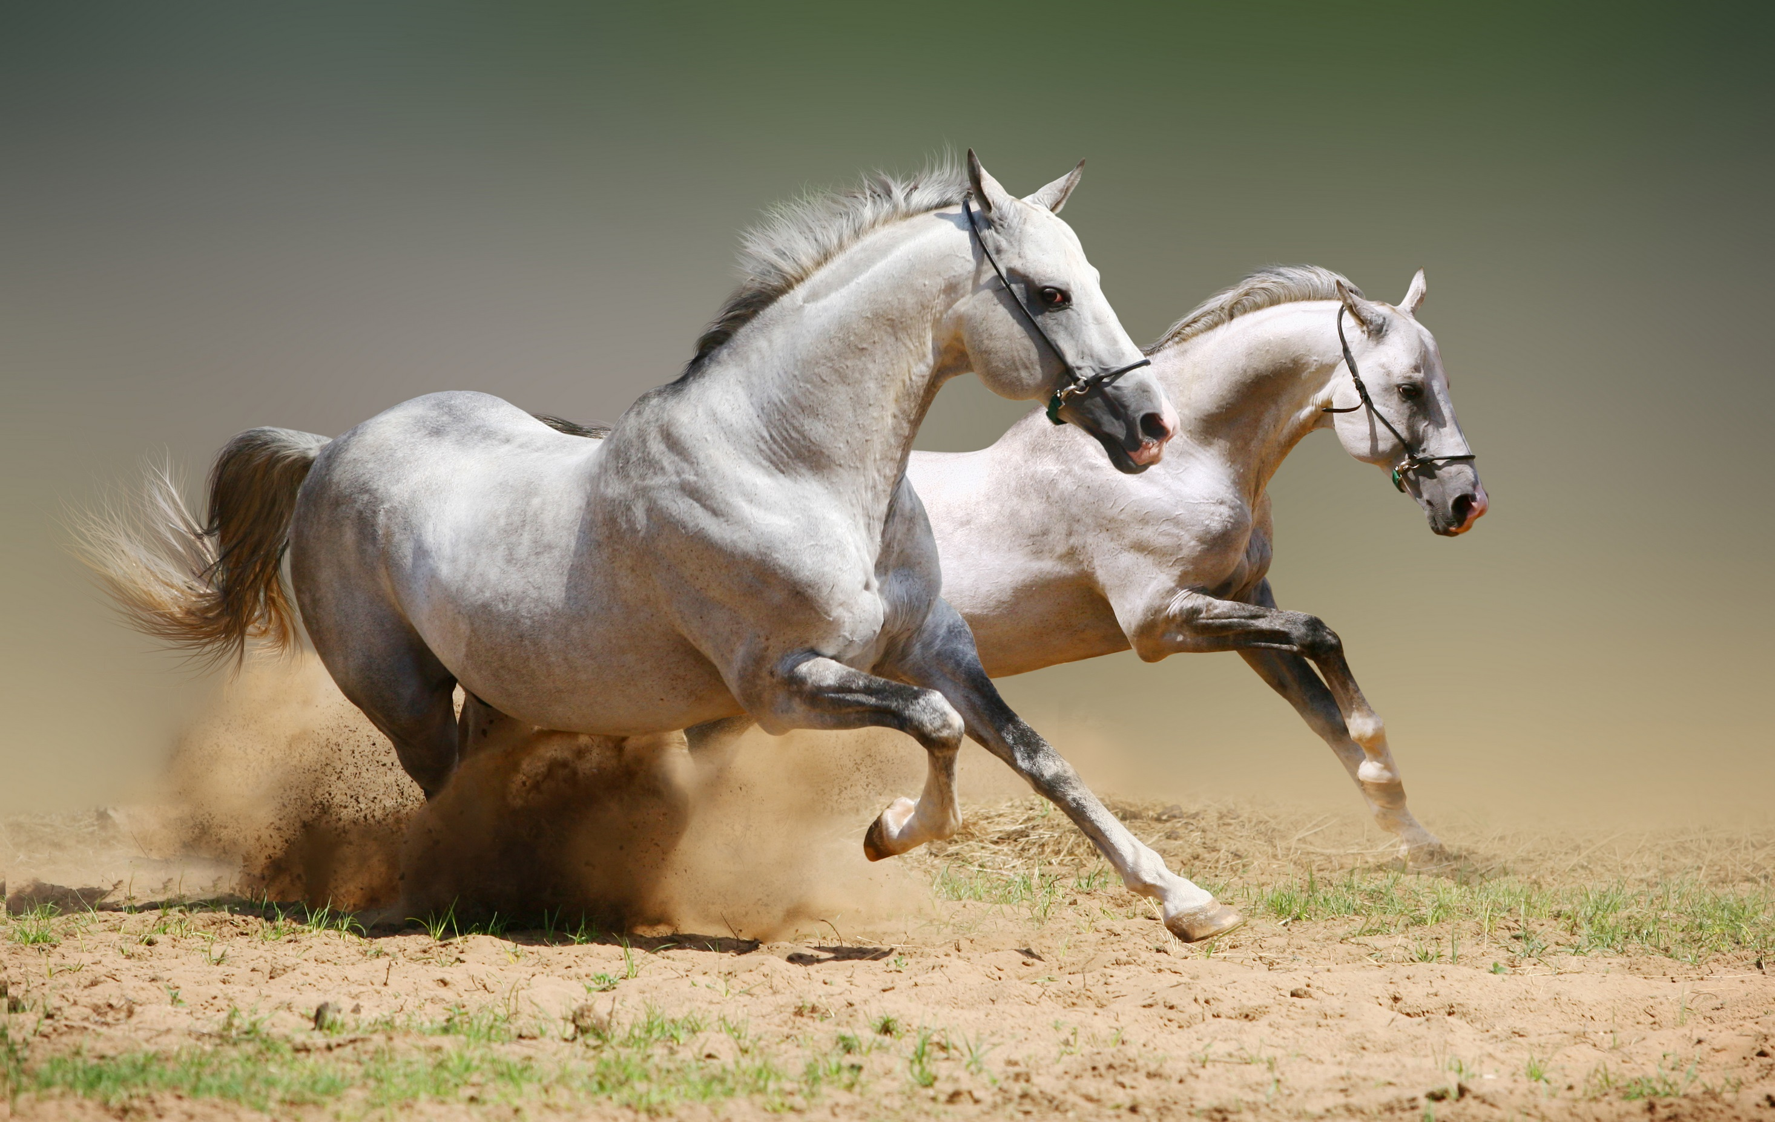
THANKS FOR YOUR ATTENTION

