Slide 1
Ina Sofie Lønøy
from Norway

Slide 2
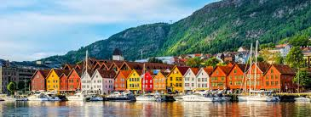
About me
I live in Sotra and is west for Bergen. Sotra is an island outside Bergen and it’s around 30 thousand people living here.
I have a mom and a dad. I have two brothers. One little brother and he is 11 years old and my big brother is one year older than me, 16 years old.
My house is a white house and we have two terraces. It’s middle size and my room is in the first floor. I have a beach right to my house and it’s so fun to swim when it’s hot outside.
I like to hang out with friend in the city Bergen, and watch netflix and chill.

Slide 3
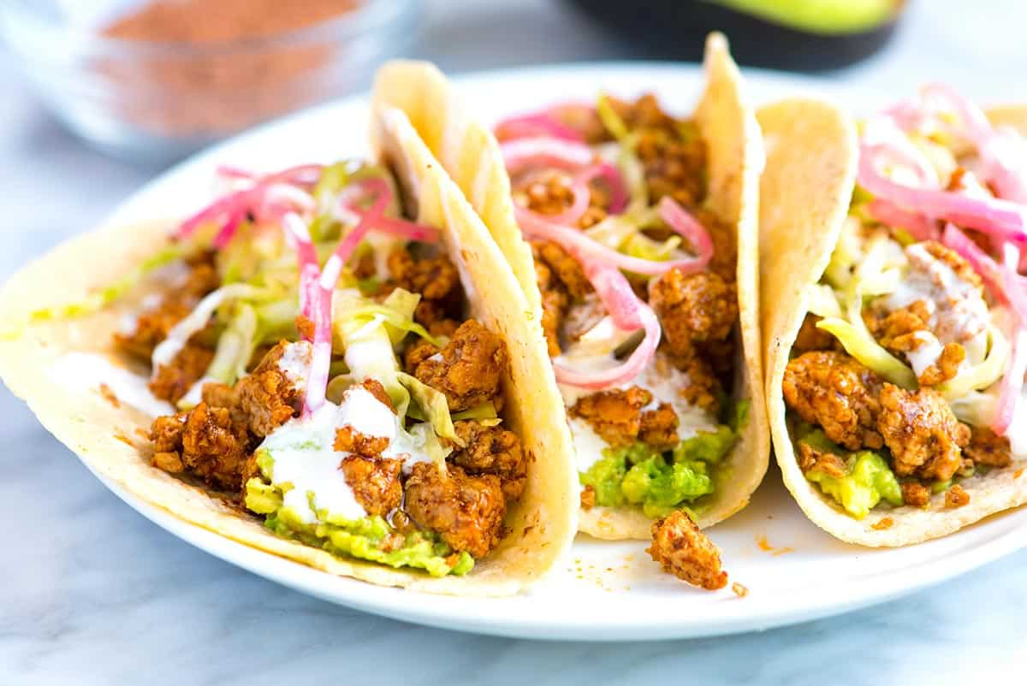
Favorite stuff
I like some different music, like pop music, rap and calm songs. I love to calm songs before I go to bed.
I don’t watch movies often, just scary movies with friends occasionally. But my favorite serie is Stranger Things.
My favorite food is TACO, i love to eat that in the weekend.
I don’t like any subject, but if I have to choose, it will be gym.
I support Manchester United in soccer.

Slide 4
More facts
I have been to Denmark, Sweden and Turkey. I been to Denmark and Sweden more than just one.
I want to be a police detective or to work with animals, like horses. I want to have a stable and a riding class to learn.
I like that it just takes around 30 minutes to Bergen from Sotra and that it is a shopping center here.
I like that in Norway we always have what we need, we have mountains and rain. Some days in the summer it’s to hot, but not usually.
I want to know about the same thing really. About yourself and what you like to do.

Slide 5
The girl to the left is me and the girl to the right is my bestfriend.

