Slide 1
Norway
Olina Toresdotter Dale
A female student at Tranevågen ungdomsskule

Slide 2
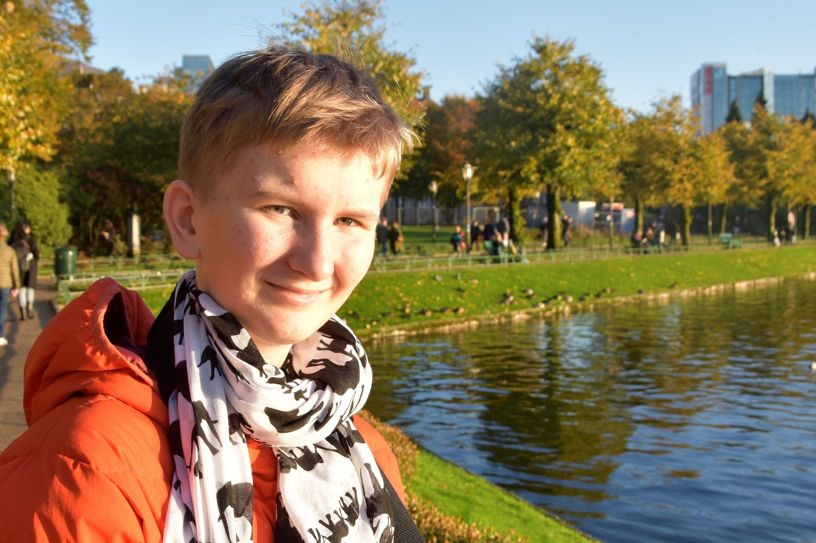
My look

Slide 3
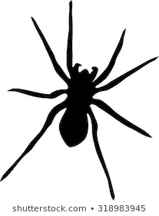
Short about me
vegetarian
like to watch anime
like to read
spend holidays at sailboat
a little shy
like to talk (not to strangers, though)
like spiders and snakes (seriously, they are really cool animals)
a little impatient
Continue reading if you want to know more ;-)

Slide 4
My home
I live on a little island called Misje. It’s thirty minutes outside Bergen.
My house is right with the sea, and we have an own quay to the sailboat.
The house has five etages, but we only use two of them as our apartment. The three other etages is an apartment we rent out, a cellar (with a climbing wall) and the garage.

Slide 5
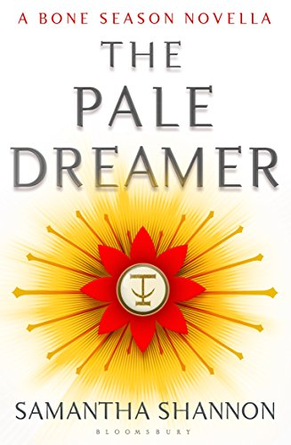
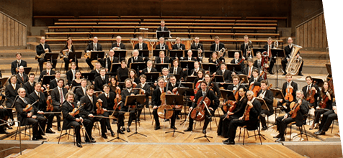
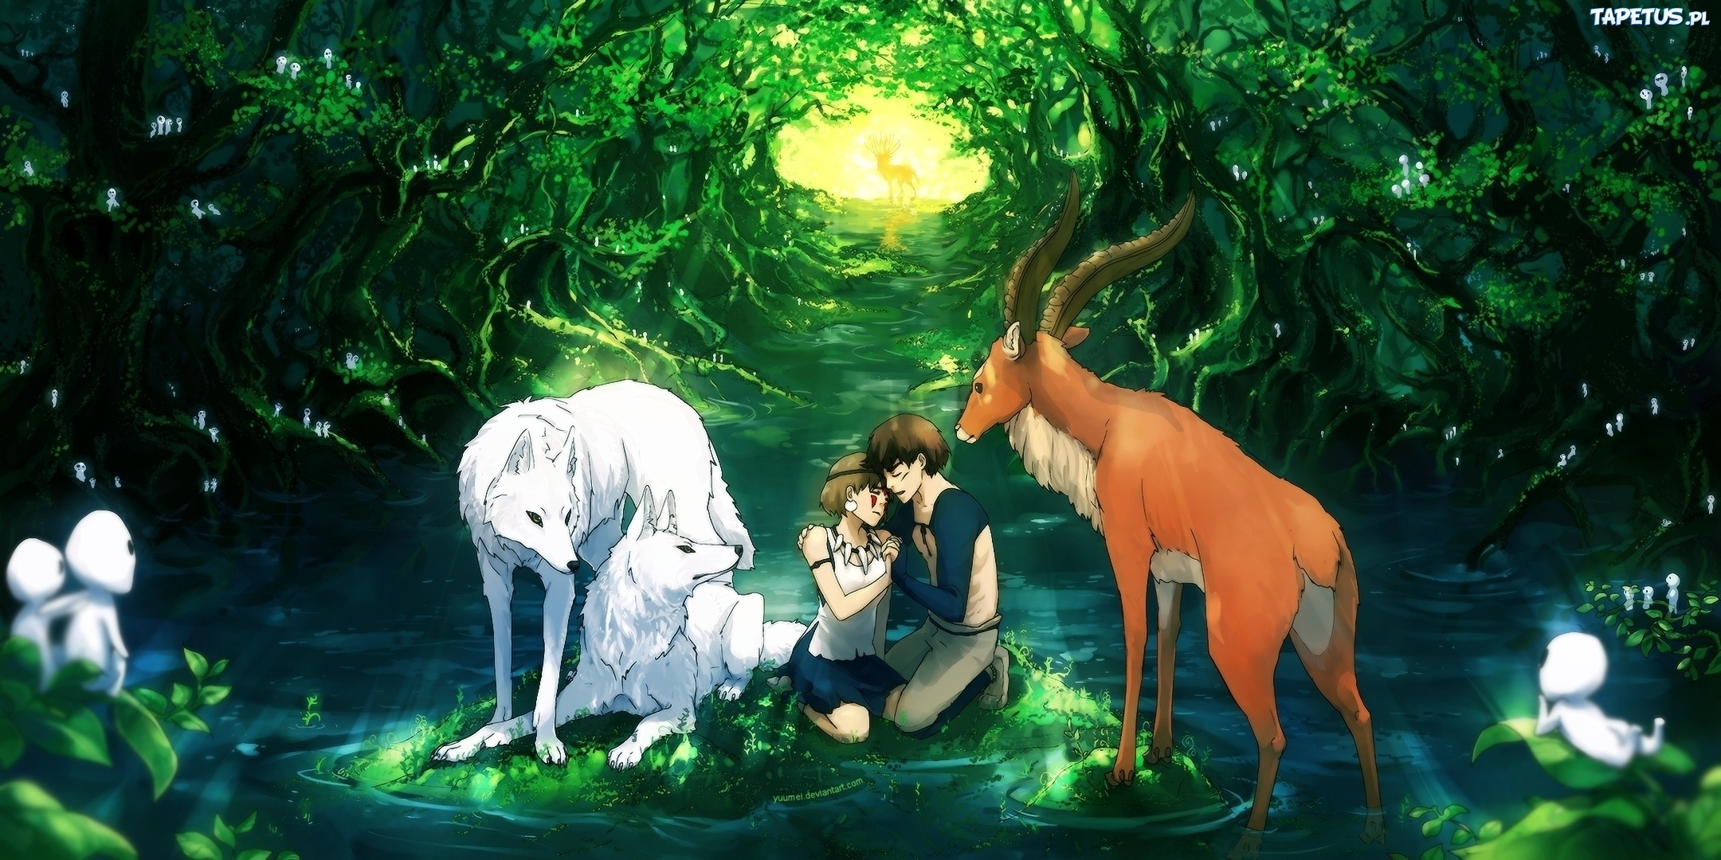
My favourites
favourite colour - dark blue
favourite meal - noodle soup (without meat)
favourite place - Fair Isle
favourite book - the pale dreamer (Samantha Shannon)
favourite series - The seven deadly sins
favourite movie - Princess Mononoke (I think)
favourite music - classical music (especially Chopin)
favourite school subjects - Norwegian, Spanish and music

Slide 6
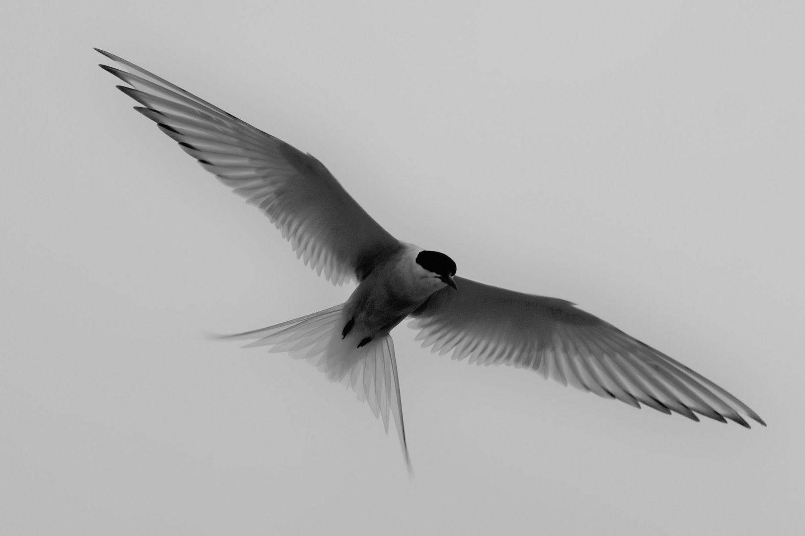
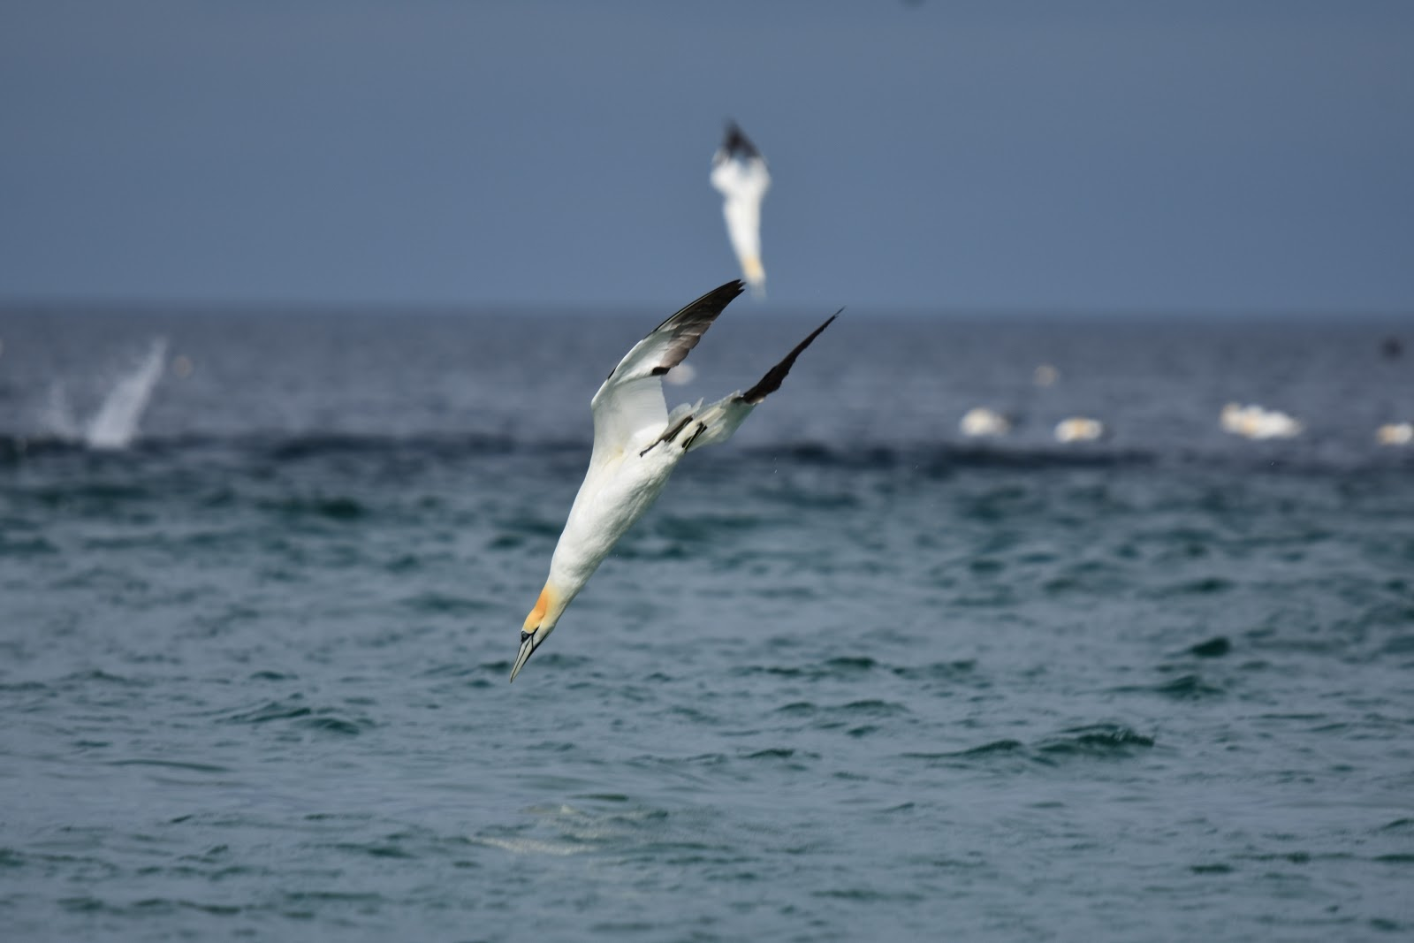
My hobbies
classical piano (and composing)
wildlife photography
writing
Me playing my own piece “Eventyr” (Adventure)wn
Shetland this summer

Slide 7
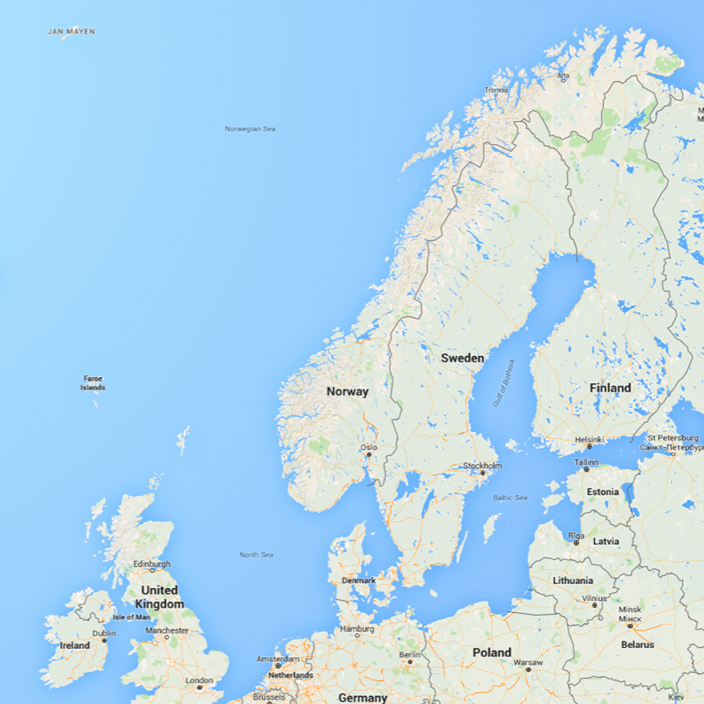
Fun things about where I live
Norway
The ocean, the islands, the sea animals
The weather (believe it or not)
The long coast
The nature
The mountains
Sotra (Fjell)
The nice bike trips
The fact that Sotra is not a city (not a city girl)
My island Misje
Sotra

Slide 8
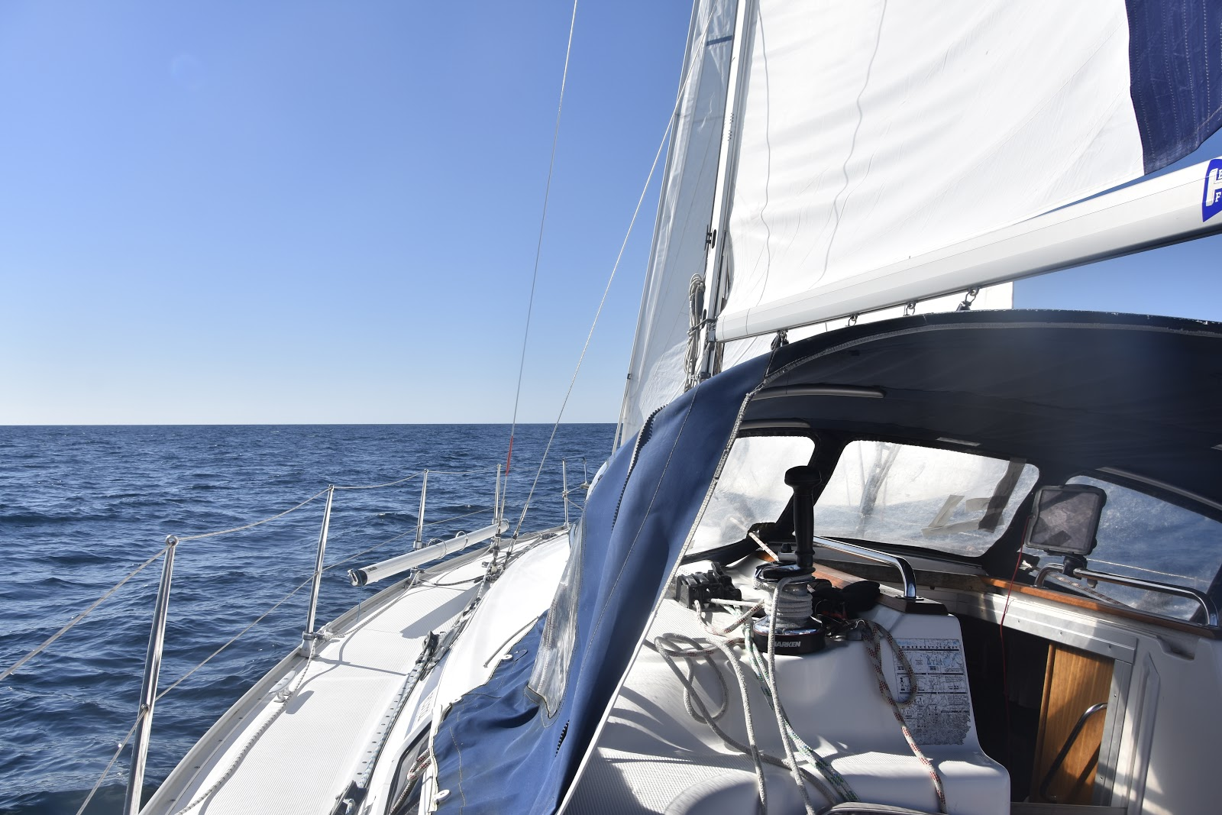
My countries
My family have a sailboat, around 12 meters long, and it is on that boat we spend our holidays.
In 2015 we were an entire year on the boat. In that year I visited Shetland, Scotland, Northern Ireland, Ireland, England (not the mainland), Spain and Morocco.
Other countries I have been it is:
Namibia, Denmark and France

Slide 9
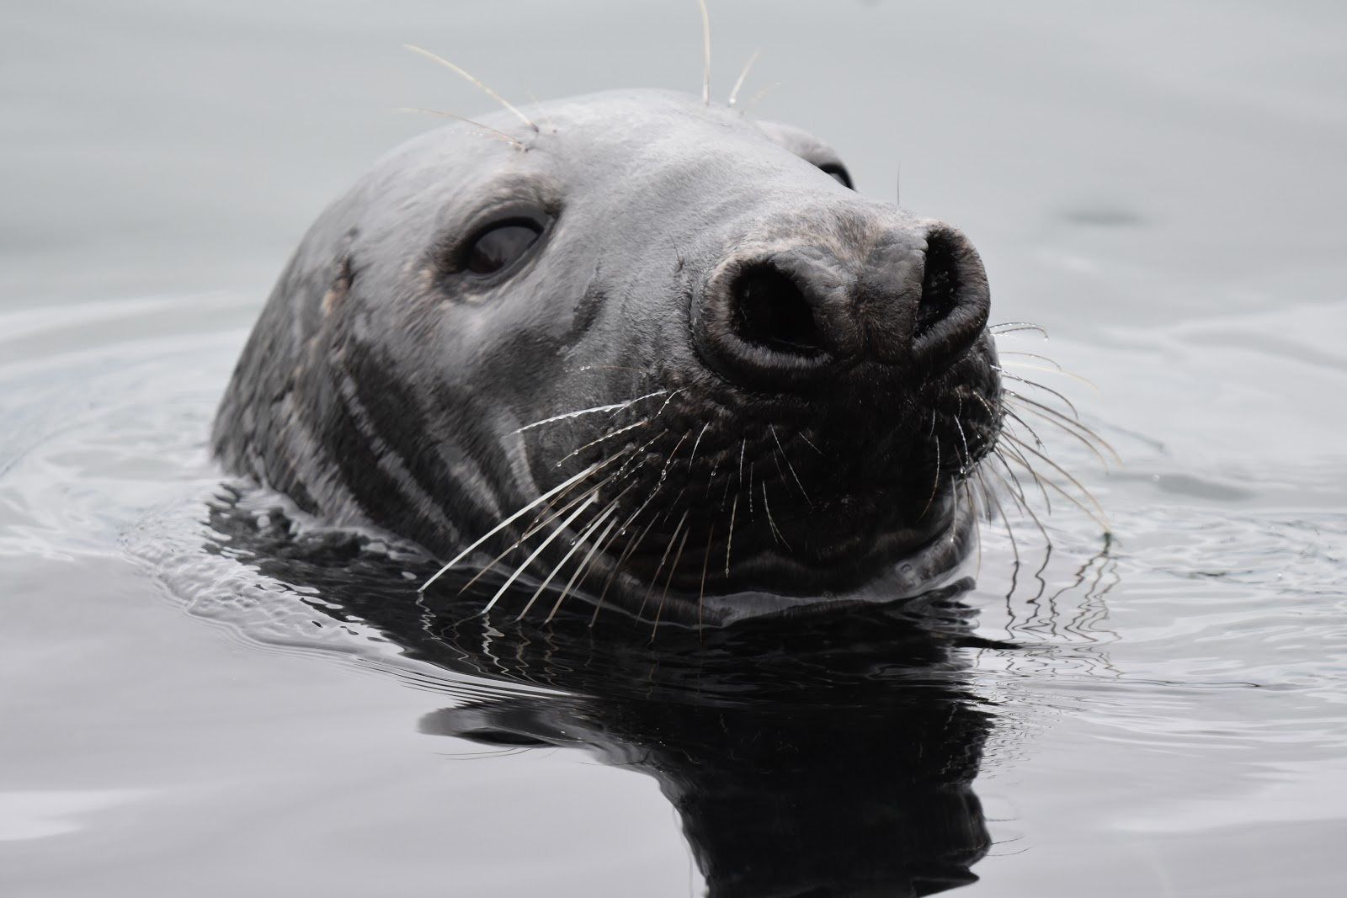
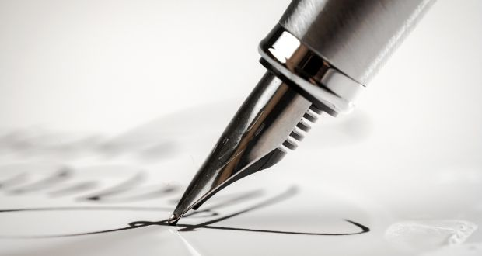
My future (I hope)
Langhaugen music program
University - bachelor - writing, music, anthropology (I think)
University - master - music (I think)
Job - wildlife photographer, writer and musician (I hope)

