Slide 1
Hello!

Slide 2
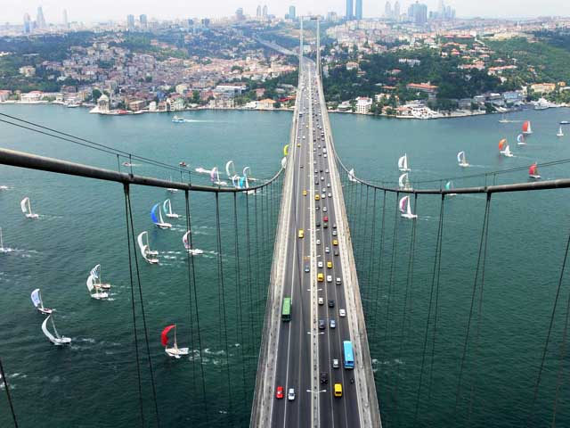
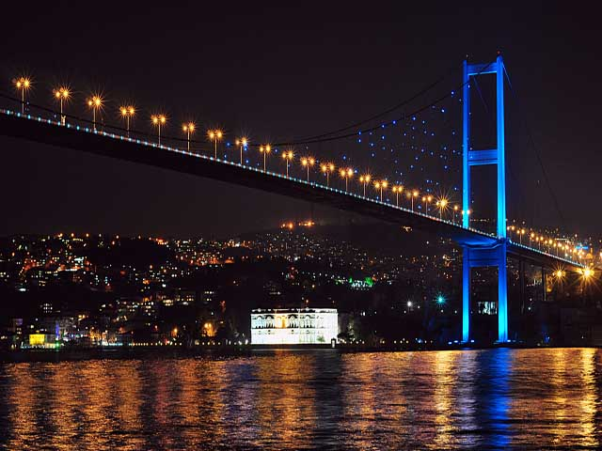
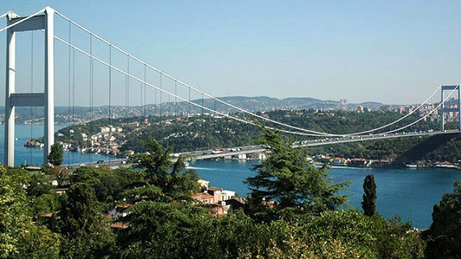
My name is Semanur.
I’m 11 years old.
I’m from Turkey.
And I live in İstanbul.
I study at Abdurrahmangazi İmam Hatip Secondary School.

Slide 3
My favourite books are İlginç Hayatlarıyla Bilim İnsanları and Eyvah Kitap.

Slide 4
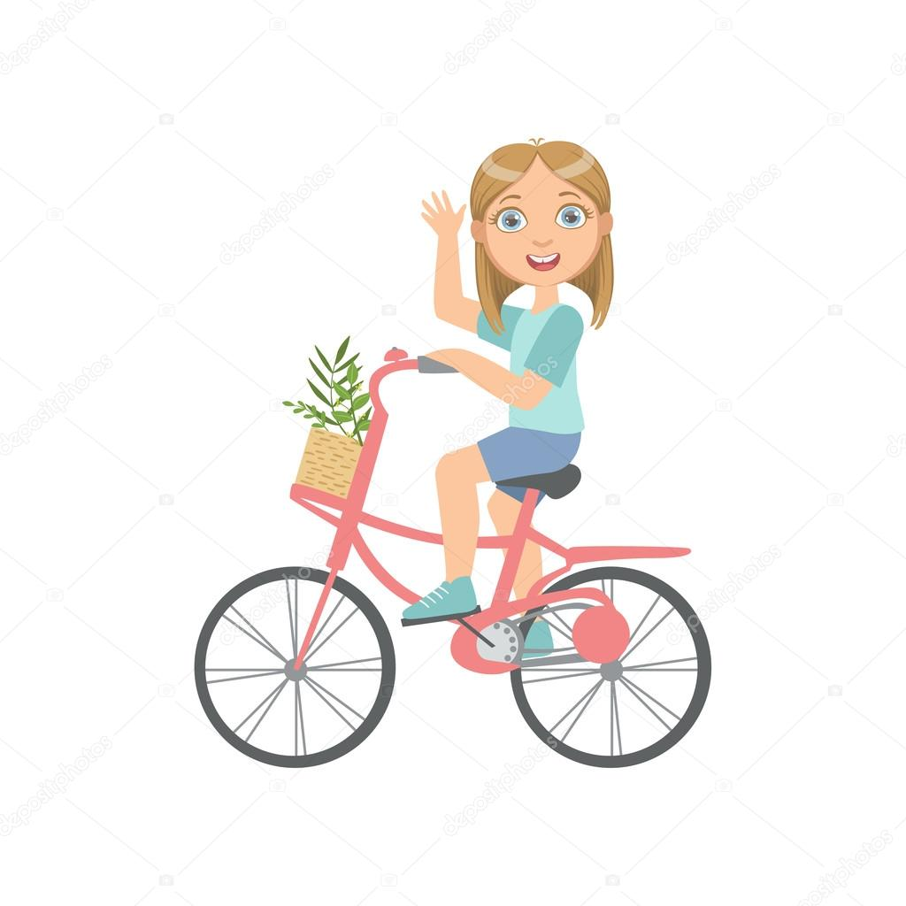
My hobbies are listening to K-pop or Rap music, swimming and riding a bike.

Slide 5
My favourite lessons are Maths , Science and of course English.

Slide 6
I like horror movies.

Slide 7
My favorite group name is BTS.

Slide 8
Thank you!!!
I’m happy to take my part in this E- Twinning project.
See You!!!

