Slide 1
Jenny-Sofie Kartfjord
From Norway

Slide 2
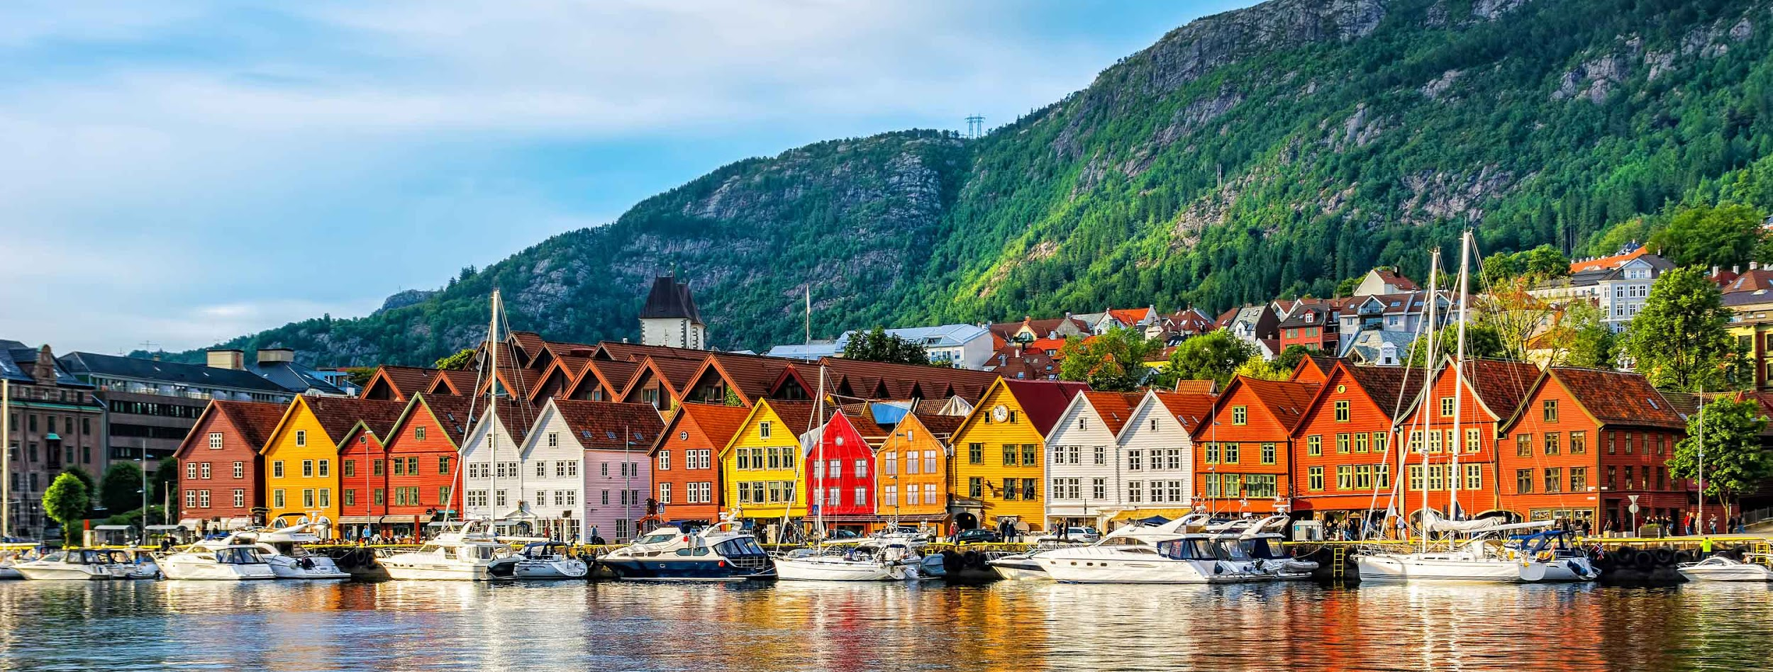
Some facts
I live at Sotra, wish is a island west for Bergen. It’s a big island, its live about around 25-30 thousand people.
I live in a house with my family. My family consists of my mum, dad and my two little sisters and my little dog. The house is a medium size with a garden. My room is on the second flour and the biggest of my sisters.
I live around 10-15 minutes walk from the school, so i walk to school everyday.

Slide 3
Here is me and my best friend, I’m her to right.

Slide 4
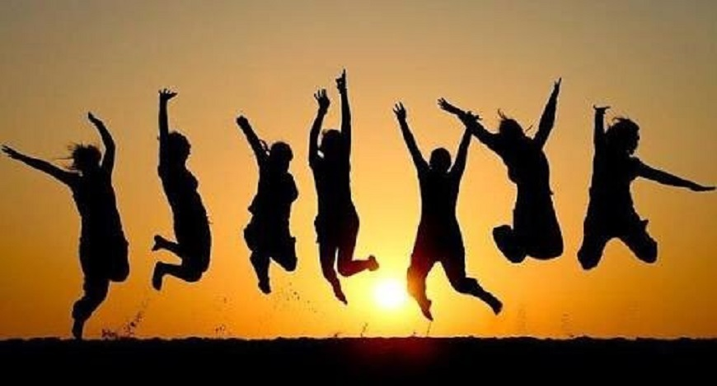
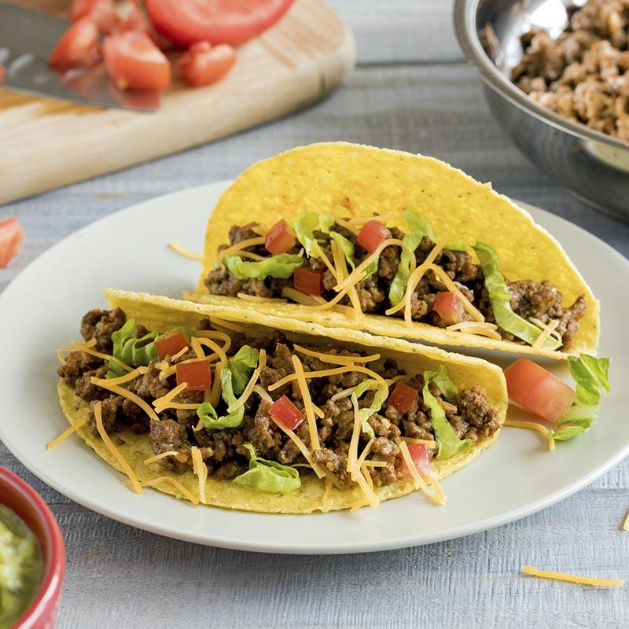
Some more facts
On my spare time i like to be with friends, work out and watch netflix.
I like to hear pop music, but i dont have one favourite artist.
My favourite series is “stranger things” and favourite movie is maybe “grown ups” or “kiss and cry”.
Favourite food is taco.
I’m not so fan of football so i dont have any favourite team.

Slide 5
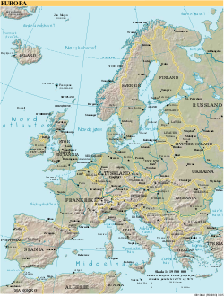
Some more facts
I have been to 12 countries: Norway, Sweden, Denmark, Germany, Poland, Turkey, Spain, England, Croatia, Montenegro, Bosnia, Greece.
In my future I want to be an ambulance worker, a police or lawyer.
What i like about staying at Sotra is that i can go in boat and swim, a big shopping center and it is not far from Bergen city.
What i like about living in Norway is that we have all we need and we can play in the snow in the winter and swim in the ocean in the summer.

