Slide 1
HİRANUR ARDIÇ

Slide 2
WHERE DO I LİVE
There aI live in ISTANBUL.ISTANBUL is more crowded then all cities.
re many beautiful buildings in İSTANBUL.ISTANBUL
Has mony places tovist.There is a lot of traffic in ISTANBUL.
It s hard to go somewhere but I LOVE LIVING IN ISTANBUL

Slide 3
ABOUT MY FAMILY
I love my famıly very much.
We are 6 in our family and we have brotherless.
I love my brothers very much.

Slide 4
LET ME TALK MYSELF
HELLO. My name is HİRA. My surname is ARDIÇ.
I was born in May 2007 in ISTANBUL.
I am from Sivas.I love my hometown.
My hobbies << to write story.I love to spend time with my friends.
I like travel .My best friend NİLAY

Slide 5
EVENT I ATTEND
I love being involved in projects.
I participated in the Arabic Projects.
I knew a country.That country İndia.
I wore the costume of that İndia.
I danced i knew İndia.
İt was very exciting and fun

Slide 6
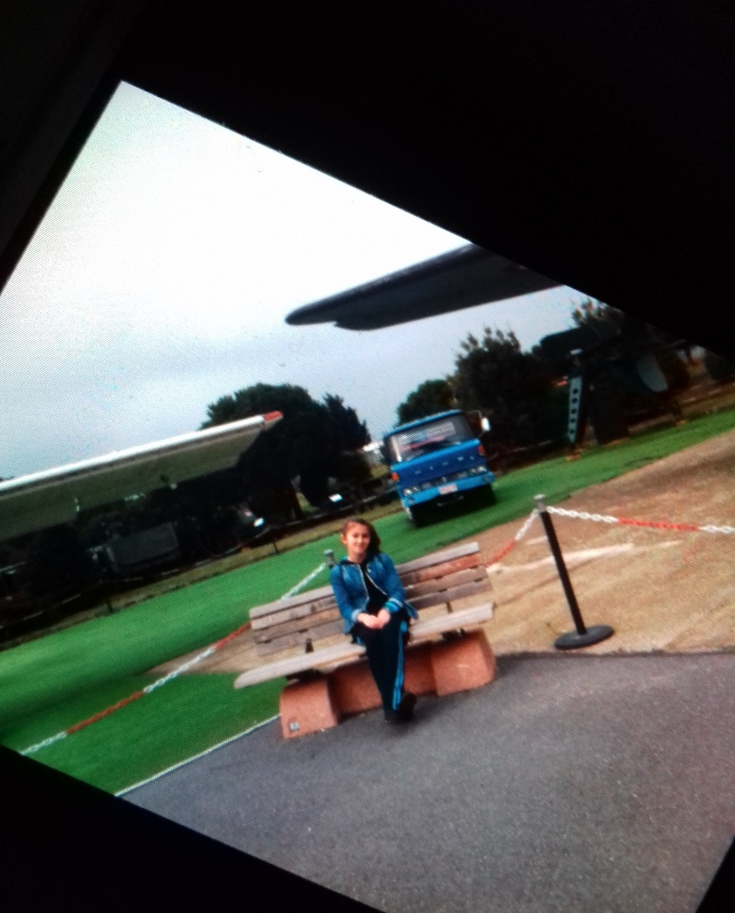
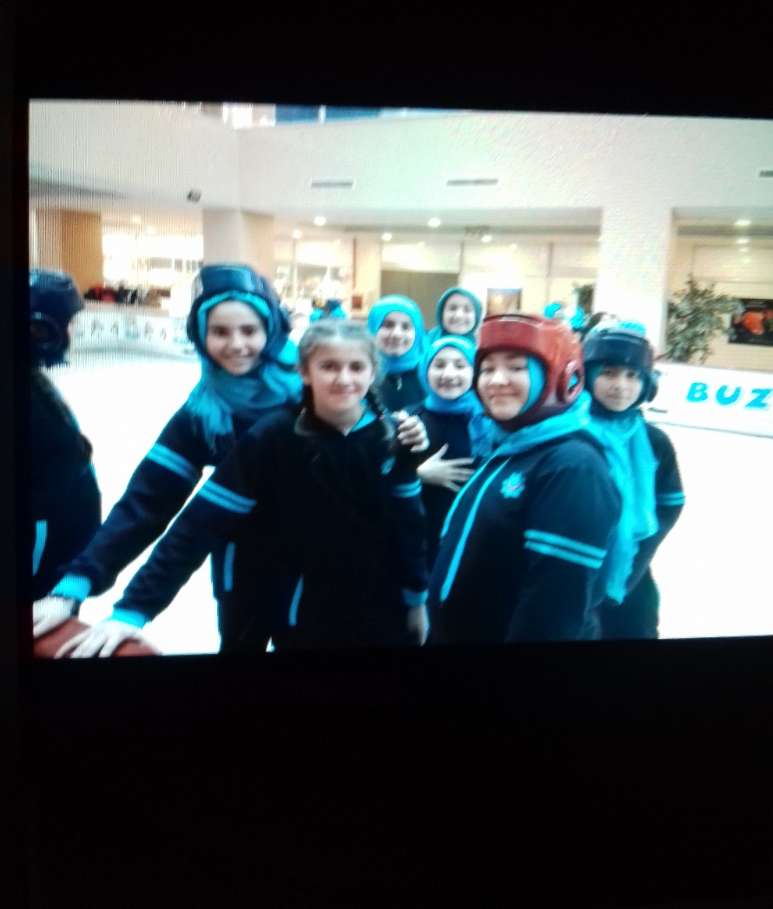
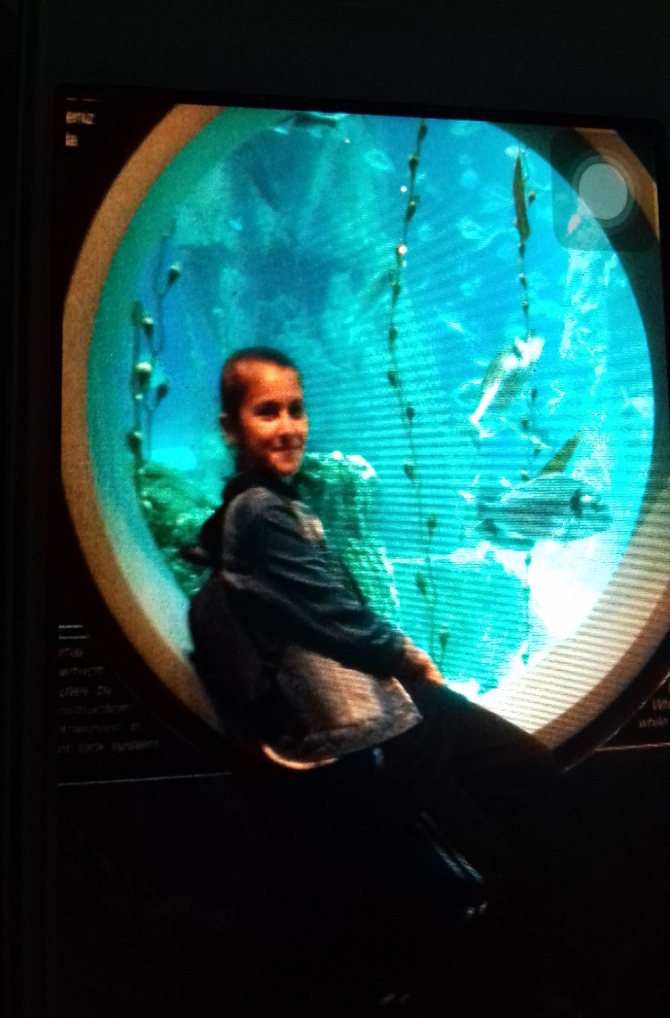
PLACES I VİSİTED

Slide 7
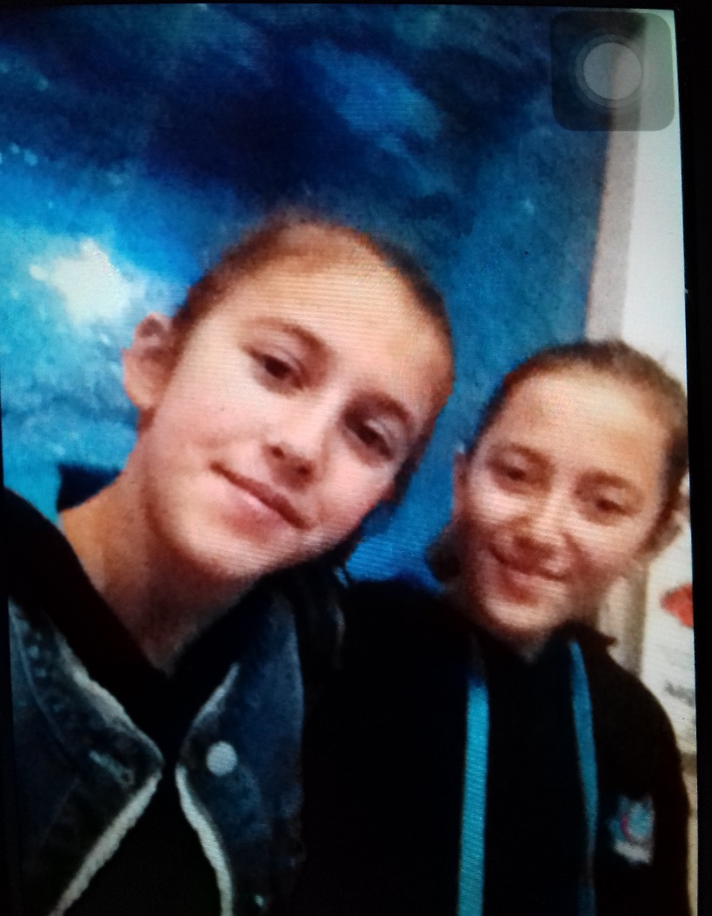
MY BEST FRENDS İS NİLAY

