Slide 1
Hello!
MY NAME IS İZEM AND MY SURNAME IS BULUT.
I’M ELEVEN YEARS OLD.
I STUDY AT ABDURRAHMANGAZİ İMAM HATİP
SECONDARY SCHOOL!

Slide 2
My hobbies are listening to music and reading books

Slide 3
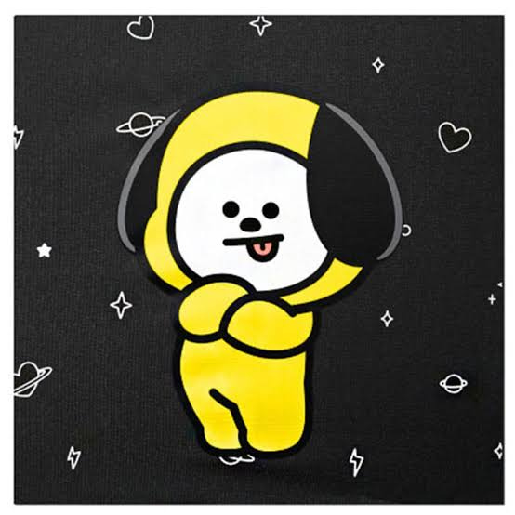
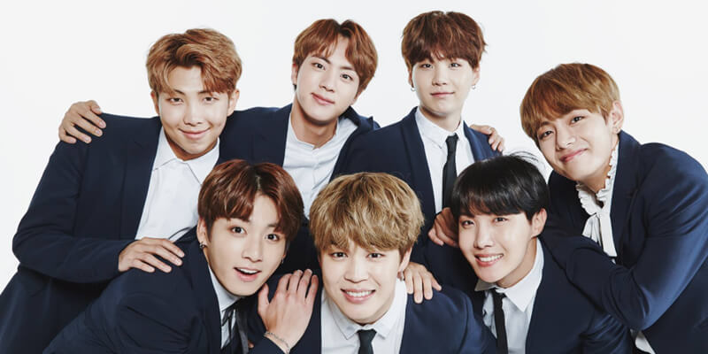
I like k-pop and bts

Slide 4
My favourite movies are sherlock holmes and miss pregreins Enfants particuliers

Slide 5
My favourite lessons are english and science

Slide 6
THANK YOU! SEE YOU...

