Slide 1
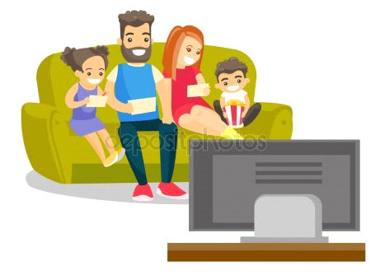
HELLO
My name is Şeyda Nur and my surname is Çinaz.
I'm eleven years old. I'm from Türkiye. I live in Istanbul
I study at Abdurrahmangazi İmam Hatip Secondary School.
My hobbies are reading books with my friends and watching TV with my family

Slide 2
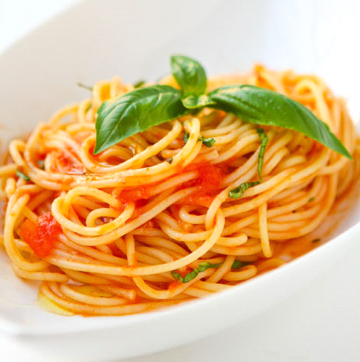
My favourite colour is red.
My favourite drink is orange juice.
My favourite food is pasta.

Slide 3
My favourite lesson is English.
I'm happy to be in the E-TWINNING project.

