Slide 1
Eline Marcelia Hodneland

Slide 2
Where do I live?
My parents are divorced, so I live two places.
Both of my parents lives in Sotra, it’s an island outside Bergen, in Norway.
My mother live at a place named Knappskog. The house is lying with the ocean, and got a great view. The house have three floors, five bedrooms and two bathrooms. The house is a semi-detached.
My father lives at Foldnes. The house is about 10 minutes away from a big mall. The house have two floors, five bedroom and three bathrooms. We also have a great view to the ocean.

Slide 3
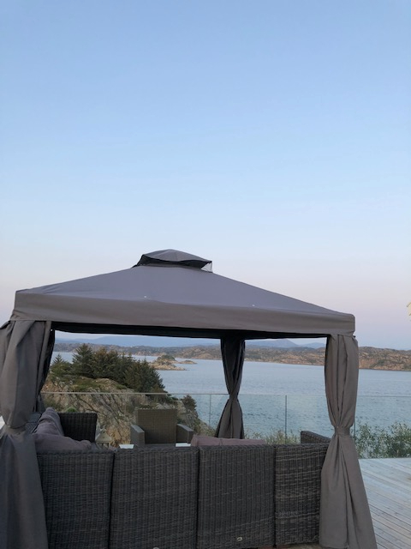
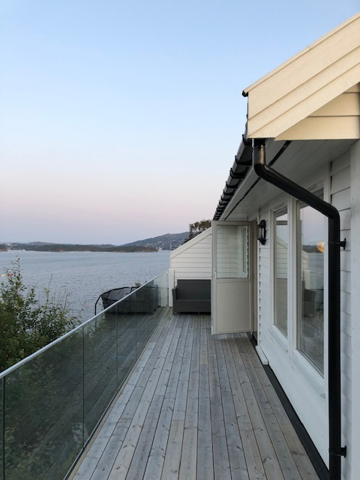
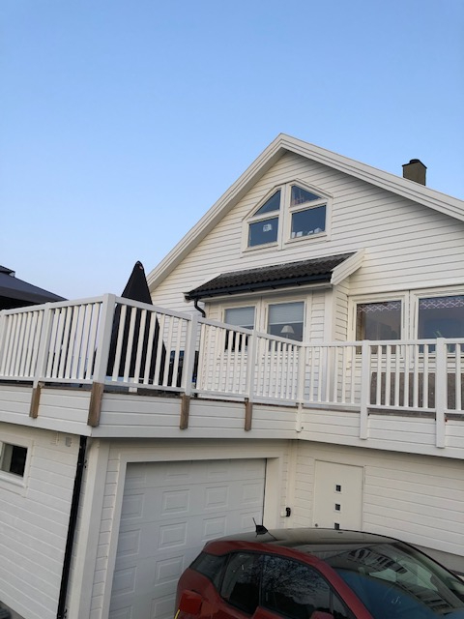
My mother’s house

Slide 4
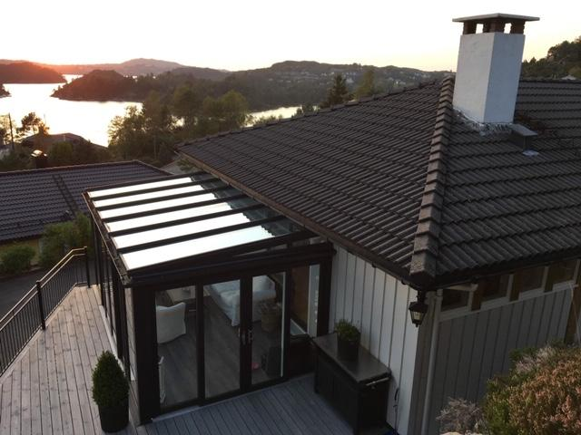
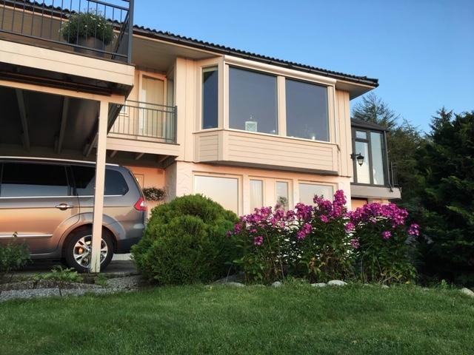
My father’s house

Slide 5
My family
Both of my parents are remarried with other people. That means that I have a really big family.
I have a twin sister named Thea and four step-sisters named Henrikke, Leonora, Oda and Anne.
My mother owns two cats named Bingo and Salto.
Me and Thea lives one week with each parent.

Slide 6
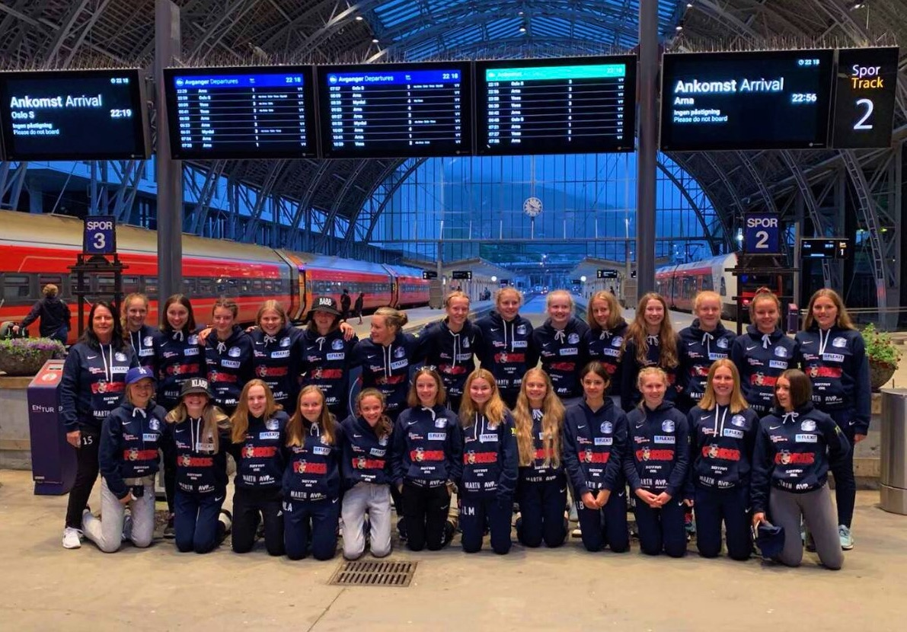
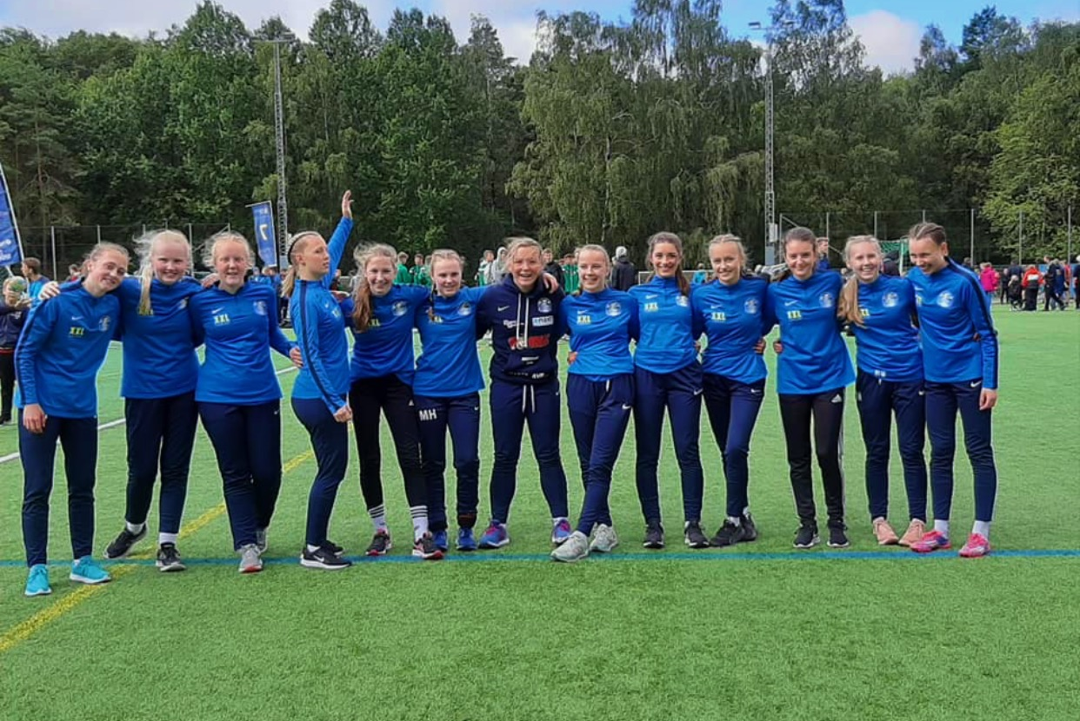
What do I like to do in my spare time?
I love to play handball.
I go to handball practise three times in one week.
My team is named Sotra <3
I have played handball almost for 9 years.

Slide 7
What is my favourite?...
My favourite food is pancakes
My favourite school subject is GYM
My favourite sport is handball
My favourite animal is cat or dog
My favourite season is summer

Slide 8
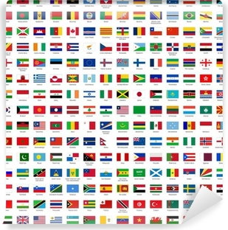
Countries
I love to travel! I have been to 10 countries:
Norway, Denmark, Sweden, Germany, Poland, England, France, Spain, Turkey, and Greece.

Slide 9
My future job
In the future, I think I’ll be working with children. Maybe a teacher or maybe work in the children welfare?

Slide 10
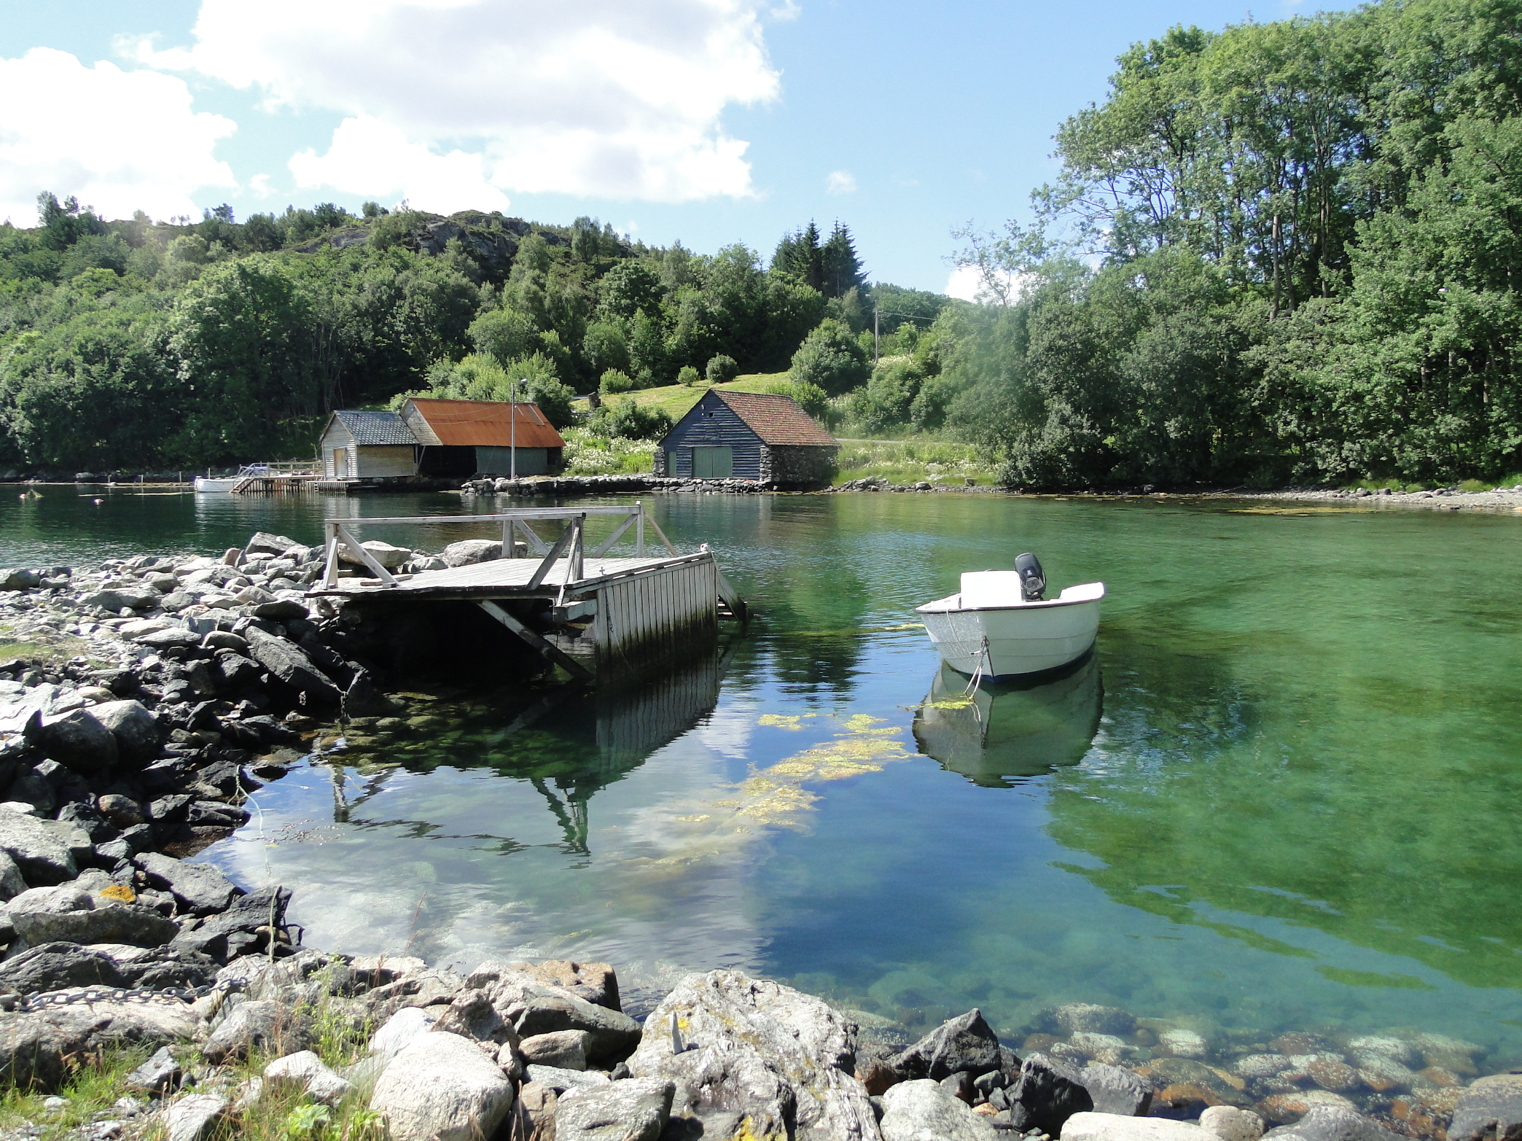
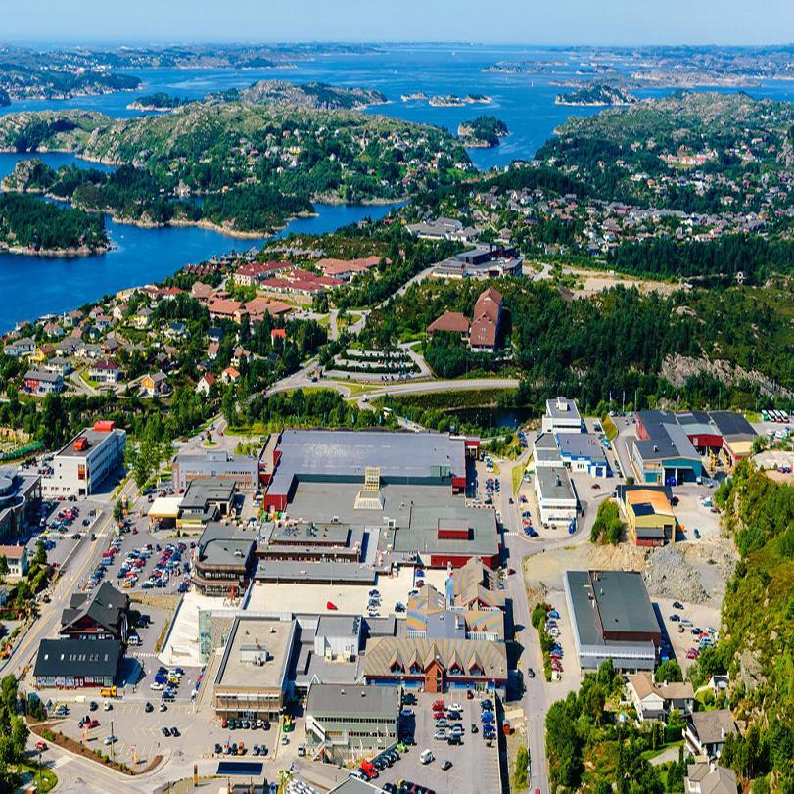
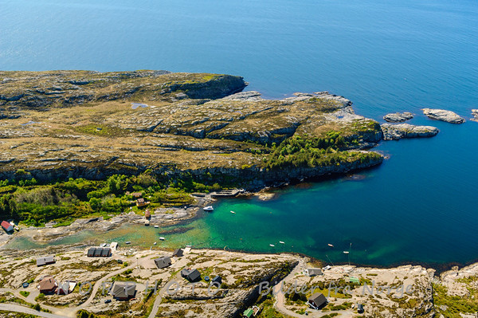
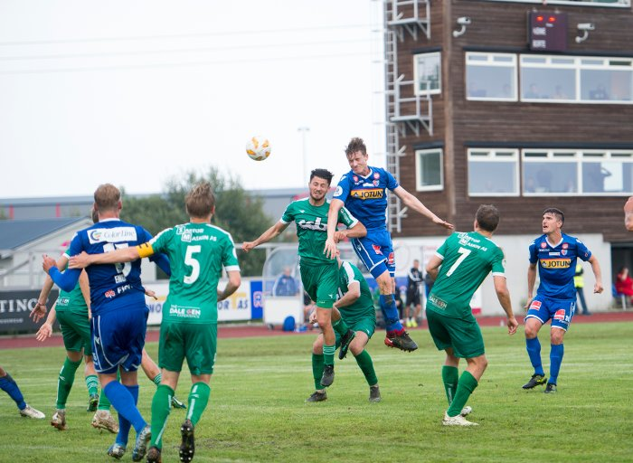
What do I like about Sotra?
Sotra is an island, not far away from Bergen. Sotra have great nature and a lot of things to do. I love fishing, bathing, shopping, and do sports. I love living at Sotra

Slide 11
What do I like about Norway?
I like that Norway is clean. Norwegian people are very concerned with climate.
I am glad there are not so many people living in norway. I feel there are a lot of people here, but when I think of other countries and how many people live there, I become a little grateful.
I like the freedom of speech, and the way people treat each other.

Slide 12
Students from other countries
I’m very curious about students from other countries. I can’t wait to meet them. I am very interested in other countries and their culture.
I am curious to know more about how they live. What they eat, which school they go to, rools, family, transport and stuff like that.

Slide 13
Here comes some pictures that I’ve taken, hope you enjoy.

Slide 14
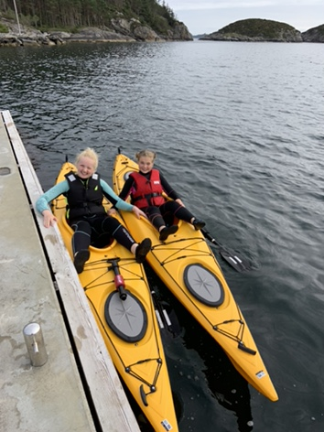
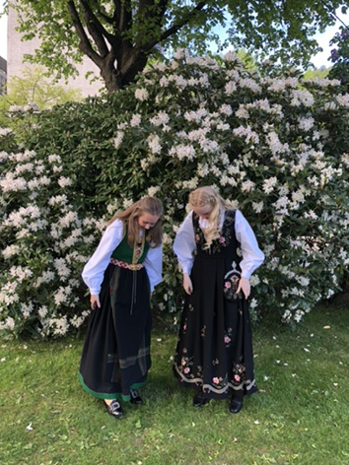
Me and my step-sister Henrikke Me and my friend wearing the national costume of Norway

Slide 15
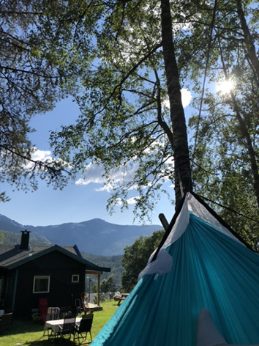
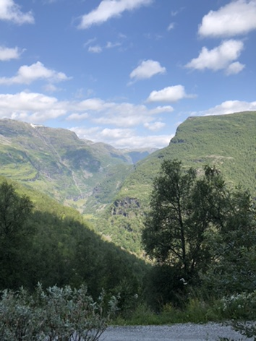
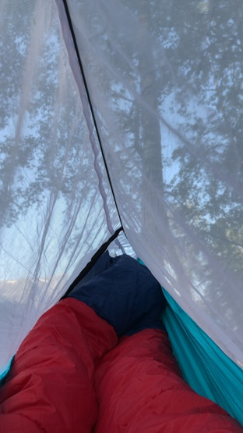
This is my cabin, it’s in a place named Reimegrend, close to another place named Voss.
We had a lot of fun this summer, when we slept in hammocks outside our cabin

Slide 16
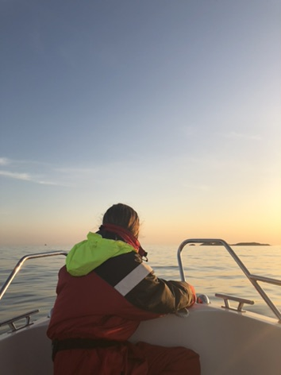
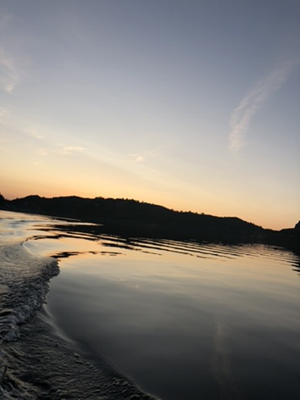
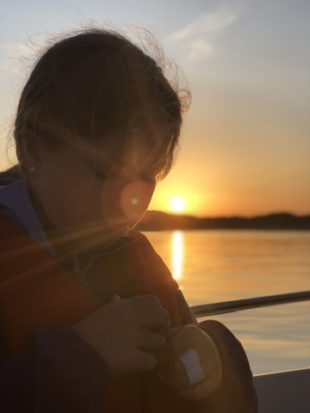
I love to take pictures and my family loves late night fishing.

Slide 17
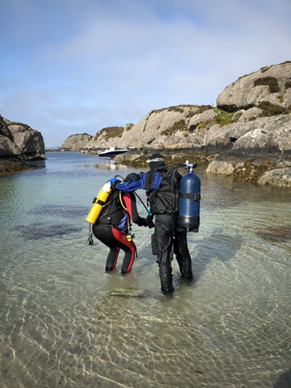
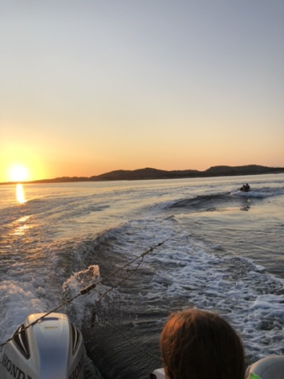
This is my first time trying diving with my step-father
This is me trying water skiing in the sunset

Slide 18
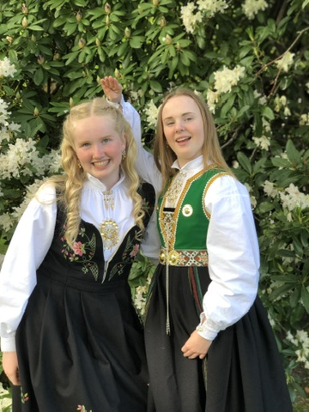
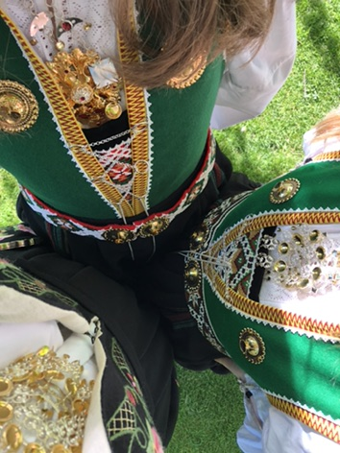
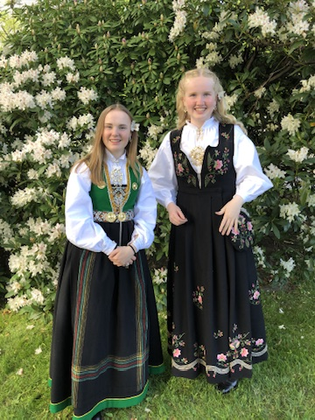
These pictures were taken on the 17th of may (The national day) Wearing the national costume of Norway. Me and my friends Malin and Ida.

