Slide 1
This is me:)

Slide 2
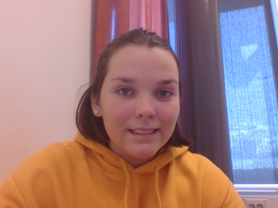
About me:
My full name is Ingrid Marie Saebo Lothe, and I am 14 years old:)
I’m from Bergen, which is in Norway.
My house is yellow, and my room is really messy. It’s clothes everywhere.
My parents is divorced, and my mom and dad has married a new one. So I have two homes. I have two big brothers at my dad, and two little brothers at my mom, soon I’ll get a sister or a brother at my mom.
In my spare time I like to box, and I like to read (My family calls me a reading lion)

Slide 3
My favorite movie:
My favorite movie is Harry Potter!!!!!
If you don’t have seen the movies, I’ll beg you to watch it.
It is 7 movies in the movie series.

Slide 4
More about me:
The music i like is pop and a little bit rock.
My favorite food is lasagna, pizza, spring rolls and chicken salad.
Favorite school subject must be electives.
My favorite football team is Liverpool.
I have been in England, germany, spain, sweden, denmark and Norway of course:)
I don’t know what I want to work with in the future.
I like that everything is so close here on Sotra.

Slide 5
Even more about me:
What I like about living in Norway is the nature, it is so beautiful.
How the school day is, and which way they are learning things.

