Slide 1
My name is Elif Eylül
about me…

Slide 2
-My name is Elif Eylül
-I am eleven years old
-I study at Abdurrahmangazi İmam Hatip Middle School.

Slide 3
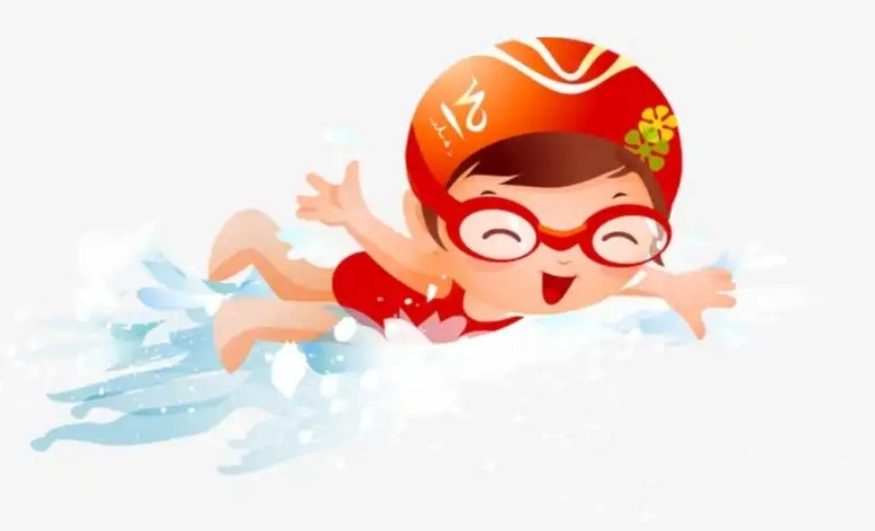
I love swimming and listenıng to music

Slide 4
My favorite films are Harry potter and order of the phonıx
My favorıte sequence ıs stranger things

Slide 5
My favorıte lessons are scıence and englısh

Slide 6
Thank you
See you later…

