Slide 1
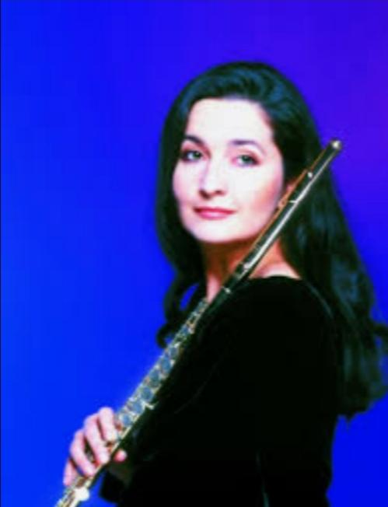
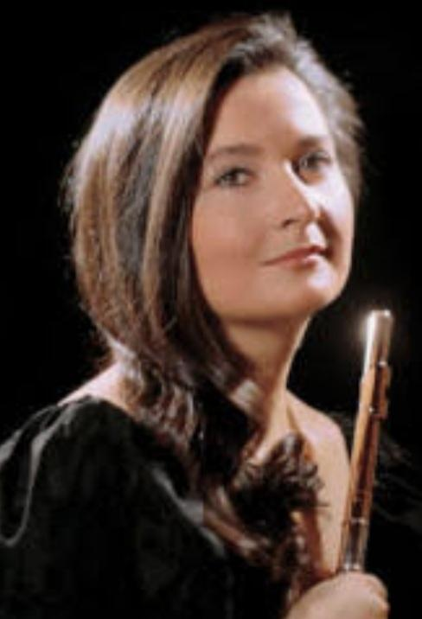
ŞEFİKA KUTLUER

Slide 2
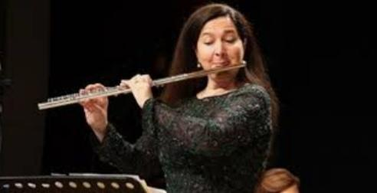
Turkish female classical flautist.

Slide 3
Şefika Kutluer studied at Ankara State Conservatory and graduated with honors and awards in 1979.
She achieved her soloist career in Vienna and Rome.
She taught at the Ankara Conservatory for several years.

Slide 4
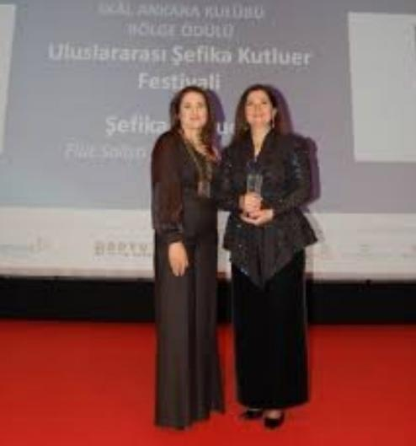
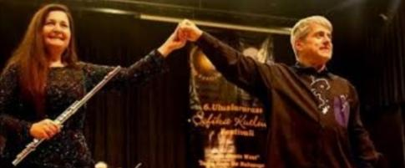
SHE HAS GOT A LOT OF AWARDS

Slide 5
She won the 3rd prize and next year the 1st prize in “ International Flute Contest “ in Vienna.
She received the 2000 Inter-Lyra Prize from the ‘Hungarian Foundation for Performing Arts’
She was awarded the presidential Medal in Turkey in 1985 and in 1998 she became a "State Artist".

Slide 6
She has been decorated with “Cavaliere dell’Ordine della Stella della Solidarieta’ Italiana”- State Medal – by the President of Italy
and with "Austrian Gold Medal of Merit" by the President of Austria
and the Cultural Medal of the Republic of Kazakhstan
and in September 2017 she received Slovak Republic’s special award - "the Golden Medal of Honour".

Slide 7
She has been appointed as the “Goodwill Ambassador of Unicef”.

Slide 8
“MAGIC FLUTE” Here is a “Magic Flute” from Turkey..........I am impressed; she is a master technician who also has great musicianship. The audience was thrilled by the technical excellence displayed by Kutluer; she has a delicate control of tone color. Her articulation of “Flatterzunge” or flutter tonguing is superb. Her fingering is the best, but flute players know that fingering is perhaps half the effort. The remainder is the responsibility of the lungs and diaphragm and the throat, lips, and tongue. Kutluer has all these components completely under control and she imparted a shimmering brilliance to the music.............” New York Times

