Slide 1
Hi, my Name is selen
I`m from TURKEY and I live in Istanbul. I’m eleve years old. I’m a student at Abdurrahmangazi İmam Hatip Secondary School.

Slide 2
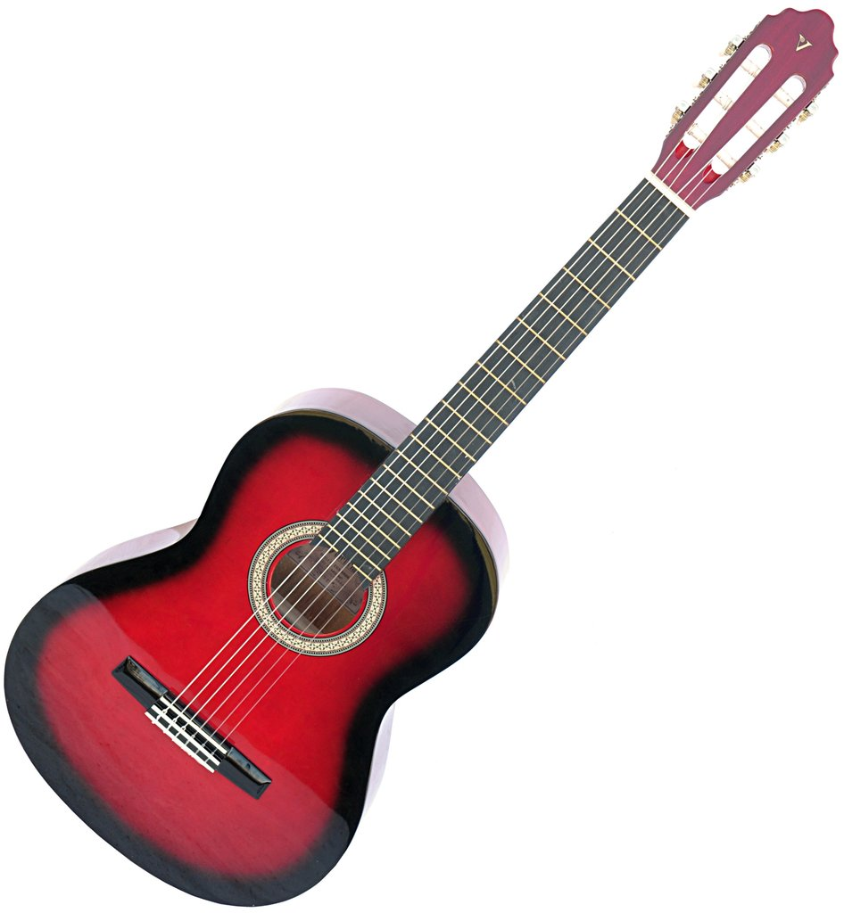
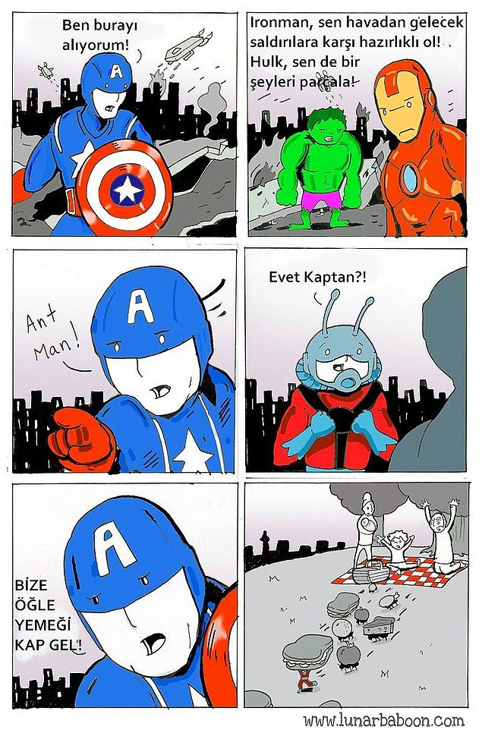
MY hobbies
I love playing handball and volleyball.
I love reading comics.
I love playing guitar

Slide 3
My favourite books
Tuhaf Bilimler Akademisi
Ütopyaya Yolculuk

Slide 4
My favourite movies
The Worst Witch
Radio Rebel

Slide 5
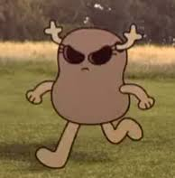
My favourite animation charachter is polly

Slide 6
My favourite lesson is english

Slide 7
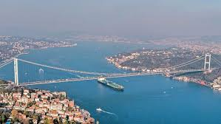
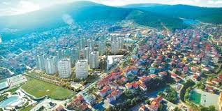
Thank you
Selen İpek 6\C from TÜRKİYE
İstanbul
Sancaktepe

