Slide 1
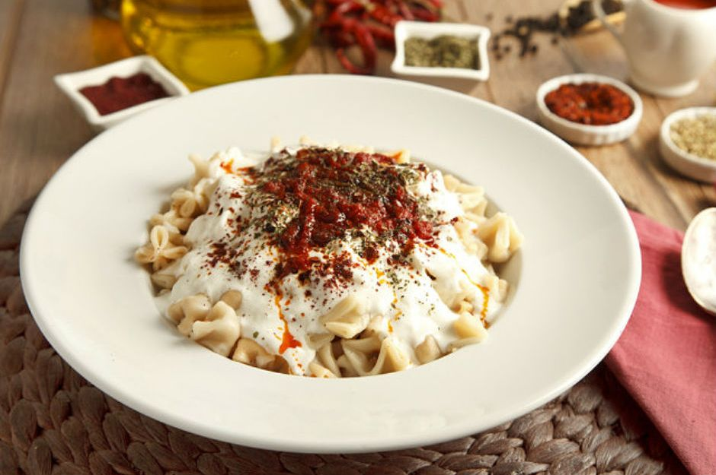
Mantı

Slide 2
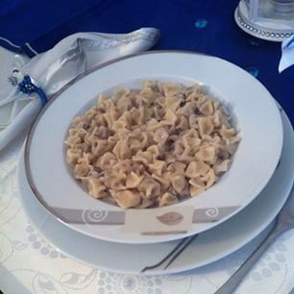
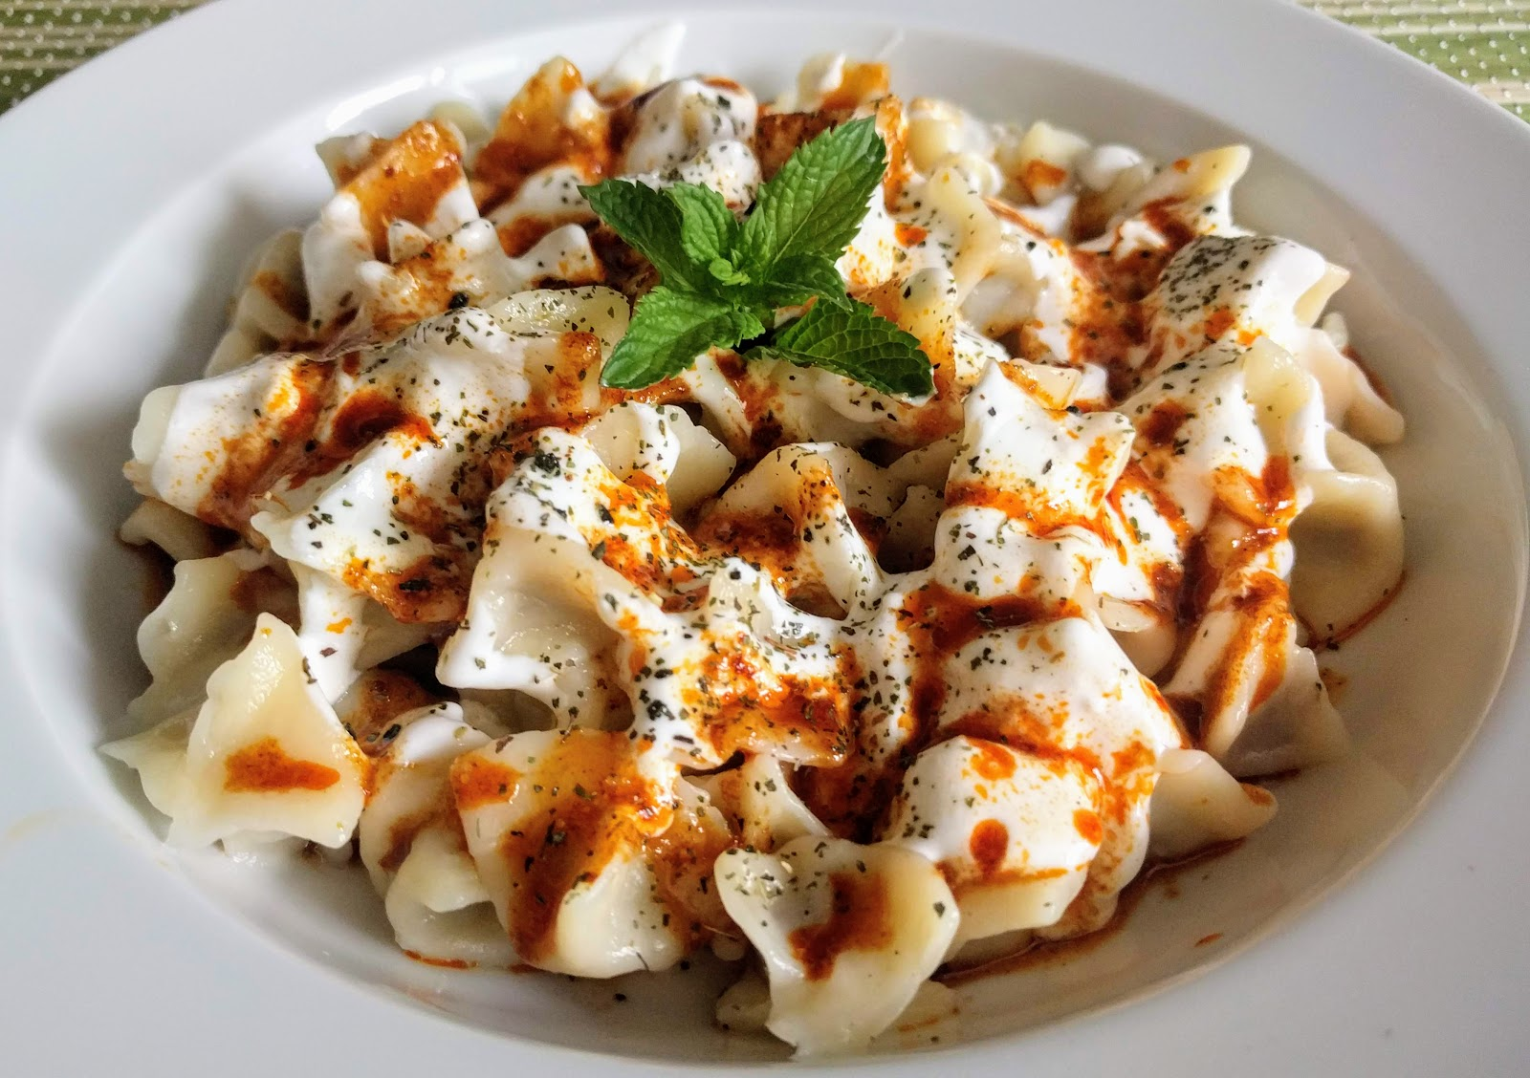
This is the food of Turkish cuisine.
It is delicious.
You should try it.
You can eat “mantı” with or without sauce. Both are delicious. ☺

Slide 3
Ingredients For Manti
50 grams of minced meat
2 onions,
3 cloves of garlic,
Olive oil,
Salt, pepper, cumin,
Mind and pepper flakes,
Butter,
Flaked red pepper ,
Garlic,
Yoghurt.

Slide 4
Recipe for mantI
The first step is to prepare the dough. Then cutting the dough into small square pieces. We will fill these pieces with minced meat which we should prepare before chopping the onions on small pieces, adding black pepper, salt and minced meet and mix them together.
After putting this mixture we should close the dough and the meat must be covered. We should put Manti into hot water and boil it about fifteen minutes.
Put boiled Manti on the plate and add yoghurt, red pepper and melted putter on it. Now you can enjoy your meal.

Slide 5
Greetings to my E –TWINNING
project partners.

