Slide 1
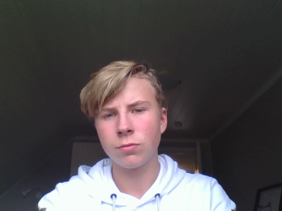
Mads
Løfvenius

Slide 2
Me
I live small housing estate in a village called Landro.
My house is about 250 square meters.
I live together with my mum and sister.
Our house lays close to the sea.
I have a boat and like to be at the sea
I have birthday May 10th
I train Athletics and play drums
I am gaming some to
I have many good friend and enjoy hanging out with them
I want to become a Civil Engineer

Slide 3
I have been to:
Egypt
Greece
Germany
Italy
England
Austria
Switzerland
Tallinn
Estland
Polen
Sweden
Denmark
My favourites
Food: Pizza
Film: Need for speed
Music: Indie- Rock
Subject: History
I love to stand at snowboard

Slide 4
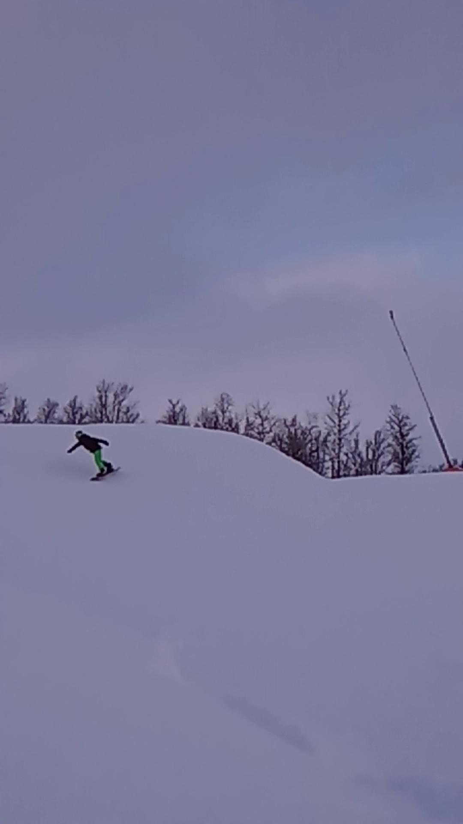

Slide 5
What I like about Norway
I like to live close to the sea
Good life qualities
Good water from the tap
Safe environment
Good schools
What i don’t like about Norway
Things are expensive
Bad weather
Cold

