Slide 1
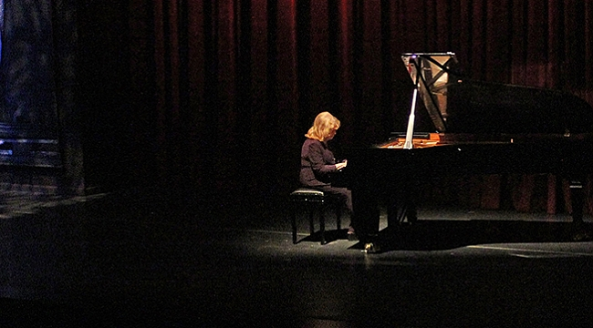
İDİL BİRET

Slide 2
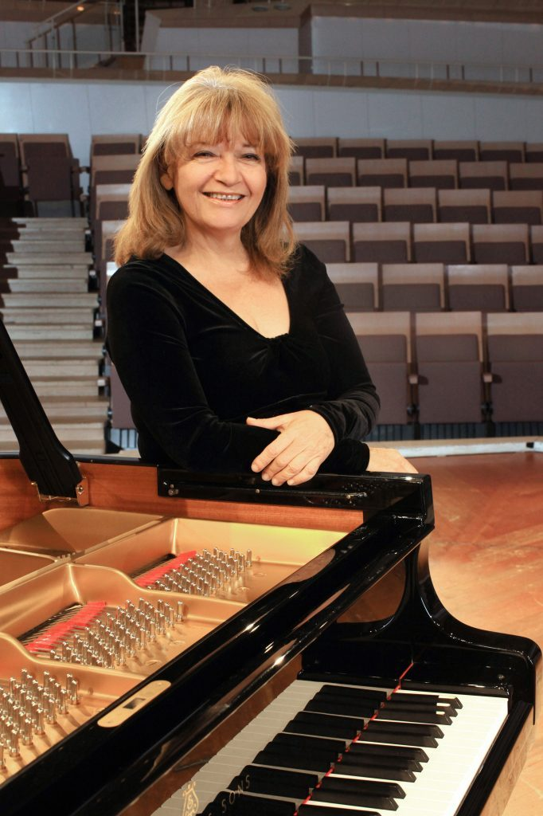
Idil Biret is a Turkish concert pianist, renowned for her interpretations of the Romantic repertoire.

Slide 3
She was born on 21 November 1941 in Ankara.

Slide 4
She studied at the Paris Conservatory.

Slide 5
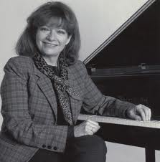
İdil Biret manifested an outstanding gift for music at the age of three and was trained at the Paris Conservatoire under the tutelage of Nadia Boulanger. She graduated at the age of fifteen with three first prizes. She studied piano with Alfred Cortot and was a lifelong disciple of Wilhelm Kempff who considered her as her best student. Since the age of sixteen İdil Biret has given concerts throughout the world with major orchestras including the London Symphony, the Philharmonia, BBC Orchestra, Leningrad Philharmonic, Boston Symphony, Leipzig Gewandhaus, Dresden Staatskapelle, Berlin Radio Symphony, French National Orchestra, Polish National Radio Symphony, Orchestre Suisse Romande, Tokyo Philharmonic and Sydney Symphony Orchestra.

Slide 6
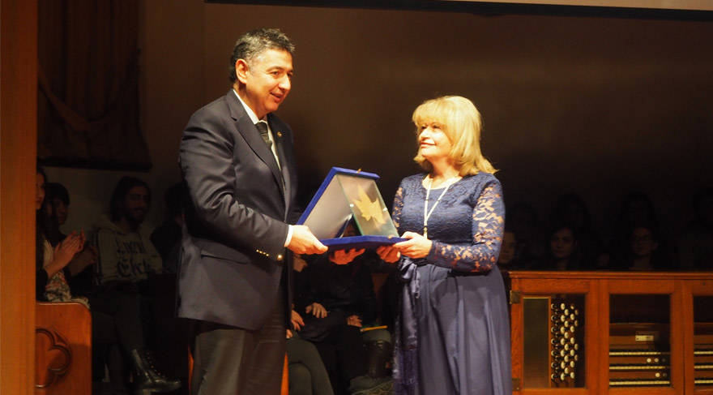
She is awarded as Turkey State Artist.

Slide 7
In 1995 her recording of the complete works of Chopin was awarded a "Grand Prix du Disque Chopin" special prize in Poland.
The same year, her recording of the Boulez sonatas won the annual Golden Diapason award and was selected among the best recordings of the year by Le Monde newspaper in France.
İdil Biret has also recorded for Naxos the Etudes of Ligeti and the Firebird ballet music's piano transcription by Stravinsky which were released in 2003. In 2004 the sale of her complete Chopin and other CDs passed two million copies worldwide. Naxos commemorated this milestone event by presenting Biret a platinum disc at her concert in Münster, Germany.

Slide 8
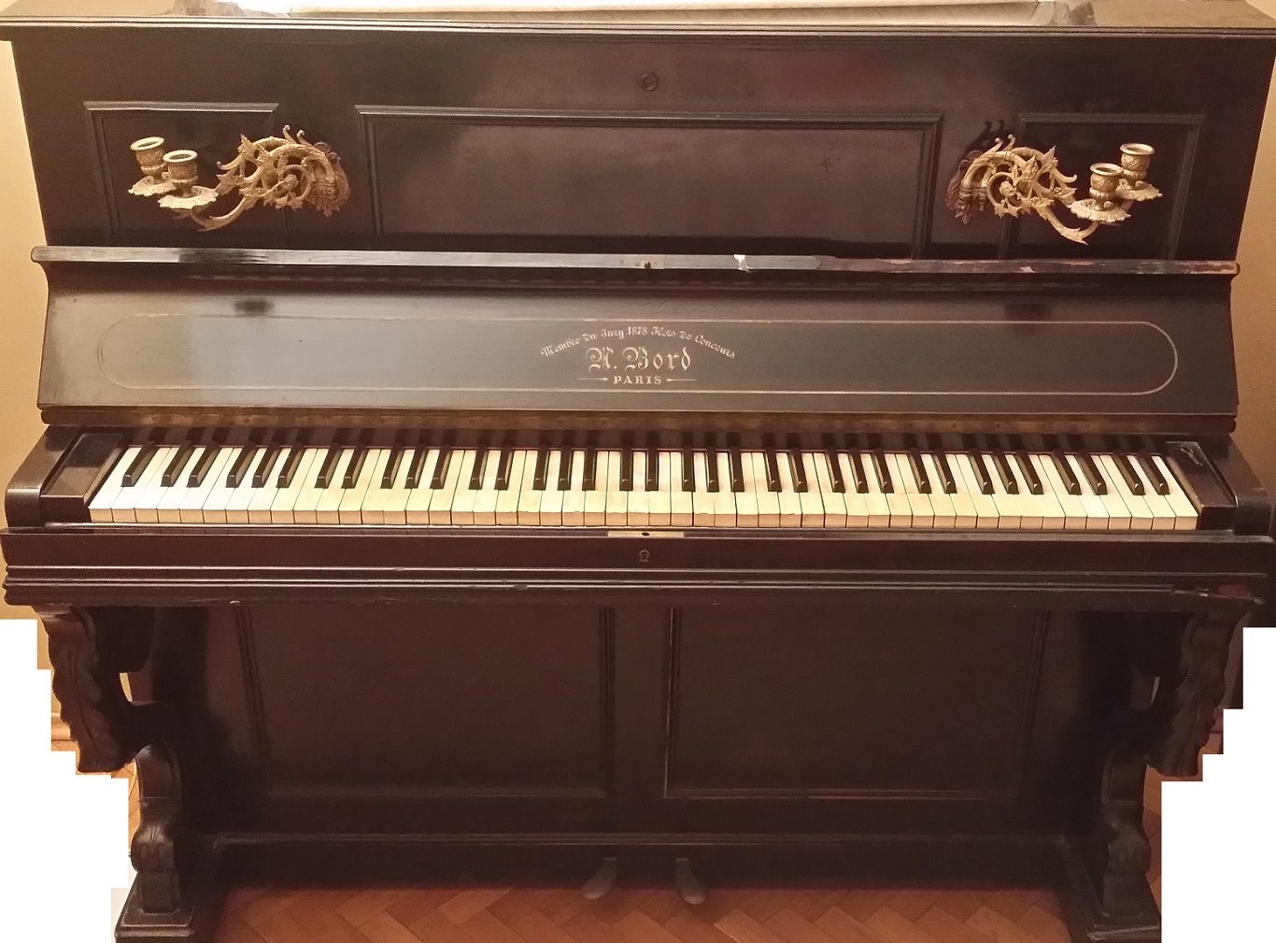
THANK YOU!!!

