Slide 1
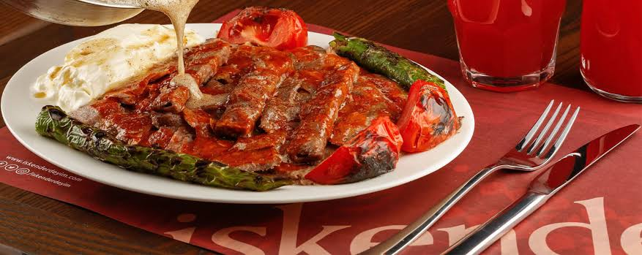
Iskender

Slide 2
Iskender
İskender is very famous in Turkey.
The story of İskender -one of the most famous dishes of Bursa region-began in 1867 in the shop of İSKENDER EFENDİ in Bursa Kayhan.

Slide 3
INGREDIENTS
We must to have;
2 tbs ofButter
1 Green Pepper
1\2 Cup Tomato Juice
300 Grams Beef or Lamb Meat (Waited In The Freezer For 2 Hours)
Salt, Black Pepper
Oil

Slide 4
How TO MAKE Iskender??
Slice the beef and lamb meat lenghtwise and mix well with the grated onion, salt and pepper. Place two slices of veal side by side on a flat floor and place two slices of lamb meat on the top. Wrap them in a roll, pressing well. Wrap with stretch film and rest overnight in the freezer. When you cook, take it out and slice it. Cook over a high heat in a pan with butter and fry them in a cooker. Then cut into pieces. Place the pita on a serving plate and place the meat on top. For the sauce, peel the tomato and dice into the pan. And salt and black pepper.

Slide 5
CountiUning...
Cook over a low heat for 5 minutes and spread over the meat. Drizzle the teased butter over the top and serve it with the yoghurt.
YUMMY!
ENJOY YOUR MEAL

Slide 6
GOoDBYE😃

