Slide 1
HELLO!
My name is Kevser. My surname is Ersoy.
I am from Türkiye. I live in Istanbul.
I study at Abdurrahmangazi Imam Hatip Secondry School.
I am eleven years old.

Slide 2
My favourite lessons are Maths, Science and English

Slide 3
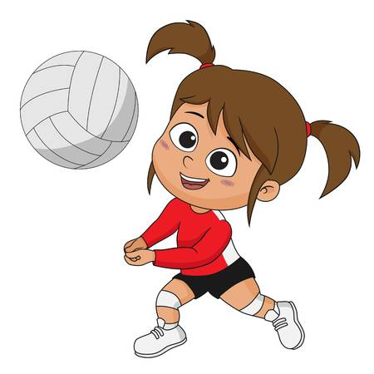
My hobbies are swimming, playing volleyball and listening to music.

Slide 4
Thank you ☺

