Slide 1
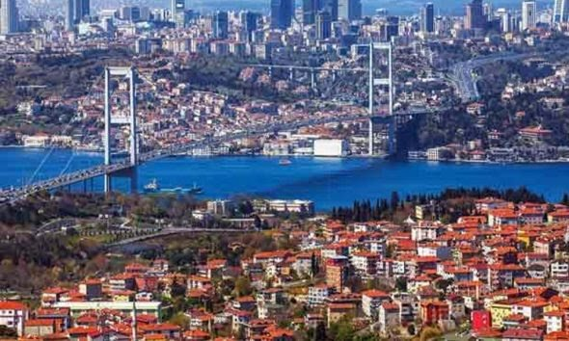
Hi
Hi!
My name is Zeynep Sude.
I'm eleven years old.
I'm from Türkiye. And I live in İstanbul.
I study at Abdurrahmangazi Imam Hatip Secondary School.

Slide 2
My favourite books are Harry Potter and Miss Peregrine’s Peculiar Children

Slide 3
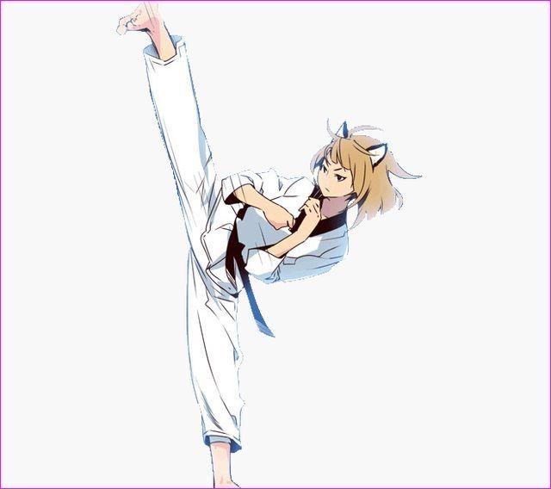
My hobbies are reading books and doing taekwando.

Slide 4
My favourites lessons are Maths and Science

Slide 5
Thank You

