Slide 1
My FavourIte song for e-twinning project “world investigation”
Team 6C_Sagiho_Turkiye

Slide 2
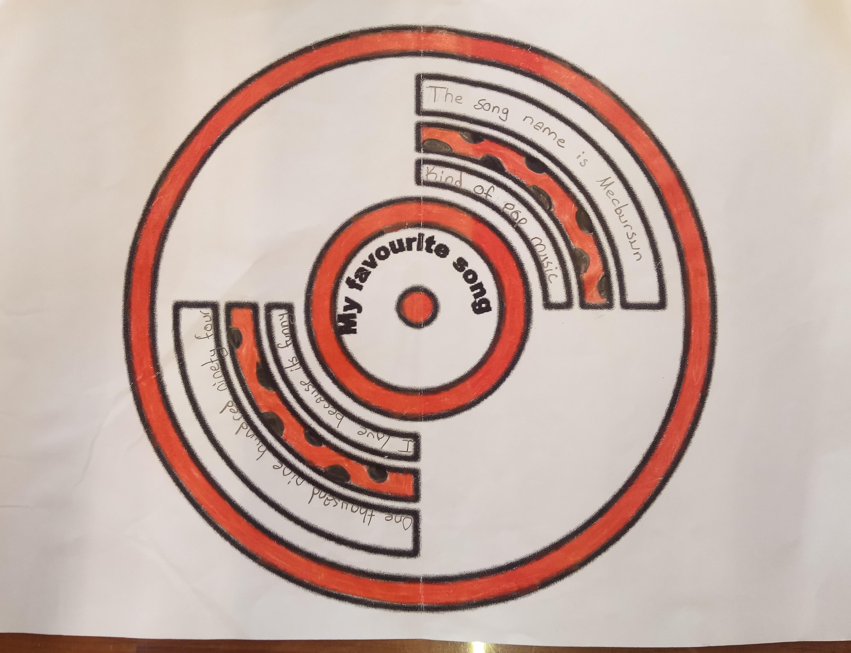

Slide 3
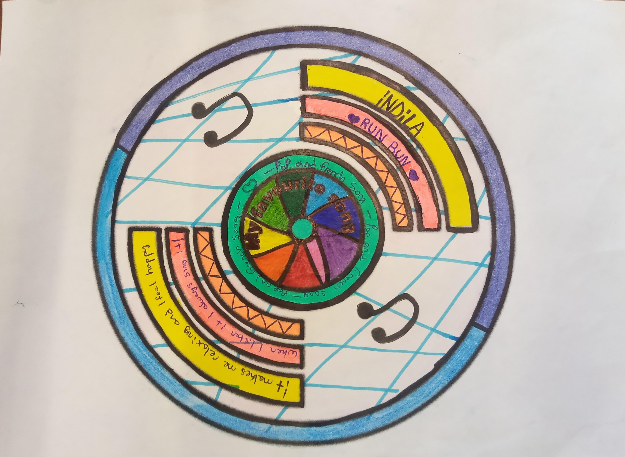

Slide 4
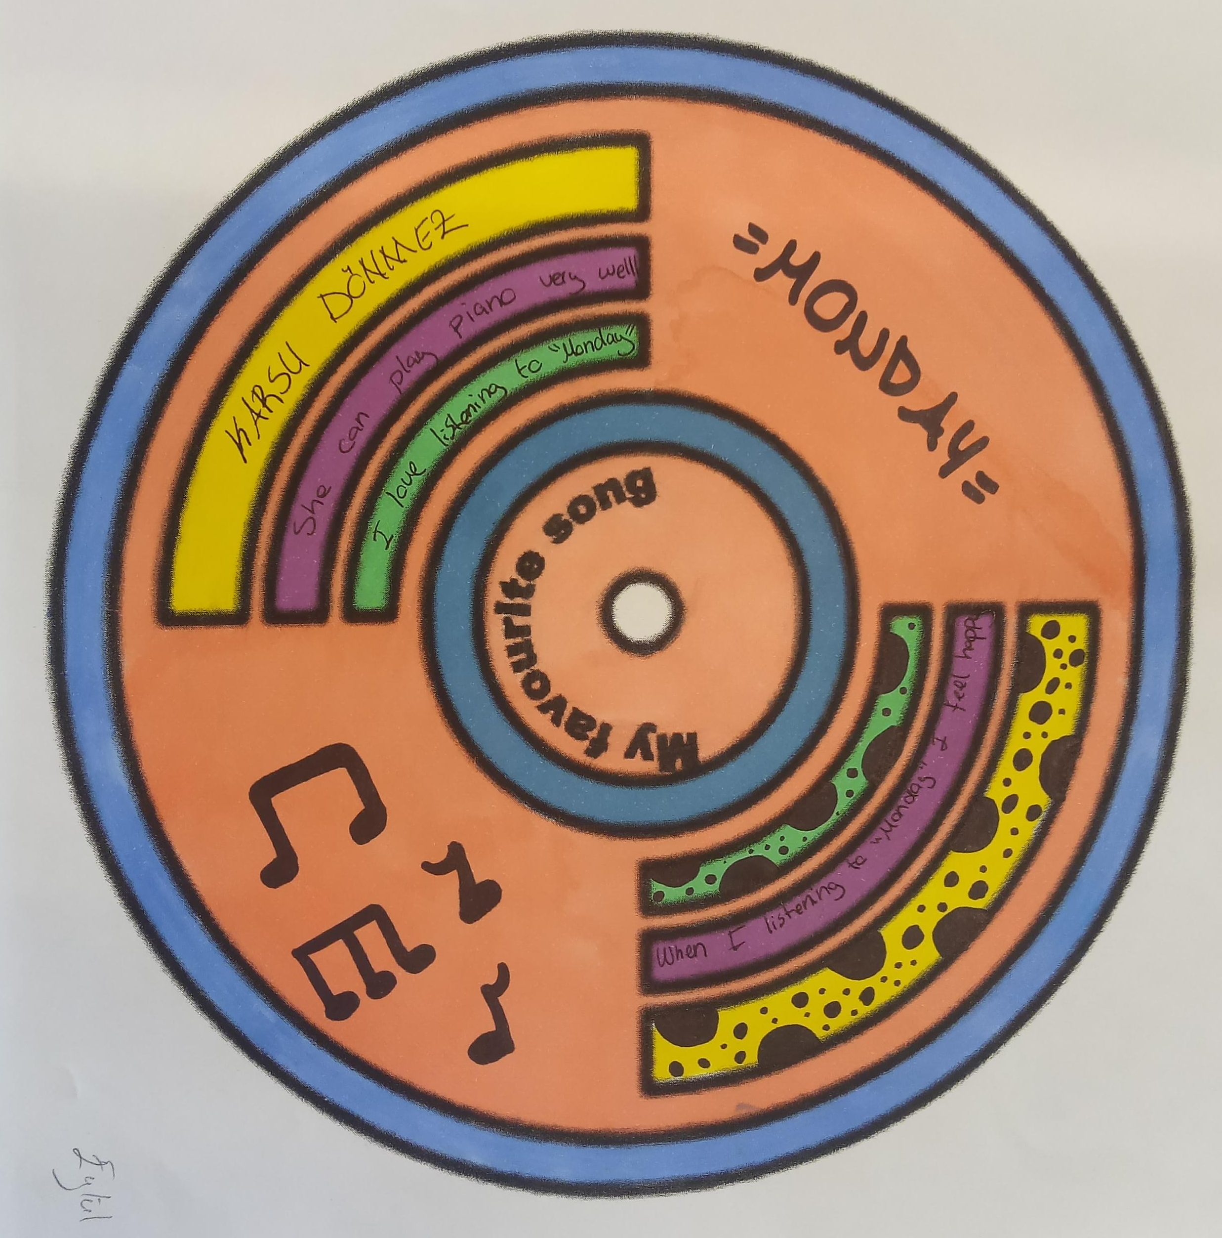
https://www.youtube.com/watch?v=fnhFlAdFyks

Slide 5
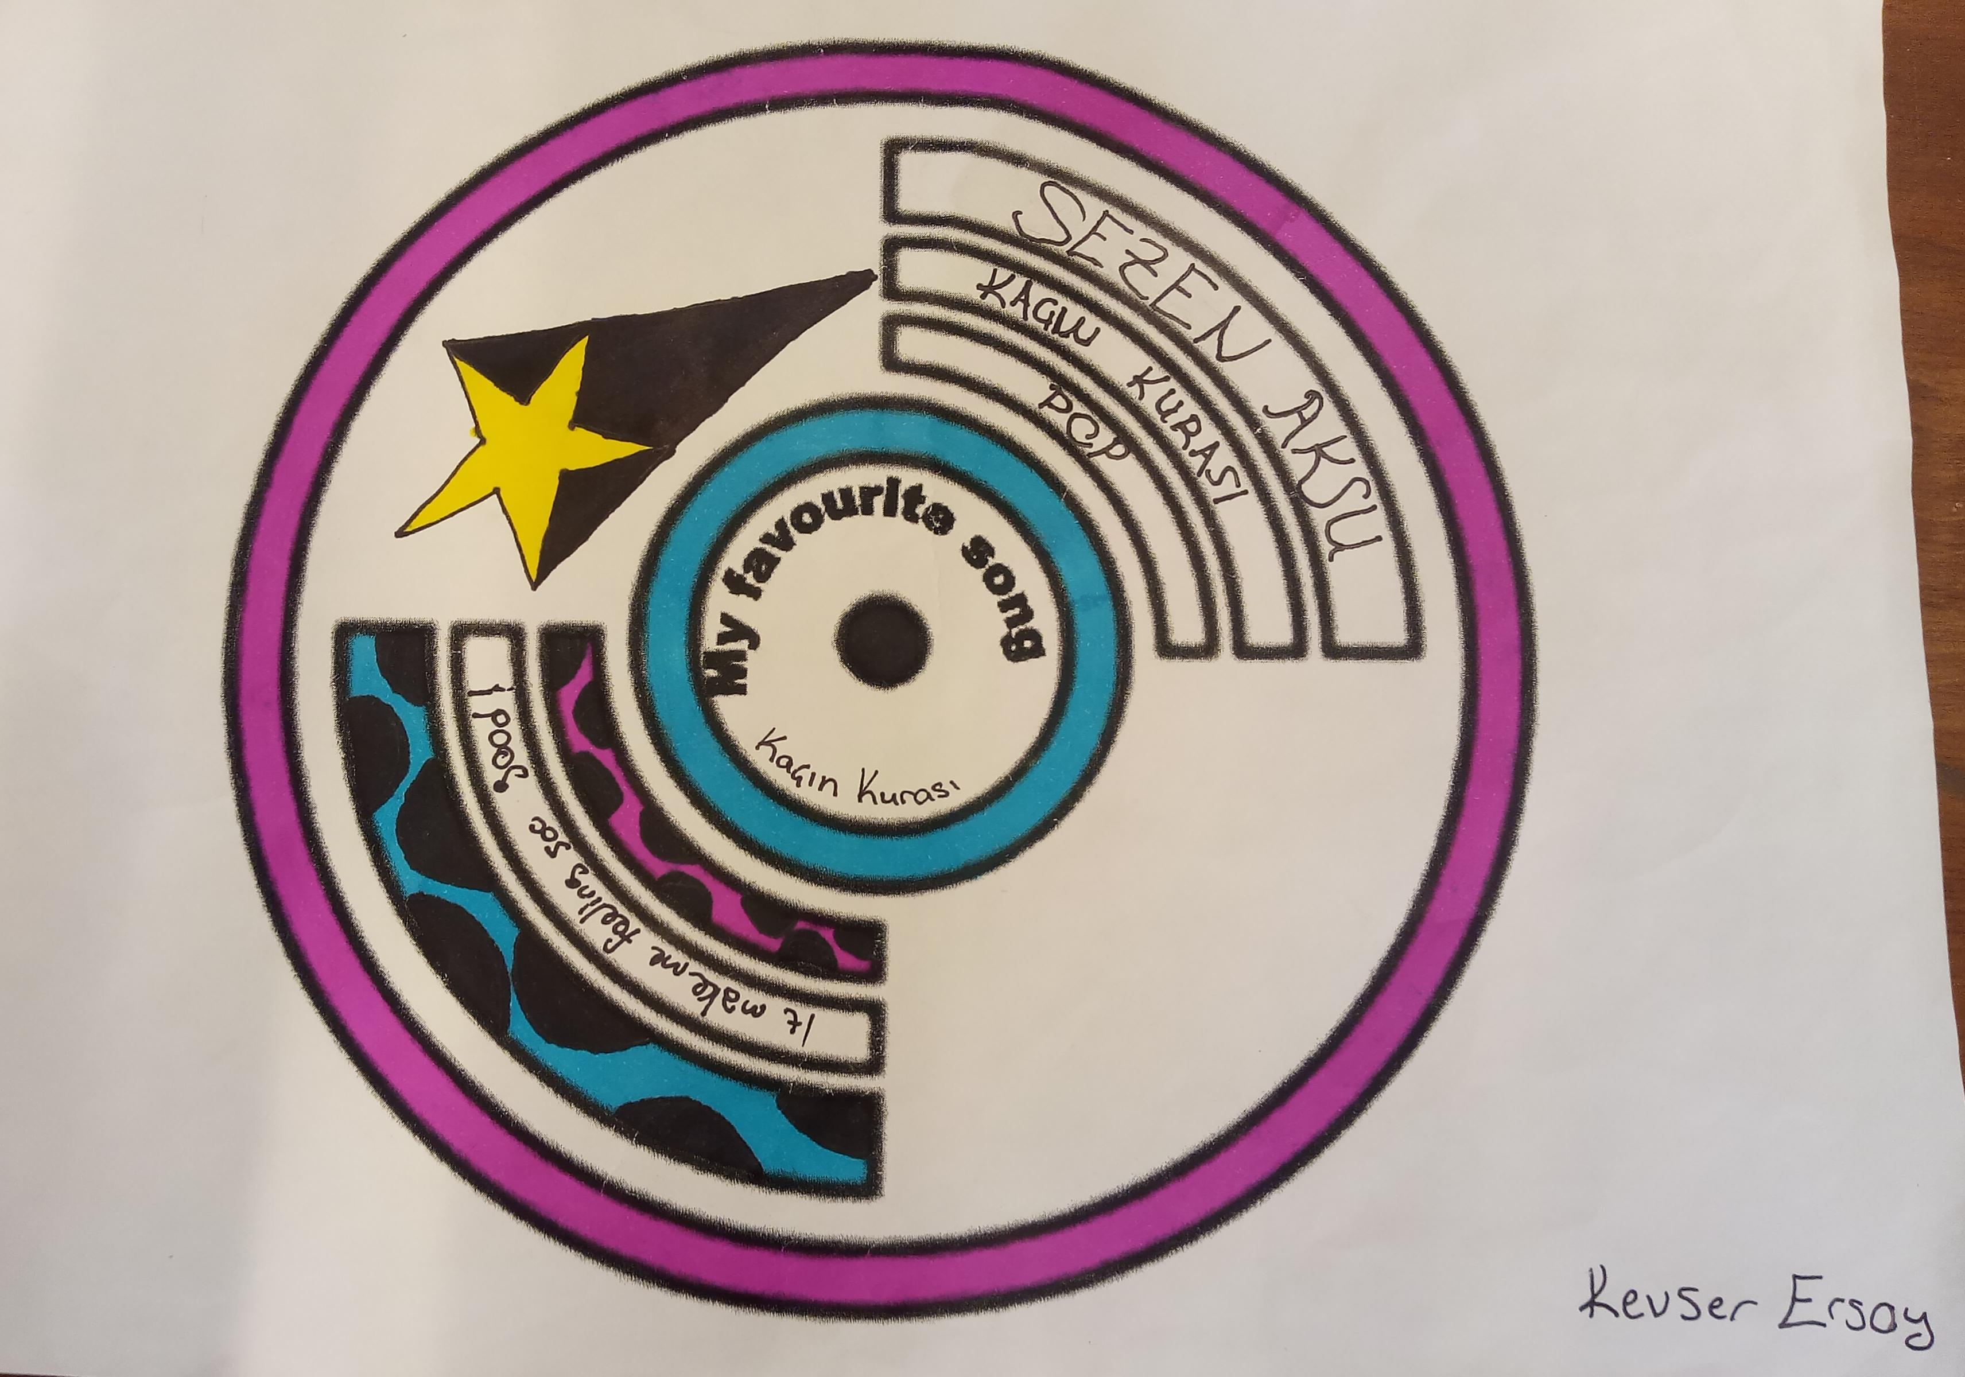

Slide 6
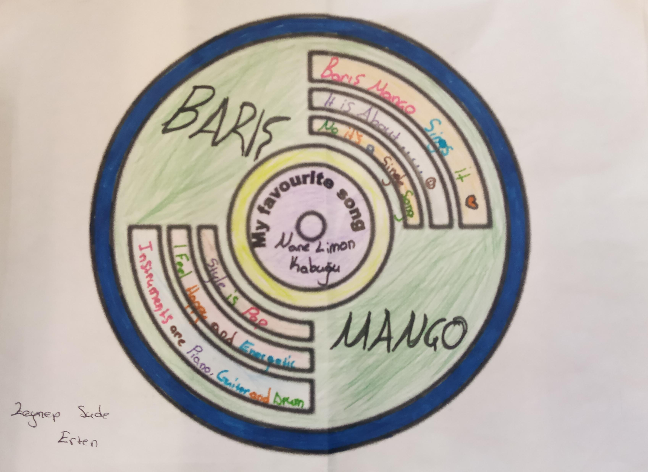
https://www.youtube.com/watch?v=f8TZJHuNImc

Slide 7
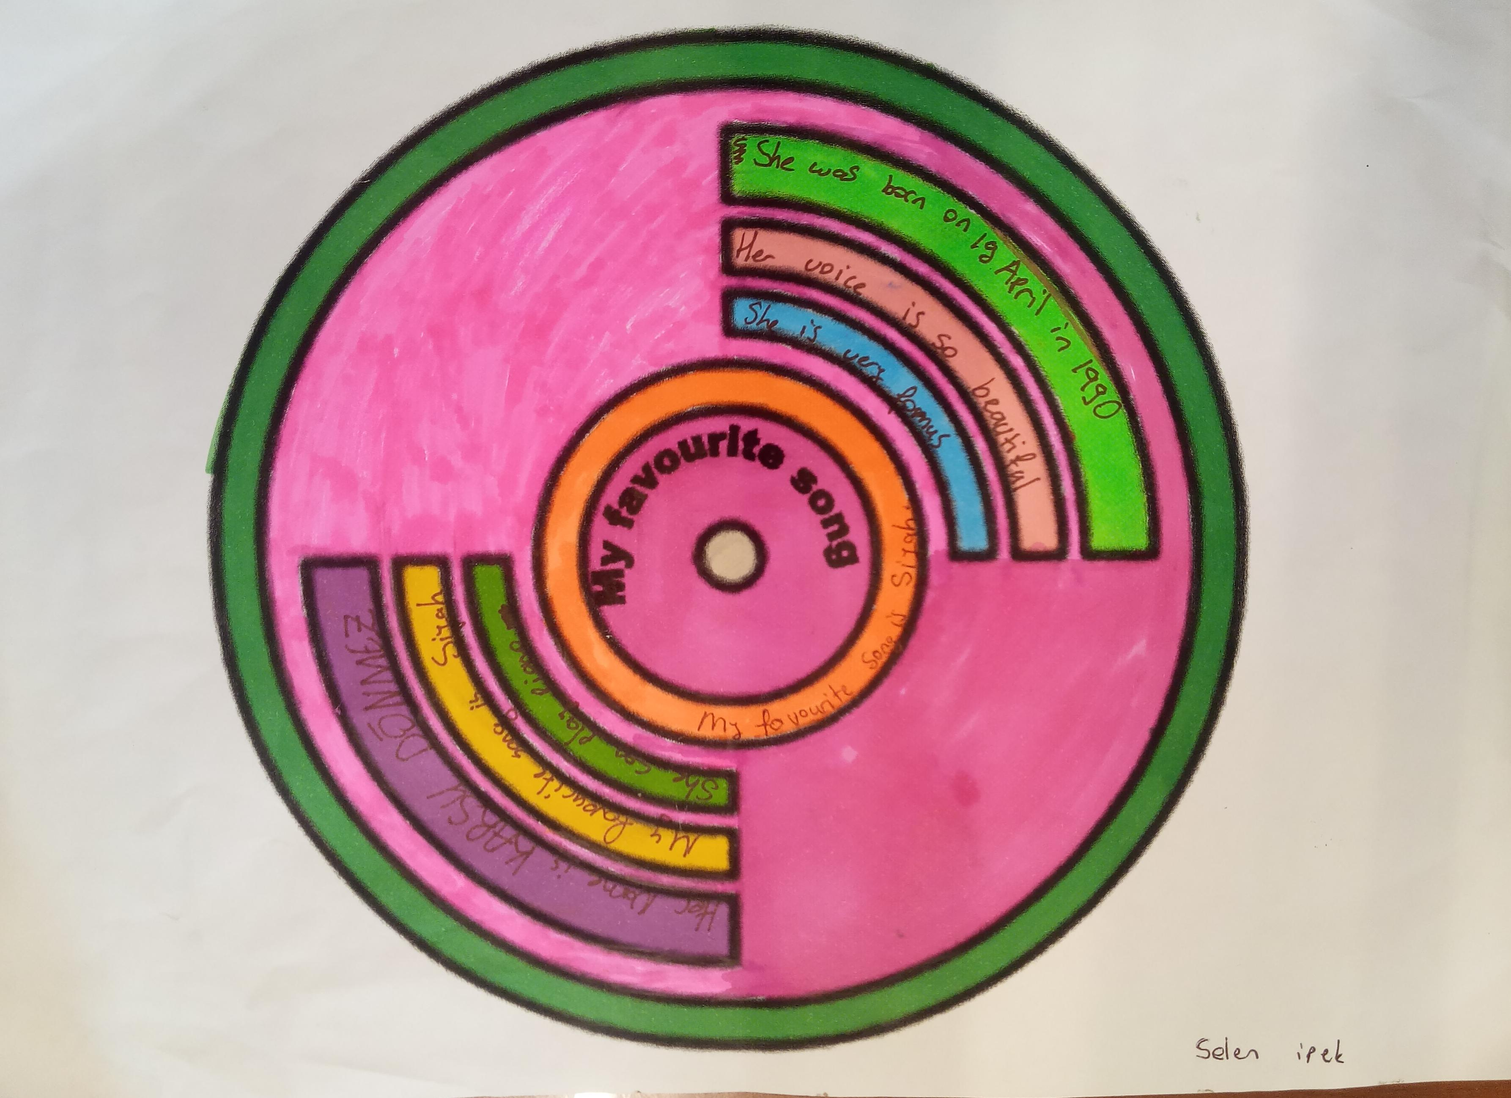
https://www.youtube.com/watch?v=tUxkqoWO2XE

Slide 8
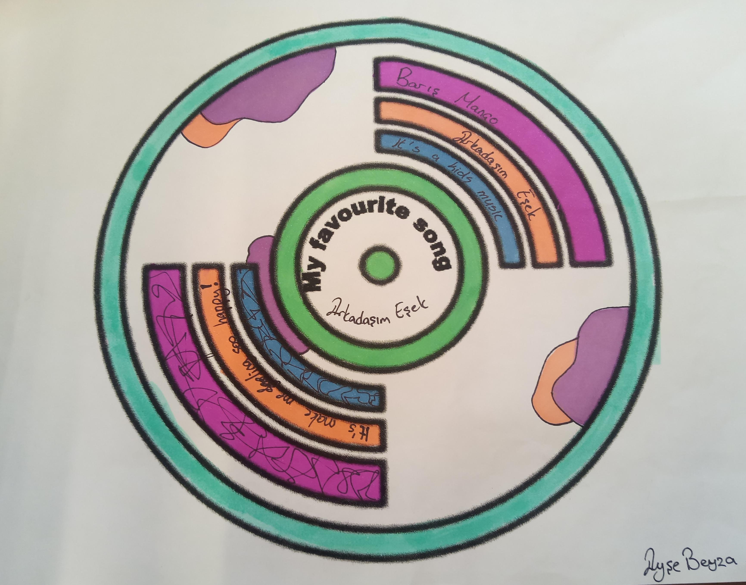
https://www.youtube.com/watch?v=p1lGR0LC_2s

Slide 9
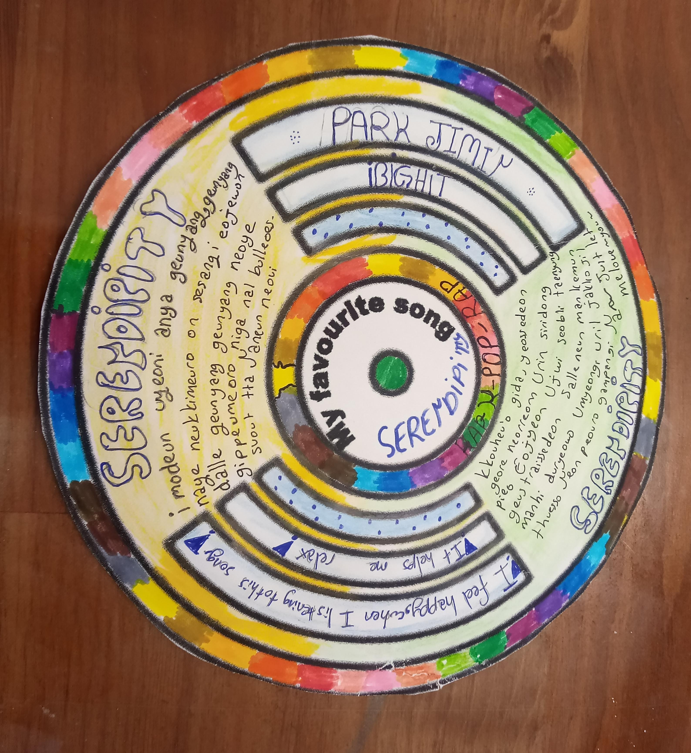

Slide 10
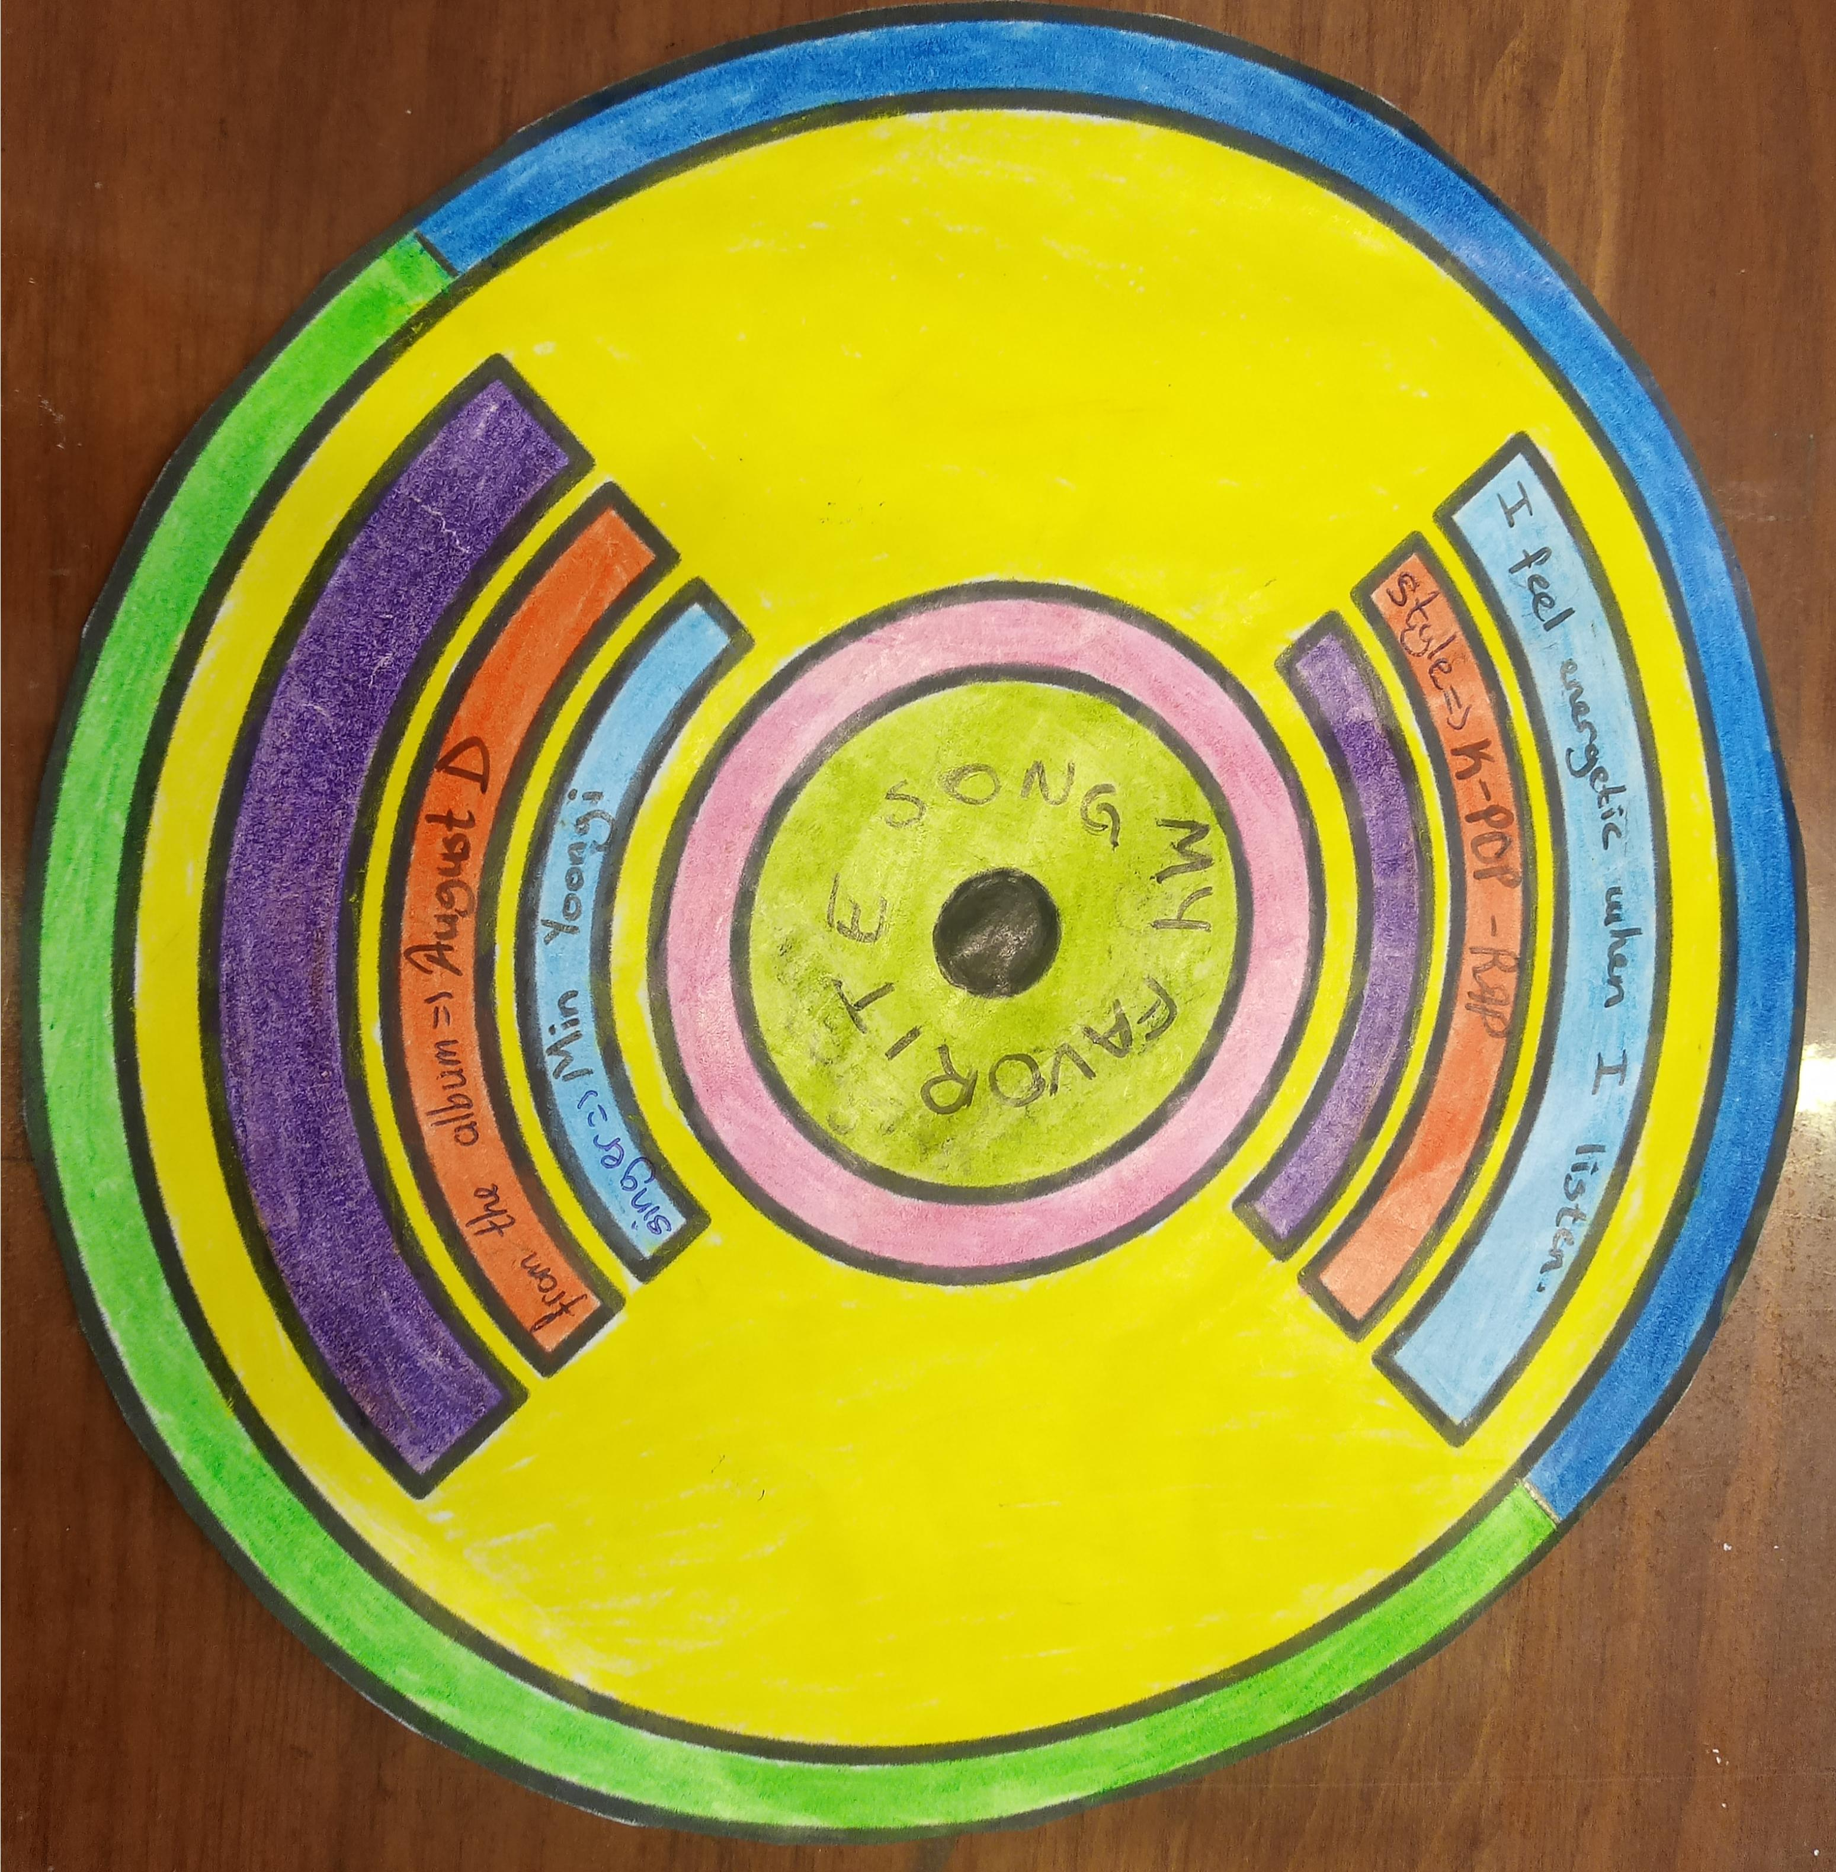

Slide 11
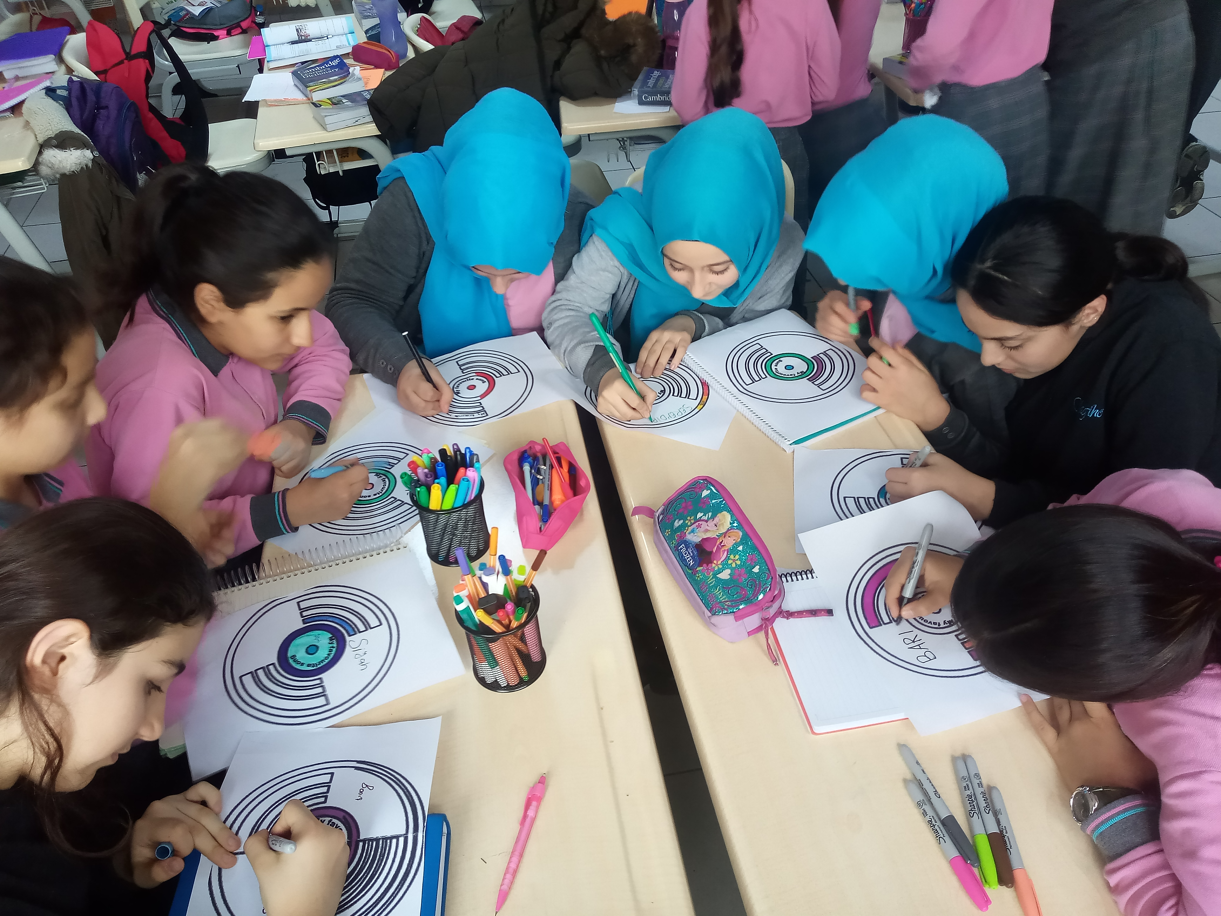
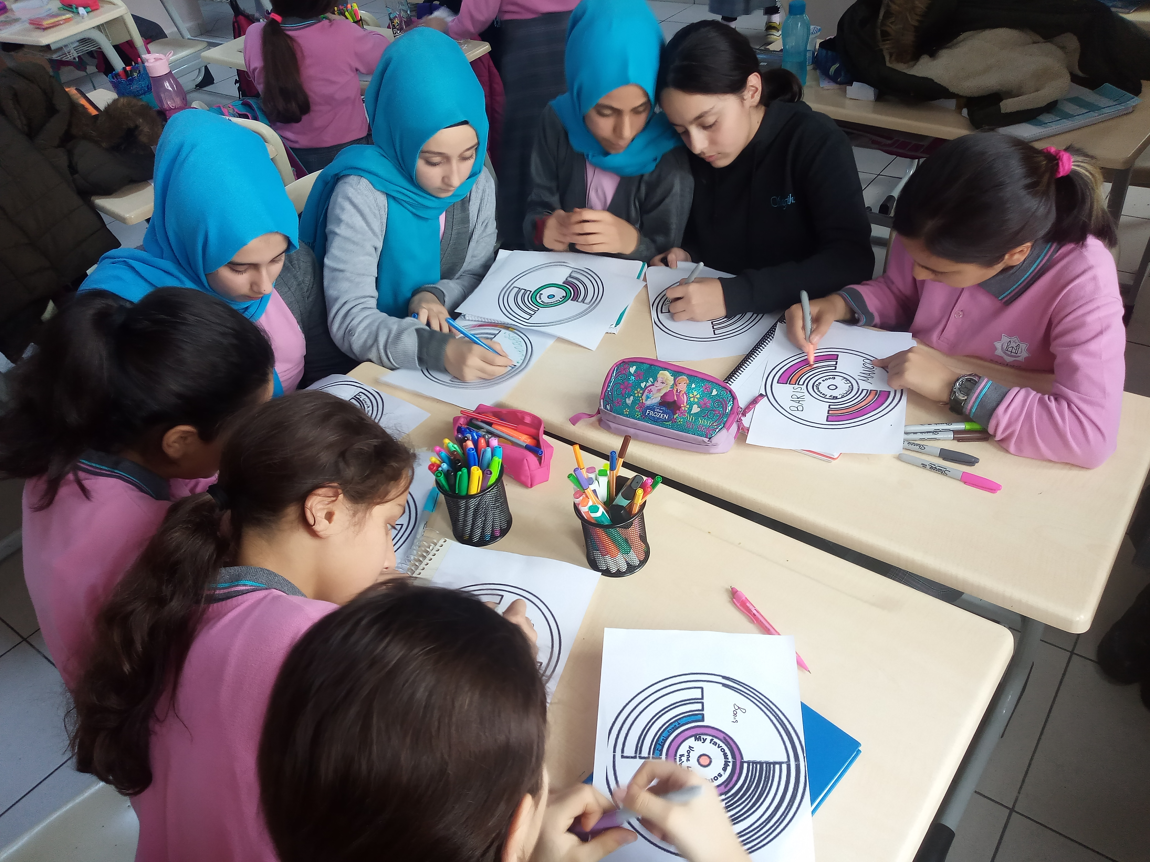

Slide 12
Thank you 🙂

