Slide 1
THE CITY ANKARA

Slide 2
The capital of turkey - ankara
Ankara, Turkey’s capital is located in the country’s central Anatolian region. It’s a center for the performing arts, home to the State Opera and Ballet, the Presidential Symphony Orchestra and several national theater companies.

Slide 3
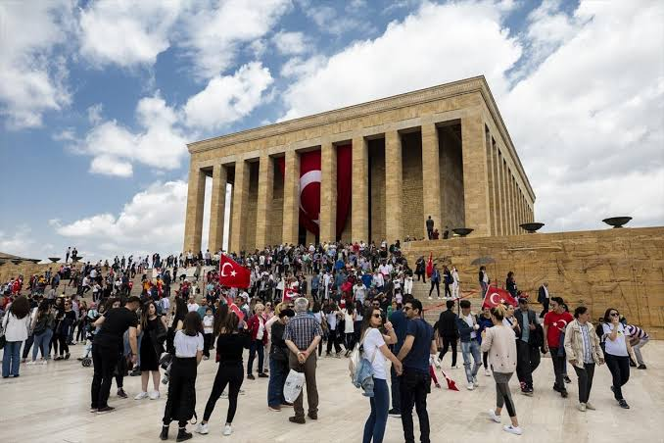
ATATURK MAUSOLEUM ANITKABİR

Slide 4
ABOUT ANITKABIR
This fine memorial complex was built in 1944, commemorates the Turkish founder, Ataturk. Known locally as the Anitkabir, the Ataturk Mausoleum is a grand and imposing attraction, located atop a series of steps and featuring a huge mosaic courtyard, together with an exceptionally beautiful gold leaf clad interior. The Changing of the Guard ceremony is well worth a look, as is the recent War of Independence Museum, which encircles the courtyard at its lower level.

Slide 5
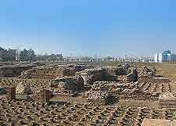
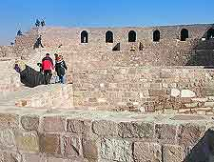
TourISt attractIons In ankara
The Roman Baths date back to the 3rd century AD and are well maintained. You can clearly see the heating system for the baths, as well as the dressing room (apoditerium), the hot room (caldarium), the warm room (tepidarium), and the cold room (frigidarium). Beneath the baths are 7th century BC remains from the Phrygian period.
ANKARA CITADEL (HISAR)
The Romans finished what the Galatians started in what is one of the oldest areas in Ankara today. The Byzantines and Seljuks also laid their mark on Hisar, and the whole area is perfect for wandering with its winding allies and old buildings that have been restored and converted into restaurants and cafés. The And Café is one of the most popular near the entrance and Angora House.

Slide 6
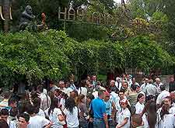
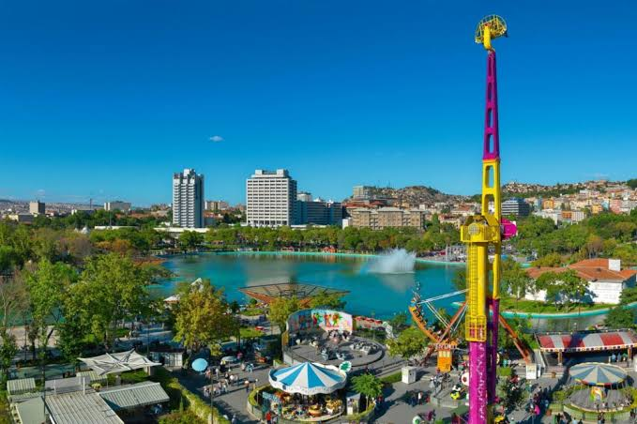
ATATURK FOREST FARM AND ZOO
This large recreational area features a zoo, farms, a brewery and good restaurants. The picnicking at the Ataturk Forest Farm and Zoo is particularly pleasant, as is the hiking and cycling along miles of established paths. Culture-vultures will want to take a look at the mock-up of Ataturk's house, where he was born in 1881. Be sure to try ice cream, while other attractions here include char-grilled kebabs at the traditional Turkish restaurant onsite.
GENCLIK PARKI (YOUTH PARK)
Genclik Parki is another great place to take kids in Ankara, as it has a pleasant lake and a funfair park. It is just south of the Old Town (Ulus), along the Ataturk Bulvari, The Luna Park funfair has many fun attractions and rides for kids, while tea gardens (çay bahçesi) are also here on the lake.

Slide 7
THANK YOU ☺

