Slide 1
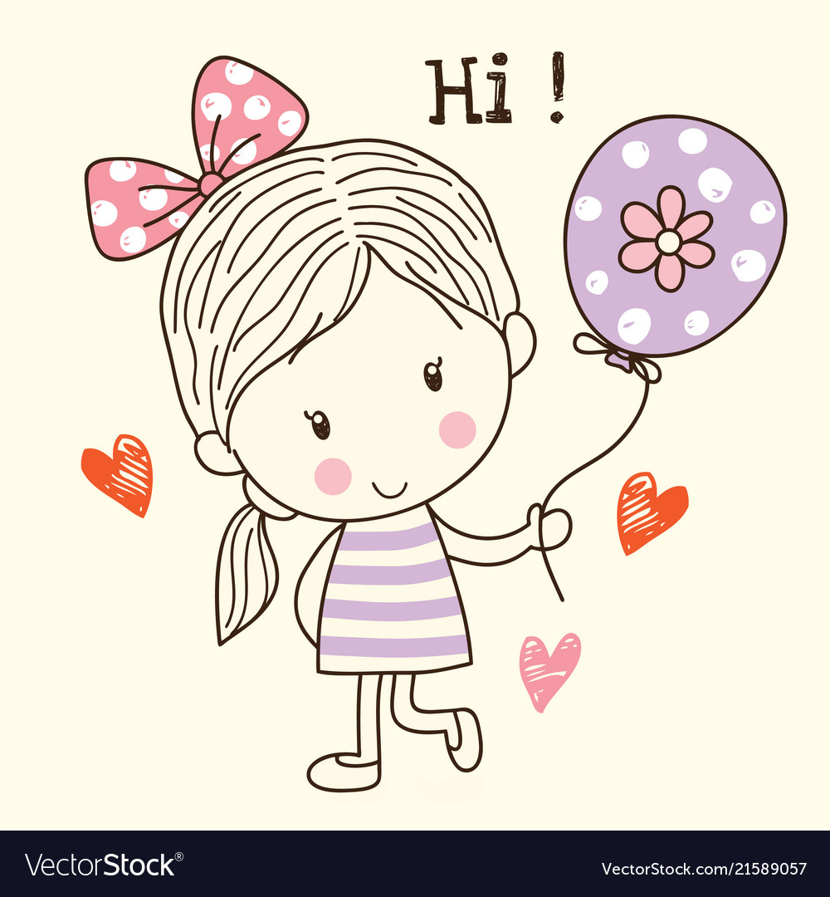
Hi

Slide 2
My name is Zeynep. My last name is Bilginkaya.
I’m eleven years old.
I am from Turkey and I live in İstanbul.
I study at Abdurrahmangazi Imam Hatip Secondary School.

Slide 3
My Hobbies Are...
Playing handball.
Drawing
Playing badminton.

Slide 4
My Favourite Lessons Are...
Science
English
Maths

Slide 5
Thank you

