Slide 1
Hello, I'm Liam...

Slide 2
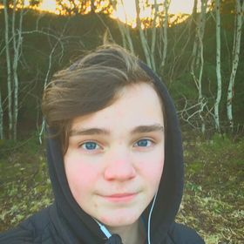
About me...
My name is Liam Johannes Oddekalv
My mom is Swedish, my dad is Norwegian. He comes from Askvoll in Norway, and my mom from Borås in Sweden.
I'm an part of an organisation called “Mental Helse Ungdom” (Norwegian Association Of Youth Mental Health) where I am a trustee of the local branch at Sotra.

Slide 3
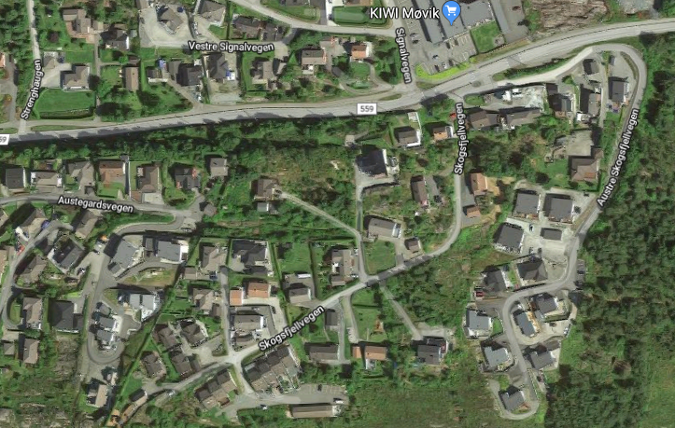
Where do i live, and my friends.
I live in an small village called Møvik on the island Sotra, it is half an hour drive from Bergen.
I live in an medium sized row house on top of an hill. And my room is on the second floor, and not giant but not small either.
My circle of friends is in some ways divided into two groups, we have we who talk a little about everything, and those who are crazy after K-pop.
My house

Slide 4
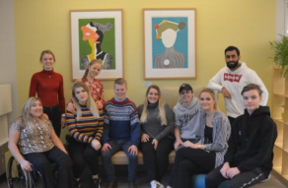
What i do in my spare time
The youth council: (me in the black hoodie)
6 saturdays a year, i'm in an youth council at my local child and youth hospital, there we get to know what is happening at the hospital, any changes, new treatment methods, everything like that, we get to know.
I'm also working as an match report responsible for my local soccer team Nest Sotra, for the top football matches. It is one of the most important jobs because of the media often use what i report.
But when i doesn’t work, i'm just at home watching some youtube

Slide 5
My favourite...
… artist: Joakim Lundell, Swedish artist and youtuber
… serie: Familjen Lundell, about Joakim’s weird family projects
… School subjects: This one is hard, but it must be social studies (samfunnsfag)

Slide 6
Norway and other countries
I have been to Sweden, Denmark, England, soon Poland and of course Norway.
What do i think of living on Sotra? I think it’s good, i don’t want to live in an city. I think it’s great here.
What do i think about living in Norway? Good, i really like me here. I like that most of the country is nature, and not built on. It just shows the natural beauty of my country.
What are you curious to know about students in other countries? How different our culture is, and how we can help each other understand the differences.

