Slide 1
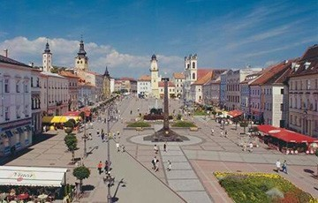
Banská Bystrica
Slovakia
Famous places

Slide 2
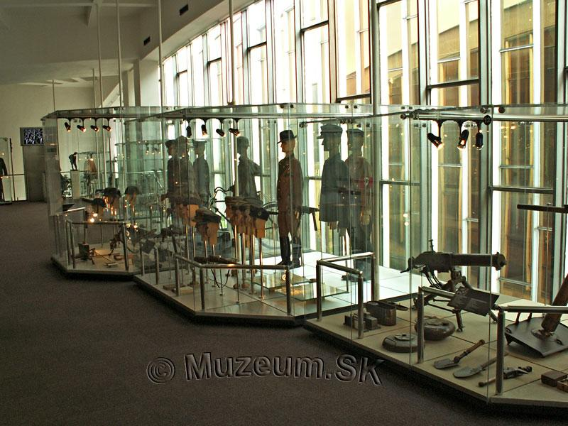
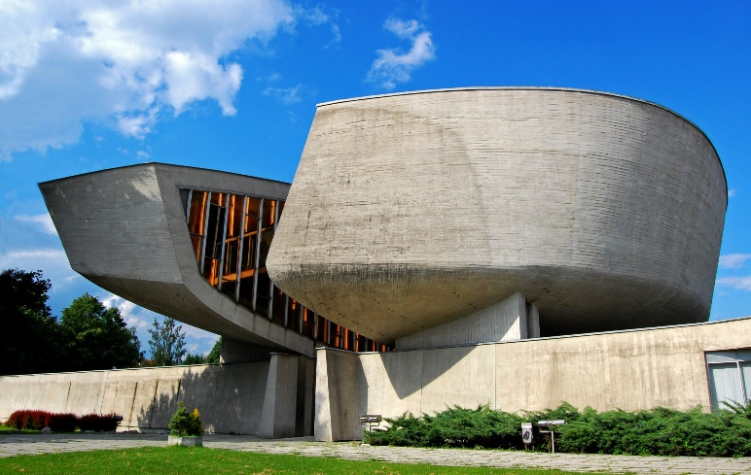
SNP Memorial
The SNP memorial in Banská Bystrica is one of the most important memorials in Slovakia, whose task is to commemorate the World War II and the Slovak National Uprising, the center of which was Banská Bystrica. It is the work of architect Dušan Kuzma. The memorial was completed in 1969.

Slide 3
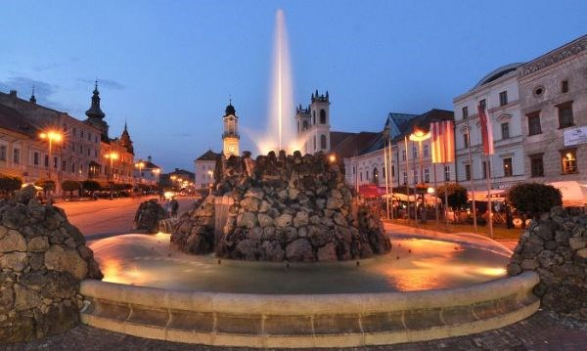
Stone fountain
One of the landmarks of the historic SNP Square in Banská Bystrica is a charming stone fountain, which dates back to the 16th century. During the season it attracts the attention of passers-by with both sound and color effects.

Slide 4
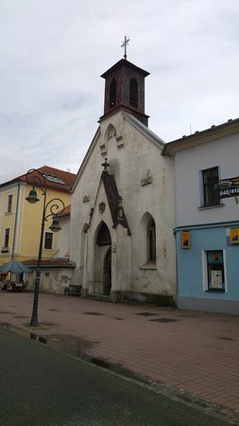
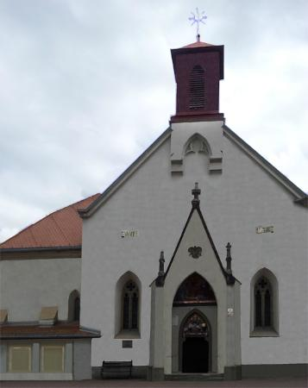
St. Elizabeth´s Church
St. Elizabeth's Church is a Roman Catholic church in Dolná Street in the historical part of Banská Bystrica.
The church is together with the former hospital. The church is one of the oldest buildings, their history dates back to 1303. The hospital belonged to the church

Slide 5
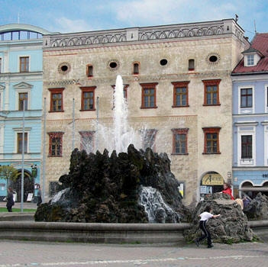
Central Slovak museum
Central Slovak Museum is a museum in Banská Bystrica.
It was founded at the instigation of the townspeople in Banská Bystrica in 1889.
The history of the museum began on 12 July 1889, when the town council of
Banská Bystrica
approved the establishment of the Town Museum. It is continually the oldest cultural
institution in the city and the second oldest in the region.
On 17 October 1909, the first municipal museum exibition was opened in
Matej's house.
At present, the Central Slovak Museum is a regional institution offering rich
documentation of the
development of society and nature of Central Slovakia. It consists of three expositions:
Matej's House, Thurzo's House and Tihányi Mansion.

