Slide 1
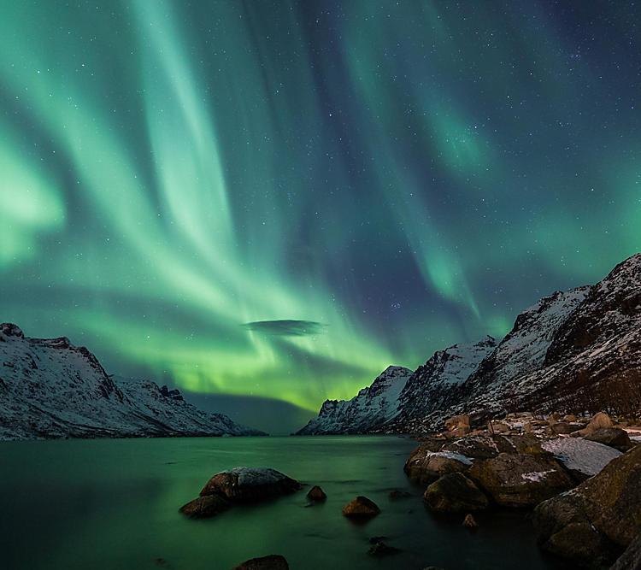
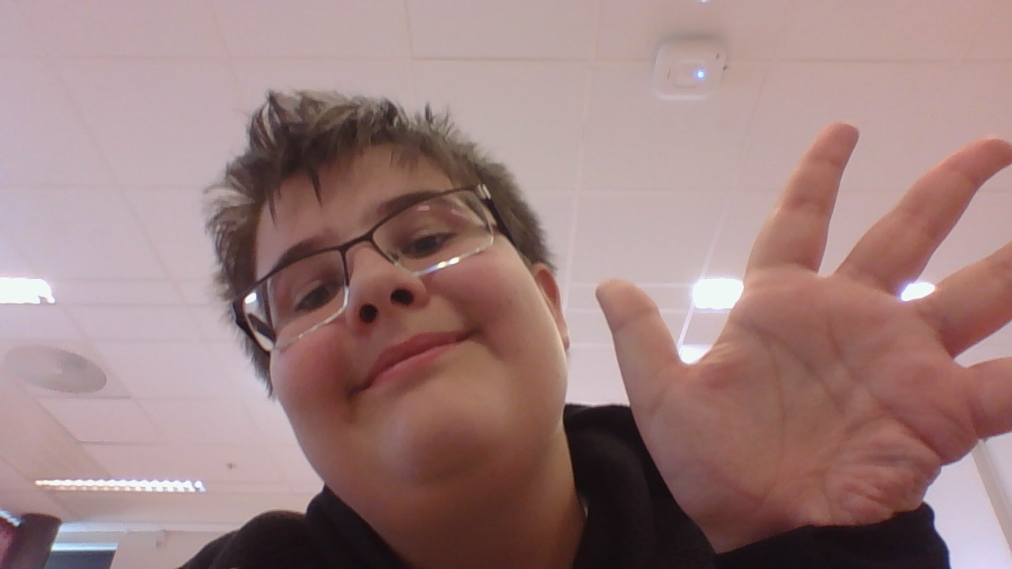
Hi my name is John-Olav pedersen skålevik
and i'm from beautiful Norway

Slide 2
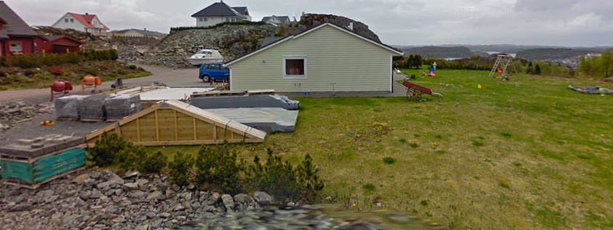
My place
I live in a place called Fagrehaugen 25 (the picture I got is from 2009 so it’s pretty outdated)
My house is quite big it has room for 5-6-7 people and my room is not that big it’s actually pretty small and a mess… but hey it is good enuf for my.

Slide 3
things about my and my family
Let’s start with my family. I have 2 sisters one whose older and one whose younger, 0 brothers a mom and a dad (could have had a brother but he is dead because crib death) my family is big and it is so big there are many family members i don’t know yet.

Slide 4
What i like to do and just like
There are many things I like to do in my spare time such as relaxing while watching youtube or watching movies with my family and that's it aint I interesting.
I like music as much as the other person, but as everyone says people have different taste and I have my own, what i like is techno music and meny good artist and youtube channels use techno music such as (youtube channels) the living tombstone and nerd out (artists) Marshmallow and Skrillex.

Slide 5
Favourite
Movies/series
My favourite movie of all time is a tie between three it’s between star wars III, flåklypa grand prix and Askeladden soria i moria slotte, and now we com to favourite series… and it is also a tie between Dr. stone and 7 seeds which are both animes ;)
food/ school subject
So to make this quick my favourite food is pizza and my favourite school subject is history.

Slide 6
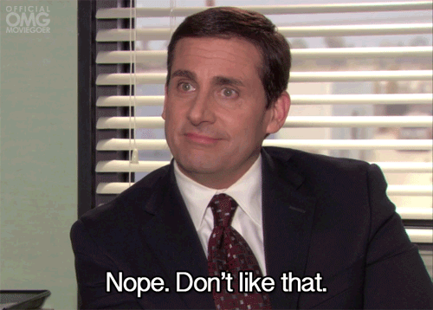
ye i don’t like this very mutch
One of the things I just don’t like is football/soccer, it’s hard to explain but it is true… I guess it might be because I don’t understand why people are so excited for some person who just kicks a ball, but hey what do i know. p.s i don’t follow any football teams o_o

Slide 7
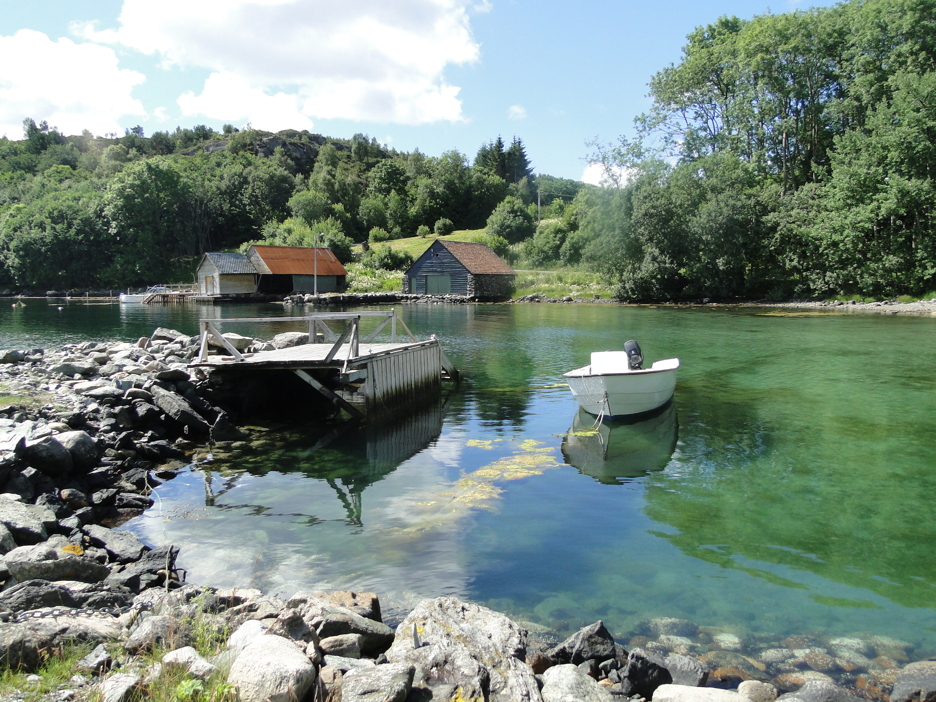
What I like about living in norway sotra
What I like about Norway
What i like the most about living in Norway is the beautiful nature, so luss and green, oh it makes my heart melt.
What I like about Sotra
The thing I like about Sotra is the coastlines with the abundance of fish.

Slide 8
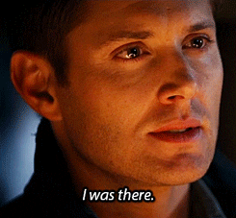
Places around the world i have been to
I haven’t been to that many places, but I have been to some so let me tell you about them, there is the country i have visited the most and that is Spain, and now for some places I only think I have been one time there is Turkey and Bulgaria, but the places I have been to the most are Sweden and only some times Denmark.

Slide 9
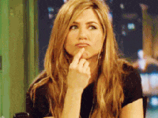
what i'm curious about other countries
Some questions i have are
Are the stereotypes true or false?
What is your favorite food?
How's the summers?
Who is the most well known historical figure?
What is the national animal of your country?

Slide 10
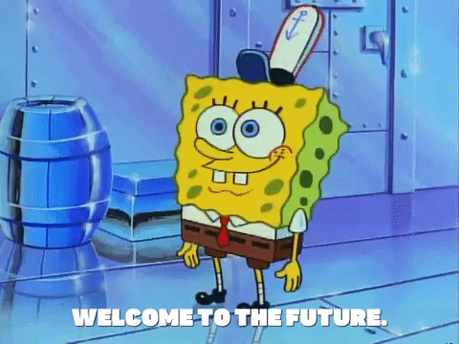
My hopeful future jobb
What I hope I get as a job in the future is paleontologist way because I have always loved dinosaurs and other prehistoric animals such as spinosaurus, carnotaurus, dodo and the hell pig.
:)

Slide 11
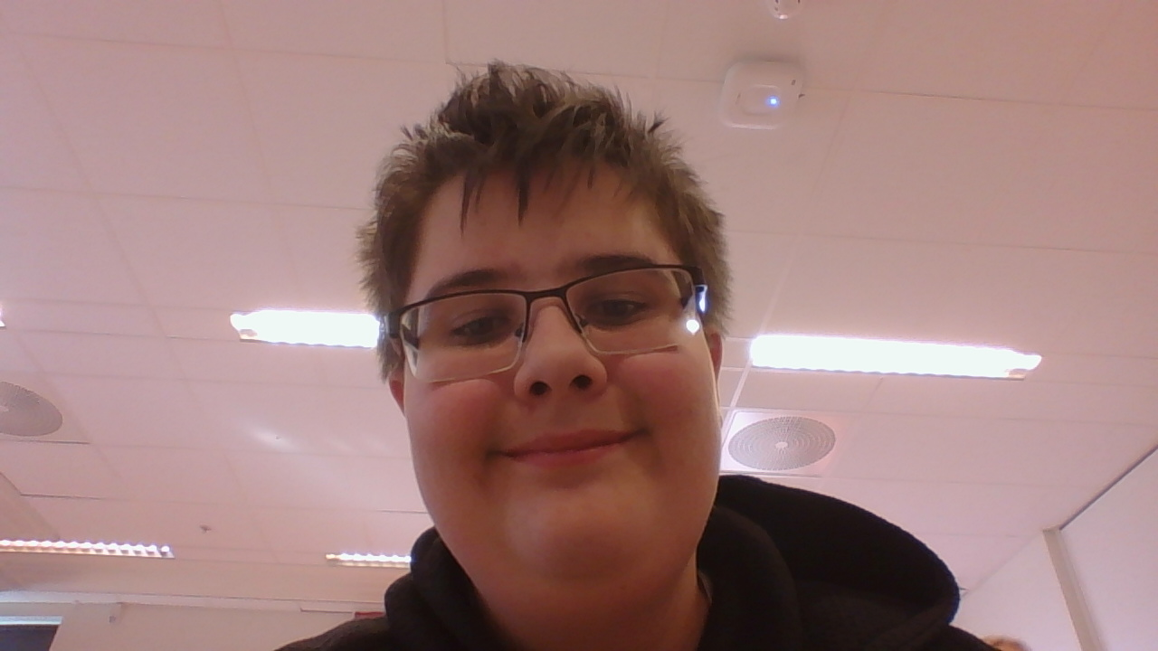
Made by My John-Olav :)
Fun fact: I like to keep my words short.

