Slide 1
About me

Slide 2
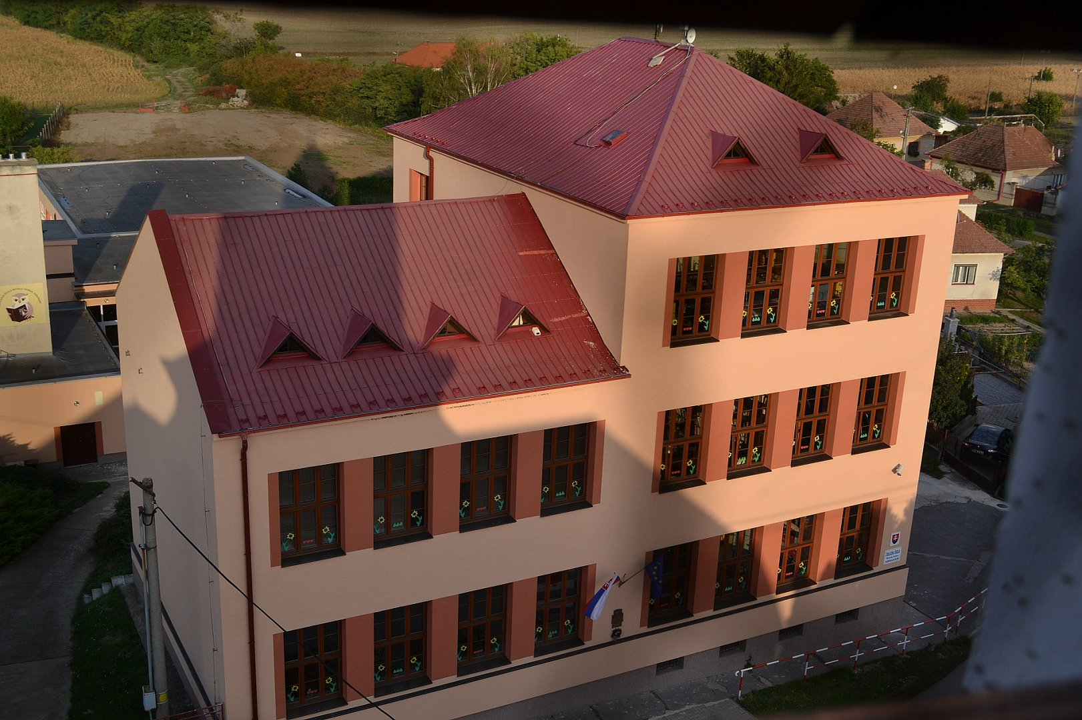
I live in slovakia and i go to school in abraham. I Am 14.

Slide 3
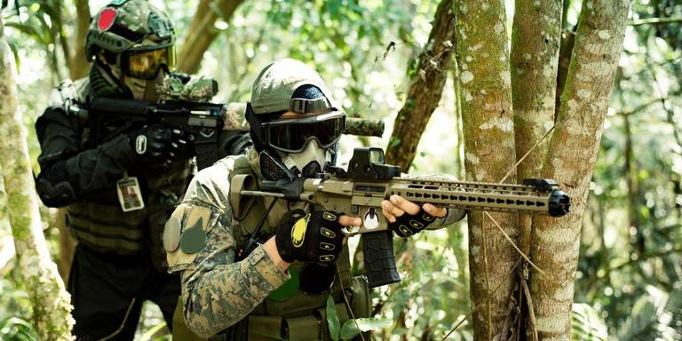
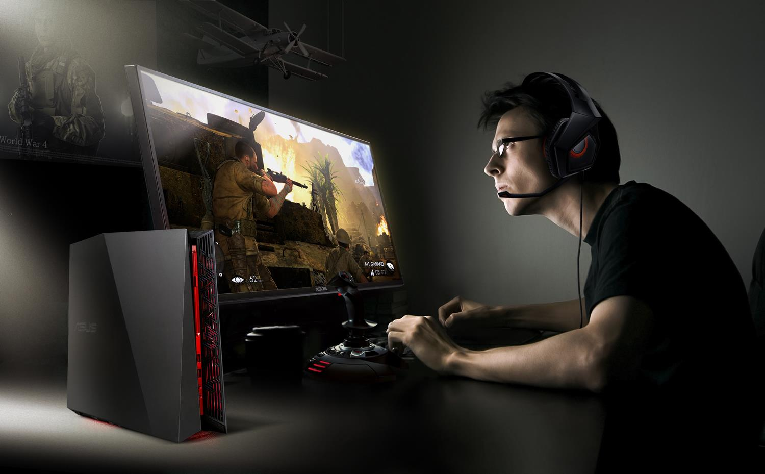
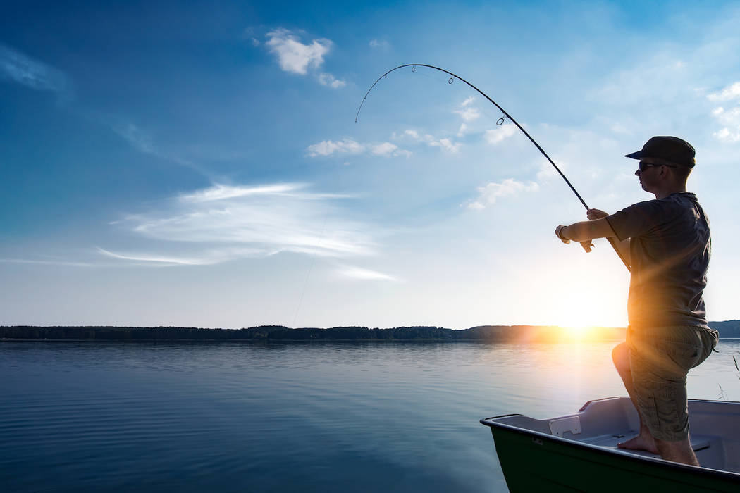
In my free time I play pc games, play airsoft, play football, fishing and i eat.

Slide 4
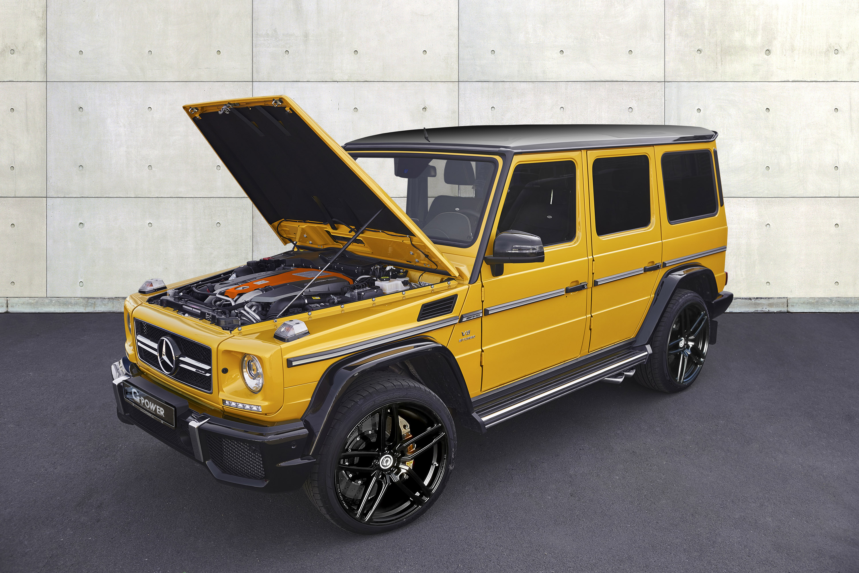
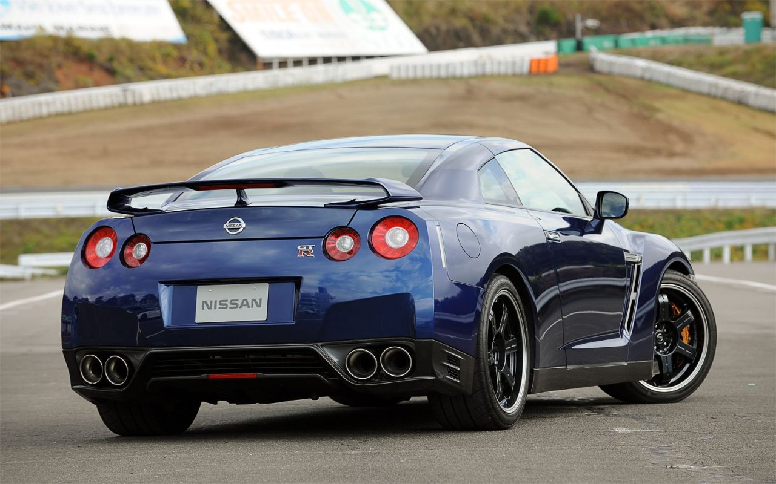
I am like a sport car,... Nissan gtr, dodge challenger, mercedes amg g63

Slide 5
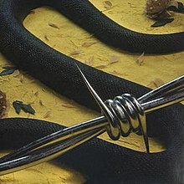
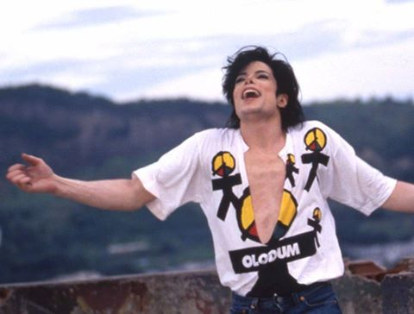
I am like songs.... Pop music,rap,...
My favourite songs is Tones And I – Dance Monkey, Post Malone – Rockstar, Michael Jackson – They don´t care about us,...

Slide 6
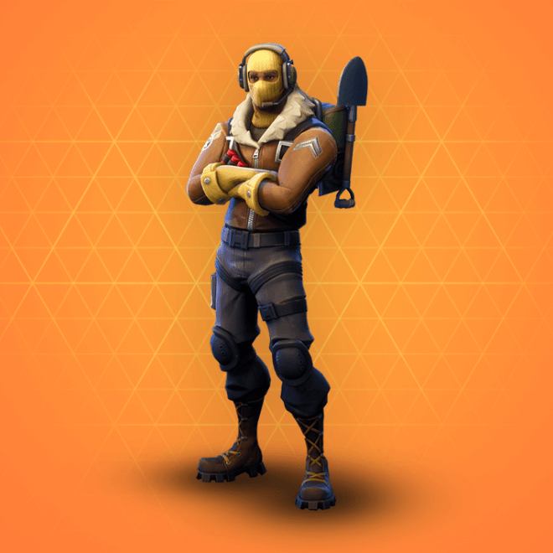
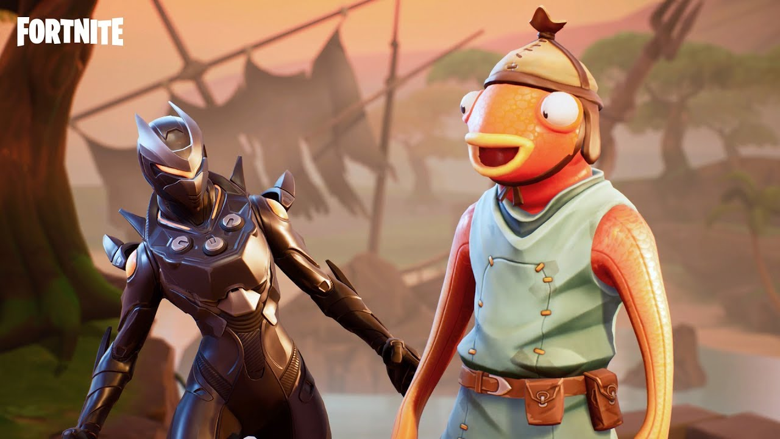
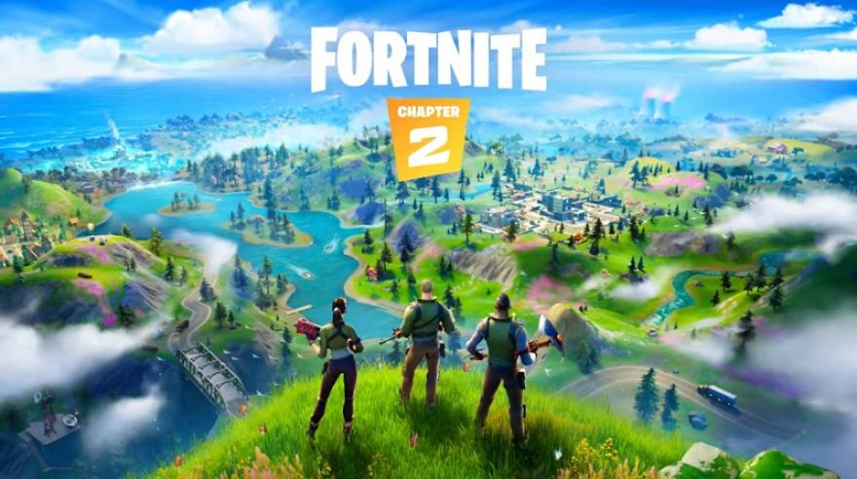
My very favourite pc game is Fortnite
Fortnite is a game where the goal is survive all players in the map. My biggest highkil in solo is 11 kills. My fovourite skin is Raptor.

