Slide 1
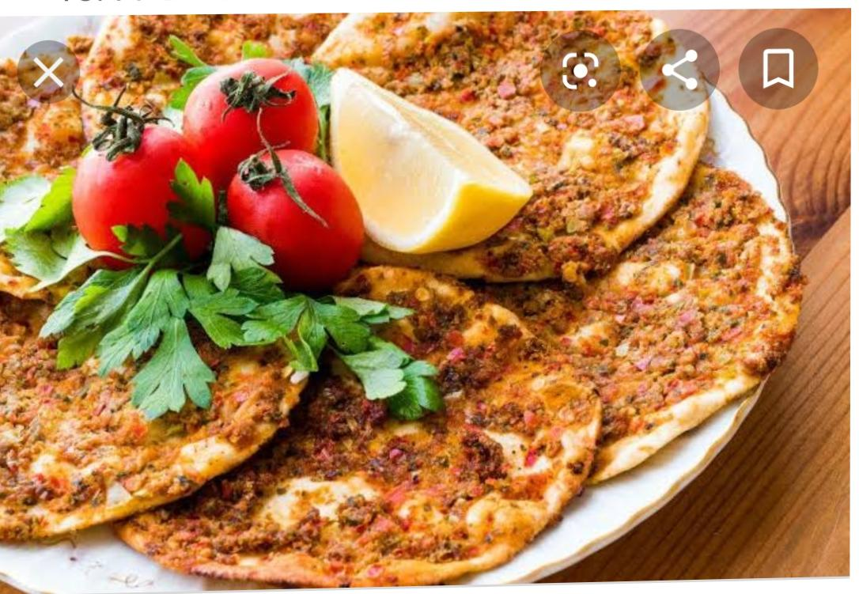
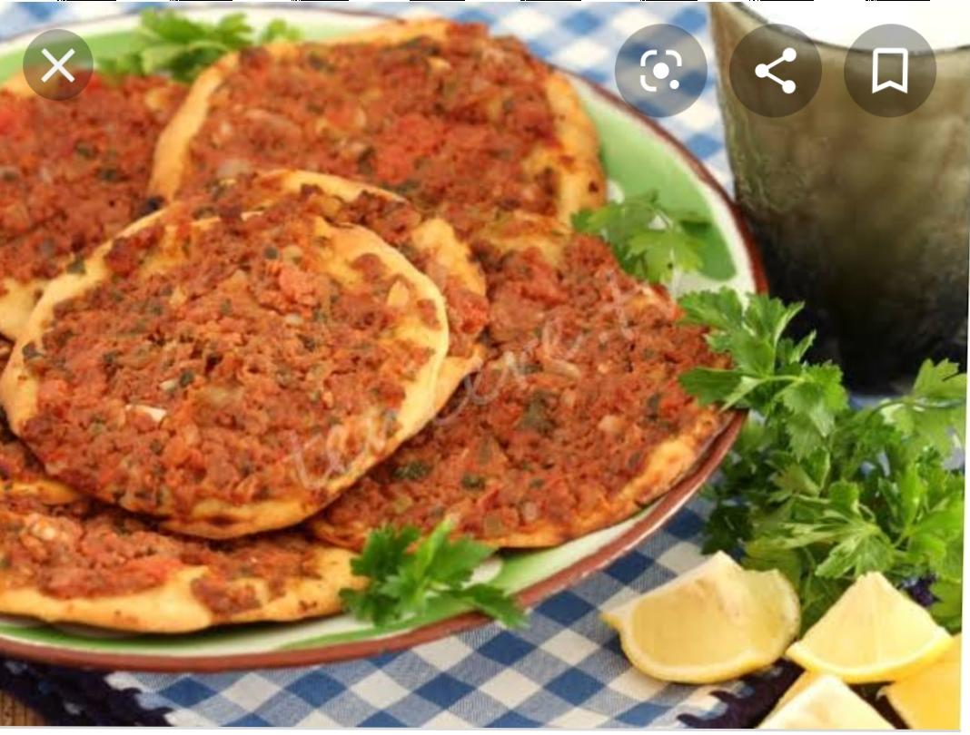
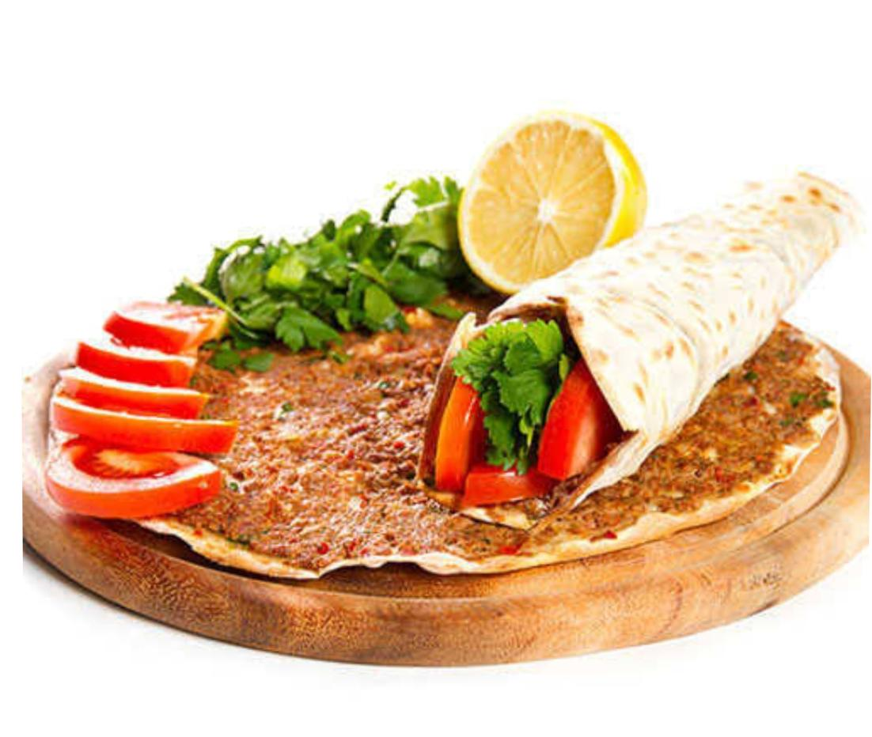
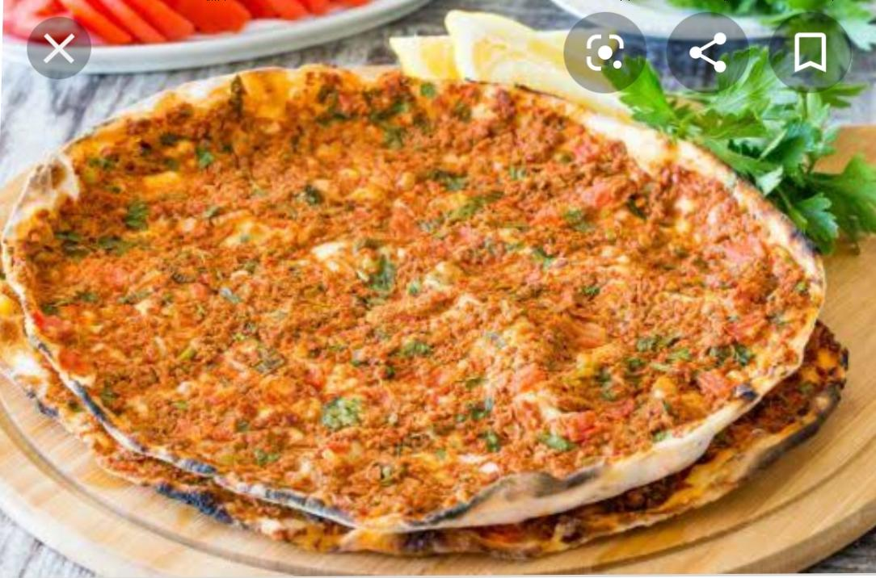
LAHMACUN

Slide 2
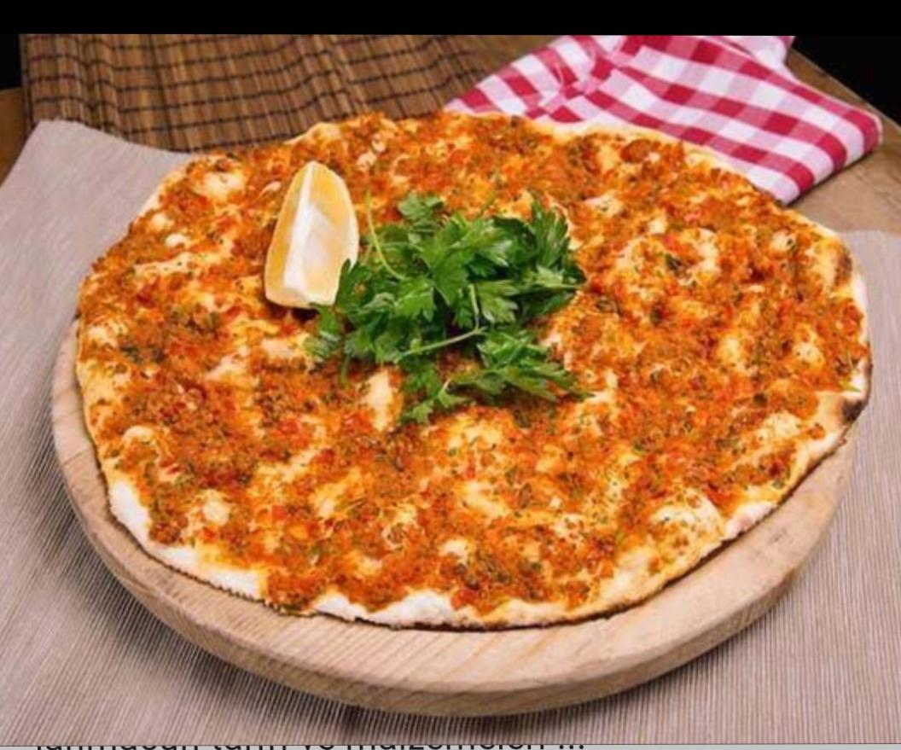
Lahmacun is a round, thin piece of dough topped with minced meat, minced vegetables and herbs including onions, tomatoes and parsley, and spices such as cayenne pepper, paprika, cumin and cinnamon, then baked.
THE CITY SANLIURFA IS FAMOUS FOR ITS DELICIOUS LAHMACUN.

Slide 3
THE INGREDIENTS OF LAHMACUN
1 PEPPER
1 FOOD SPOON PEPER PASTE
1 TEASPOON OF SALT
1 TEASPOON BLACK PEPPER
CHİLİ PEPPER İN A TEA CROTCH
1/2 BUNCH OF PARSLEY
FOR DOUGH:
500 GRAMS FLOUR
200 GRAMS WATER
10 GRAMS SALT
500 GRAMS OF GROUND BEEF
1 ONİON
1 GARLİC CLOVES
1 TOMATO

Slide 4
AFİYET OLSUN bon appetit! ☺

