Slide 1
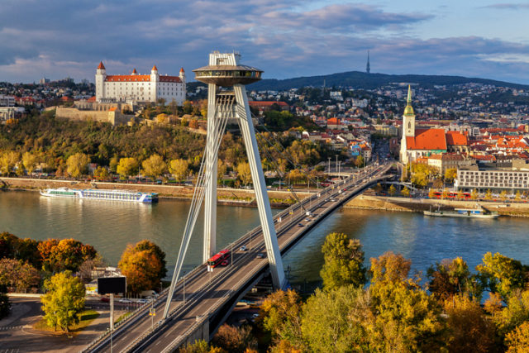
Bratislava

Slide 2
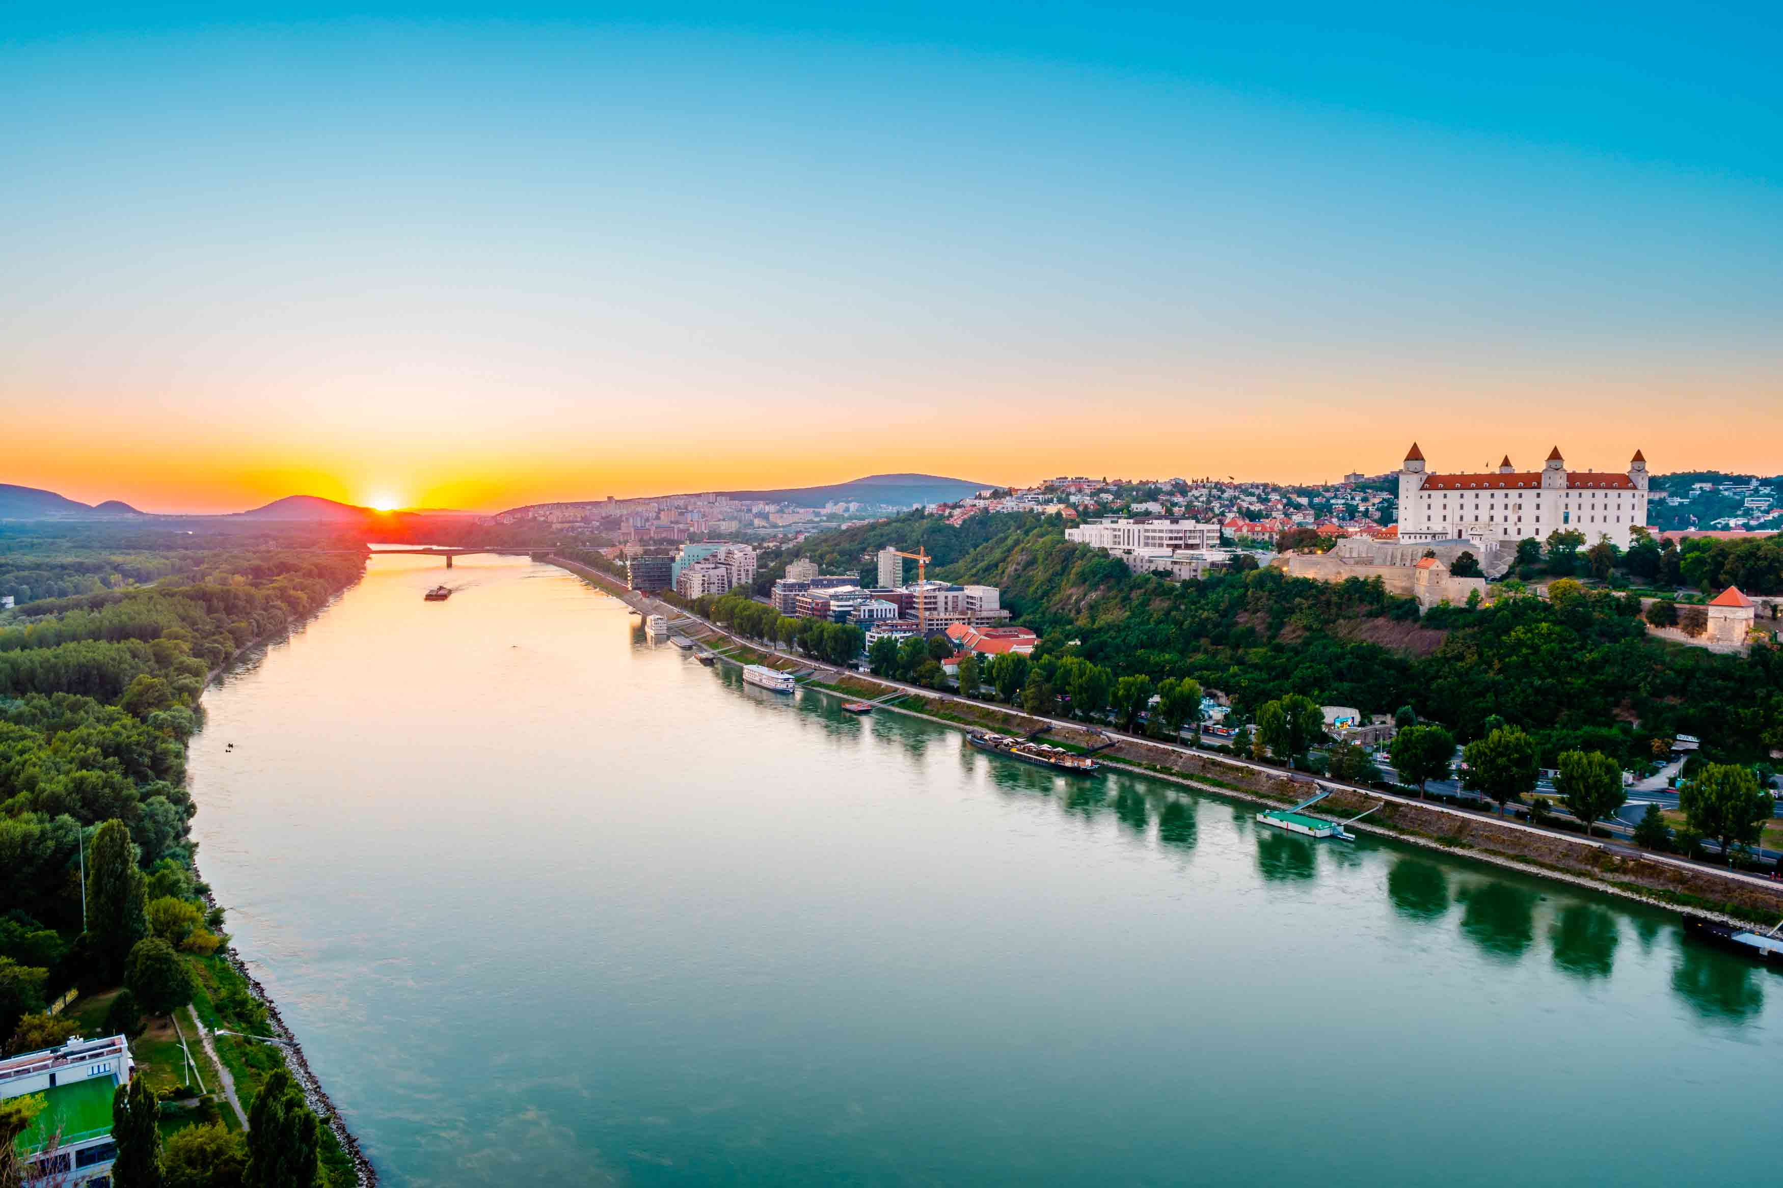
Bratislava is the capital and biggest city of Slovakia with about 400 000 peoples. There is Dunaj the biggest river of Slovakia.

Slide 3
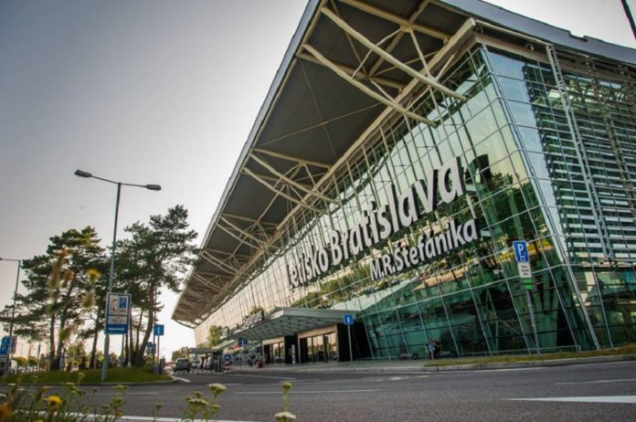
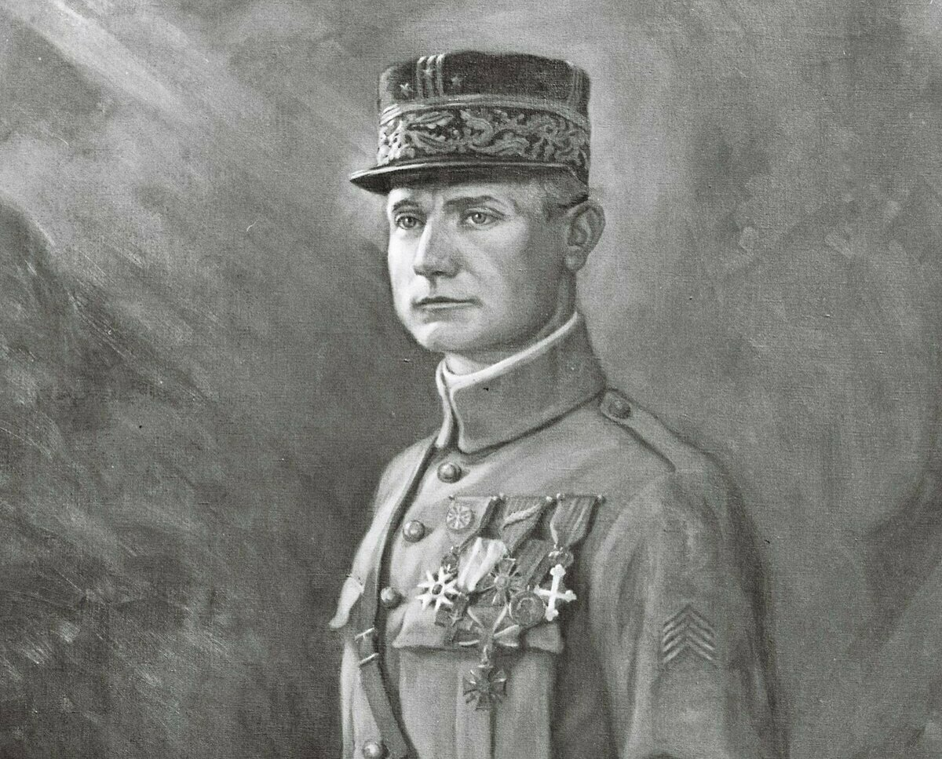
There is airport of Milan Rastislav Štefánik, which was one of the main leaders for which we have separate state. He was military pilot, general, diplomat, politician. In this airport is replica of aircraft which with he crashed.

Slide 4
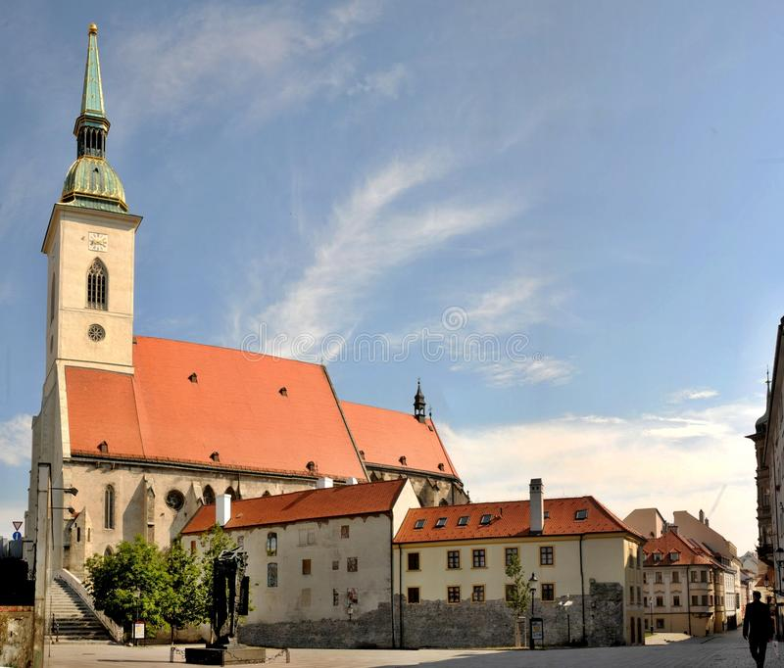
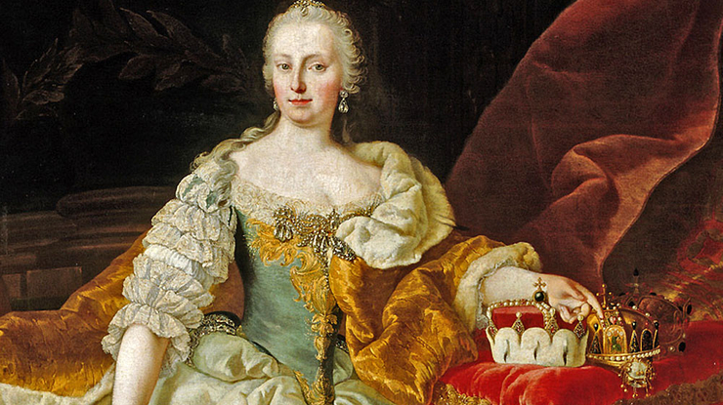
The most famous church in Bratislava is church of saint Martin- build in 13th century, which was using to corunations. Mária Terézia – most famous leader of Austria Hungarian monarchy was corunated there.

Slide 5
Legend of castle in bratislava
It was still in ancient times. The inhabitants of the castle woke up completely broken once a year. Even the water from the containers leaked, the porcelain from the shelves and the pictures from the walls fell. Even the flags on the towers were dirty, as if they were rolling in the mud. There was no hurricane, so no one could explain it.
The Lady of the Castle invited the fortune teller to find out what happened. The old fortune teller had something to do, but eventually revealed the truth: "It's Klingsor!" Nobody knew the name in the castle, so the fortune teller explained it. Klingsor is a massive giant, a wizard who lives in Transylvania, but returns to his native Germany once in a while.
Presporok (old name of Bratislava) lies about halfway, so he stops there to rest. He would use the castle for that. He grabs it with a powerful hand, flips it over, and turns it into a table. On leaving it returns to its original position.
The Castle Lady was in shock, but the old woman offered to try to handle it with Klingsor. She sent him a white crow message, and although she was afraid that the field would be angry, the opposite was true. The thoughtful wizard stopped shifting the castle.

Slide 6
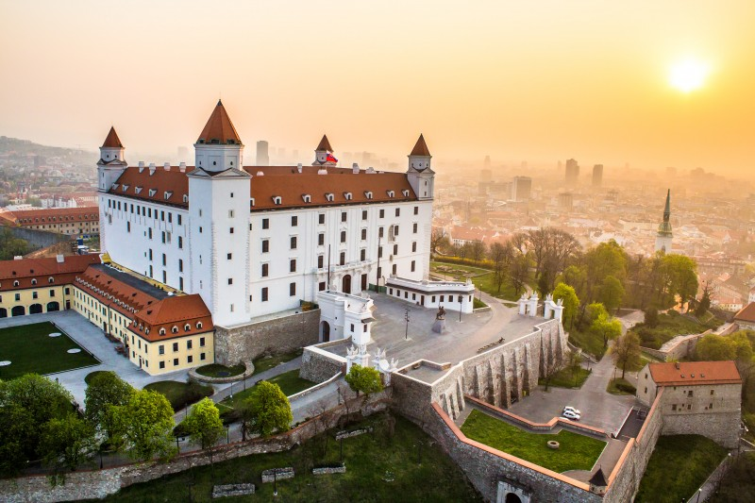
Castle in Bratislava looks like fliped table, so this was artwork to write the legend. It has 4 towers, 3 are smaller, 1 is bigger.

Slide 7
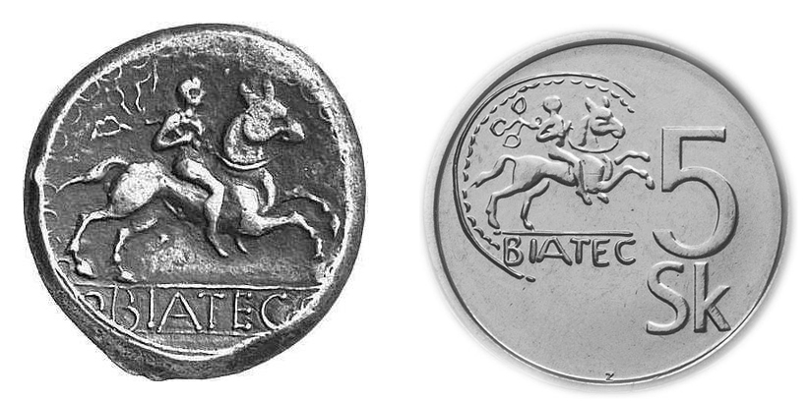
Biatec was celtic leader, in Bratislava was found coins with his portrait. This ancient celtic coins are called Biatec. On old coin - 5 koruna which we had before euro, was biatec.

