Slide 1
Introductions of the Moroccan Students

Slide 2
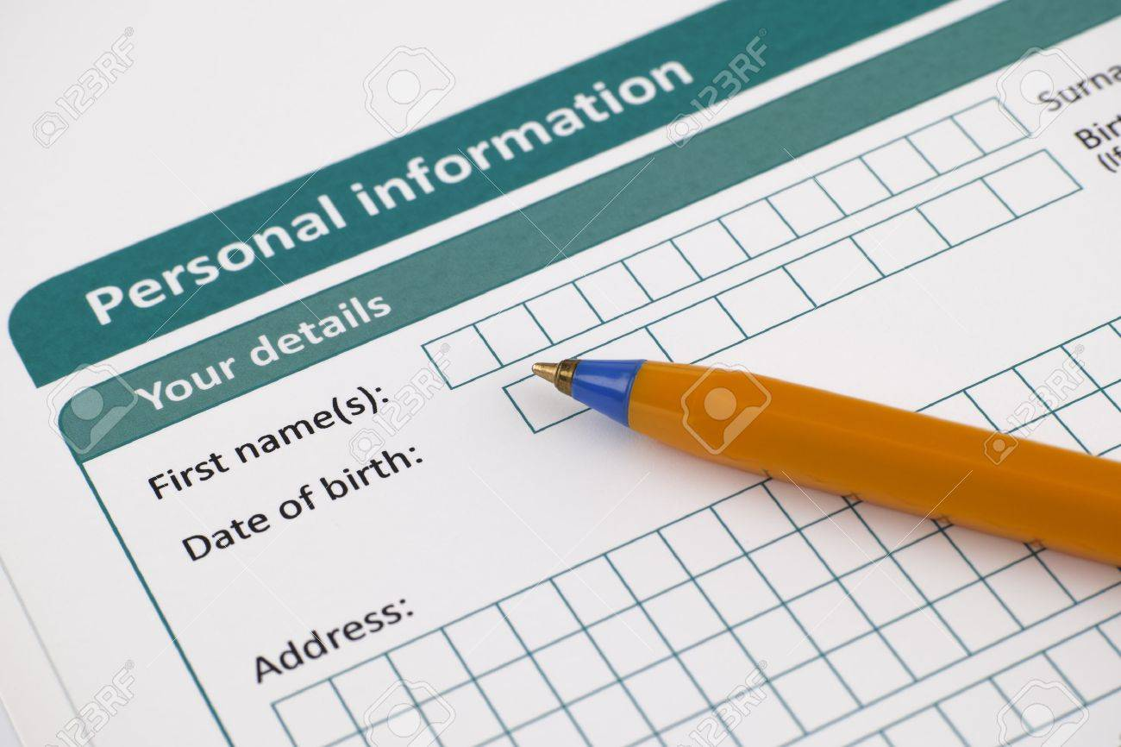
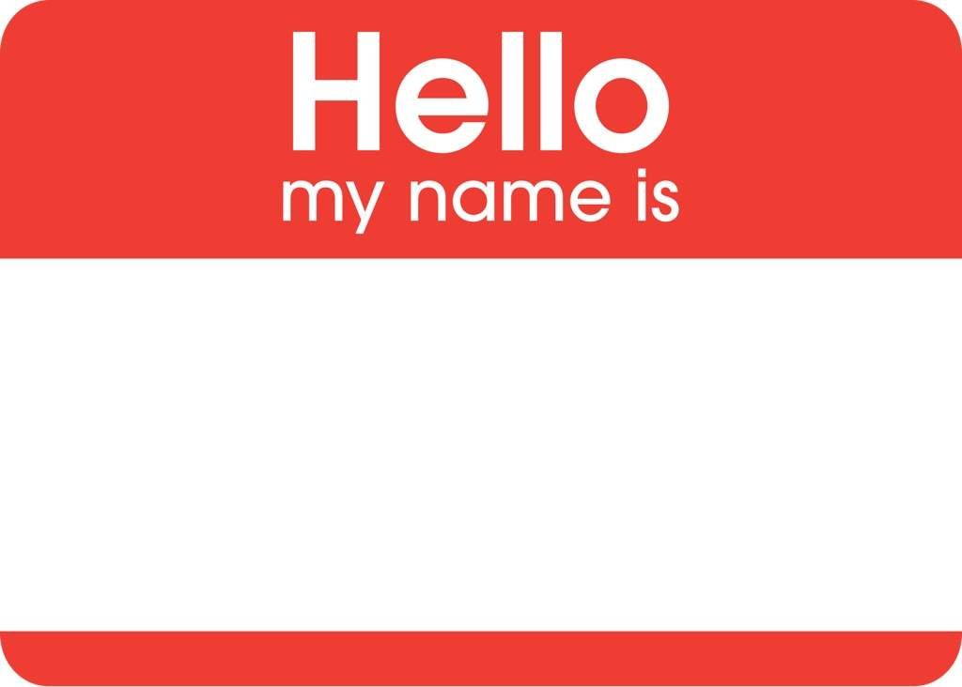

Slide 3
My biggest dream is to travel aound the world especially Bali and Dubia, Singapore. I like to discover new placxes and different cultures and taste new food
I am sixteen years old. I live in Massa which is a small town near Agadir. I study in Almassira Alkhdra
My Name is Sana Boumaad
I a person who is ambitious and kind. I am honest with everyone without exception. I don’t like fake poeple. But I like the ones who behave spontaneously.
My hobbies are reading self developmnt books. I like to help animals and feed them. I lobe photography. I love capturing sunset photos.

Slide 4
My Dreams are My biggest goals are to have a good job in the future, to go to America, and to help poor people.
I am I'm a science student from Morocco, I’m 16 years old . I live with my family. I was born in 29/1/2003. My school’s name is Al massira Al khadra , there are a lot of students in my school about 1800. My school has got a lot of facilities: there is a library, science labs, a large playground, a gym, a garden and many classrooms
My Name is Kawtar Ghazouani
I am a very social, nice and hardworking person
I love my family and I like spending the holidays with them. In my free time, I read books and stories, I watch TV or listen to music, But my favorite leisure activity is jogging, I love it.

Slide 5
My dream is to have a lot of money and expensive watches.
I am 17 years old. I am from Morocco and proud of that. I am a first year baccalaureate student. I live in a small village called Ait Milk
My Name is Adil Bouchouari.
I am a brave and tolerant person. I solve my problems intelligently
My hobbies are reading and learning foreign languages, swimming, fishing, surfing and diving in the sea.

Slide 6
My dream is to be a businessperson and to finish my studies.
I am a student in Almassira Alkhadra school. I am 19 years old.
My Name is Laarbi Assbane
I am a happy and open-minded person
My hobbies are playing football and chatting with people from different countries and cultures.

Slide 7
My dream is to get my baccalaureate with an excellent mark. I love travelling and my dream is to travel to the Maldives.
I am 16 years old. I live in a small village called Massa with my parents, brothers and sister.
My Name is Fatima Ezzahra Douksas
I am a sociable person. I love spending time with others and trying out new experiences
My hobbies are watching movies, cycling and reading.

Slide 8
My dreams are to succeed in my studies; to set up an animal welfare association. I also want to visit all the historical sites in Morocco.
I am 16 years old. I am a student in first year baccalaureate science, and I live in Massa.
My Name is Mina Louihne
I am hardworking and lovable. I am not nervous, I am very calm. I am hesitating a bit when making decisions.
My hobbies are reading books; travelling. I like bike riding and pet breeding.

Slide 9
My dreams is to have a good career
I am seventeen years old. I live in Massa. I am a student at Al massira al Khadra high school.
My Name is Soukaina zadouyab
I am an intelligent and hardwoking gilr.
My hobbies are playing basketball, swimming, taking pictures an reading books

Slide 10
My dreams are to participate in the development of my country and make my parents proud. I also want to be a famous doctor.
I am sixteen years ld. I live in Massa which is a small village in Morocco. I am a students in first baccalaureate
My Name is Salma Marhis
I am a serious and harworking girl. I am fuunny but just sometimes because I don’t like being funny all the time espcially in the classroom.
I like to do gymnastics and playingand basketball. I also like reading

Slide 11
My dreams is to travel around the world.
I am sixteen years.
My Name is Yassine Fikri
I am funny but serious at the same time.
My hobbies are reading and drawing. I also watch Japanese anime

Slide 12
My dreams is to travel to Singapore.
I am sixteen years old. I live in Massa
My Name is Maria Bouhssine
I am a nice and honest girl.
My hobbies are reading self development books. I also like discovering new things.

Slide 13
My dreams are to make positive change in our society.
I am sixteen years old. I live in Massa. I am lucky because I have one sister and one brother. I am a student in first baccalaureate class.
My Name is Safa Sassi
I am a serious and hardwoking student.
My hobbies are photography and autonumous learning

Slide 14
My dreams are to make positive change in our society.
I am sixteen years old. I live in Massa. I am lucky because I have one sister and one brother. I am a student in first baccalaureate class.
My Name is Safa Sassi
I am a serious and hardwoking student.
My hobbies are photography and autonumous learning

