Slide 1
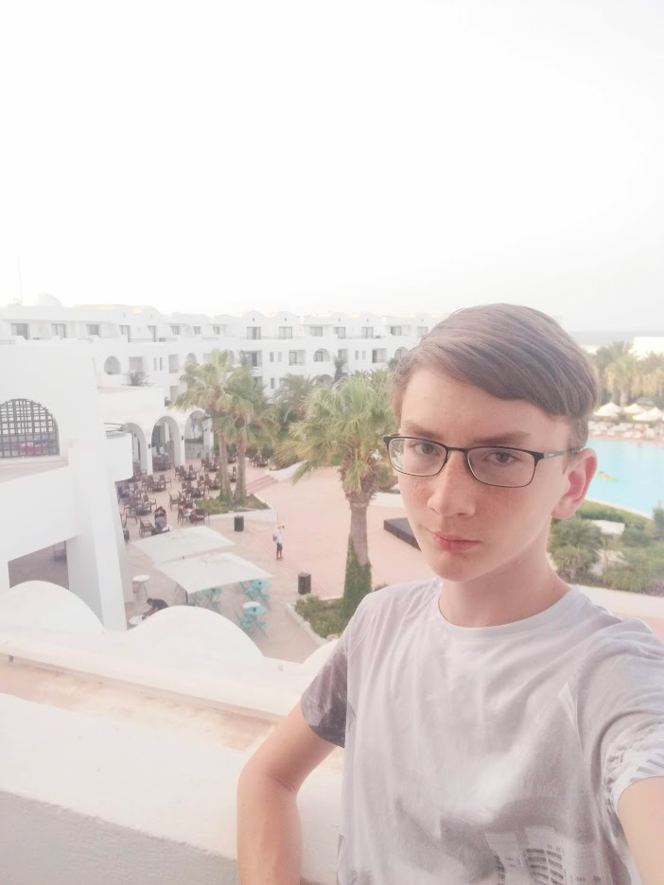
Marián štefunko

Slide 2
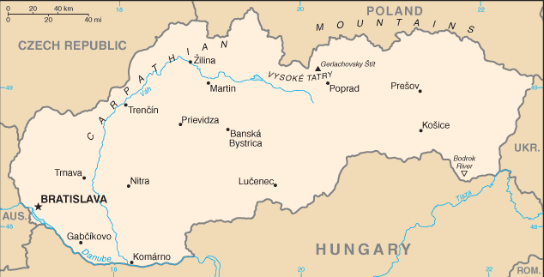
I live in Abrahám - small village with 1,300 villagers.
It´s near Trnava - 7th biggest city of Slovakia.
It´s in Slovakia (not Slovenia but Slovakia, it´s 2 different countries).
Abrahám

Slide 3
In short about me:
Boy
Single
14 years old
175 cm tall
Brown eyes
Brown hair

Slide 4
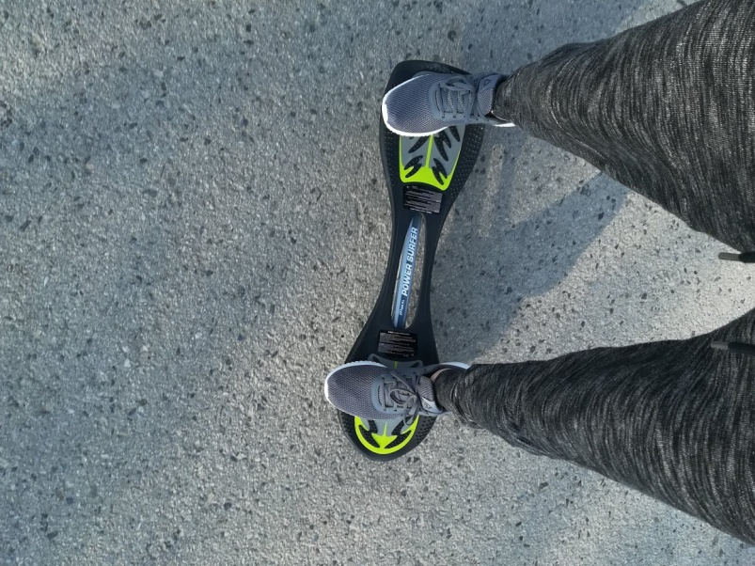
Hobbies:
Fishing
Airsoft
Waweboard
Going to walk
PC games: World of Tanks
Minecraft (it´s popular in 2019)

Slide 5
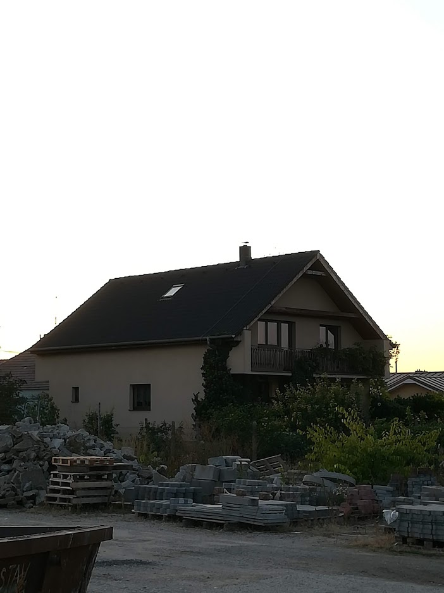
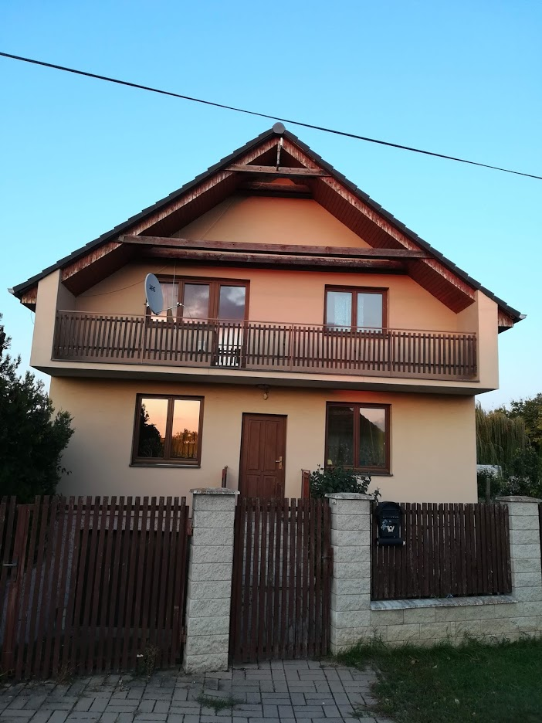
My house:
The construction waste is not our.
The construction waste is not our.

Slide 6
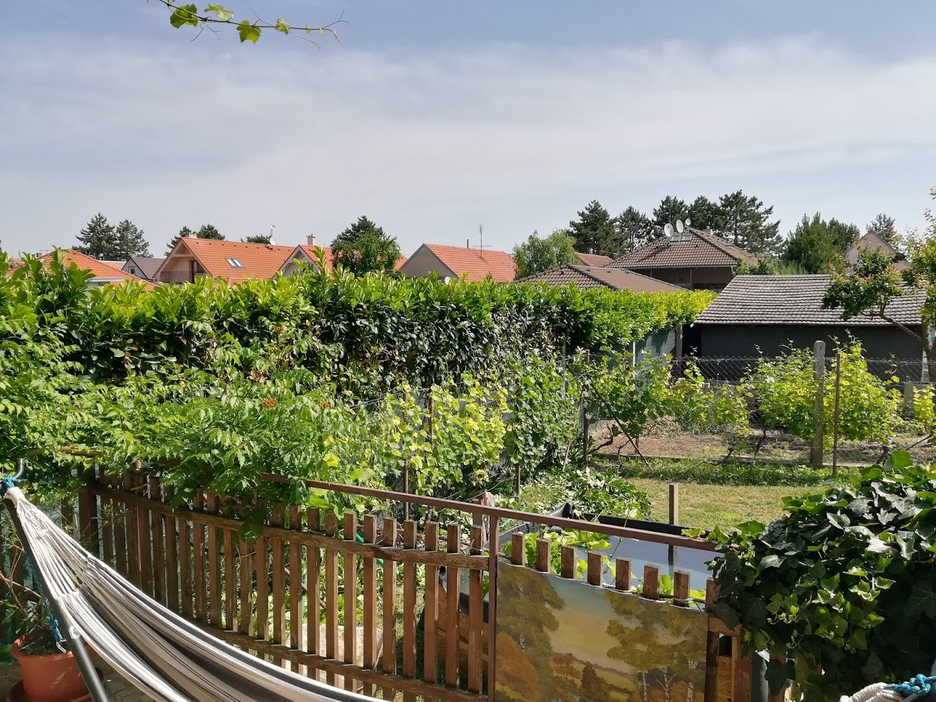
The view from our terace:

Slide 7
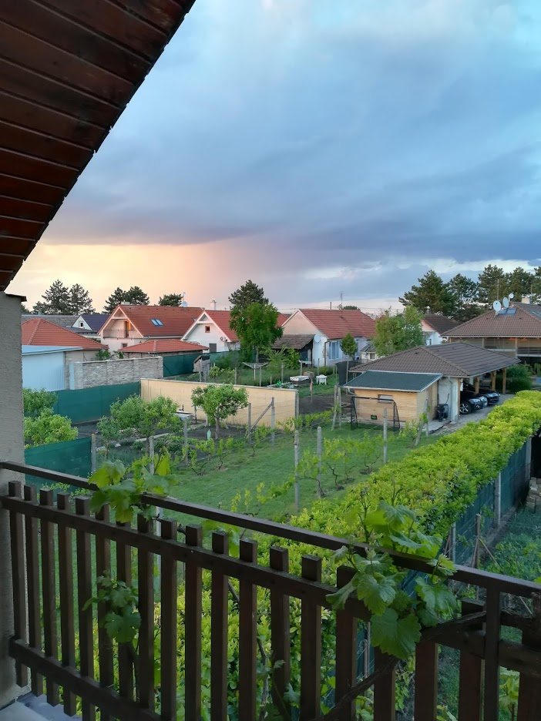
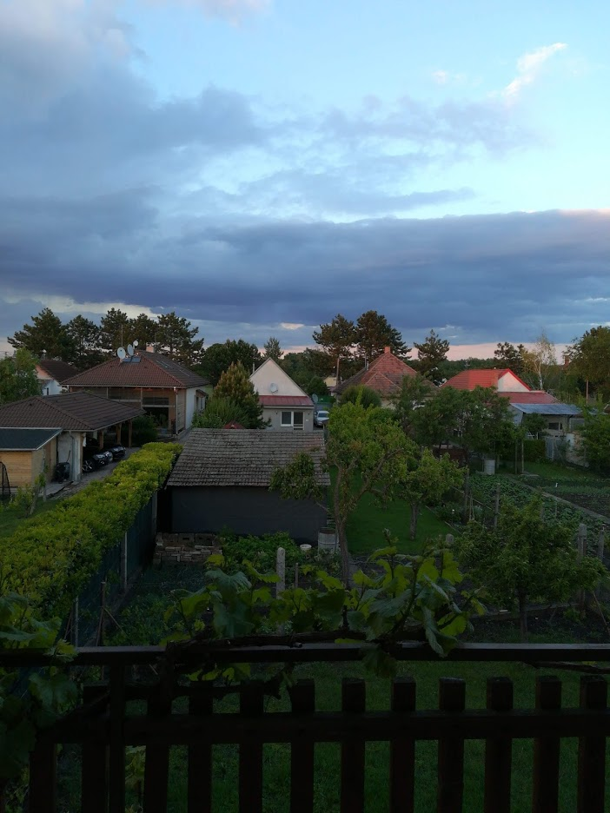
The view from my balcony:

Slide 8
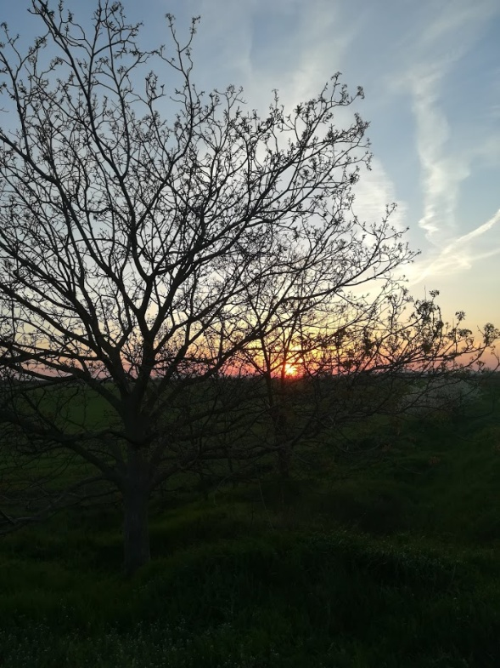
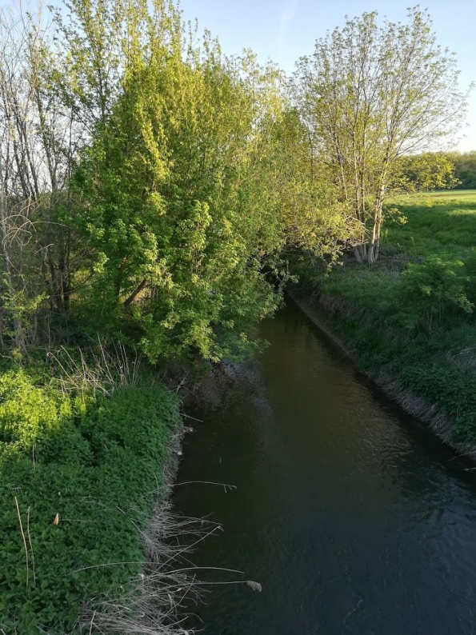
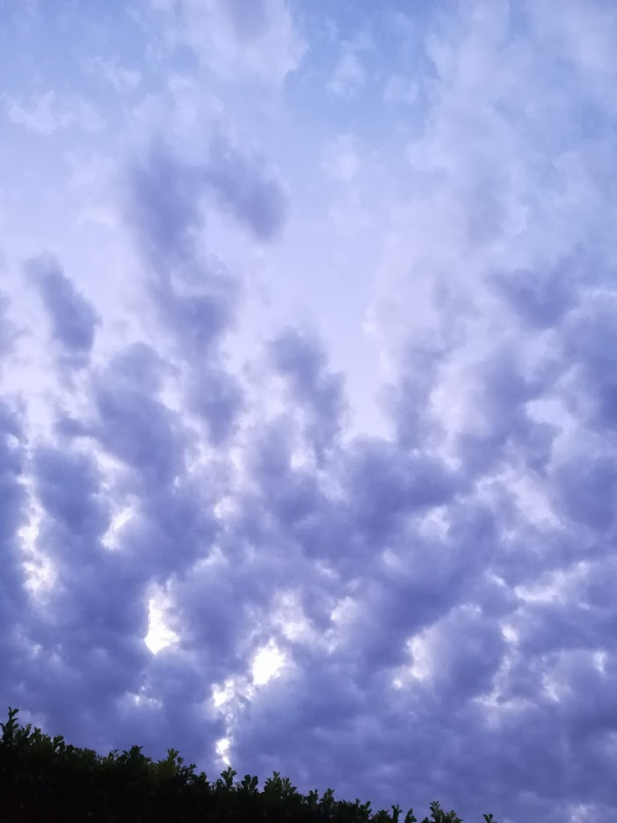
Abrahám has beautiful nature:

Slide 9
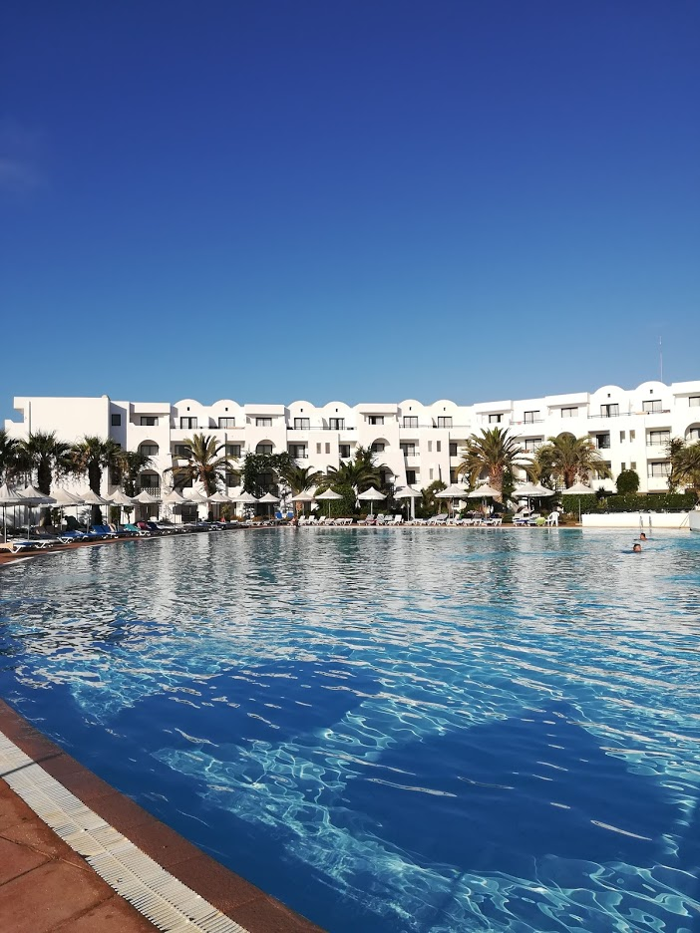
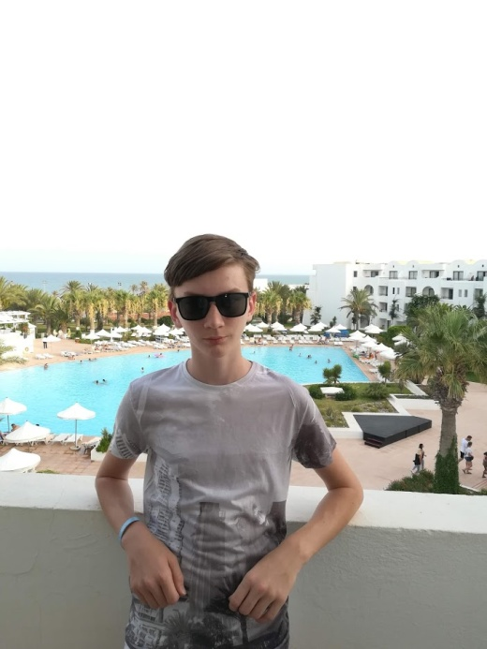
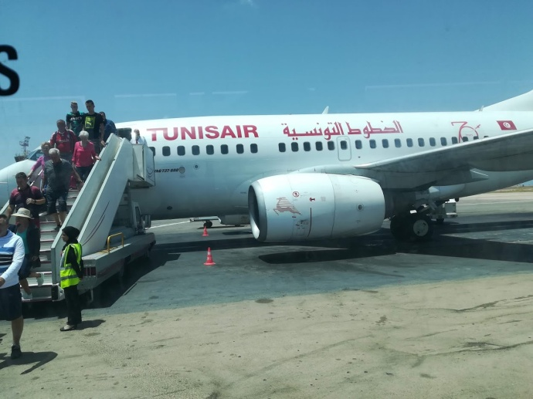
Traveling:
I was in Czech republic, Hungary, Austria, Croatia, Italy, Germany, Bulgaria and last summer in Tunisia.

Slide 10
Thanks for watching
Contact on me:
Facebook: Marián Štefunko
Instagram: _blyatiful_boy
Snapchat: stefunkom
If you want, write me, especially pretty girls.

