Slide 1
A presentation about myself

Slide 2
About me
My name is Adrian Aksnes Nesse, and Im 14 years old.
I live in Kolltveit and i am from Bergen.
I live in a kinda big house, and my room is often messy.
We are 4 people in my family. Its me, my mom, dad and little sister.
in my spare time i like to be with my Girlfriend and friends and play football.
My favorite music type is Hard bass and some old songs. my favorite artist is G-Eazy

Slide 3
My favorite movie is The cabin in the woods
I like it because it’s a fun horror film and i have met one of the actors.

Slide 4
More
My favorite food to eat is lasagne. i don't know why but its just my favorite food
My favorite school subject is English.
The football team i support is the six times UCL Champions LIVERPOOL!!!
I have been to Sweden, Denmark, Turkey, Spain, And Croatia
I am hopefully be a Pro football player and if not probably a game designer.
I like to live in sotra because it's a small place and you know a lot of the people here.

Slide 5
Even more
I like to live in Norway because i like to fish and there's a lot of places to fish.
i wanna know what is your national food.

Slide 6
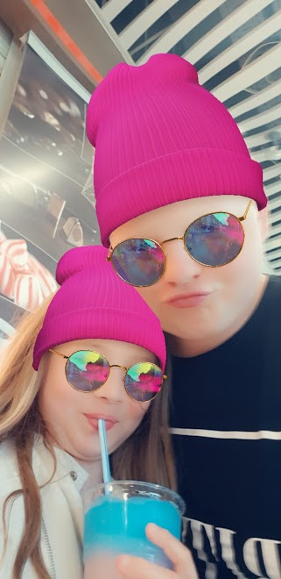
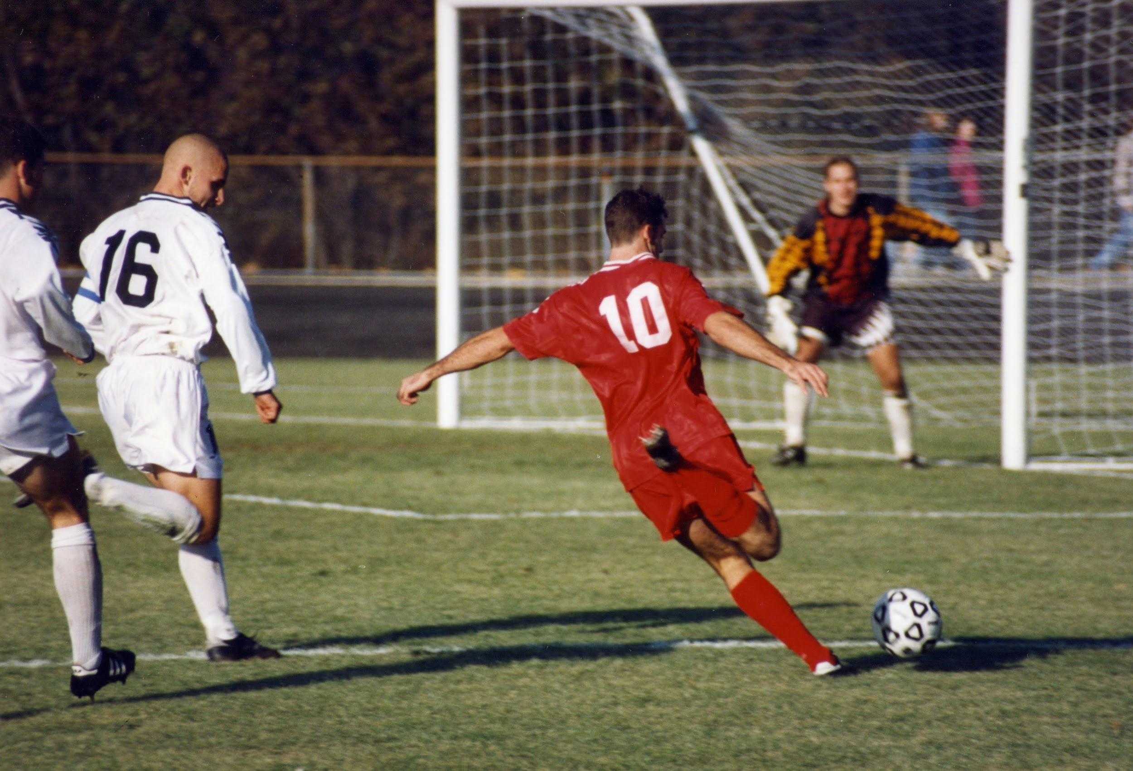
Pictures
Me and my sister.
The sport i go to
And the game i play the most

