Slide 2
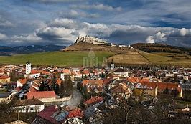
Spiš (Spišský Region of tourism) is one of the Slovak regions and tourist regions. In the broader sense, its territory is identical to the territory of the Spišská County, in the narrower (e.g. as a tourist region) it is the territory of the districts of Kežmarok, Spišská Nová Ves, Gelnica, Košice-surroundings (in part), Levoča and Poprad.

Slide 3
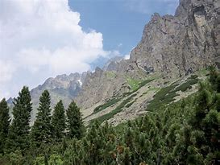
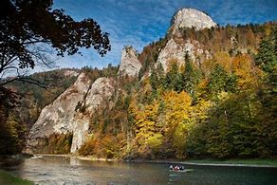
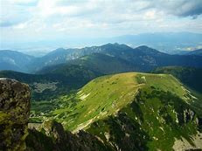
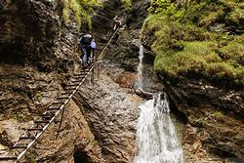
National Parks
Tatra National Park in the northwest
Pieniny National Park in the north
National Park Slovak Paradise in the southeast
Low Tatras National Park in southwestern

Slide 4
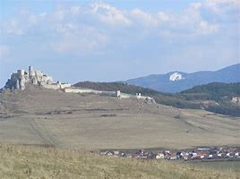
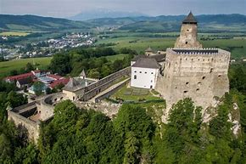
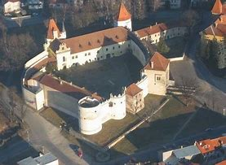
Castles
Spissky Castle (the largest in central Europe)
Castle, a unique city castle, the seat of the Thököly family and the Hungarian king Imricha Thökölyho
Castle Stara Ľubovna, the seat of the mayor of the preoccupied Spišské cities from the Polish genus Lubomirski

Slide 5
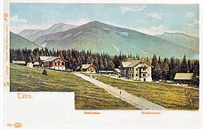
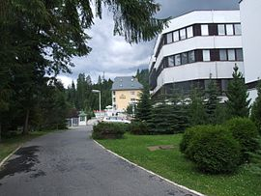
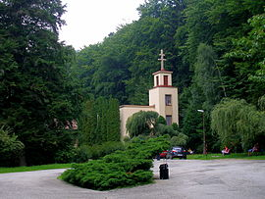
Spa-Tatranské Matliare
Vyšné Ružbachy
Štós
Kúpele sú situované pod výbežkami ihličnatého lesa, obklopené parkom. Zemitouhličité pramene patriace k najvýdatnejším v Európe, sú základom liečby nervových chorôb a depresívnych stavov, prispievajú k liečbe krvného tlaku a mozgovej arteriosklerózy.

Slide 6
There are eight ski lifts on slopes with varying degrees of elevation and difficulty, with artificial snow and night skiing, horse-drawn skis, sledge sightseeing and quality cross-country trails.

